Slide 1

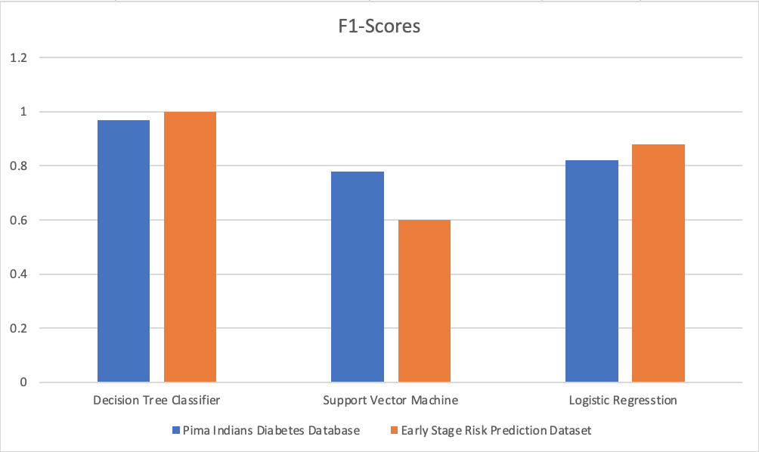
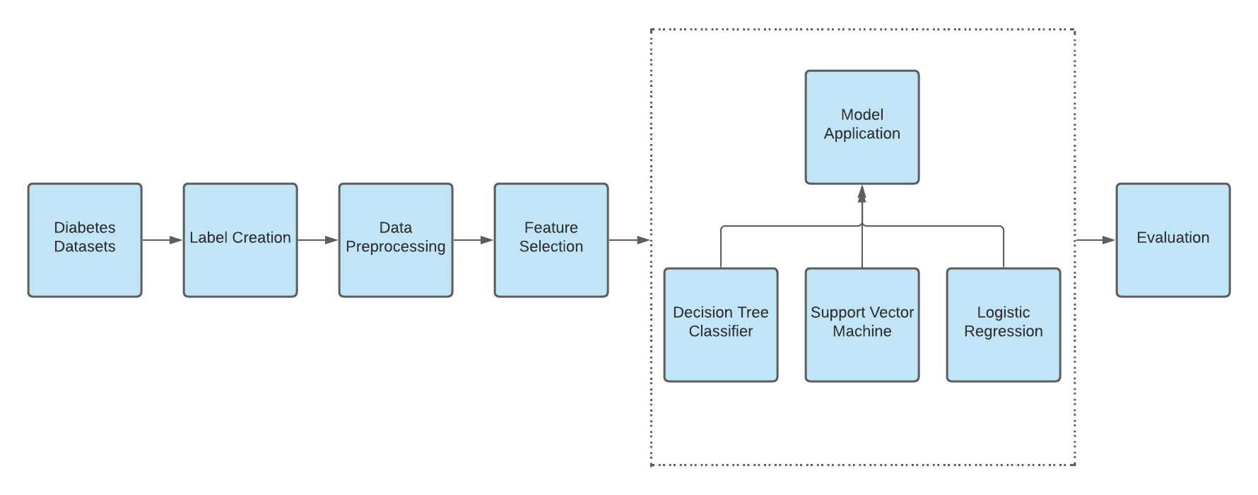
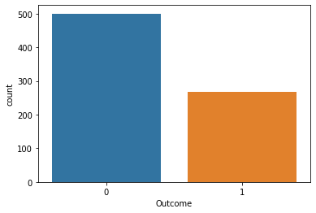
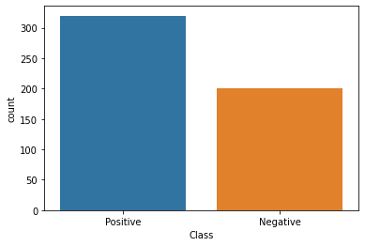
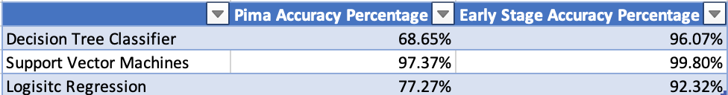
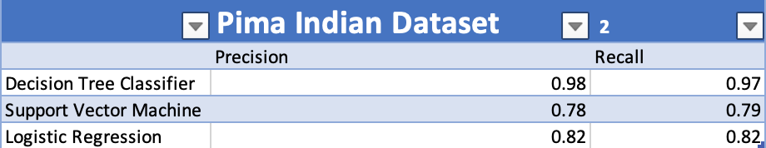
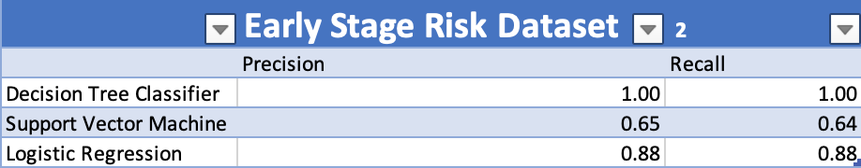
Type 1 Diabetes Prediction using Data Mining Techniques
Students: Jake Leslie, Shermana Akter, Nathan Boyar, College of Engineering & Science
Supervisor: Dr. Shadi Bani Ta’an, College of Engineering & Science
Abstract
Overall Approach
Type 1 diabetes is a chronic condition where one’s pancreas produces little to no insulin, which results in individuals using insulin therapy or other forms to keep their blood sugar levels at a healthy standard. Although type 1 diabetes impacts nearly 1.6 million people in the United States alone, some patients can go untreated which can create long-term negative effects on their health. Using data mining, the chances of patients who have type 1 diabetes going untreated can be cut down drastically. This research paper will focus on two datasets and different algorithms to determine the accuracy of identifying type 1 diabetes patients. Some of the sets will focus on looking at a patient’s glucose levels, blood pressure, insulin, diabetes pedigree function, and other traits that can determine if a patient may or may not have the disease. The results determine that the Decision Tree Classifier is the most accurate out of all classification algorithms for both datasets
Results
Conclusion
Datasets
Data mining is an incredibly useful tool by compiling incredible amounts of data to solve problems that would be impossible to do by hand. In our case, understanding correlations in the data can help susceptible patients gain not only knowledge about type 1 diabetes but can help manage the lifelong illness. Type 1 diabetes affects a significant portion of the population; therefore it is important that there should be efforts made to find the most accurate classification model to predict this disease so people can get the care they need faster. We learned from other similar reports that discuss type 1 diabetes and data mining, how important the issue is. These multiple reports also discuss the diagnosis of type 1 diabetes growing around the world. We can assume that this is because the way to diagnose type 1 diabetes is becoming a quicker process as technology advances. Additionally, but more importantly to our studies, we learned what data mining techniques would be the most useful to analyze patient data to determine if they are T1D positive.
Our work focuses on two datasets that have patient information to help determine if someone is T1D positive. We used different algorithms to conclude on which algorithm is most accurate when it came to the datasets. Through our methods of analysis, we found that the Decision Tree Classifier was the most accurate data mining model in terms of consistency and outcomes. We hope that scientists can use data mining techniques in order to predict those who may have type 1 diabetes before it gets to a point where they have long-lasting issues. As we learned from Kavakiotis and colleagues [8], early diagnosis can slow disease progression, improve medication selection, prolong life expectancy, and reduce future complications. Thus, data mining can be used to improve the lives of those who must type 1 diabetes. This type of algorithm-based data mining on datasets related to patient health can lead to early diagnosis for other illnesses as well. As data mining continues to progress and be more accurate, the hope is to help all patients in need, not just T1D positive patients.
Pima Indian Diabetes Dataset
Number of instances: 768, Number of attributes: 9
Attributes: Pregnancies, Glucose, BloodPressure, SkinThickness, Insulin, BMI, DiabetesPedigreeFunction, Age, Outcome
Early Stage Diabetes Risk Dataset
Number of instances: 520,
Number of attributes: 17
Attributes: Age, Gender, Polyuria, Polydipsia, SuddenWeightLoss, Weakness, Polyphagia, GenitalThrush, VisualBlurring, Itching, Irritability, DelayedHealing, PartialParesis, MuscleStiffness, Alopecia, Obesity, Class

