Slide 1
Neil’s Pizzeria
Prototype

Slide 2

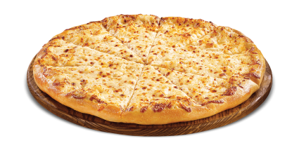
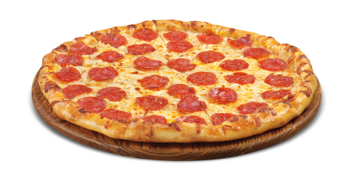
Neil’s Pizzeria
Logo
Home
About Us
Menu
Order Online
Directions/Contact Us
Welcome to Neil’s Pizzeria!
Traditional Italian Food
588 Valley Rd, Wayne, NJ 07470
(973) 305-0405

Slide 3
Neil’s Pizzeria
Home
About Us
Menu
Order Online
Directions/Contact Us
About Us
About Us Information…
*This is the format for all of the pages*
588 Valley Rd, Wayne, NJ 07470
(973) 305-0405

