Slide 1
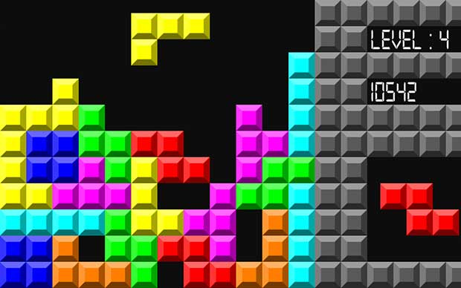
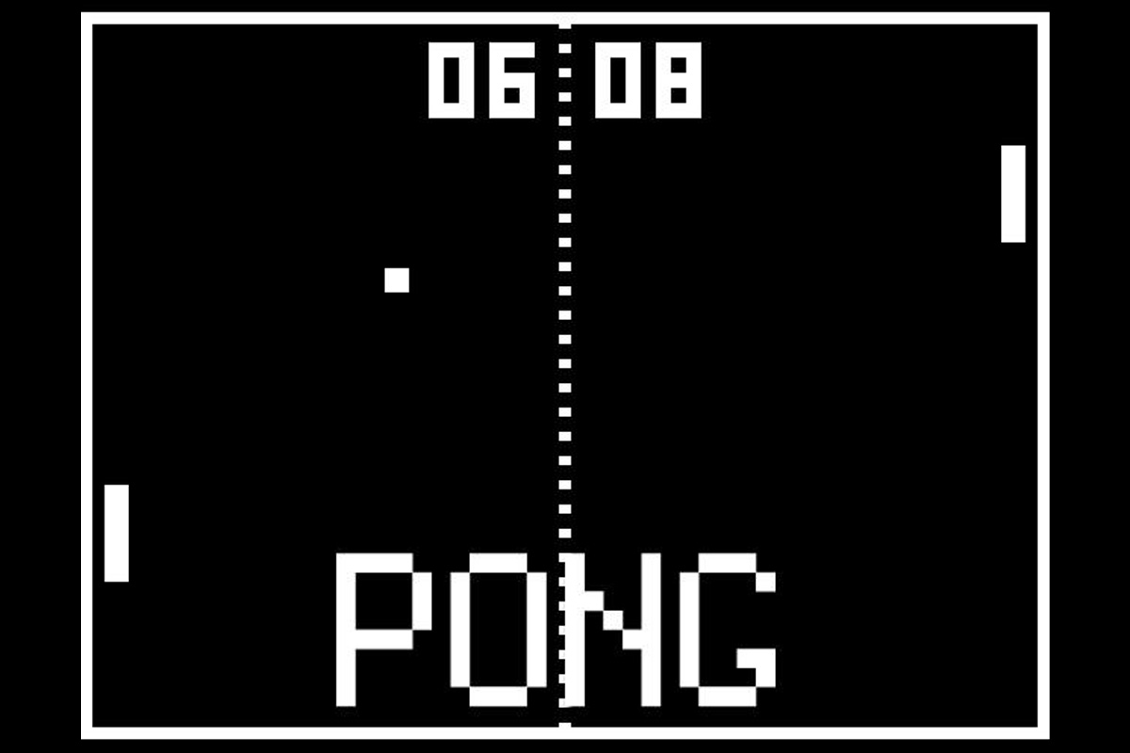
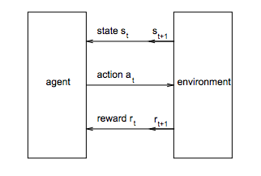
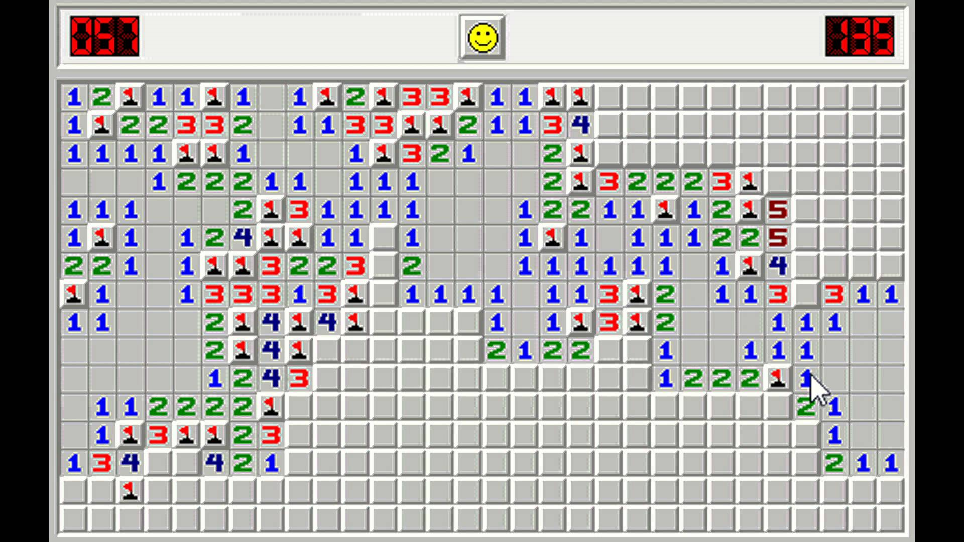
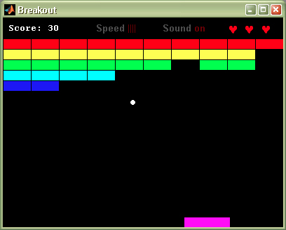
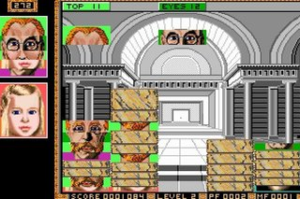
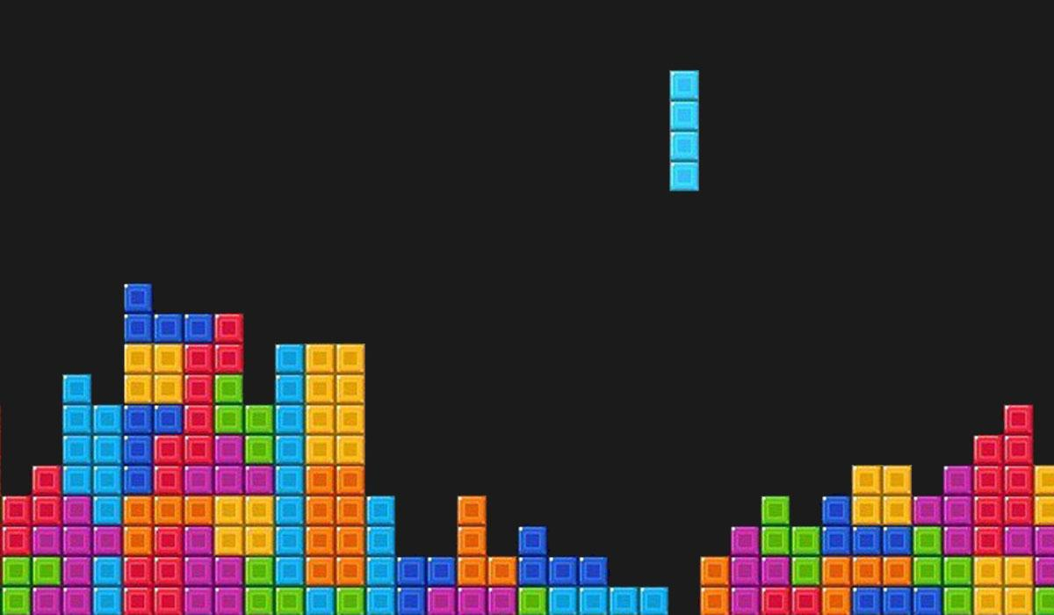
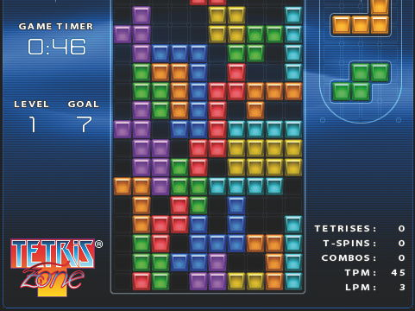
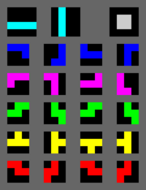
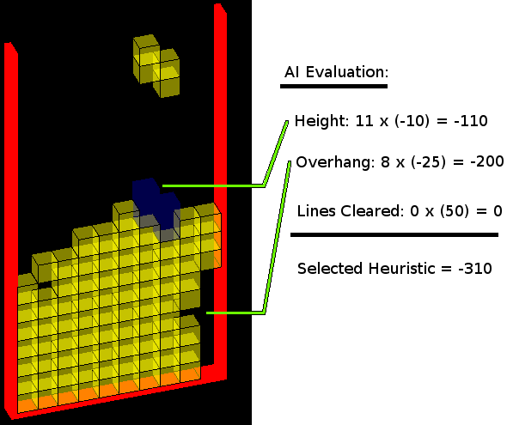



Solving Tetris: A Heuristic-Based Reinforcement Learning Approach
Alex Bartlett, Jake Lynch, Austin King
INTRODUCTION
HEURISTIC & STATE SPACE
APPLYING Q-LEARNING
NEXT STEPS
Artificial Intelligence in Game Playing
Computer science and algorithms found in the field of artificial intelligence have been used to attempt to play and solve popular games for decades (Grob et al., 2008)
Classic video games like Tetris, Pong, Breakout, and Minesweeper are particularly interesting problems because of the computer involvement
Expansions on these games are even more challenging to solve
Challenges in Tetris Heuristic
Difficult to develop good heuristic because goal of game (removing rows) can only be discretized in terms of how many rows a piece can remove, which is between 0 and 4 inclusive
Additional difficulty: removing rows is not the only desired metric to consider, e.g. a piece that removes a row but encloses 15 empty spaces is undesirable
Developing a Heuristic
We considered 4 characteristics of optimal game playing, 1) attempting to remove rows, 2) attempting not to trap empty space, 3) attempting to decrease average height of piece on board, 4) attempting to minimize the height differential between resting place of falling piece and next horizontally adjacent piece
Our original heuristic used characteristics 1 and 2 because they were sufficiently easy to parameterize and adequately increased the performance of the game-playing agent
Reinforcement Learning for Tetris
Tetris is NP-complete, therefore it is impossible to find an optimal policy effectively. Reinforcement learning is especially useful for Tetris because it can be used to approximate useful solutions
Reinforcement learning generally used when action in current state can be selected from action space, must estimate utility of states based on received rewards feedback over time
Tetris is not winnable, therefore reward must be granted throughout game, not at end
Reward function we used is based on normalizing the heuristic and taking into account the highest used row of the board before and after an action
Adversarial Tetris
A new more difficult version of Tetris in which the user plays against the computer, which gives the user the least useful piece possible at every opportunity
Solving this would require use of adversarial game playing algorithms like Minimax as well as our current framework
Faces-tris
Pieces must be arranged to form a complete face of a historical figure
Multiple difficulty levels and a head-to-head mode
Algorithm would need to be trained on each individual face and modified to include multiplayer capability
Figure 1: Traditional representations of classical video games that have been solved using CS. Top left: Tetris, top right: Pong, bottom left: Minesweeper, bottom right: Breakout
Figure 6: An interface of Faces-tris, showing how pieces can be manipulated to form human faces in different columns
Figure 4: A diagram showing the interaction between the game playing agent and its environment, in our case, the Tetris board (Grob et al., 2008)
LITERATURE CITED
BASIC OBJECTIVES
Q Learning for Tetris
Value of each (s, a) pair initialized to 0, updated based on temporal difference estimate
Temporal difference estimate: previous value of pair, discounted reward of taking action a and arriving at state s’, and discounted difference between value of (s’, a’) where a’ is best action at s’ and the value of (s, a)
Running algorithm many times creates even more reliable estimates of values of (s, a) pairs, which means that the best actions are more reliably chosen and the best states are more reliably reached
Solving Traditional Tetris
Main goal: build a Tetris game-playing agent
Develop a heuristic for finding the optimal resting position and rotation for whichever random piece is currently falling
Rotate and place the piece optimally
Improve performance over time using Q-learning
Display self-solving game in a traditional interface
Figure 3: Example of necessary heuristic complexity. Although the piece falling in the board on the left will only complete 1 row, it will not enclose any open space, avoiding the fate of the highly undesirable board on the right
Carr, Donald. “Applying Reinforcement Learning to Tetris.” 2005. Web. 4 Dec 2015.
Groß, Alexander, Jan Friedland, and Friedhelm Schwenker. "Learning to Play Tetris Applying Reinforcement Learning Methods." European Symposium on Artificial Neural Networks. Bruges. 23 Apr. 2008. Lecture.
Challenges in Representing the State Space
A standard Tetris board has 10 columns and 20 rows and each square can be filled or unfilled, leading to approximately 2²⁰⁰ states (Grob et al., 2008)—way too many to store!
Need ways to reduce number of states heuristic and Q-learning must consider
One possibility: consider top 4 filled rows, state space ~10¹², still too large, limiting rows further not insightful enough
Another possibility: consider each column of 4 rows separately, and encode the height of the highest filled cell. This yields ~ 10⁷ different states—reasonable! We will use this approach to representing the state of the board
Drawback to best possibility: no way of representing enclosed open space
ACKNOWLEDGEMENTS
Figure 5: Mathematical representations of how the value of each state is updated. Top: finding the best action at a state using the reward and the discounted value of the next state. Middle: the optimal value function as determined by the reward and an MDP. Bottom: the temporal difference estimate for the optimal value function (Carr 2005)
We thank all of the CS 182 course staff, especially Professor Rush and our assigned project TF, Jaemin Cheun. We also thank the MCB Graphics office for their assistance in printing our poster
Figure 2:
Left: All possible rotations of all possible tetris pieces
Right: An example of a tetris-solving heuristic

