Slide 1



Summer 2025
Quant Finance Mini projects
GitHub Repo
Jake McGrath – Department of Physics, UT Austin
Notes:
1

Slide 2
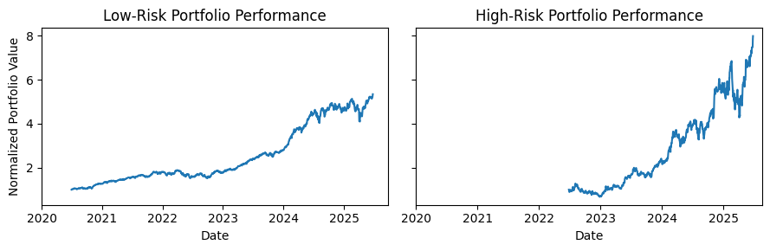
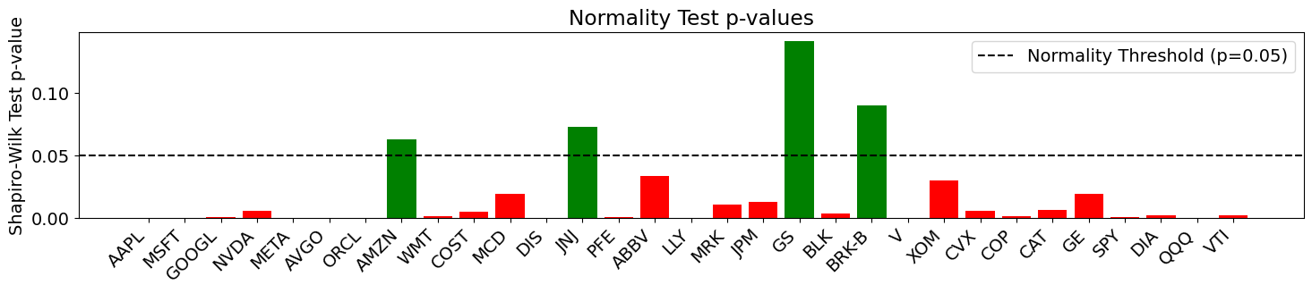
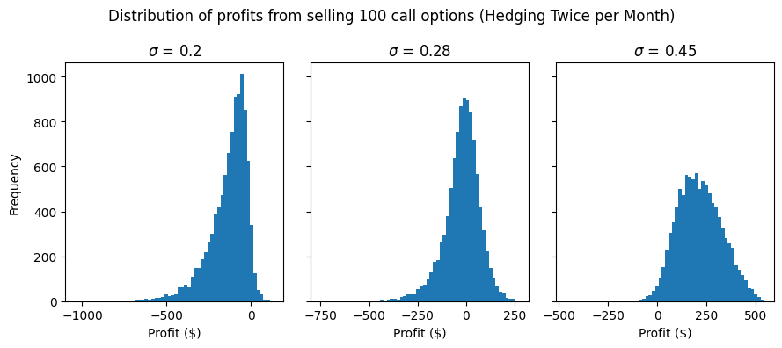
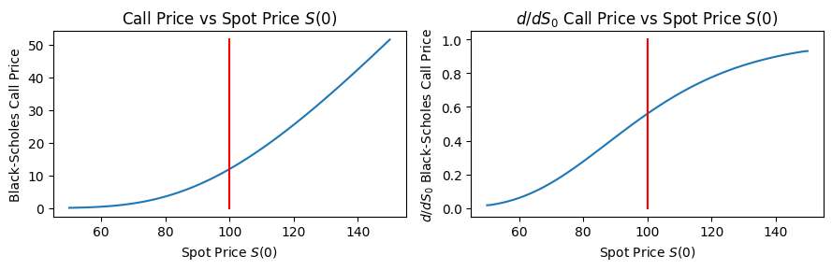
Roadmap
Portfolio Construction
Designed both high-risk and low-risk portfolios using historical stock data from yfinance.
Statistical Assumptions
Tested core assumptions of financial mathematics, including whether stock log-returns follow a normal distribution.
Option Pricing Visualization
Created visualizations to illustrate how option prices evolve with changes in spot price and time to maturity.
Hedging Under Dynamic Volatility
Investigated how time-varying volatility affects the performance of delta hedging strategies.

Slide 3
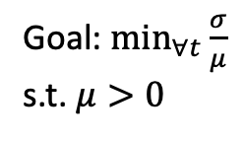

Portfolio Construction
 | Low Risk Portfolio | High Risk Portfolio
Goals | Capital preservation with moderate growth | Rapid growth with volatility
Who’s it for? | Long term gains and stability | Potential large gains with risk tolerance
Quantification metric | Minimize volatility to returns ratio | Maximize returns
Import data for large collection of stocks
Trim stocks that do not meet goals
Assign weights to optimally maximize goal
Construct portfolio
Goal: $\min_{∀t}{\frac{σ}{μ}}$
s.t. $μ>0$
Goal: $\max_{∀t}{μ}$

Slide 4
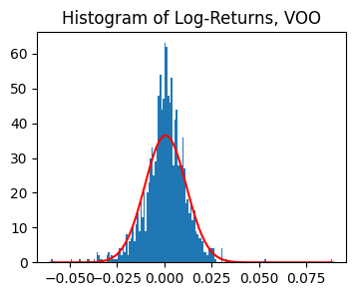
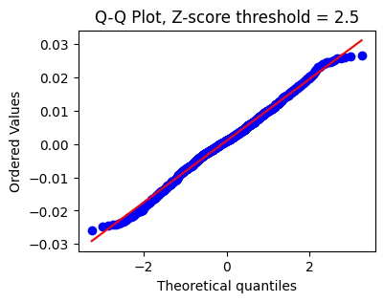
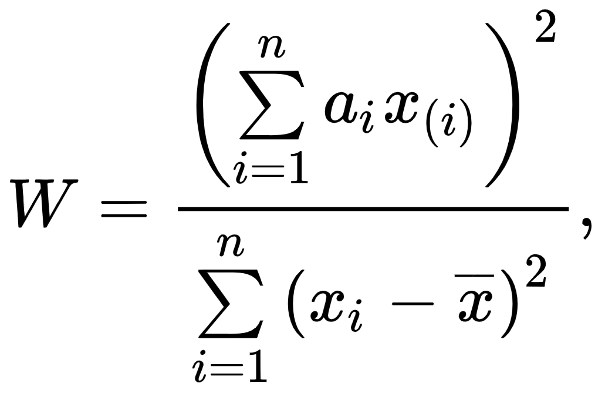
Statistical Assumptions
In financial mathematics, we assume that the log returns of a stock are normally distributed. But are they actually?
Visual inspection with fit
Q-Q Plot with cutoff
Shapiro-Wilk test
Only after trimming extreme values!

Slide 5
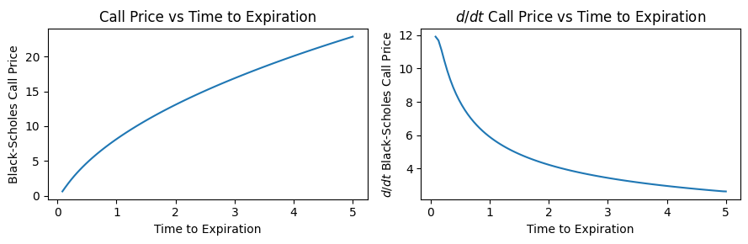
Option Pricing Visualization
How do the Black-Scholes call/put options price changes with respect to time and spot price?

Slide 6
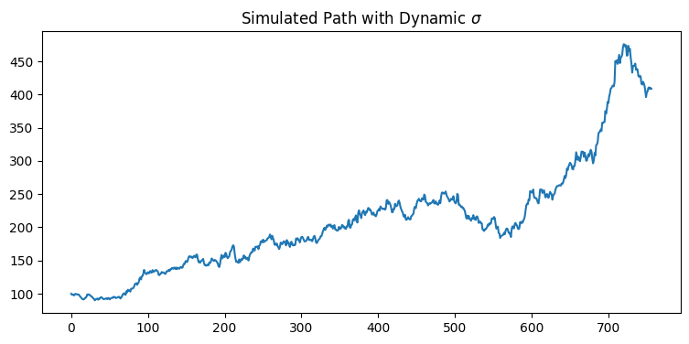
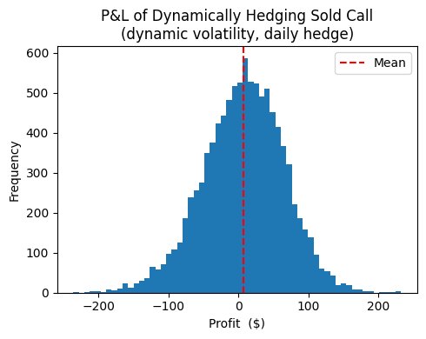
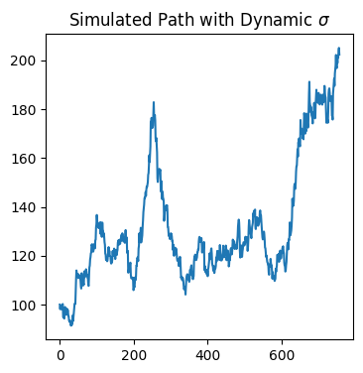

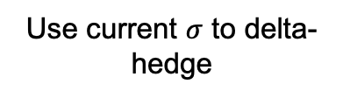

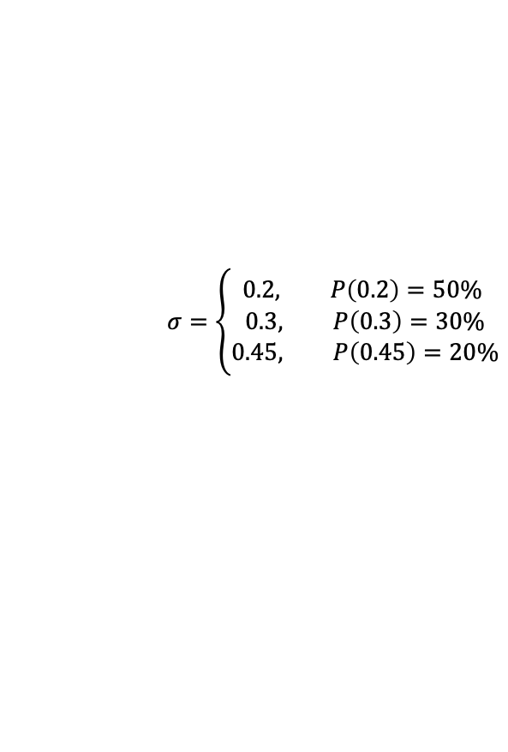
Hedging Under Dynamic Volatility
How does dynamic volatility affect hedging strategies?
Take rolling window of previous stock data
Estimate current $σ$
$$σ=\left\{\begin{aligned}0.2, P\left(0.2\right)=50\% \\ 0.3, P\left(0.3\right)=30\% \\ 0.45, P\left(0.45\right)=20\%\end{aligned}\right.$$
Use current $σ$ to delta-hedge
Repeat for next window
More useful strategy if $σ$ has some sense of momentum or history dependence (and not inherently random)

Slide 7
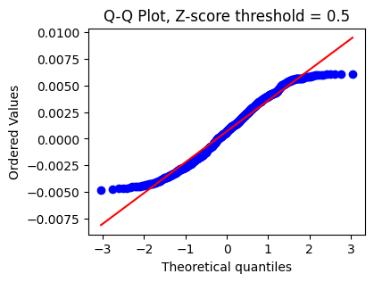
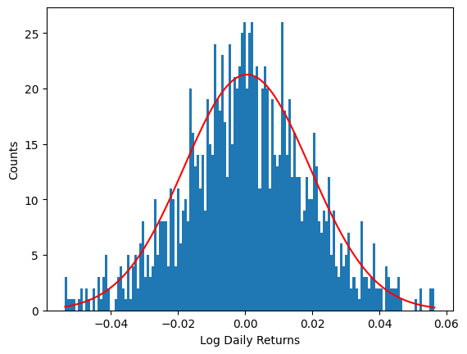
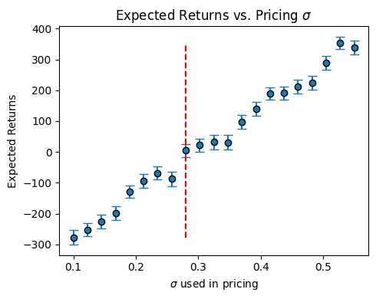
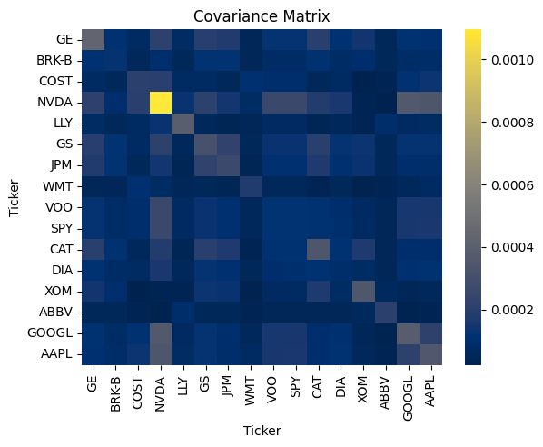

Conclusions
Thanks to the Erdős Institute and please find my LinkedIn profile and GitHub repository below!
LinkedIn Profile
GitHub Repo

