Slide 1


Fall 2022
Muscle modeling
Jake McGrath – Department of Physics, UT Austin
Notes:
1

Slide 2
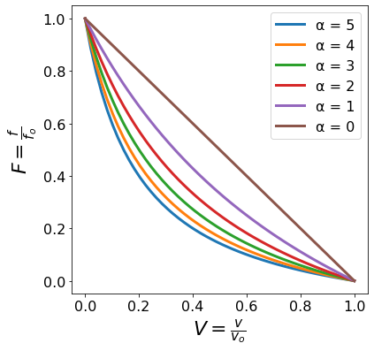
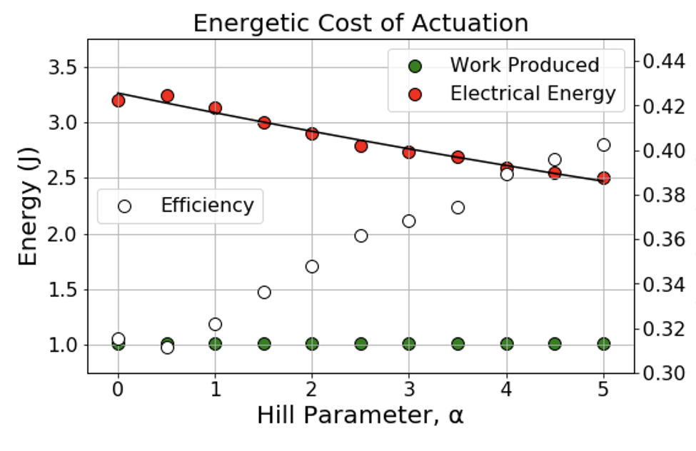
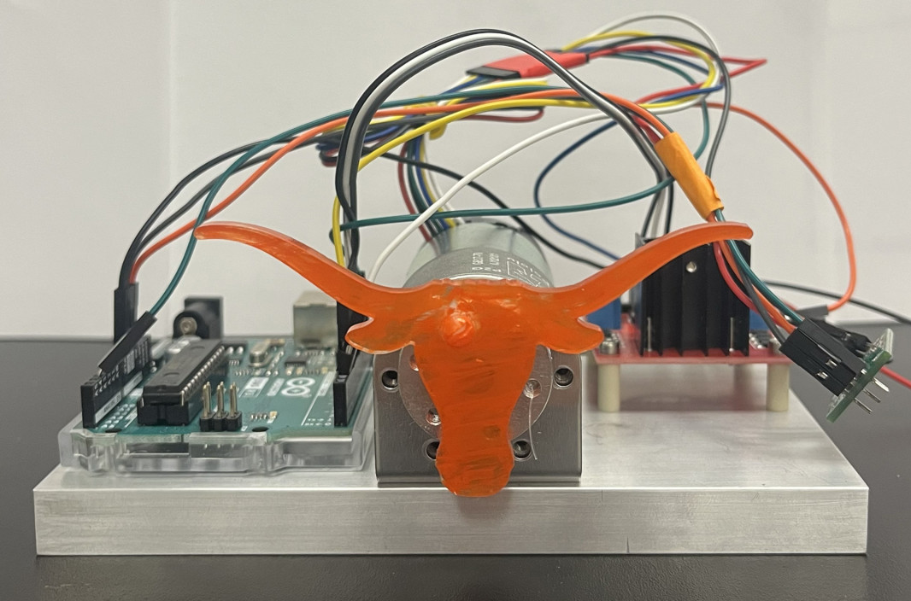
Using code for research
How do the mechanical design principles of biological systems manifest optimal mechanics?
Energy economy
Inherent stability
Reduced information entropy

Slide 3
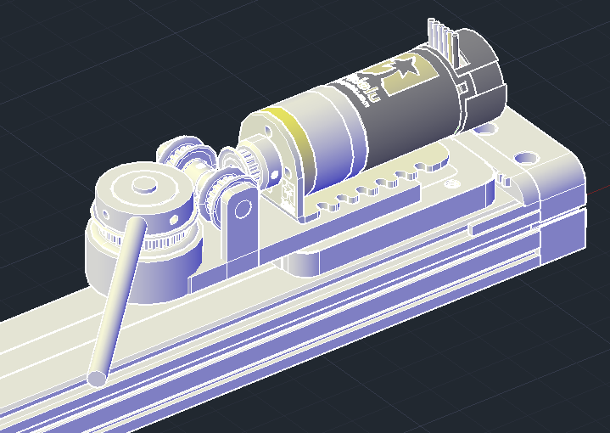
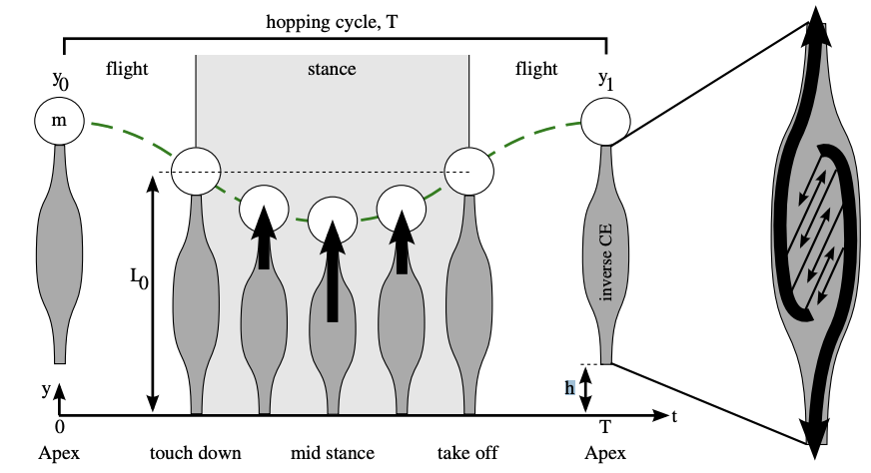
Using code for research
How do the mechanical design principles of biological systems manifest optimal mechanics?
Energy economy
Inherent stability
Reduced information entropy
How does muscle’s nonlinear design generate inherent stability without sensory feedback?
Answer with pairing of simulation and engineered hopper

Slide 4
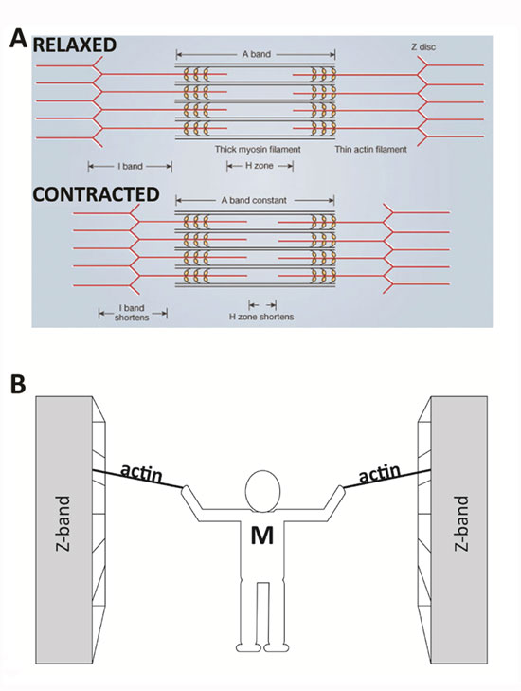
Muscle background
Actin tethered to z-bands at lateral ends of muscle
Myosin walks along actin filaments
Shortening of actin generates tension
Thus, shortening of sarcomere and muscle

Slide 5
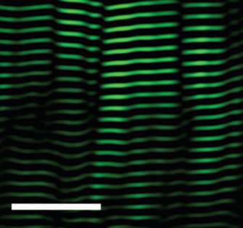
Sliding filament theory of muscle
Muscle arranged in sarcomere pattern
Building blocks of muscle
Many parallel actin and myosin filaments
Huxley (1954) observed A band remained constant length during contraction
l band of thin filaments changes length
Sliding of actin past myosin generates muscle tenson
Introduce tendon / macro stuff / musculoskeletal system not on micro structure of A and l bands
How to input trigger activation trigger dynamics
Looks at ‘alberts’ – ask james
Maybe stick with cartoon or find different image (cross-section view quasi-crystal “fruit fly”)
25 μm

Slide 6
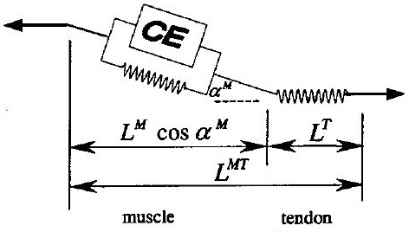
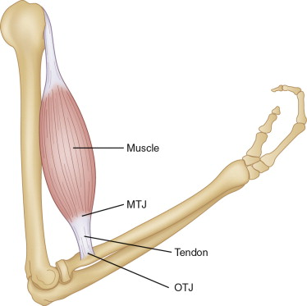
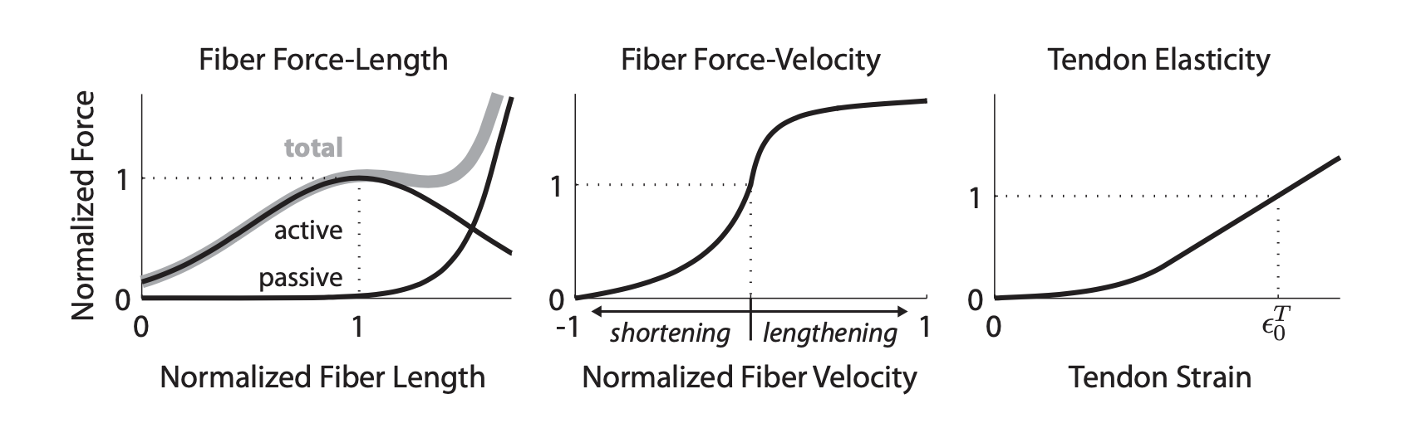
Macroscopic properties of muscle
Parallel element –
Passive connective tissue
Contractile element –
Actin-myosin cross bridges
Series element –
Tendon

Slide 7
Macroscopic properties of muscle
Tendon spring returns energy to system
Make it clear what contractile element is doing
Maybe picture of muscle and tendon in series right here
Make connection between slides before and the model clear
Break up into build animations and fill space

Slide 8
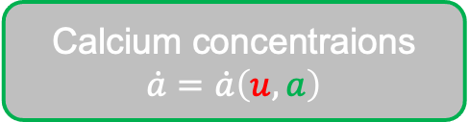
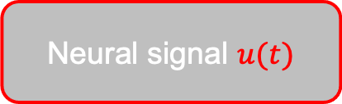
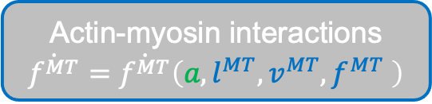
Modeling muscle from neural input
Formulating muscle’s dynamics
Input dynamics
Activation dynamics
Contraction dynamics
Neural signal $u(t)$
Calcium concentraions $\dot{a}=\dot{a}\left(u,a\right)$
Actin-myosin interactions $\dot{f^{MT}}=\dot{f^{MT}}\left(a,l^{MT},v^{MT},f^{MT} \right)$
Muscle
Tendon
Activation Models
Thelen
Winters
Zajac
Manal
Chadwick
Contractile element
Parallel element
Rengifo
AModel
Nagano
Cavallaro
Force-velocity
Force-length

Slide 9
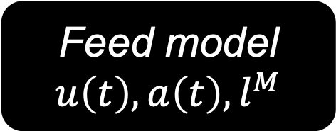

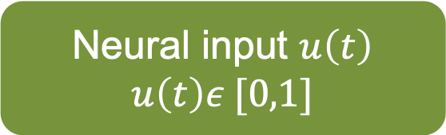
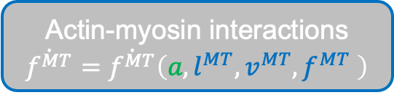
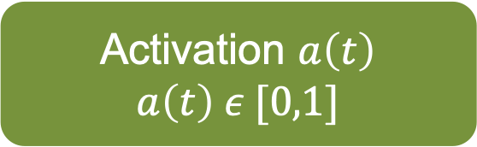
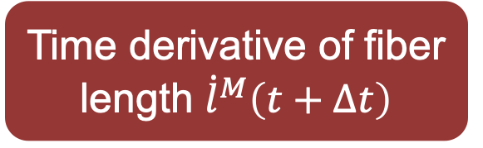
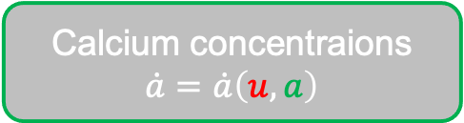
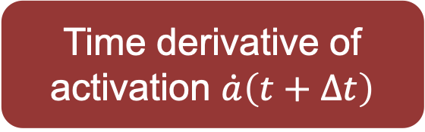
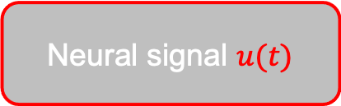
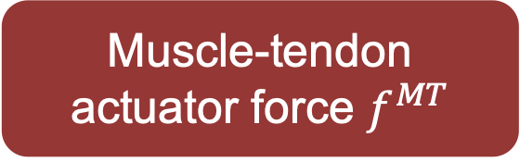
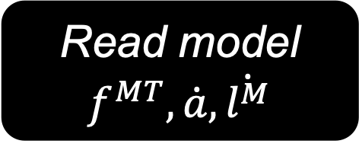
Code structure
Neural signal $u(t)$
Calcium concentraions $\dot{a}=\dot{a}\left(u,a\right)$
Actin-myosin interactions $\dot{f^{MT}}=\dot{f^{MT}}\left(a,l^{MT},v^{MT},f^{MT} \right)$
Inputs
Outputs
Declare activation model
Neural input $u\left(t\right)$
$$u\left(t\right)ε [0,1]$$
Muscle-tendon actuator force $f^{MT}$
Feed model $u\left(t\right), a\left(t\right),l^{M}$
Activation $a\left(t\right)$
$$a\left(t\right) ε [0,1]$$
Time derivative of activation $\dot{a}\left(t+Δt\right)$
Read model $f^{MT},\dot{a},\dot{l^{M}}$
Fiber length $l^{M}$
Time derivative of fiber length ${\dot{l}}^{M}\left(t+Δt\right)$

Slide 10
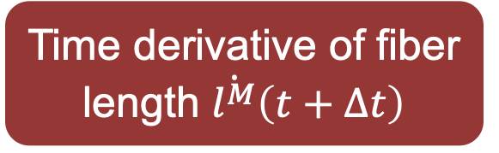
Code structure
Neural signal $u(t)$
Calcium concentraions $\dot{a}=\dot{a}\left(u,a\right)$
Actin-myosin interactions $\dot{f^{MT}}=\dot{f^{MT}}\left(a,l^{MT},v^{MT},f^{MT} \right)$
Inputs
Outputs
Declare activation model
Neural input $u\left(t\right)$
$$u\left(t\right)ε [0,1]$$
Backup slides with equations
Muscle-tendon actuator force $f^{MT}$
Feed model $u\left(t\right), a\left(t\right),l^{M}$
Activation $a\left(t\right)$
$$a\left(t\right) ε [0,1]$$
Time derivative of activation $\dot{a}\left(t+Δt\right)$
Read model $f^{MT},\dot{a},\dot{l^{M}}$
Fiber length $l^{M}$
Time derivative of fiber length $\dot{l^{M}}\left(t+Δt\right)$

Slide 11

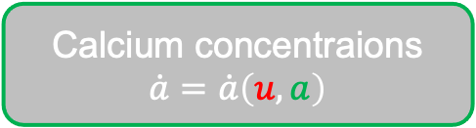
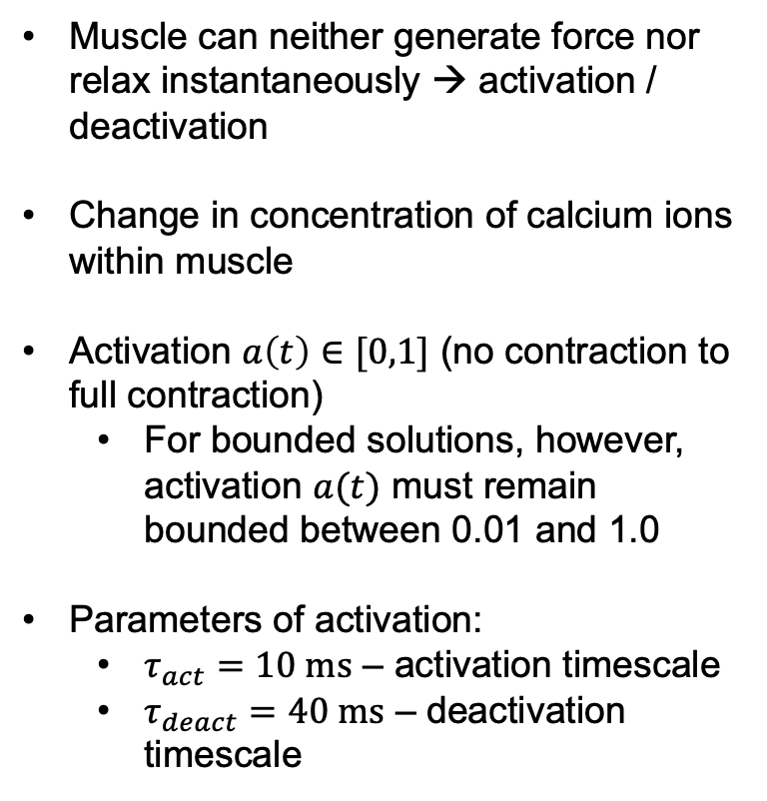

Choice in activation dynamics
Activation dynamics
Calcium concentraions $\dot{a}=\dot{a}\left(u,a\right)$
Muscle can neither generate force nor relax instantaneously → activation / deactivation
Change in concentration of calcium ions within muscle
Activation $a\left(t\right)∈[0,1]$ (no contraction to full contraction)
For bounded solutions, however, activation $a(t)$ must remain bounded between 0.01 and 1.0
Parameters of activation:
$τ_{act}=10 ms$ – activation timescale
$τ_{deact}=40 ms$ – deactivation timescale
Activation Models
Thelen
Winters
Zajac
Manal
Chadwick
Rengifo
AModel
Nagano
Cavallaro
Returns $a(u)$
Returns $\dot{a}(u,a)$
Manal
Chadwick
Thelen
Winters
Zajac
AModel
Cavallaro
Rengifo
Nagano
Delete slide (redundant)

Slide 12
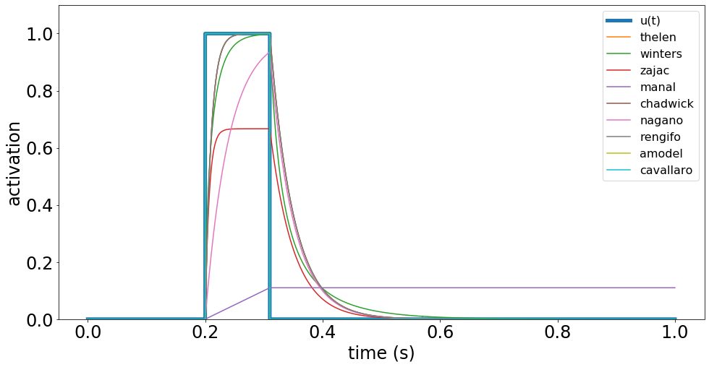
Activation response

Slide 13
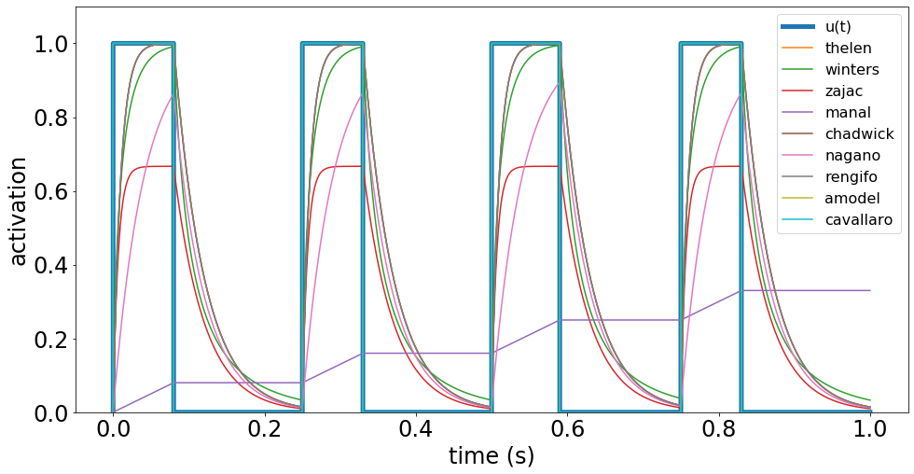
Activation response

Slide 14
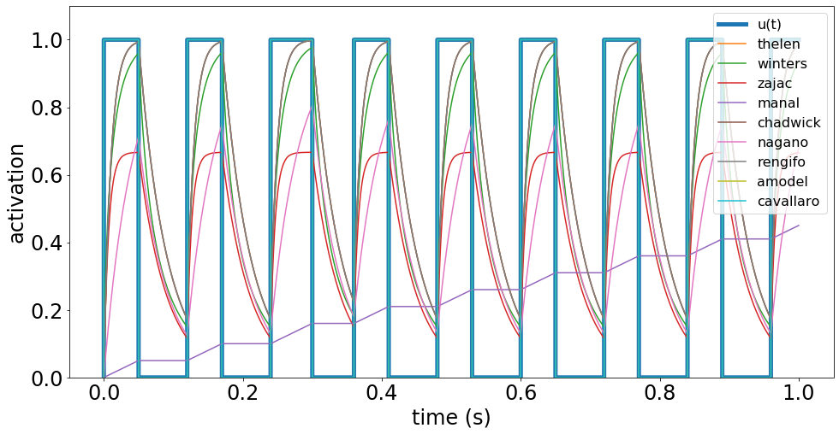
Activation response

Slide 15
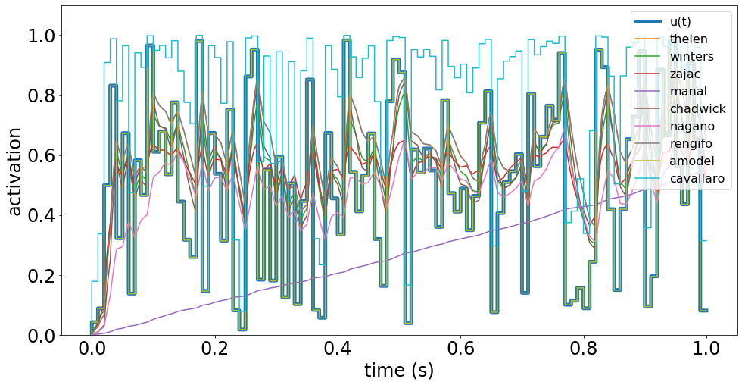
Activation response

Slide 16
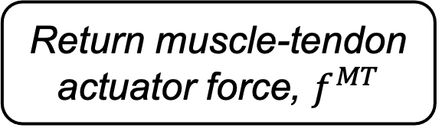
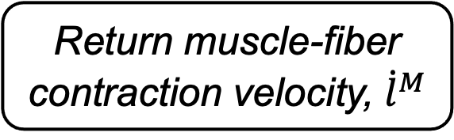
Code structure
model.fiber_velocity()
model.mt_force()
Inverse FV
Tendon force
Active force
Contractile force
muscle = Contraction(signal, activation, length)
Tendon strain
Pennation angle
Passive force
Tendon force
Tendon length
Tendon strain
Return muscle-fiber contraction velocity, ${\dot{l}}^{M}$
Return muscle-tendon actuator force, $f^{MT}$
Tendon length

Slide 17
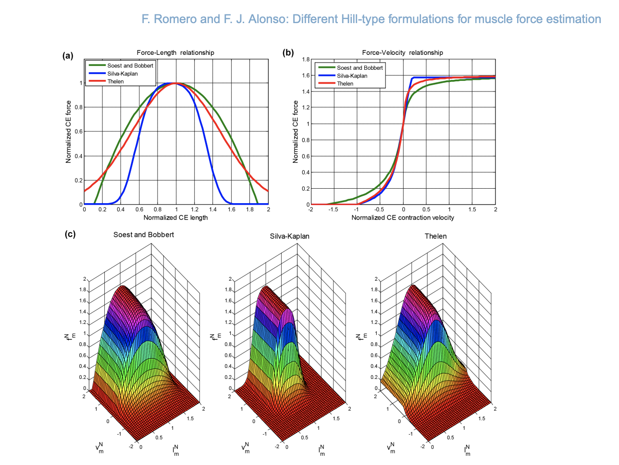
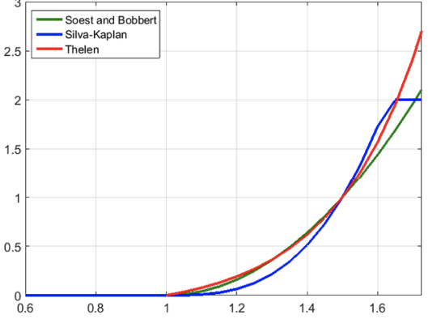
Code Outputs
Normalized force
Normalized active length
Normalized passive length
Normalized force
Normalized contraction velocity

Slide 18
Code Outputs

Slide 19
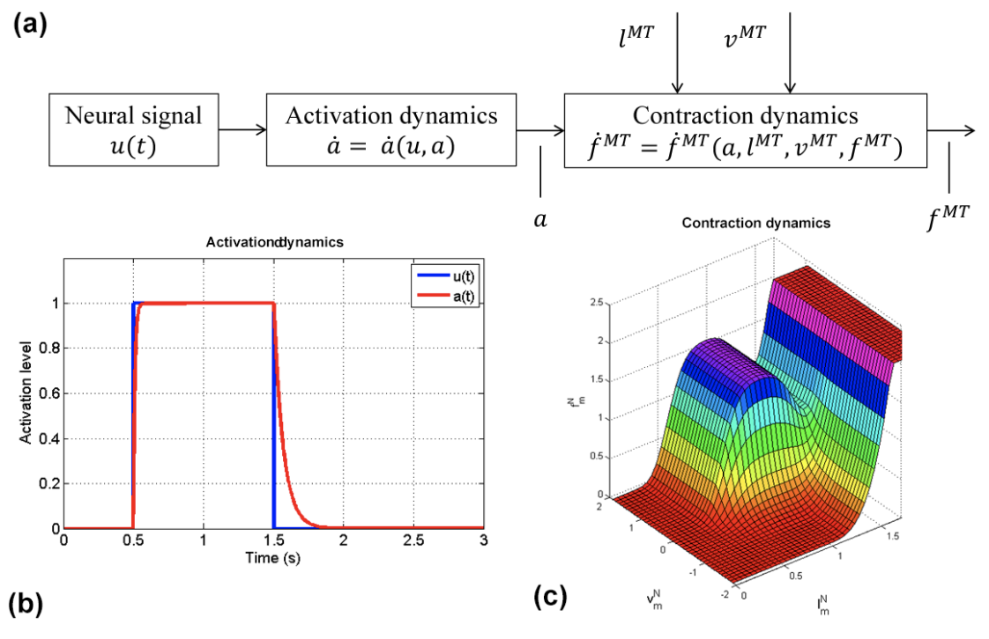
Summary
How does muscle’s nonlinear design facilitate inherent stability?
Pair physical model with simulation
Simulation with easily tunable parameters simplifies study of how tendon elasticity generates stability

Slide 20
Code Outputs
How do different activations generate different landscapes
Which landscape holds the most area?
No activation models depend on differential equations of calcium consumption?
Future work: can supervised learning predict what activation model I used?
Make labels larger

