Slide 1
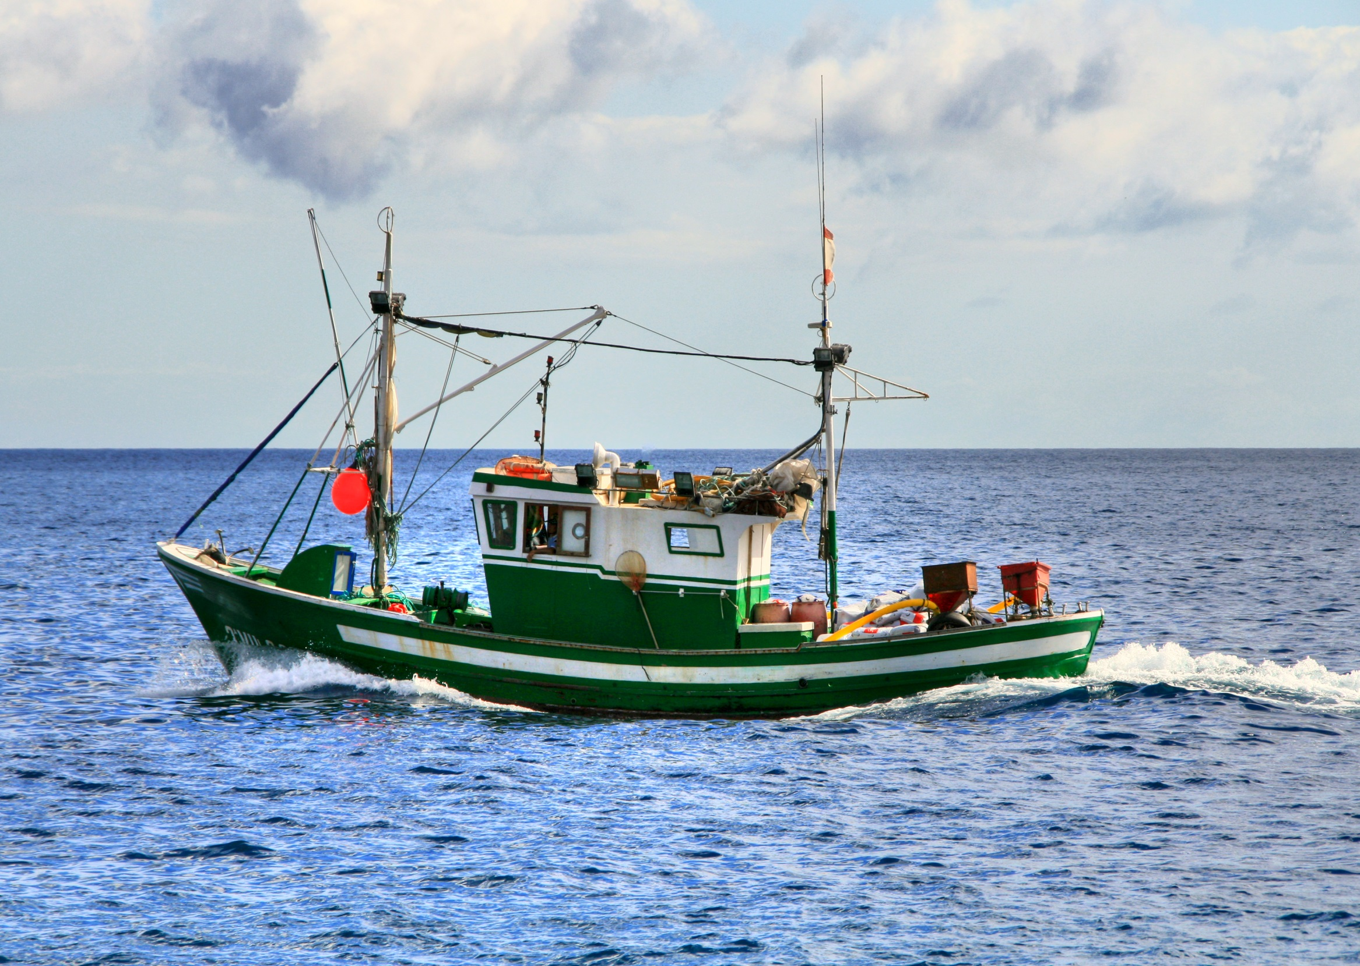
Jake McKay DAT 7
Assessing the Change in Australian Fishing Productivity in the Eastern Indian Ocean from 1950-2013

Slide 2

Question of Interest
How have Australian fishing harvests changed in the Eastern Indian Ocean from 1950-2013?
Avid fisherman, minimal knowledge of international fishing
Intended for fun rather than business value

Slide 3
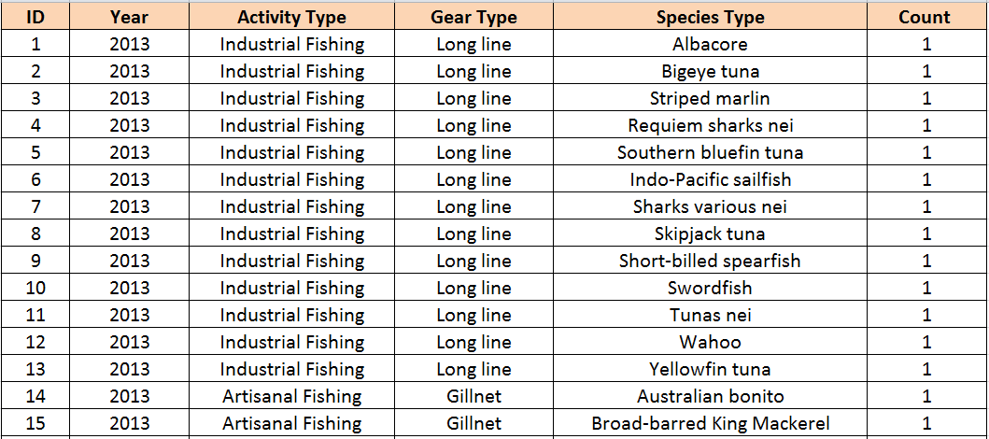
Data Collection and Cleaning
What data have you gathered, and how did you gather it?
Through Indian Ocean Tuna Commission (IOTC) I gathered aggregated annual catches for each IOTC-designated statistical area, by species and fishing gear made by vessels of various countries. The data was aggregated by calendar year for tuna and tuna-like species and non-target species (by-catch). The data set extends back to the 1950’s and is focused on the Eastern Indian Ocean.
Which areas of the data have you cleaned, and which areas still need cleaning?
Removed several variables from original data set to narrow scope
Reduced scope of original data set from 57 countries to 1, Australia.
Reduced scope of original data set from 2 areas of the Indian Ocean to 1, Eastern Indian Ocean
Added a ‘Count’ variable for the response, with each record/row representing one fish caught
Added a ‘ID’ variable to assign each record/row a unique identifier
*nei = “Not Elsewhere Included”
http://www.iotc.org/documents/nominal-catch-species-and-gear-vessel-flag-reporting-country

Slide 4
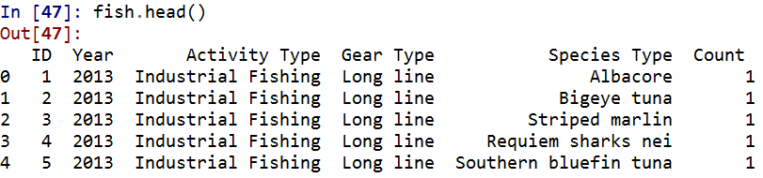
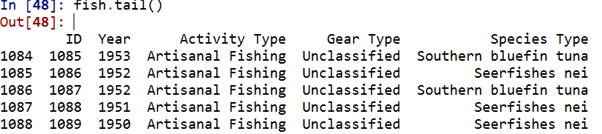
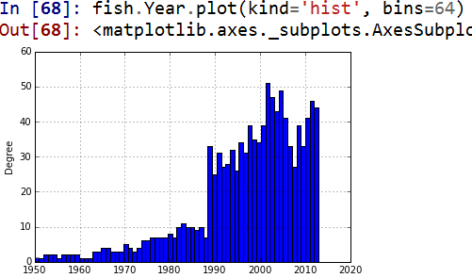
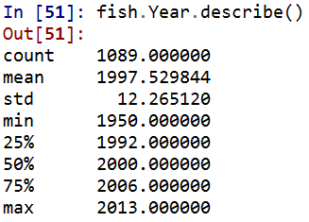
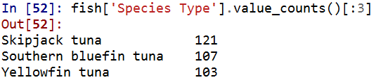

Data Exploration and Preliminary Insight
What steps have you taken to explore the data?
What insights have you gained from your exploration?
Will you be able to answer your question with this data, or do you need to gather more data (or adjust your question)?

Slide 5
Next Steps
The following next steps will be taken to more comprehensively explore the question at hand:
-- Additional Data Visualization techniques will be useful in enhancing my initial understanding of the data and determining whether or not other variables should be considered for inclusion or existing variables should be refined
Checks such as Residual Plots will be useful in terms of determining whether or not linear regression should be used under these circumstances – how much variability exists between each set of feature and response relationships?
Multiple Linear Regression modeling may be the most logical model given the multiple features and the discrete response and identify which combination of the investigated features has the most statistically significant impact on fishing productivity
Confidence Intervals will be useful in terms of anticipating how closely representative these sample fish counts are of the larger population

