Slide 1




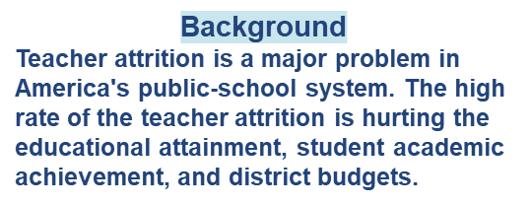
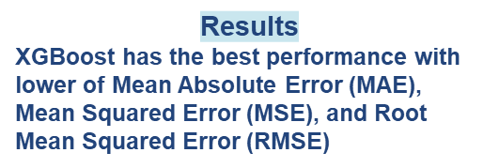
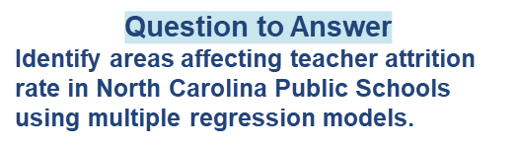
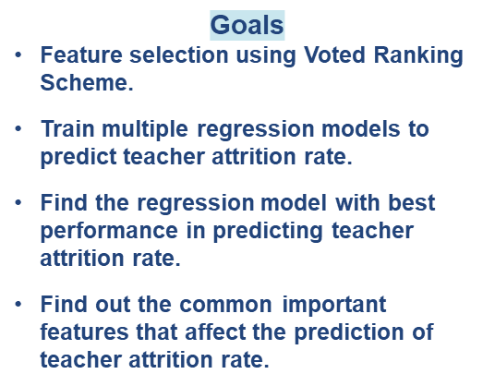
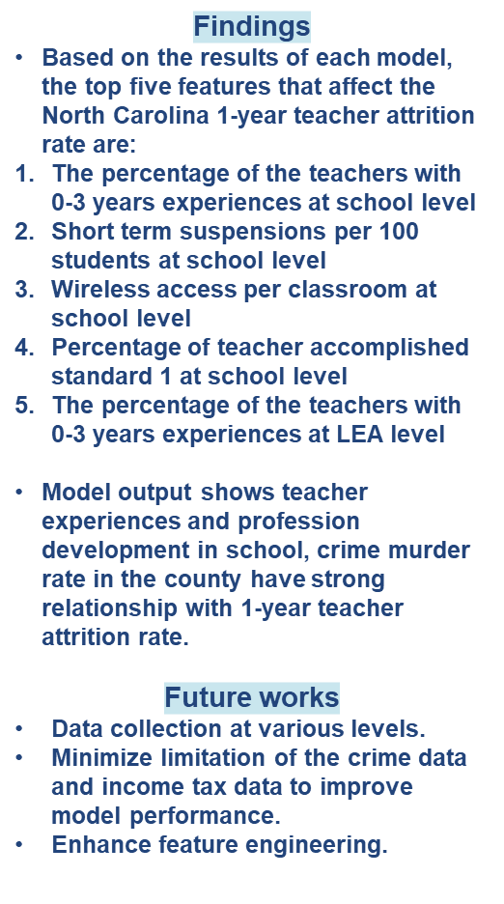
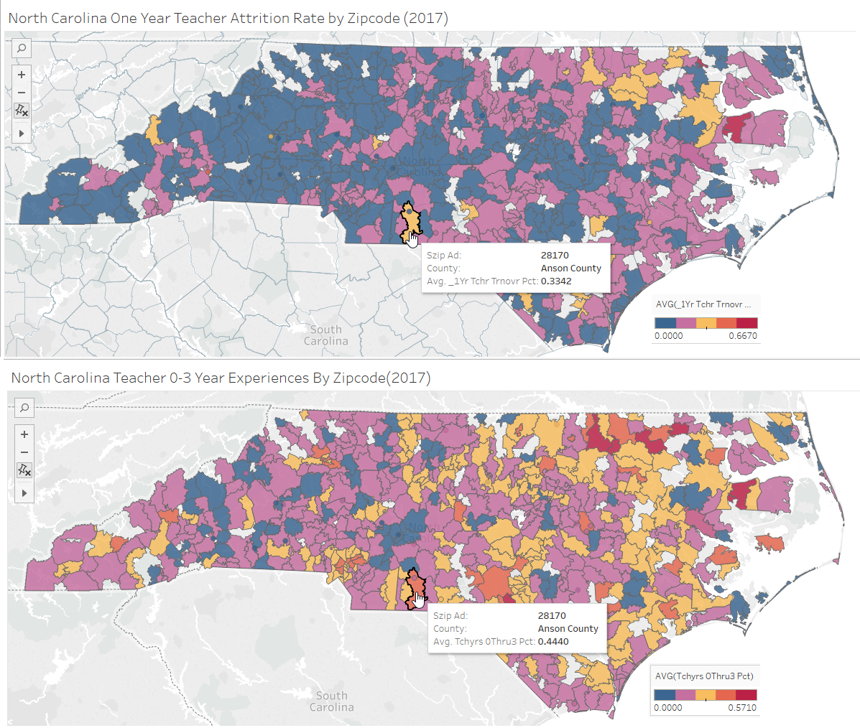
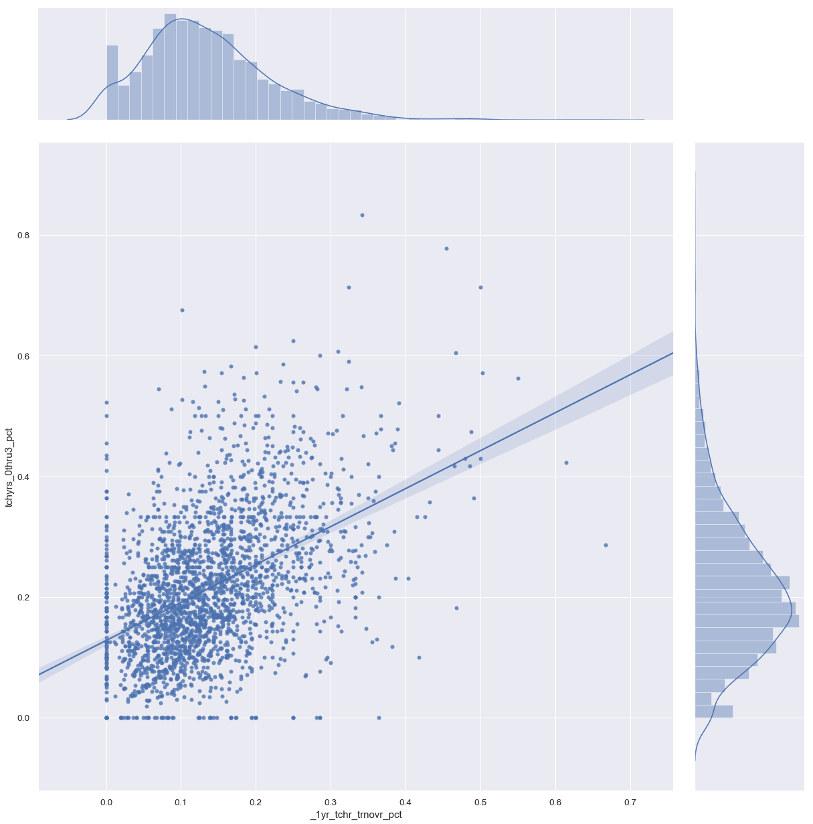
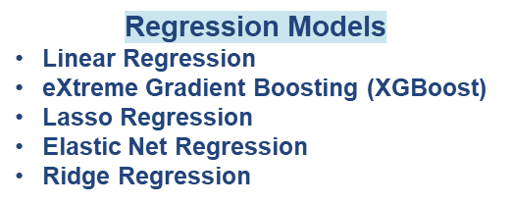
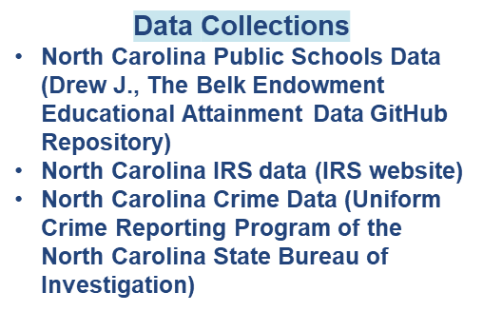
Teacher Retention: Identifying Areas to Improve Teacher Retention in North Carolina Public Schools
Bin Yu, Nuoya Rezsonya, Dr. Jacob Drew
Master of Science in Data Science
Southern Methodist University, Dallas, TX 75275, USA
Features | Linear Reg. | Ridge Reg. | Lasso Reg. | Elastic Net Reg. | RFE | Random Forest | Linear Corr. | MIC | Mean
tchyrs_0thru3_pct | 0.30 | 1.00 | 1.00 | 1.00 | 0.89 | 1.00 | 1.00 | 1.00 | 0.90
lateral_teach_pct | 0.30 | 0.39 | 0.70 | 0.63 | 0.75 | 0.08 | 0.74 | 0.63 | 0.53
Proficient_TCHR_Standard 1_Pct | 0.30 | 0.53 | 0.52 | 0.54 | 0.86 | 0.10 | 0.48 | 0.49 | 0.48
tchyrs_11plus_pct | 0.30 | 0.77 | 0.30 | 0.31 | 0.85 | 0.06 | 0.45 | 0.52 | 0.44
flicensed_teach_pct | 0.30 | 0.23 | 0.33 | 0.22 | 0.85 | 0.19 | 0.66 | 0.69 | 0.43
Developing_TCHR_Standard 4_Pct | 0.30 | 0.48 | 0.60 | 0.60 | 0.61 | 0.03 | 0.32 | 0.31 | 0.41
Crime_Rate_Murder_Rate | 0.30 | 0.63 | 0.55 | 0.63 | 0.75 | 0.02 | 0.15 | 0.14 | 0.40
st_avg_student_num | 1.00 | 0.43 | 0.33 | 0.31 | 0.99 | 0.00 | 0.01 | 0.11 | 0.40
Attrition Other Reasons Perct | 0.30 | 0.48 | 0.52 | 0.48 | 0.89 | 0.08 | 0.16 | 0.24 | 0.39
Model | MAE | MSE | RMSE
XGBoost | 0.0335 | 0.0018 | 0.0426
Lasso | 0.0530 | 0.0050 | 0.0705
Elastic Net | 0.0542 | 0.0052 | 0.0717
Ridge Reg. | 0.0552 | 0.0053 | 0.0730
SVR | 0.0569 | 0.0056 | 0.0747
Linear Reg. | 0.0573 | 0.0076 | 0.0852
In 2016-2017 school year, Anson county:
Average 33.42% teacher attrition rate
Average 44.40% of teachers have 0-3 years teaching experiences
Relationship between 1-year teacher attrition rate and the percentage of teachers with 0-3 years experiences.

