Slide 1
Output
Llama 3.1 405 B
Softmax
Linear
SwiGLU
Rotary Operation Applied
RMS Norm
Nx
Matrix Addition
Masked MHA
Q
K
V
RMS Norm
Embeddings

Slide 2
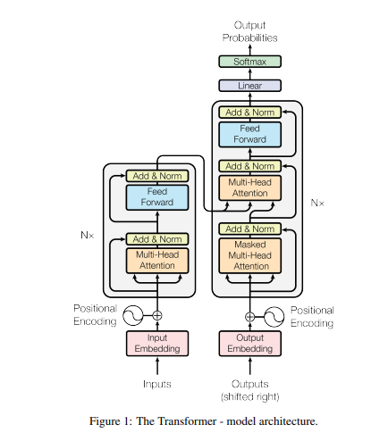

Slide 3
Output
Hybrid 2
Softmax
Linear
GEGLU
Rotary Operation Applied
RMS Norm
Nx
Matrix Addition
MHA
Q
K
V
RMS Norm
Embeddings

Slide 4
Gated Linear Units

Slide 5
Expanded Activation

Slide 6
ReZero

Slide 7
Rotary
Output
Softmax
Linear
SwiGLU
Rotary Operation Applied
RMS Norm
Nx
Matrix Addition
Self Attention
Q
K
V
RMS Norm
Embeddings

