Slide 1
Capstone Projects
Jake Reccelle
7/1/2020

Slide 2
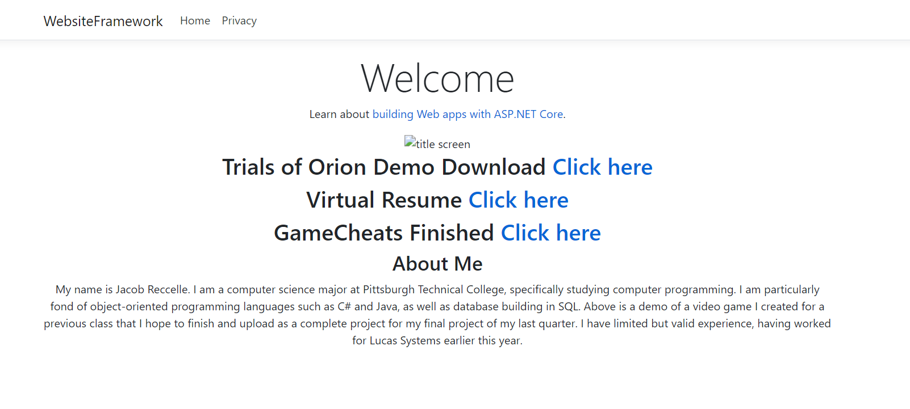
Website Interface
Simple design
Very user friendly, obvious annotations
Everything needed is presented immediately

Slide 3
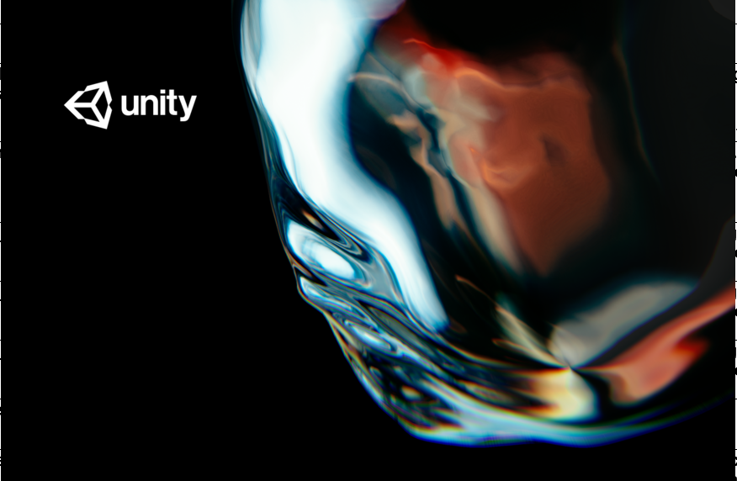
Project 1: Trials of Orion - Program
Made in Unity
Many prior classes of experience
Interesting & fun to use
Provides many assets for devs to utilize

Slide 4
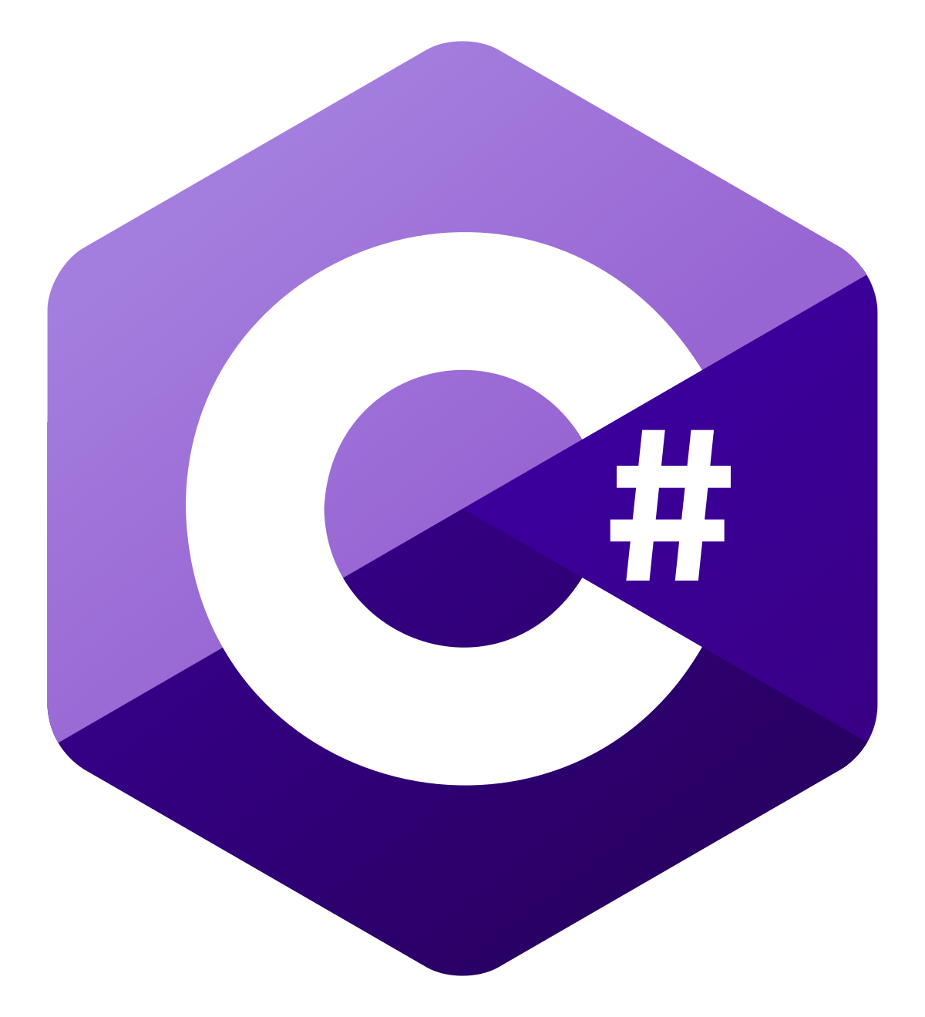
Project 1: Trials of Orion - Language
Written entirely in C#
Personally know C# better than any other object-oriented language
Easy use for scripting
Modern and simple to parse
Plenty of online support, well documented

Slide 5
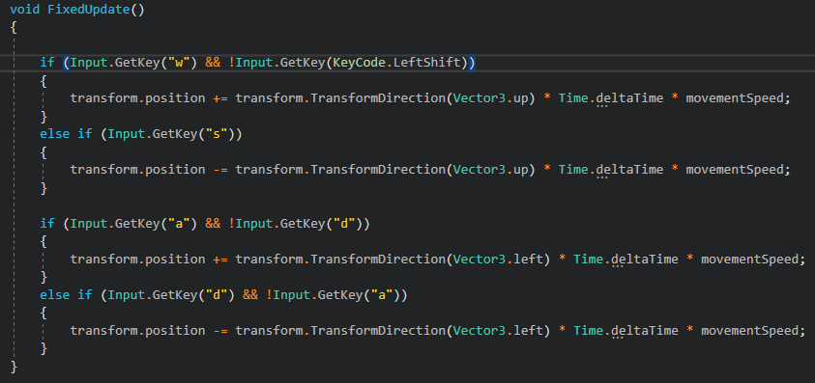
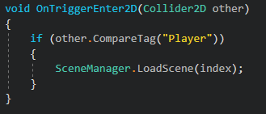
Project 1: Trials of Orion - Processes
Some processes include FixedUpdate() and OnTriggerEnter2D
Used for things like walk cycles, key inputs, and loading the world/levels correctly
SceneManager loads order of scenes and levels correctly

Slide 6
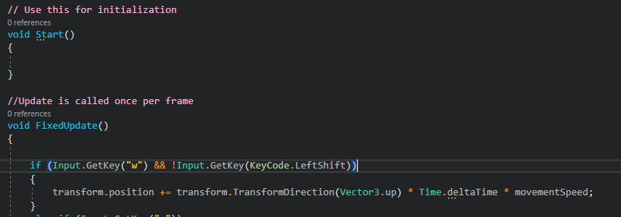
Project 1: Trials of Orion - Documentation
In pink is documentation
Utilized to separate functions and different parts of the code
Mainly used for organizational purposes
Makes it easy to pinpoint bugs

Slide 7
Project 1: Trials of Orion - Reflection
Pros
Cons
Fun to make
Challenging – pushed myself
Interesting to take an existing idea and make it better
Used a lot of online sources and assistance
Could have been better with a little more time invested
Couldn’t get a few animations to work correctly

Slide 8

Project 2: Virtual Resume - Program
Made in Brackets
Full HTML/CSS/JavaScript support
Plenty of prior knowledge in this program
Very user friendly

Slide 9
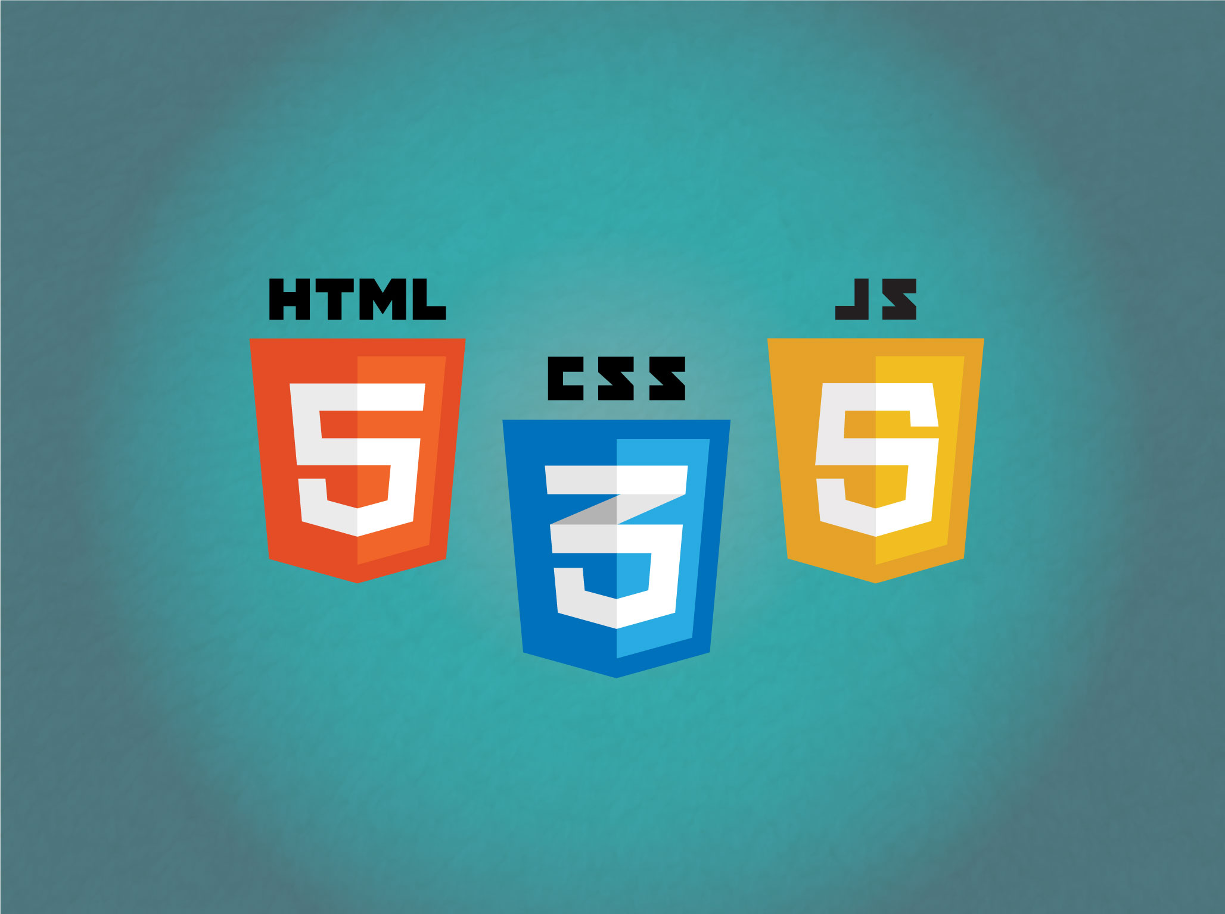
Project 2: Virtual Resume - Language
Made with HTML/CSS/JavaScript
One of my best languages
All go hand in hand – easy to use together
Tons of online support for each one
Quick and easy to learn, making it intuitive for users

Slide 10
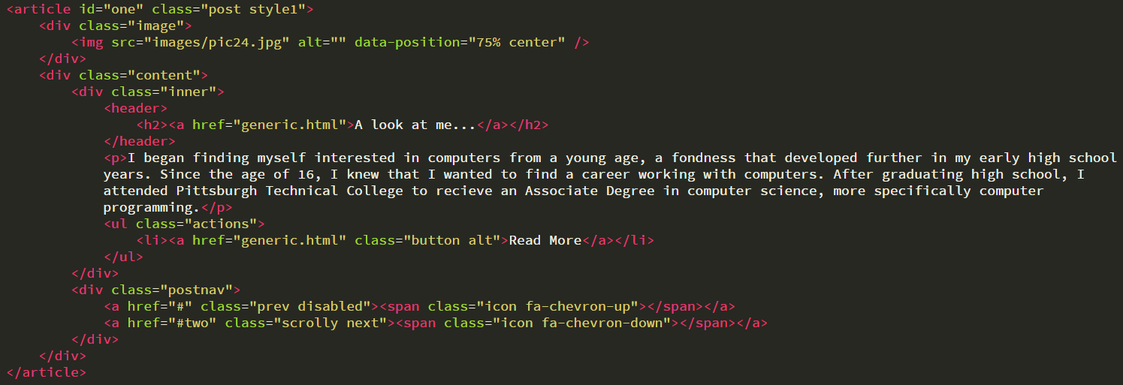
Project 2: Virtual Resume - Processes
Utilization of <div> tag - used to separate code and entries
Used <ul> and <li> tags to create unordered lists and list entries – makes it easy on the eyes for viewers and makes direction of site easy to follow
<div class> tag used for preset individualization of each part of website

Slide 11
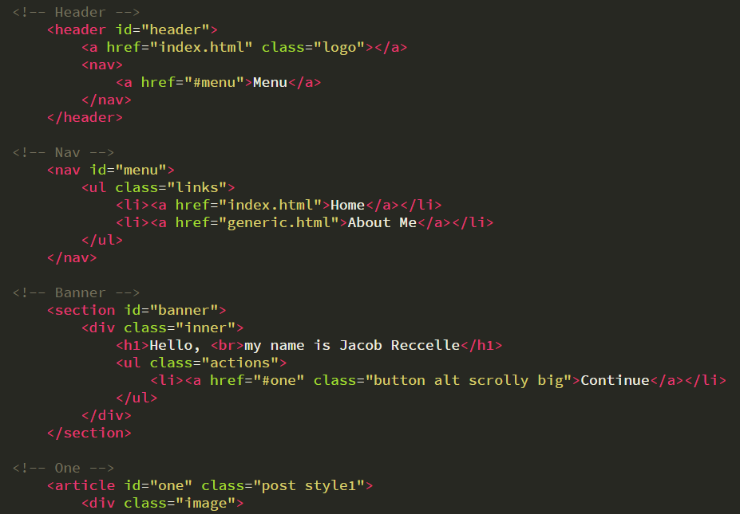
Project 2: Virtual Resume - Documentation
Grayed out text is documentation
Mainly used to divide up separate parts of the code
Useful in pinpointing parts for any reason – bug fixing, minor tweaking to visuals

Slide 12
Project 2: Virtual Resume - Reflection
Pros
Cons
Enjoyed making this because it has potential for future use
Finished quick because of prior experience using software and language
Allowed me to take creative control
Used a hefty bit of online support – looking up tutorials on how to make certain things look good
A little too simplistic – wanted something a little more eye-catching
Felt a little rushed towards the end but still turned out good

Slide 13

Project 3: GameCheats Revisited - Program
Made in Microsoft Visual Studio
Support for 10+ languages including C# and HTML
Heavily used for schooling – know my way around the software
Industry standard for modern day software development

Slide 14
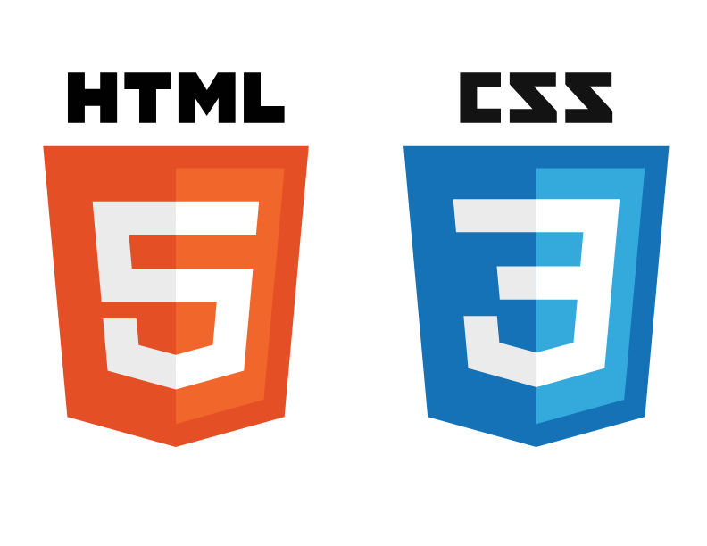
Project 3: GameCheats Revisited - Language
Used a combination of HTML/CSS and C# for this project
Visual studio allows for .Net framework support, as well as hardcoding controllers within the websites that are created
Combining the two was me challenging myself
Allowed me to make a more in depth, full website experience without making it overly complicated

Slide 15
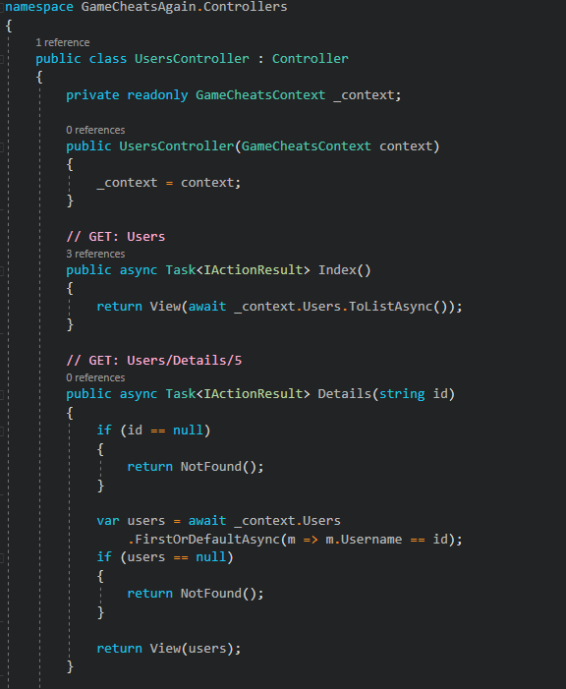
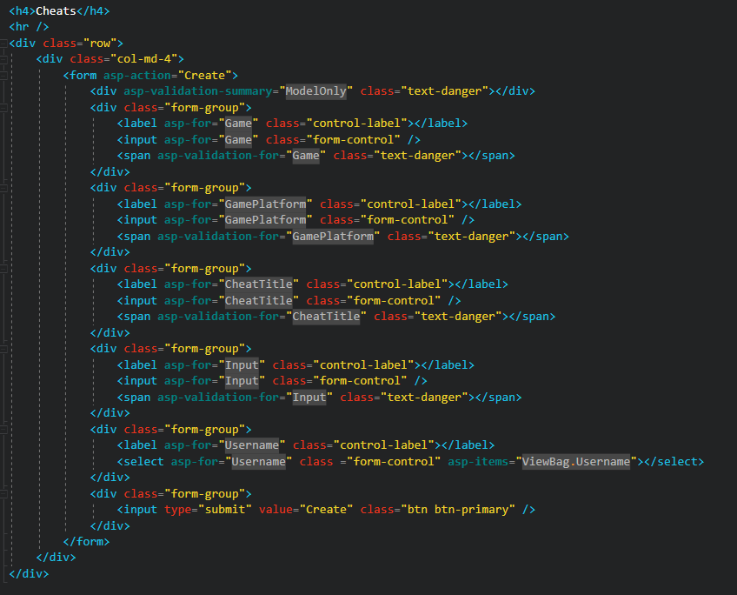
Project 3: GameCheats Revisited - Processes
Namespace used to access controllers and separate functions that work with the program as a whole
Var variable type used to create empty variables that can be assigned as needed
<div> tags used again to assist with spacing and visual appeal of website

Slide 16
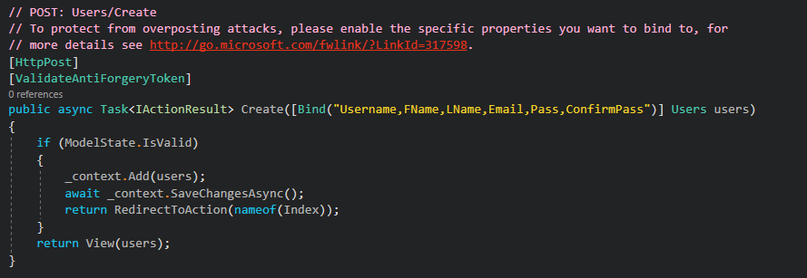
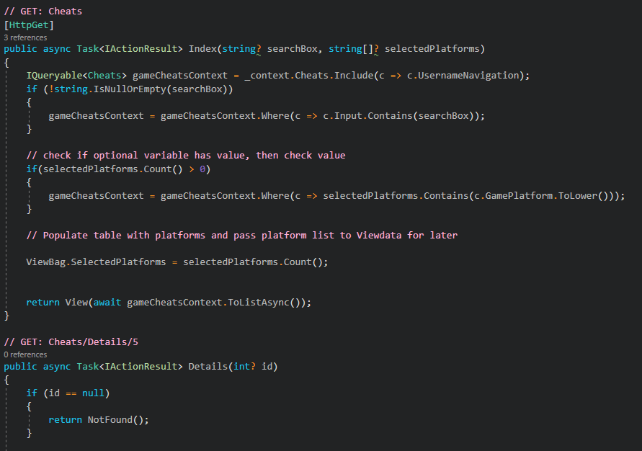
Project 3: GameCheats Revisited - Documentation
Documentation is in pink
Used to explain what each input of code does and what it effects
Useful for debugging and sorting issues
Also allows me to see what piece of code does what and why it is necessary to the program

Slide 17
Project 3: GameCheats Revisited - Reflection
Pros
Cons
Made a previous project feel more completed – got closure in a sense
Felt appropriate as a final project
Utilizing more than one language on a project made it feel like real professional work
Was a previously created project, so not necessarily a new or refreshing idea
Ultimately could have been done better from scratch, but working with what was there felt like more of a challenge
Hard to build on because the original project was difficult to make as well

Slide 18
Works Cited
Mahalle Games. “Dungeonizer - Easy Random Dungeon Generator: Systems: Unity Asset Store.” Systems | Unity Asset Store, 28 Feb. 2019, assetstore.unity.com/packages/templates/systems/dungeonizer-easy-random-dungeon-generator-22162.
Webb, Scott. “Binary by TEMPLATED.” TEMPLATED, 10 Aug. 2016, templated.co/binary.

