Slide 1
House Prices: Advanced Regression Techniques
Jake Rhodes, Phd candidate, Statistics
Matthew Lister, Master’s student, Computer Science
Chase Mortensen, Undergraduate, Computer Science
Notes:
Jake 4,5, 6, 7 14-17, 21
Chase 17-20
Matthew 1,2,3, 8-13

Slide 2
Introduction to the Competition
Dr. Dean De Cock collected data from Ames County while he was on sabbatical
The data was ‘cleaned’ by removing multiple listings, multi family homes, and condos.
This data set was originally used as a semester project for De Cook’s Statistics classes
After publication, the data migrated to Kaggle becoming a training tool for aspiring data scientists
“Over the years I have continued to use this data set [Boston housing], but with each passing year I have become more dissatisfied with its use. The original data set is from the 70’s and the housing prices have become unrealistic for today’s market” --De Cook on the Boston housing data set
Notes:
Matt

Slide 3
Housing Data
Data Summary
2919 Observations (1460 training, 1459 test)
80 Predictor Variables
20 Numerical
60 Categorical
Response: Sale Price
Examples:
Lot Square Footage
Basement Square Footage
Neighborhood
Notes:
Jake 4,5, LASSO ELASTIC

Slide 4
Data Preparation
Missing values
Manual imputation
Removing variables entirely
Categorical Variables
One-hot encoding
Numerical Variables
Log transformations
Standardization
Outliers
Detected via scatterplots and Cook’s Distance
Notes:
Jake

Slide 5
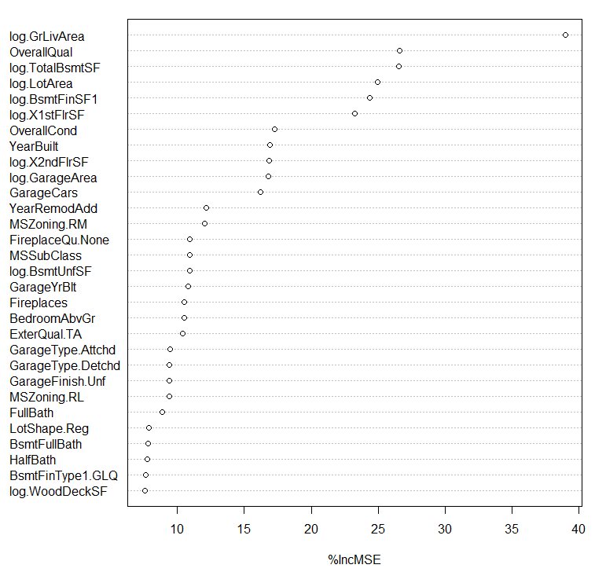
RF Variable Importance (Breiman)
Notes:
Jake

Slide 6
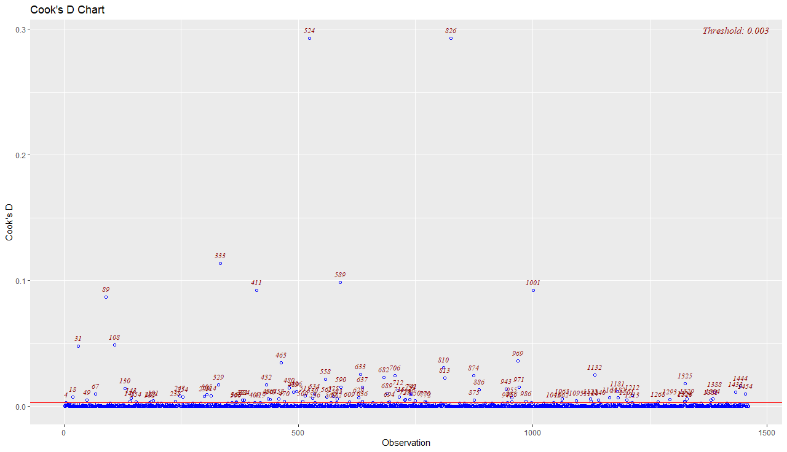
Notes:
Jake
Threshold value 4/#of observations, but we decided to only remove the top 7

Slide 7
Models
Simple Model
Model Extensions
Ensemble
Linear Regression
Random Forests
Principal Components Regression
Ridge Regression
Lasso
Elastic Net
XGBoost
Weighted XGBoost with LASSO

Slide 8

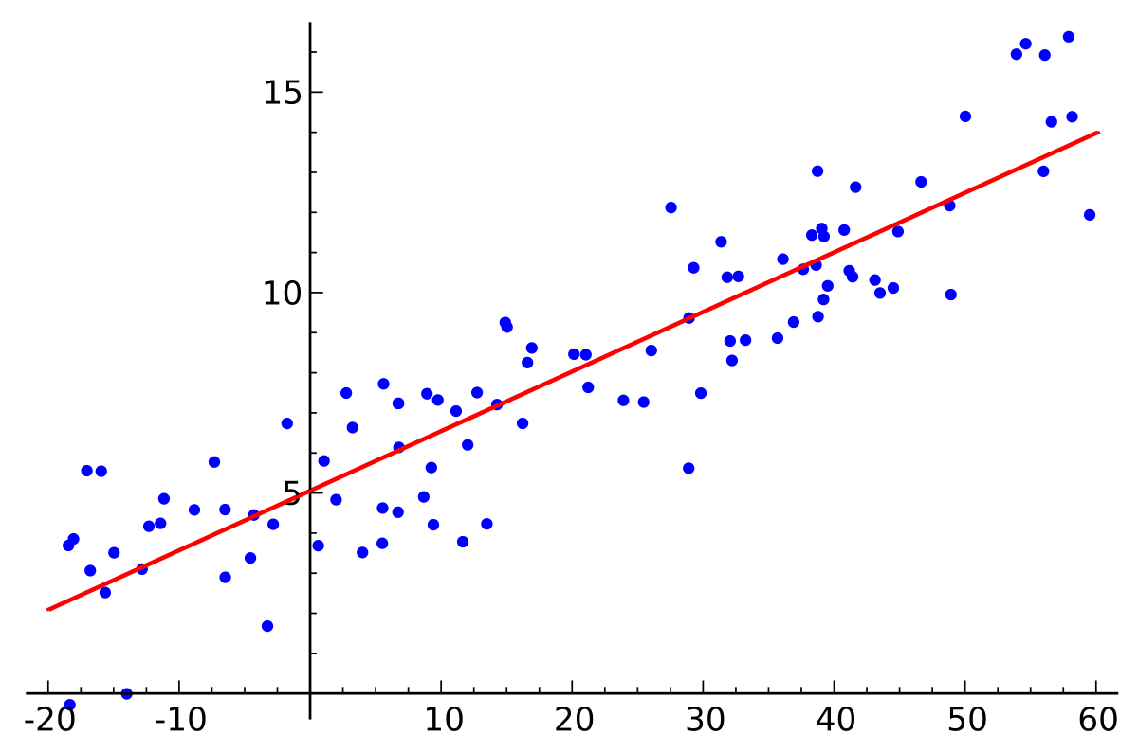
Linear
Regression
Minimizes the Mean-Squared Error
Generally zero bias in the estimators
High variance for some parameters
https://en.wikipedia.org/wiki/Linear_regression

Slide 9
Shortcomings of linear regression
Predictive ability
Interpretative ability
* adapted from lecture slides: Tibshirani, Data Mining. “Modern Regression 1: Ridge Regression. Carnegie Mellon. 5-19-2013.
zero bias -> large variance
Considers all variables equally
Notes:
1. Predictive ability: prediction error results from bias and variance. Linear regression has low bias (zero bias) but suffers from high variance. Ridge regression sacrifices some bias to achieve a lower variance 2. Interpretative ability: with a large number of predictors, identifying a smaller subset of important variables and shrinking the others to improve accuracy. Linear regression is not capable of this.

Slide 10
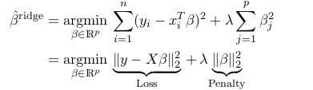
Ridge Regression
Extension of OLS regression
L2 Penalty
Reduces overfitting
Optimization Equation
* adapted from lecture slides: Tibshirani, Data Mining. “Modern Regression 1: Ridge Regression. Carnegie Mellon. 5-19-2013.
Notes:
Developed by Hoerl and Kennard
Ridge regression is like least squares but shrinks the estimated coefficients towards zero. Given a response vector y ∈Rn and a predictor matrix X ∈Rn×p, the ridge regression coefficients are defined as

Slide 11
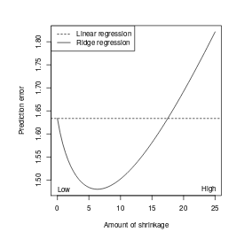
Ridge Regression idea
* adapted from lecture slides: Tibshirani, Data Mining. “Modern Regression 1: Ridge Regression. Carnegie Mellon. 5-19-2013.
We can reduce the coefficients to find a smaller variance by adding a penalty term

Slide 12
Introducing λ
When λ= 0, we get the linear regression estimateI
When λ=∞, we get βridge= 0I
For λ in between, we are balancing two ideas: fitting a linear model of y on X, and shrinking the coefficients
* adapted from lecture slides: Tibshirani, Data Mining. “Modern Regression 1: Ridge Regression. Carnegie Mellon. 5-19-2013.
λ also called a shrinkage parameter, is a penalty term applied to the linear regression equation to penalize large coefficients
Notes:
So how do we choose lambda?
Cross-validation --partition data into even sized groups, train model on all groups except 1, test the model on remaining, then iterate through all groups.
Remember that lambda may reduce a coefficient to close to zero but generally doesn’t ignore them completely in a statistically useful model which brings us to LASSO

Slide 13
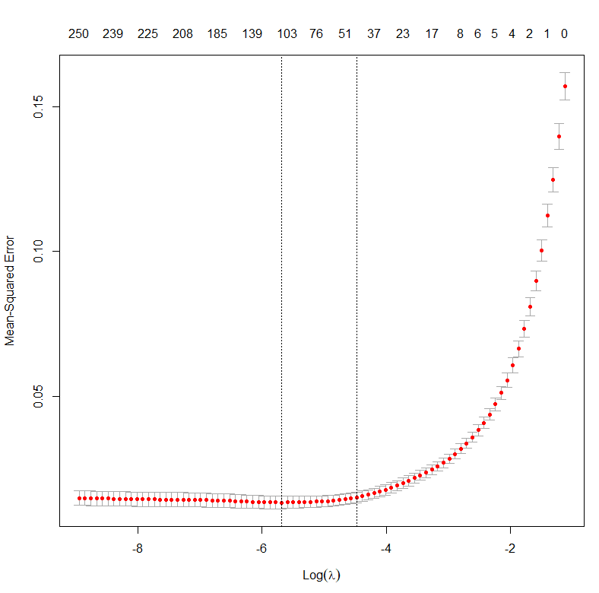
Selecting λ
Range of values considered:
Min: 0.0001
Max: smallest value for which all coefficients are 0
Cross validation is used for λ selection
Measure: MSE
λ 1-se used to prevent overfitting
(Hastie and Quian)
Notes:
Lambda 1-se gives the most regularized model within one standard error of the lambda min.

Slide 14

LASSO
L1 Penalty
Reduces overfitting by “shrinking” variables
Eliminates unnecessary variables
Quick to run
(Least absolute shrinkage and selection operator)
Notes:
Jake

Slide 15
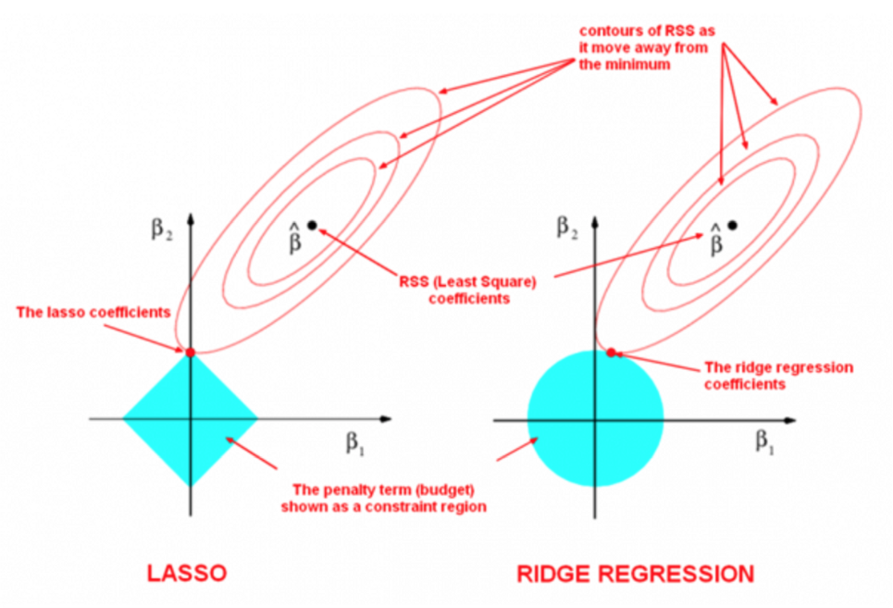
https://medium.com/uwaterloo-voice/a-deep-dive-into-regularization-eec8ab648bce
Notes:
Jake
https://medium.com/uwaterloo-voice/a-deep-dive-into-regularization-eec8ab648bce

Slide 16

Elastic Net
Combines ideas of Ridge regression and LASSO
L1 and L2 penalties applied
Works well even if predictors are correlated
Works for p > n problems

Slide 17
XGBoost
Extension of Gradient Boosting
Gradient Boosting:
Trains weak learners
Data weighted based on accuracy
Yields stronger learners
XGB Uses Newton tree boosting (Nielsen)
Notes:
Jake

Slide 18
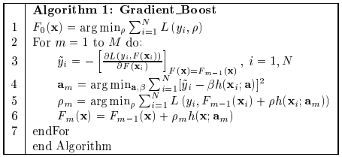
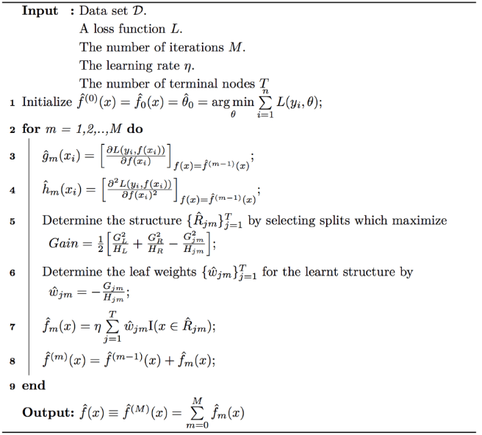
Gradient Boosting vs Newton Boosting

Slide 19
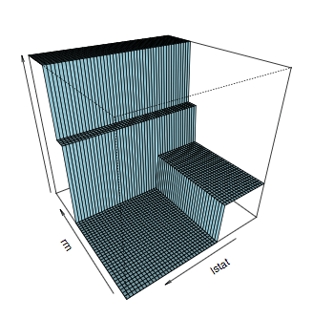
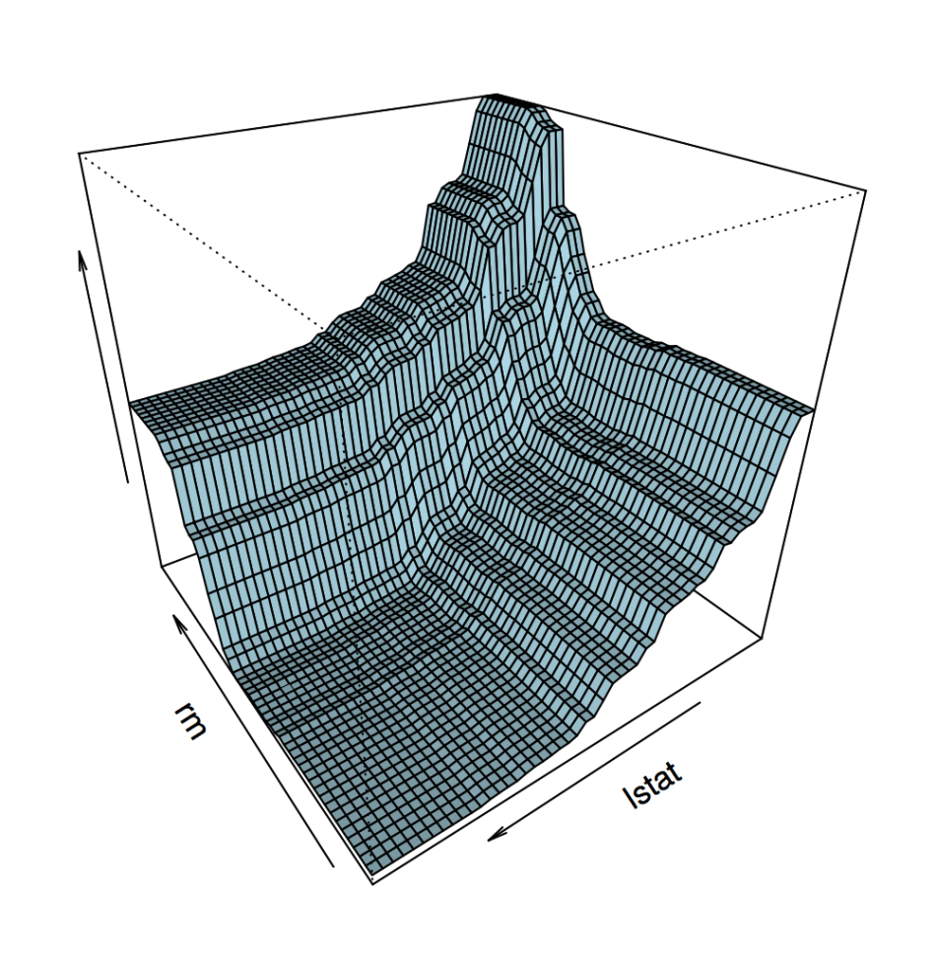
Decision Tree Boundary
XGBoost Boundary
(Nielsen)

Slide 20
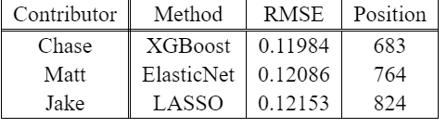
Personal Bests

Slide 21
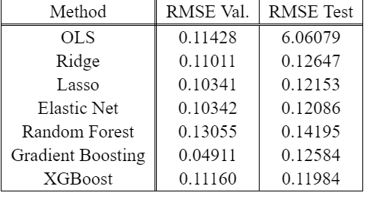
Results
Notes:
Jake

Slide 22
Questions
Sources
Tibshirani, Rob. “Modern regression 1: Ridge regression.”Lecture slides, Carnegie Mellon, 2013.
2: Breiman, L. Random Forests. Machine Learning 45, 5–32 (2001). https://doi.org/10.1023/A:1010933404324
3: https://medium.com/syncedreview/tree-boosting-with-xgboost-why-does-xgboost-win-every-machine-learning-competition-ca8034c0b283

Slide 23
Sources
Leo Breiman. 1998. Arcing classifier (with discussion and a rejoinder by the author).Ann. Statist.26, 3 (06 1998), 801–849.https://doi.org/10.1214/aos/1024691079
Breiman, L. Random Forests. Machine Learning 45, 5–32 (2001). https://doi.org/10.1023/A:1010933404324
Didrik Nielsen. 2016.Tree boosting with xgboost-why does xgboost win "every" machine learning competition? Master’s thesis. NTNU.
Jerome H Friedman. 2001. Greedy function approximation: a gradient boosting machine. Annals of statistics(2001), 1189–1232.
Arthur E. Hoerl and Robert W. Kennard. 2000. Ridge Regression: Biased Estimation for Nonorthogonal Problems. Technometrics 42, 1 (Feb. 2000), 80–86. https://doi.org/10.2307/1271436
Robert Tibshirani. 1996. Regression Shrinkage and Selection via the Lasso.Journal of the Royal Statistical Society. Series B (Methodological)58, 1 (1996), 267–288
Hui Zou and Trevor Hastie. 2005. Regularization and Variable Selection via the Elastic Net. Journal of the Royal Statistical Society. Series B (Statistical Methodology) 67, 2 (2005), 301–320. http://www.jstor.org/stable/3647580
https://web.stanford.edu/~hastie/Papers/Glmnet_Vignette.pdf

Slide 24
Sources
Tianqi Chen and Carlos Guestrin. 2016. XGBoost: A Scalable Tree Boosting System. In Proceedings of the 22nd ACM SIGKDD International Conference on Knowledge Discovery and Data Mining (San Francisco, California, USA) (KDD ’16). ACM, New York, NY, USA, 785–794. https://doi.org/10.1145/2939672.2939785
Leo Breiman. 1996.Vertex Types in Book-Embeddings. Technical Report. Berkeley, CA, USA.
Dean De Cock. 2011. Ames, Iowa: Alternative to the Boston Housing Data as an End of Semester Regression Project. Journal of Statistics Education 19, 3 (2011), 1–14. www.amstat.org/publications/jse/v19n3/decock.pdf

