Slide 1
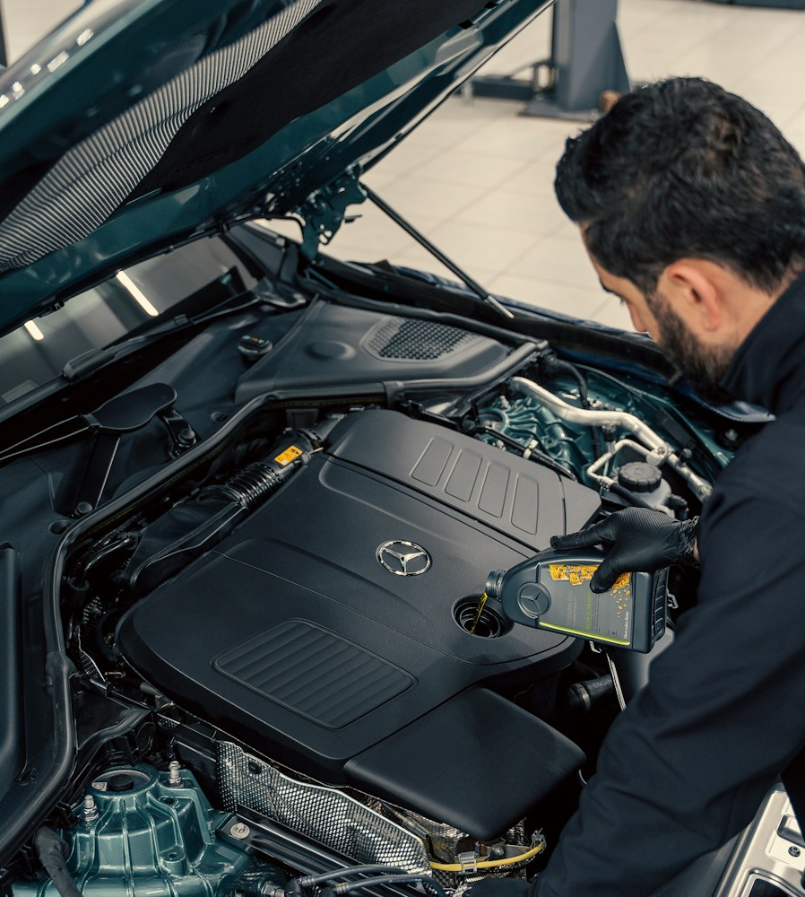
Engine fault
detection from
sound
Can a short recording help a fleet
prioritize inspections?
Jeffrey Gregory and Jake Van Slyke
Notes:
~40 seconds. A fleet shop has a limited number of technician hours and has to decide which vehicles to look at first. We asked whether a short audio recording can add evidence to that decision. Our best model performed well on the public test split, but the experiment also revealed how strongly the model can recognize recording source. For a 4–5 minute delivery, spend 20 seconds on this cover and roughly 40 seconds each on slides 2, 4, 5, 8, 10 and 11. The full sequence runs about 11 minutes. A natural handoff is after the experiment comparison on slide 5.
Source: Dextar Studio on Unsplash, https://unsplash.com/photos/mechanic-inspecting-a-car-engine-with-hood-open-erWc6mrOq_I

Slide 2
Engine inspection triage
A service writer records up to 10 seconds of engine sound.
A fault flag helps a technician decide what to inspect first.
≥85%
≤20%
<1 s
Mean recall across
knock and misfire
Healthy clips
flagged for inspection
Target per clip
on a laptop CPU
Missed faults can delay repairs. False alarms use technician time.
Notes:
~55 seconds. The current workflow depends on reported symptoms and a technician listening to or examining the engine. The proposed model gives the service writer one more input for triage. Fault recall is the average of recall for knock and misfire, so a rare fault matters as much as a frequent one. A healthy false alarm is the fraction of healthy recordings flagged as either fault. We tracked these together because one could catch every fault by flagging every vehicle. The laptop timing target reflects the likely shop hardware.
Source: https://github.com/jakeryderv/car-sound-fault-detection/blob/refactor/lean-notebook/notebooks/engine_fault_classification.ipynb

Slide 3
The KweriMoto recordings
1,067 clips, three labels, up to 10 seconds each
Recording source | Healthy | Knock | Misfire
AudioSet | 0 | 322 real | 0
Revix | 271 | 286 synthetic | 0
Hugging Face | 80 | 0 | 108
721 train, 154 validation, 154 mixed test, 38 real-knock test
We kept related recordings and overlay sounds in the same split.
Notes:
~65 seconds. KweriMoto provides mono 16 kHz clips and grouped splits. Revix knock examples are made by overlaying an AudioSet knock on another car recording. The table shows the central limitation: every misfire comes from one source, and every clip in the AudioSet source group is a real knock. Grouping clips and checking overlays prevents leakage across our splits. It cannot disentangle the source and fault labels or rule out overlap with the original AST pretraining data. The 38-clip real-knock split measures knock recall only.
Source: https://huggingface.co/datasets/rayyyyy007/kwerimoto-engine-sounds
Source: https://github.com/jakeryderv/car-sound-fault-detection/blob/refactor/lean-notebook/notebooks/engine_fault_classification.ipynb

Slide 4
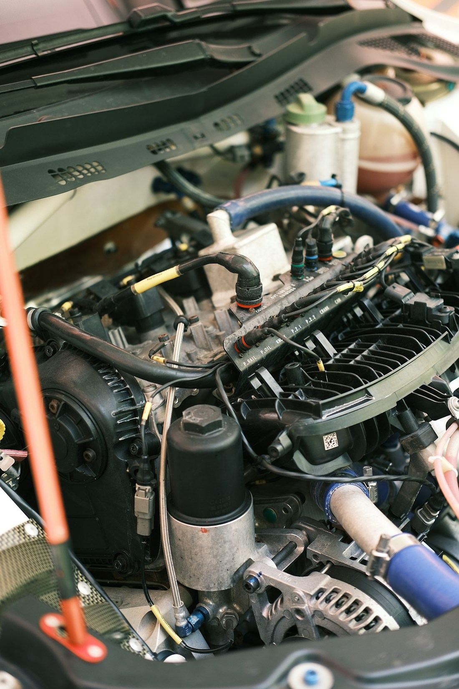
A pre-trained model with a small classifier
Audio Spectrogram Transformer (AST)
AudioSet training gives AST a starting point for recognizing patterns in engine sounds.
Frozen AST baseline
AST summarizes each recording. We train a 2,307-parameter classifier on those summaries.
Alternative model
CLAP matches audio to text prompts. Its zero-shot fault recall was 22.2% on validation.
Notes:
~55 seconds. AST converts the audio to a spectrogram, which represents frequency content over time. Its AudioSet checkpoint already recognizes many sounds, including engine-related classes. We used its 768-dimensional summary as input to a linear classifier. Keeping the backbone frozen meant training only 2,307 parameters. CLAP is another reasonable audio model because it can score prompts for all three labels. Our zero-shot CLAP result compares that starting point on these prompts. Fine-tuning CLAP would be a different experiment.
Source: https://huggingface.co/MIT/ast-finetuned-audioset-10-10-0.4593
Source: https://www.isca-archive.org/interspeech_2021/gong21b_interspeech.html
Source: https://huggingface.co/laion/clap-htsat-unfused
Source: https://github.com/jakeryderv/car-sound-fault-detection/blob/refactor/lean-notebook/results/clap_zero_shot.csv
Source: Cemrecan Yurtman on Unsplash, https://unsplash.com/photos/the-engine-compartment-of-a-car-with-the-hood-open-sk6fOQYIO1o

Slide 5
Validation results across the five runs
Same grouped validation set for every run. Targets were ≥85% recall and ≤20% false alarms.
Run | Change | Fault recall | False alarms
Benchmark | Always predict knock | 50.0% | 100.0%
Baseline | Frozen AST + linear classifier | 81.5% | 19.2%
1. Fine-tune | Train the top two AST blocks | 80.5% | 21.2%
2. Class weights | Increase weight for rare faults | 86.0% | 19.2%
3. Real knocks only | Remove synthetic training knocks | 77.5% | 15.4%
Class weighting recovered two misfires and missed three additional knocks.
Notes:
~70 seconds. The majority benchmark always says knock. It therefore gets all knocks, zero misfires and flags every healthy clip. The baseline establishes a useful comparison. Experiment 1 adapts the top of the backbone and raised knock recall, but missed additional misfires. Experiment 2 puts more weight on rare classes. It recovered two misfires while missing three more knocks and was the only default-seed configuration to meet both targets. Experiment 3 removes synthetic knocks from training, holding validation fixed. Real-knock recall rose from 83.7% to 93.0%, while synthetic-knock recall fell from 67.4% to 41.9%. Removing overlays also reduced the training share of knocks, so both effects matter for interpretation.
Source: https://github.com/jakeryderv/car-sound-fault-detection/blob/refactor/lean-notebook/results/experiment_log.csv

Slide 6
Fine-tuning missed more misfires
Validation loss reached its minimum at epoch 2.
Misfires caught
14 of 16 with the baseline
12 of 16 after fine-tuning
Training cost
3 minutes to train
Baseline took about 2 seconds
Notes:
~60 seconds. We expected that adapting two transformer blocks would help AST distinguish engine faults better. The training loss fell from about 0.26 to 0.02. Validation loss improved until epoch 2, then ended above its minimum. The divergence is consistent with overfitting on the small training set. Knock recall did improve, but two more misfires were missed and mean fault recall fell by about one point. This was the most expensive run, with 14.2 million trainable parameters, and our primary metric declined, so we kept the frozen backbone in the final candidate. The epoch axis is zero-based, matching the notebook.
Source: https://github.com/jakeryderv/car-sound-fault-detection/blob/refactor/lean-notebook/notebooks/engine_fault_classification.ipynb
Source: https://github.com/jakeryderv/car-sound-fault-detection/blob/refactor/lean-notebook/results/experiment_log.csv

Slide 7
Three confident validation errors
Baseline predictions
Actual recording | Predicted label | Confidence
Revix synthetic knock, 4.1 s | Healthy | 96.8%
AudioSet real knock, 10 s | Healthy | 95.3%
Hugging Face healthy engine | Misfire | 92.2%
Engine noise could mask an overlay. Even a full-length real knock was missed.
A high model score can still delay an inspection or send a healthy vehicle to the shop.
Notes:
~65 seconds. The Revix clip was a short synthetic overlay. One possibility is that the underlying engine noise masked it. The second error is a full-length real knock, so clip length alone cannot explain the failures. The third is a healthy engine flagged as misfire. Normal sound variation or recording conditions could contribute, and we did not verify the cause. The scores are softmax outputs, not calibrated probabilities. The business costs differ: a missed knock can delay a needed inspection, whereas a false alarm uses capacity. These examples motivate retaining the technician's judgment in any future workflow.
Source: https://github.com/jakeryderv/car-sound-fault-detection/blob/refactor/lean-notebook/results/baseline_val_errors.csv

Slide 8
AST features reveal recording source
98.1%
76.9%
Source-classifier accuracy
on healthy validation clips
Accuracy from guessing
the most common source
Fault signals still appeared within a source.
Baseline AUC was 0.865 for Revix knock overlays and 0.859 for Hugging Face misfires.
Notes:
~70 seconds. This was the turning point. A separate classifier trained on the same AST features could tell which source a healthy recording came from 98.1% of the time, even though every clip in this probe had the same health label. That makes recording source a plausible shortcut. Then we compared faulty and healthy clips within a single source. AUC measures how often the fault score ranks a faulty recording above a healthy one, where 0.5 is chance. Both AUCs were above chance, so there is evidence of useful fault information as well. The Revix comparison uses synthetic overlays, and the Hugging Face comparison contains only 28 clips. Our source-adversarial experiment also left healthy-source accuracy at 100% for a fresh balanced probe.
Source: https://github.com/jakeryderv/car-sound-fault-detection/blob/refactor/lean-notebook/results/within_source.csv
Source: https://github.com/jakeryderv/car-sound-fault-detection/blob/refactor/lean-notebook/results/adversarial_runs.csv
Source: https://github.com/jakeryderv/car-sound-fault-detection/blob/refactor/lean-notebook/notebooks/engine_fault_classification.ipynb

Slide 9
Class weights helped across seeds
Ten paired training seeds on the same validation clips
Configuration | Mean fault recall | Mean false alarms | Seeds meeting both
Frozen baseline | 76.5% | 20.0% | 0 of 10
Class-weighted head | 84.7% | 19.6% | 2 of 10
+8.2 points
Average gain in fault recall. The weighted head improved recall in all ten paired runs.
Notes:
~55 seconds. A single seed can make a small dataset look more stable than it is. We trained the two frozen heads with ten paired seeds and chose the higher mean fault recall among configurations with mean false alarms at or below 20%. The weighted head improved recall for every seed, and its mean false-alarm rate was within the guardrail. It cleared both individual targets in just two seeds. The mean recall was slightly below 85%. This favors class weighting for continued development and gives us a reason to test stability again with independent data.
Source: https://github.com/jakeryderv/car-sound-fault-detection/blob/refactor/lean-notebook/results/seed_stability.csv

Slide 10
Held-out performance of the selected model
Class-weighted frozen AST, chosen on validation before test evaluation
90.6%
11.3%
33 of 38
Mean fault recall
154 mixed test clips
Healthy false alarms
6 of 53 healthy clips
Real knocks caught
separate knock-only split
247 ms per clip on the test machine’s CPU for AST feature extraction.
Notes:
~55 seconds. We picked the weighted configuration on validation, then evaluated its default-seed model on the held-out splits. Mean knock and misfire recall was 90.6%. Six of 53 healthy mixed-test clips triggered a false alarm. The separate real-knock set had 38 clips, and the model caught 33. Since that set consists only of knocks, it cannot estimate false alarms. The AST pass averaged 247 milliseconds per clip on our CPU with one clip at a time. We still need a timing check on actual shop hardware. The source composition and potential overlap with AudioSet pretraining limit how far we can generalize the held-out result.
Source: https://github.com/jakeryderv/car-sound-fault-detection/blob/refactor/lean-notebook/results/final_test.csv
Source: https://github.com/jakeryderv/car-sound-fault-detection/blob/refactor/lean-notebook/results/experiment_log.csv

Slide 11
Recommendation for the fleet
Continue development before a pilot
Collect recordings under the same conditions
Record healthy engines and confirmed faults across vehicles with the same phone and procedure.
Validate on different fleet vehicles
Check both decision targets and measure latency on the shop’s hardware.
How much recall would carry over to a different fleet?
Notes:
~60 seconds. The frozen weighted model is the best candidate to carry forward. We recommend continued development because the source signal is strong and only two of ten validation runs met both targets. Collect real faults and healthy recordings with the same protocol, with labels confirmed by technicians. Keep vehicles independent across splits and require the original recall, false-alarm and latency targets on the fleet's own holdout. A subsequent shadow evaluation could compare flags with normal inspections before any change to shop decisions. For discussion: What recording differences would matter most when transferring the system to another fleet, and how would we test them?
Source: https://github.com/jakeryderv/car-sound-fault-detection/blob/refactor/lean-notebook/results/seed_stability.csv
Source: https://github.com/jakeryderv/car-sound-fault-detection/blob/refactor/lean-notebook/results/final_test.csv
Source: https://github.com/jakeryderv/car-sound-fault-detection/blob/refactor/lean-notebook/report/report.qmd

