Slide 1
Tornado onset from radar
Can the TorNet detector be re-aimed at the ten minutes before a tornado shows up?
Jake Van Slyke, Jeffrey Gregory

Slide 2
The problem
TorNet is a tornado detection benchmark: radar chips of a storm, labeled for whether a tornado is in them, and a published CNN that answers that from one scan
Detection isn’t what’s missing in the last minutes before a touchdown. What’s missing is a signal before the signature is obvious
So the question is prediction: given the two oldest of a sample’s four scans, how likely is a tornado in each of the two newest, about +5 and +10 minutes out?

Slide 3
Keeping it honest: what gets scored
A tornado already on the radar is trivial to carry forward
So we score only pre-onset cases: nothing tornadic in the input scans, a tornado in the last target scan
Negatives are the hard ones: storms under a tornado warning that never produced one

Slide 4
Keeping it honest: floor and ceiling
Both come from the published detector itself, frozen, as released
Floor: the detector on the newest observed scan. What a forecaster already has
Ceiling: the detector on the real future scan. What detection gives if the radar forecast were perfect
A model lands somewhere between. The result is its paired difference from the floor on the same test files, with a 95% interval

Slide 5
The data
TorNet v1.1: 203,133 samples, 2013 to 2022. Four NEXRAD dual-pol scans per sample about five minutes apart, six products at two tilts, a label per scan
Repackaged on the Hugging Face Hub as Parquet by year, detector weights alongside: nothing to download by hand
This round is 2014 and 2015, cut two ways
  detection steps: 6,414 clips split by storm group, 1,422 test with 89 positives
  onset steps: the authors’ partitions, 37,168 train, 6,448 test with 495 pre-onset cases

Slide 6
Model A: frozen features, small head
The published CNN, frozen: four CoordConv blocks ending in a 384-channel map over an 8 × 15 grid
Each scan reduced to its 384 pooled features, scaled, read by a 385-parameter linear head
Target: tornado presence in the current scan
With two scans, the current and the one five minutes earlier, the feature vectors are averaged
Three seeds, validation picks the epoch and threshold, test touched once

Slide 7
Model B: two scans, the authors’ head, onset target
The same CNN run on both input scans, the two maps concatenated cell by cell into 768 channels
On top, a fresh copy of the authors’ own head: 1×1 convs to a per-cell logit, max over cells
One logit per horizon, weighted cross-entropy against the future scans’ labels
CNN frozen in one run, fine-tuned at a tenth of the head’s learning rate in the other
Early stopping on validation AUC, cap of five epochs

Slide 8
The ladder: five steps, one change each
step | what changes | question
0 | nothing trained: the published detector, one scan | what does it already give?
1 | new linear head on frozen features, current scan | can a retrained head beat the detector at its own job?
2 | the scan five minutes earlier added, features averaged | does a second scan carry anything the first doesn’t?
3 | frozen CNN, both scans, the authors’ head retrained on +5 / +10 labels | can the features be re-aimed at “will it appear”?
4 | the CNN unfrozen | does adapting the features buy more?

Slide 9
Steps 1 and 2: the detection task
configuration | validation AP | test AP | at the locked threshold
original pretrained CNN |  | 0.517 | 68 of 89 found, 276 false alarms
step 1: current scan, linear head | 0.658 | 0.508 | 70 found, 571 false alarms
step 2: two-scan mean, linear head | 0.675 | 0.548 | 69 found, 564 false alarms
current scan, MLP head | 0.670 |  | not selected
warned negatives ×2 | 0.656 |  | not selected

Slide 10
Steps 1 and 2: what they say
Step 1: no. A new head on the frozen features doesn’t beat the detector’s own, and neither head capacity nor reweighting changes that
The detector’s readout is about as good as its features get: more needs new information, not a better readout
Step 2: yes, with a caveat. Only the second scan moved validation, and it carried to test: it carries signal the first scan doesn’t
But false alarms doubled at the same recall, and the paired interval on the gain, [−0.06, +0.16], includes zero

Slide 11
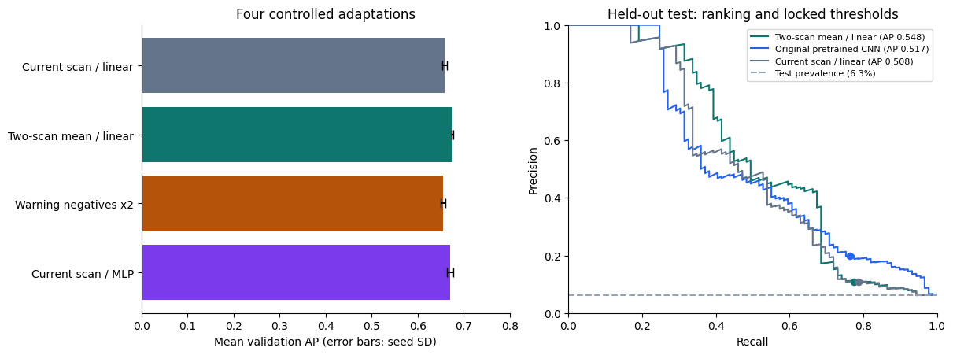
Steps 1 and 2: the picture

Slide 12
Step 0: the stakes
pre-onset AUC vs warned storms, 2014–2015 | +5 min | +10 min
floor: detector on the newest scan | 0.731 | 0.726
ceiling: detector on the future scan | 0.769 | 0.797
ceiling minus floor, paired | +0.038 [+0.016, +0.063] | +0.071 [+0.048, +0.093]

Slide 13
Step 0: what it says
The detector carried forward already scores 0.73 on 495 pre-onset cases: the signature is often half-formed five minutes before the label flips
The gap to the ceiling is the entire prize for forecasting the radar: 0.04 at +5, 0.07 at +10
Even a perfect picture of the next scan, read by this detector, adds that much and no more. Anything steps 3 and 4 gain has to fit inside it

Slide 14
Steps 3 and 4: the onset task
pre-onset AUC vs warned storms | +5 min | paired vs floor | +10 min | paired vs floor
floor | 0.731 |  | 0.726
3: frozen CNN, two scans, new head | 0.699 | −0.032 [−0.045, −0.020] | 0.710 | −0.017 [−0.024, −0.010]
4: fine-tuned | 0.724 | −0.007 [−0.031, +0.015] | 0.728 | +0.001 [−0.016, +0.018]
ceiling | 0.769 |  | 0.797

Slide 15
Steps 3 and 4: what they say
Step 3 lands below the floor, and not by noise. Step 1’s answer again on the harder task: a new head on frozen features doesn’t match the published head carried forward
Step 4 recovers the floor and no more. Fine-tuning lifts the head by about 0.02 to a tie with the detector at both horizons
Validation was still rising at the epoch cap, so a longer fine-tune might take a little more. The ceiling bounds how much
Same picture in each year: ties the floor in 2015, trails it in 2014

Slide 16
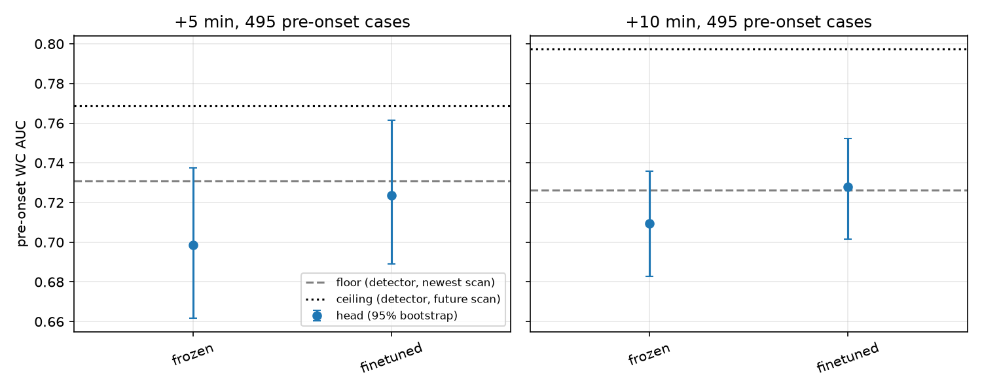
Steps 3 and 4: the picture

Slide 17
The takeaway
A detector can be pointed at the ten minutes before a tornado, and what it finds there is what it already finds in the latest scan
Its features carry a real early signal, which is why the floor sits at 0.73
Re-reading or fine-tuning them over two scans adds nothing to it, and even a perfect next scan would add only a few hundredths

Slide 18
What’s next: cheap
The full dataset. Ten years is a config change
It fixes the two things that limited this round: a fine-tune still improving at the cap, and test intervals wide enough to hide a gain of a couple of hundredths

Slide 19
What’s next: larger
Use the detector for detecting, and build what’s missing around it
Longer storm histories than two scans, so a temporal model learns how a storm has been evolving rather than one difference
A forecasting model that learns those patterns and does two jobs: hands the detector the context one scan leaves out, and predicts the radar itself, so the detector reads a forecast scan
The ceiling is exactly that model with perfect predictions, and the first number in this project that clears the floor

