Slide 1



Recognizing Heterogeneous Cross-Domain Data via Generalized Joint Distribution Adaptation
IEEE International Conference
on Multimedia and Expo. 2016
Yuan-Ting Hsieh¹, Shi-Yen Tao¹,
Yao-Hung Hubert Tsai², Yi-Ren Yeh³, and Yu-Chiang Frank Wang²
¹Department of Electrical Engineering, National Taiwan University, Taipei, Taiwan
²Research Center for IT Innovation, Academia Sinica, Taipei, Taiwan
³Department of Mathematics, National Kaohsiung Normal University, Kaohsiung, Taiwan
Notes:
語速太快，內容太少。

Slide 2
Outline
Motivation
Domain Adaptation
Proposed Method
Experiment
Conclusion

Slide 3
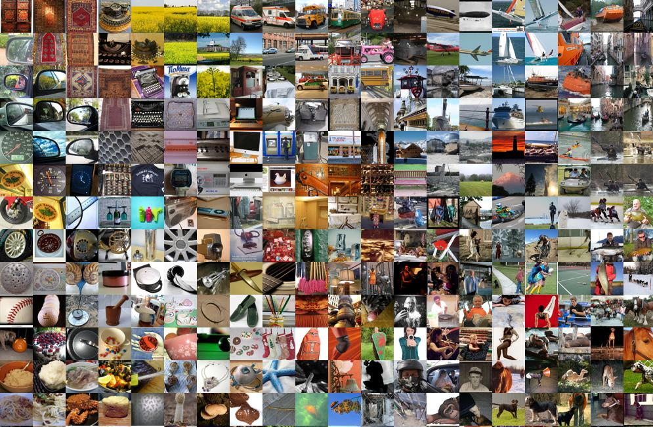
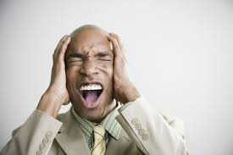
Motivation
Labeling a huge amount of data for training is time-consuming!
*Courtesy Andrej Karpathy
Notes:
To begin with, let me introduce the motivation of the domain adaptation,
As we want to acquire more images to capture the real world better, so that the machine can do visual recognition better and to be more like human.
The manual labeling of a huge amount of images is extremely time consuming and almost intractable.
So the question is , how can we transfer the labeled information of the existing datasets to the newly acquired images with no or a few labels available.
On the other hand, many factors, such as pose, illumination, or image quality, can cause mismatch, which is called domain discrepancy, between the source domain on which we trained the classifiers, and the target domain to which these classifiers are applied.
These domain discrepancies will lead to poor performance if they are not correctly handled.
Domain adaptation aims to solve these problems.

Slide 4
Motivation (cont’d)
Labeling a huge amount of data for training is time-consuming!
Can take data from one dataset, and apply the learned classifiers for another??
*Courtesy Andrej Karpathy
Notes:
To begin with, let me introduce the motivation of the domain adaptation,
As we want to acquire more images to capture the real world better, so that the machine can do visual recognition better and to be more like human.
The manual labeling of a huge amount of images is extremely time consuming and almost intractable.
So the question is , how can we transfer the labeled information of the existing datasets to the newly acquired images with no or a few labels available.
On the other hand, many factors, such as pose, illumination, or image quality, can cause mismatch, which is called domain discrepancy, between the source domain on which we trained the classifiers, and the target domain to which these classifiers are applied.
These domain discrepancies will lead to poor performance if they are not correctly handled.
Domain adaptation aims to solve these problems.

Slide 5
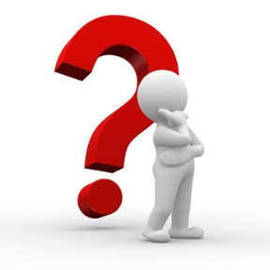
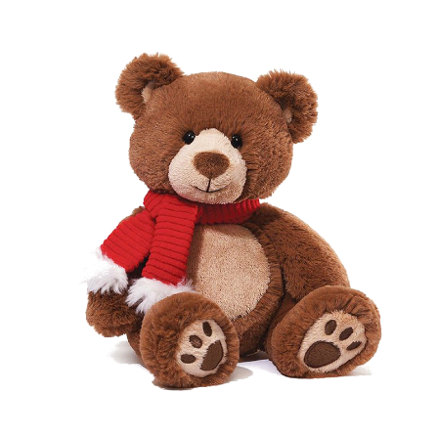
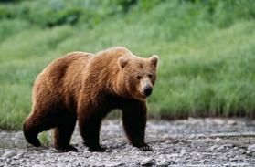
Motivation (cont’d)
Labeling a huge amount of data for training is time-consuming!
Can take data from one dataset, and apply the learned classifiers for another?? Not A Good Idea!!
Possible mismatch between datasets/domains (see example below)
Source Domain/Dataset
Target Domain/Dataset
Notes:
To begin with, let me introduce the motivation of the domain adaptation,
As we want to acquire more images to capture the real world better, so that the machine can do visual recognition better and to be more like human.
The manual labeling of a huge amount of images is extremely time consuming and almost intractable.
So the question is , how can we transfer the labeled information of the existing datasets to the newly acquired images with no or a few labels available.
On the other hand, many factors, such as pose, illumination, or image quality, can cause mismatch, which is called domain discrepancy, between the source domain on which we trained the classifiers, and the target domain to which these classifiers are applied.
These domain discrepancies will lead to poor performance if they are not correctly handled.
Domain adaptation aims to solve these problems.

Slide 6
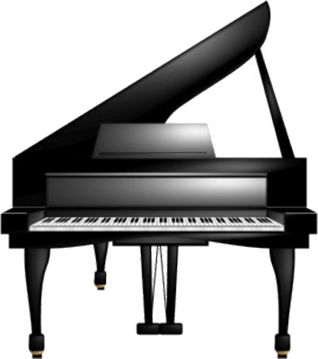
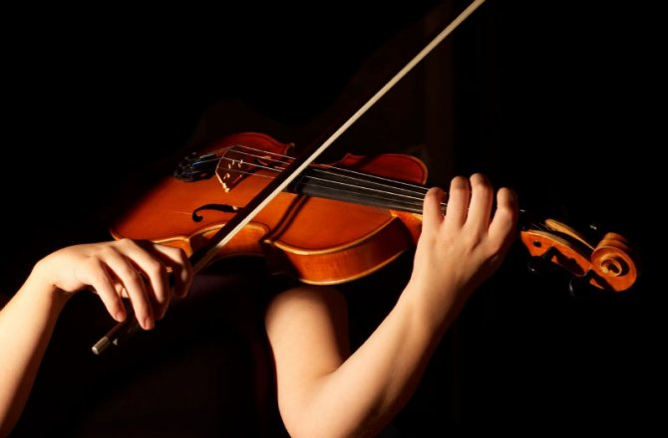
Examples of Domain Mismatch
Music Retrieval
Source
Target

Slide 7


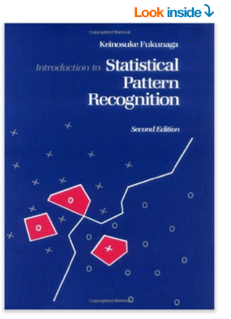
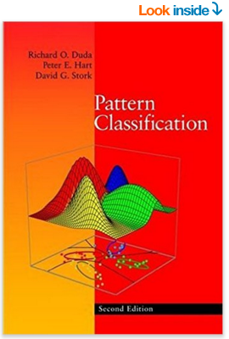


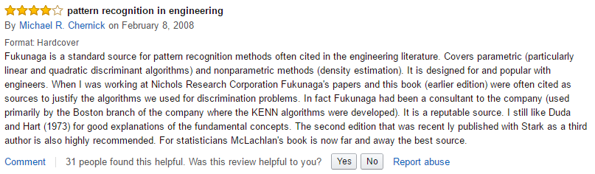
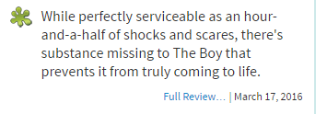
Examples of Domain Mismatch (cont’d)
Semantic Analysis
Source
Target

Slide 8
What Can We Do?
To solve the above cross-domain recognition tasks…
Domain Adaptation
Aim to address the (same) learning task across different domains
Source Domain/Dataset
Target Domain/Dataset
Notes:
太籠統~~~
DA講得清楚一點，就是兩個領域怎樣怎樣~~~source target adapt apply

Slide 9
Outline
Motivation
Domain Adaptation (DA)
Semi-Supervised vs. Unsupervised DA
Proposed Method
Experiment
Conclusion

Slide 10
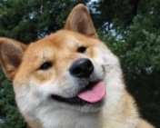
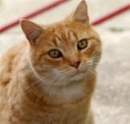
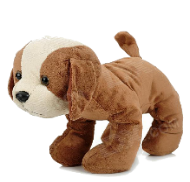

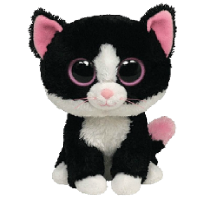
Semi-Supervised DA
Source domain: label-data available
Target domain: few label data, most are unlabeled
Source Domain
Target
Domain

Slide 11
Unsupervised DA
Source domain: label-data available
Target domain: only unlabeled data are presented
Source Domain
Target
Domain

Slide 12
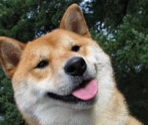
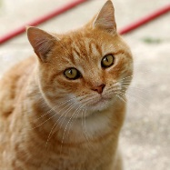
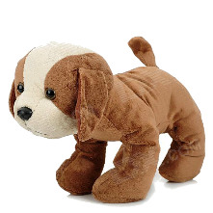
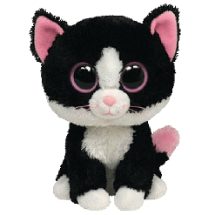
Goal of Semi-Supervised/Unsupervised DA
Adapt the learned model from source to target domains
Source Domain
Target
Domain

Slide 13
Goal of Semi-Supervised/Unsupervised DA (cont’d)
Adapt the learned model from source to target domains
Source Domain
Target
Domain

Slide 14
Goal of Semi-Supervised/Unsupervised DA (cont’d)
Adapt the learned model from source to target domains
Source Domain
Target
Domain

Slide 15
Goal of Semi-Supervised/Unsupervised DA (cont’d)
Adapt the learned model from source to target domains
Source Domain
Domain
Adaptation
Target
Domain

Slide 16
Outline
Motivation
Domain Adaptation
Semi-Supervised vs. Unsupervised DA
Homogeneous vs. Heterogeneous DA
Proposed Method
Experiment
Conclusion

Slide 17
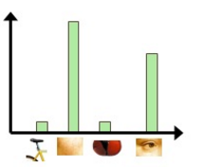

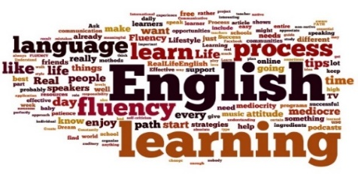

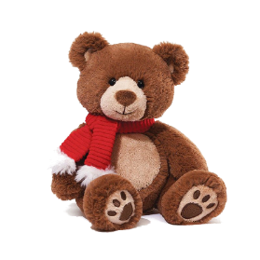

Homogeneous DA
Source and target-domain data are with the same feature type
Can be applied to semi-supervised or even unsupervised DA
Image
Classification
Document Categorization
Source Domain
English
BOW
Target
Domain
BOW
English
Notes:
放一些小圖。

Slide 18
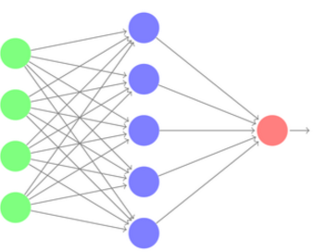
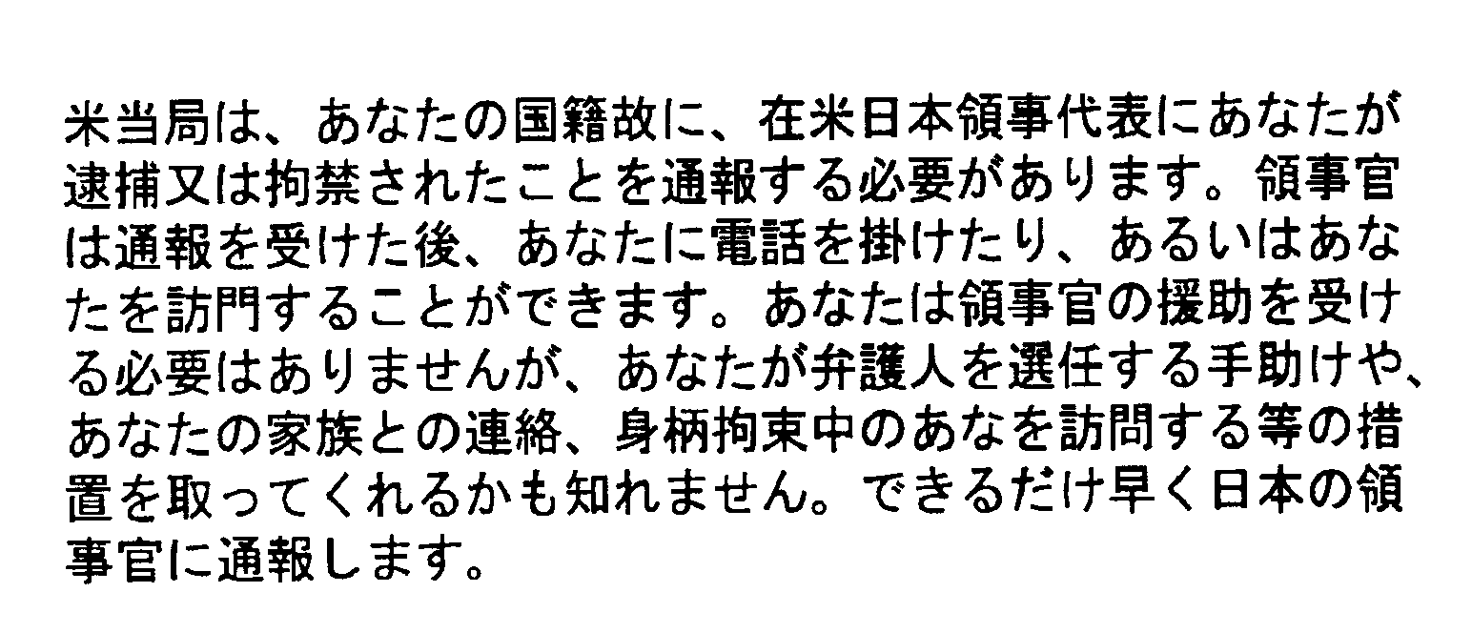
Heterogeneous DA
Source and target-domain data are with the different feature types/dims
Typically require semi-supervised DA settings
(i.e., at least few labeled data presented in the target domain)
Image
Classification
Document Categorization
Source Domain
English
BOW
Target
Domain
CNN
Japanese

Slide 19
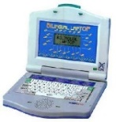




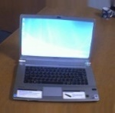
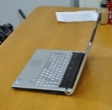


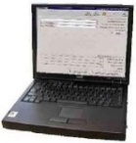


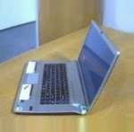

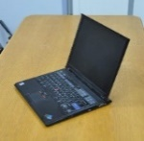





What we address in our work…
Semi-supervised & Heterogeneous DA
With applications to
Cross-Domain Object Recognition
Cross-Lingual Text Categorization

Slide 20
Outline
Motivation
Domain Adaptation
Proposed Method
Experiment
Conclusion

Slide 21



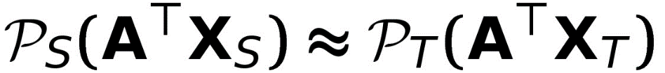
Motivation: Joint Distribution Adaptation
Joint Distribution Adaptation (JDA) for homogeneous DA [Long et al., ICCV’13]
Find a proper common feature space via transformation matrix , so that
both marginal and conditional distributions can be matched.
: Source-Domain Data
: Target-Domain Data
Source Domain
Target Domain
Common Feature Space
Notes:
標註common feature space 。!!!!

Slide 22

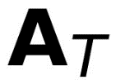
Our Proposed Method
Generalized Joint Distribution Adaptation (G-JDA)
JDA only addresses homogeneous DA & does not utilize any target-domain labels
For semi-supervised & heterogeneous DA
Derive transforms and for relating source and target domain data.
: Source-Domain Data
: Labeled Target-Domain Data
: Unlabeled Target-Domain Data
Source Domain
Target Domain
Common Feature Space
Notes:
Our gjda，破題~~~~

Slide 23
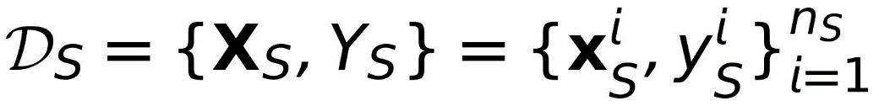
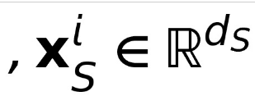
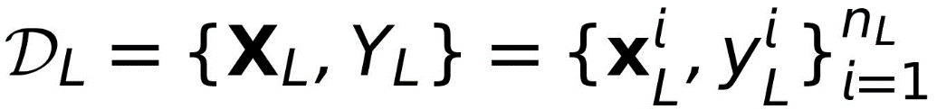
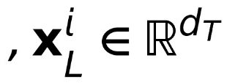

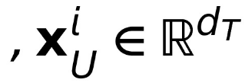
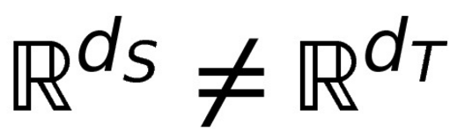
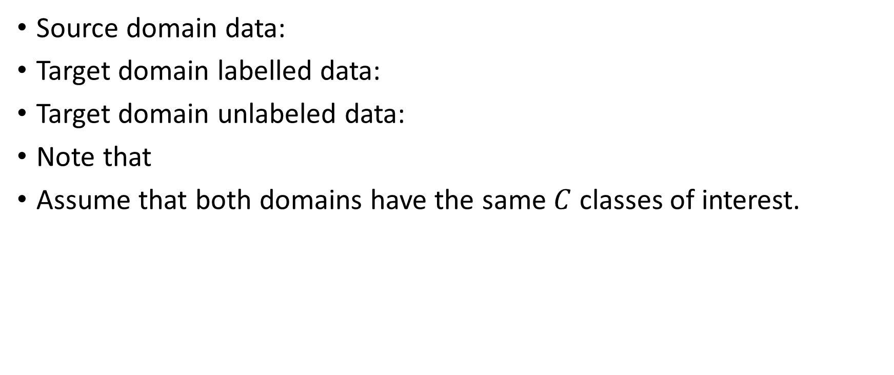
Notation
Source domain data:
Target domain labelled data:
Target domain unlabeled data:
Note that
Assume that both domains have the same $C$ classes of interest.

Slide 24
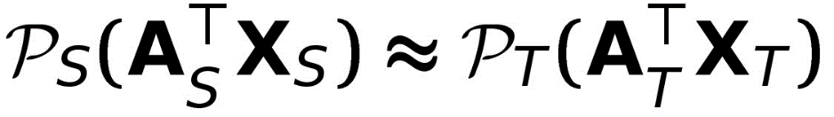
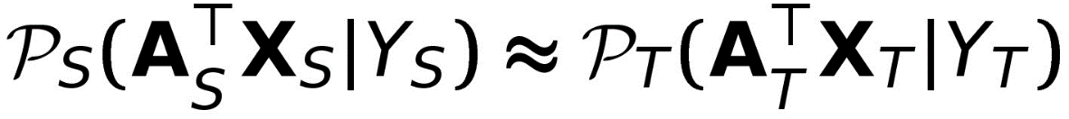
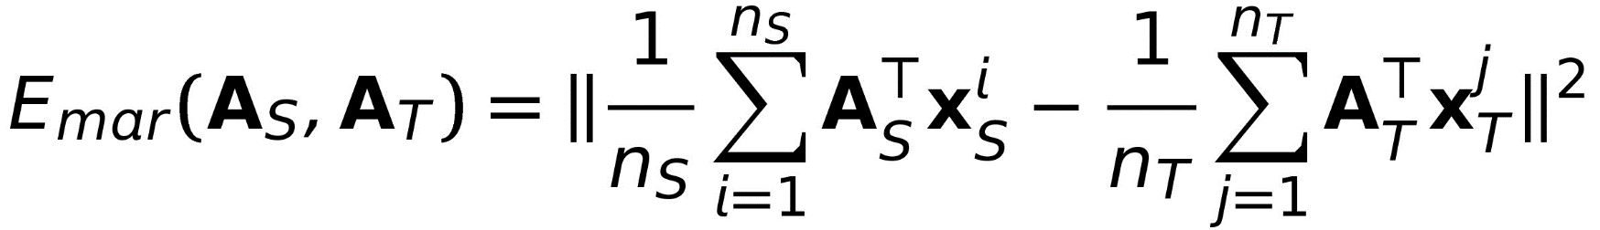
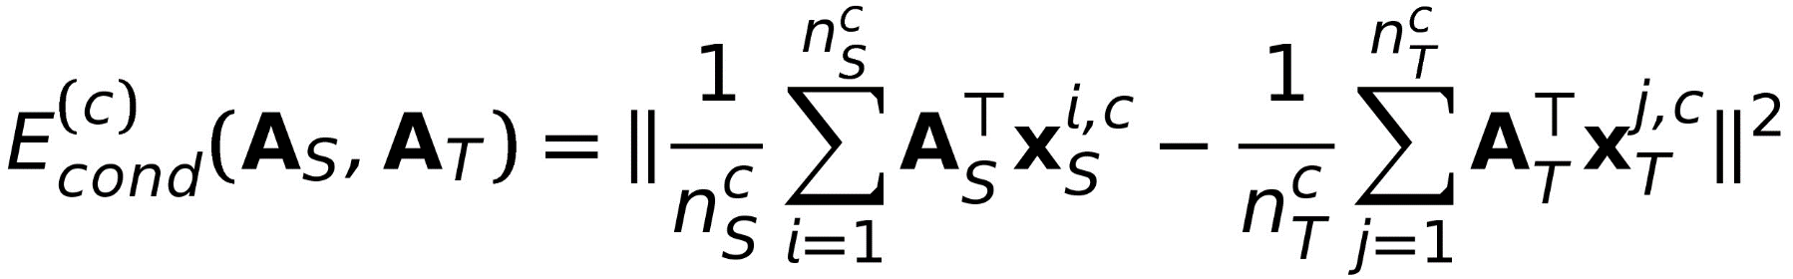
Distribution Alignment for G-JDA
G-JDA aims to find a common feature space where both marginal & conditional distributions are matched.
Following JDA, we apply MMD to measure distribution discrepancy. [A. Gretton et al., NIPS 2006]
Marginal distribution discrepancy
Conditional distribution discrepancy

Slide 25
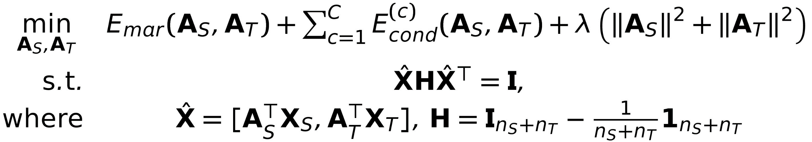
Objective Function of G-JDA
Derive transforms and for relating source & target domain data.
The resulting feature space would better match the marginal and conditional distributions of projected cross-domain data.
Prevent trivial solution
Notes:
To prevent overfitting, we add two l2 regularization terms.

Slide 26

G-JDA Algorithm
1. Use labeled data in both domains to initialize $A_{S}$ and $A_{T}$.
: Source-Domain Data
: Labeled Target-Domain Data
: Unlabeled Target-Domain Data
Source Domain
Target Domain
Notes:
家數字,下標

Slide 27
G-JDA Algorithm (cont’d)
2. Project all labeled and unlabeled data onto the resulting feature space.
: Source-Domain Data
: Labeled Target-Domain Data
: Unlabeled Target-Domain Data
Source Domain
Target Domain
Notes:
放一張是意圖，說我們是HDA setting。Target domain 有一些有label的data。

Slide 28
G-JDA Algorithm (cont’d)
3. Train a (linear) SVM in the common feature space.
: Source-Domain Data
: Labeled Target-Domain Data
: Unlabeled Target-Domain Data
SVM
Source Domain
Target Domain
Notes:
放一張是意圖，說我們是HDA setting。Target domain 有一些有label的data。

Slide 29
G-JDA Algorithm (cont’d)
4. Predict the pseudo labels for the projected unlabeled target-domain data.
: Source-Domain Data
: Labeled Target-Domain Data
: Unlabeled Target-Domain Data
SVM
Source Domain
Target Domain
Notes:
放一張是意圖，說我們是HDA setting。Target domain 有一些有label的data。
用predict

Slide 30
G-JDA Algorithm (cont’d)
5. Apply exiting and pseudo labels for cross-domain data to update A_{S} and A_{T}.
: Source-Domain Data
: Labeled Target-Domain Data
: Unlabeled Target-Domain Data
Source Domain
Target Domain
Notes:
放一張是意圖，說我們是HDA setting。Target domain 有一些有label的data。

Slide 31
G-JDA Algorithm (cont’d)
6. Update the SVM and the pseudo labels.
: Source-Domain Data
: Labeled Target-Domain Data
: Unlabeled Target-Domain Data
SVM
Source Domain
Target Domain
Notes:
放一張是意圖，說我們是HDA setting。Target domain 有一些有label的data。

Slide 32
G-JDA Algorithm (cont’d)
7. Repeat the same process
until converge.
: Source-Domain Data
: Labeled Target-Domain Data
: Unlabeled Target-Domain Data
SVM
Source Domain
Target Domain
Notes:
放一張是意圖，說我們是HDA setting。Target domain 有一些有label的data。

Slide 33
Outline
Motivation
Domain Adaptation
Proposed Method
Experiment
Conclusion

Slide 34
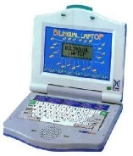



















Image Classification Task
Office and Caltech-256 datasets
Office: Amazon (A), Webcam (W), DSLR (D) [K. Saenko et al., 2010]
Caltech (C) [G. Griffin et al., 2007]
Notes:
10 common classes。
每個class大概幾張。

Slide 35
Settings & Features
10 overlapped classes across domains
Feature: Decaf₆ [J. Donahue et al., 2014] and Surf [H. Bay et al., 2006]
Source domain : randomly select 20 images per class.
Target domain: randomly select 3 images per class as labeled data.
Notes:
10 common classes。
每個class大概幾張。

Slide 36
Recent HDA Methods
Baseline : SVM in target domain [C.-C. Chang and C.-J. Lin, LIBSVM 2011]
DAMA : [C. Wang and S. Mahadevan, IJCAI 2011]
HFA : [L. Duan et al., ICML 2012 ]
MMDT : [J. Hoffman et al., ICLR 2013]

Slide 37
Cross-Feature Recognition
Notes:
Source和target from same dataset

Slide 38
Cross-Feature Recognition (cont’d)

Slide 39
Recognition Across Domains & Features

Slide 40
Recognition Across Domains & Features (cont’d)

Slide 41
Cross-Lingual Text Categorization
Multilingual Reuters Collection Dataset [M. Amini et al., NIPS 2009]
11K articles from 6 categories in 5 languages
English, French, Italian, German, and Spanish
BOW + TF-IDF with 60% energy preserved via PCA [L. Duan et al., ICML ’12]
Source domain : randomly select 100 articles per class.
Target domain: randomly select {10,20} articles per class as labeled data, and randomly select 500 articles per class as unlabeled data.
Notes:
Target domain 考慮幾張。

Slide 42
# of Labeled Target-Domain (Spanish) Data per Category = 10

Slide 43
# of Labeled Target-Domain (Spanish) Data per Category = 20

Slide 44
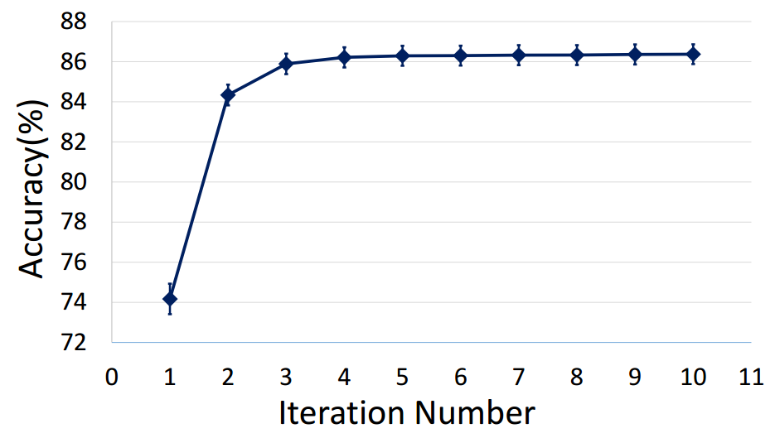
Convergence analysis
Image classification task with cross domains & features
Source: Caltech with SURF
Target: DSLR with Decaf₆

Slide 45
Outline
Motivation
Domain Adaptation
Proposed Method
Experiment
Conclusion

Slide 46
Conclusion
We proposed Generalized Joint Distribution Adaptation (G-JDA) for associating & recognizing heterogeneous cross-domain data.
By learning a pair of feature transformations for source and target-domain data, G-JDA derives a domain-invariant common feature space for addressing the above goal.
Our experiments on cross-domain visual and text classification tasks verified the effectiveness of our proposed G-JDA for HDA.

Slide 47

Q & A
Notes:
加上conclusion!!!!!

Slide 48

Thank You!

Slide 49
Outline
Motivation
Domain Adaptation
Proposed Method
Experiment
Conclusion
Appendix

Slide 50
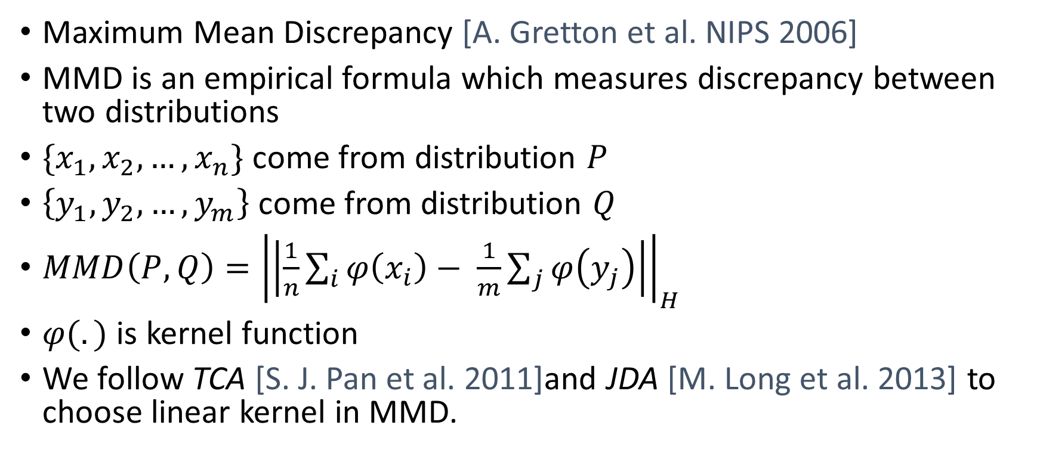
Distribution Measure: MMD Criteria
Maximum Mean Discrepancy [A. Gretton et al. NIPS 2006]
MMD is an empirical formula which measures discrepancy between two distributions
$\{x_{1},x_{2},…,x_{n}\}$ come from distribution $P$
$\left\{y_{1},y_{2},…,y_{m}\right\}$ come from distribution $Q$
$MMD\left(P,Q\right)={\left|\left|\frac{1}{n}\sum_{i}{φ\left(x_{i}\right)}− \frac{1}{m}\sum_{j}{φ\left(y_{j}\right)}\right|\right|}_{H}$
$φ(.)$ is kernel function
We follow TCA [S. J. Pan et al. 2011]and JDA [M. Long et al. 2013] to choose linear kernel in MMD.

Slide 51
Optimization
1. Rewrite the equation as compact trace form

Slide 52
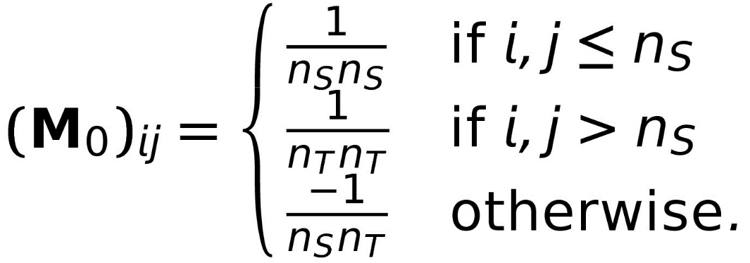
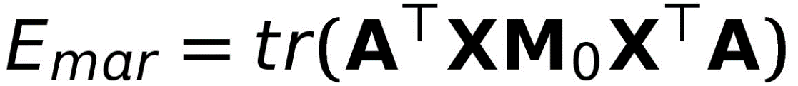




Optimization
1. Rewrite the equation as compact trace form

Slide 53

Optimization
2. The formula becomes

Slide 54



Optimization
3. Solve generalized eigenvalue decomposition problem
A can be determined by $d_{K}$(dimensionality of latent space) smallest eigenvectors

Slide 55

Parameter sensitivity
Dimensionality of the common feature space

Slide 56

Parameter sensitivity
Lambda

Slide 57
Parameter sensitivity
Iteration number

