Slide 1
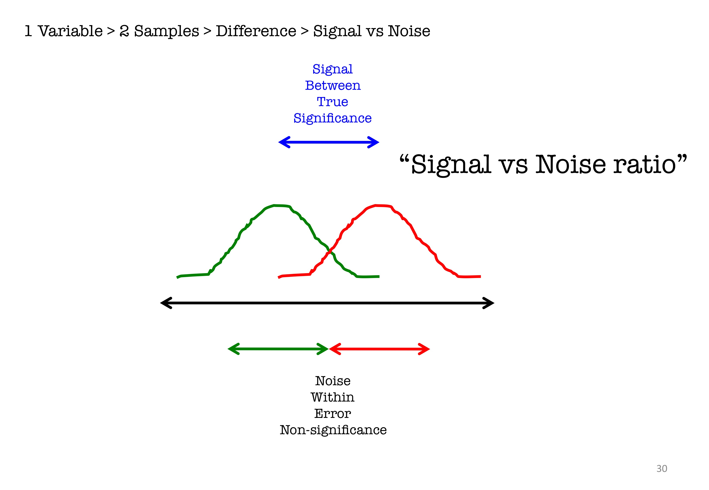
Increase Your Sample Size without Increasing Your Sample Size
Jake Schumaker, Software Engineer, Promotions

Slide 2
Overview
Easy to implement tracking can improve the value of A/B tests
e.g. Libra tests
Increase the effective sample size of our tests.
Why:
We run A/B tests to see if new features we make improve the site.
But we get a lot of null results – i.e. we’re not sure if we’re improving the site.
http://justinmrao.com/lewis_rao_nearimpossibility.pdf
How:
1) Track which users are exposed to variation content.
Two ways to un-muddy the waters
2) Use the tracking in analysis
Collaborate w/ analytics

Slide 3
Background
Treatment = Variation
Compliance = took the treatment (took the medicine)
ITT = Intention to Treat Effect
Treatment Avg – Control Avg
ATT = Average Treatment Effect among the Treated
Treatment – Control for the subset treated

Slide 4
Theory
Treatments only affect those who receive the treatment
i.e. The un-treated are just noise
We want to exclude the un-treated as much as possible while still measuring the causal effect of our treatments.
They only muddy the waters.
Random differences in behavior, propensity to behave
Increase power / reduce noise
Power: Likelihood of detecting treatment effects when they exist

Slide 5
Two Methods
Both variations of the Average Treatment Effect among Treated (ATT)
1) Complier Average Causal Effect (CACE)
Compliance only measurable among treatment group
2) Filtered Average Causal Effect (FACE)
Compliance can be measured among treatment and control
FACE is better, but not always possible
e.g. can’t always measure control compliance

Slide 6
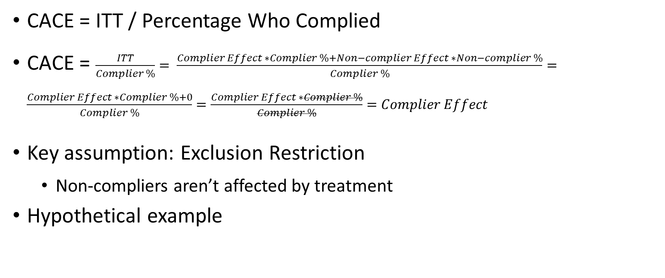
Method 1: CACE
CACE = ITT / Percentage Who Complied
CACE = $\frac{ITT}{Complier \%}= \frac{Complier Effect ∗Complier \%+Non−complier Effect ∗Non−complier \%}{Complier \%}=\frac{Complier Effect ∗Complier \%+0}{Complier \%}=\frac{Complier Effect ∗Complier \%}{Complier \%}=Complier Effect$
Key assumption: Exclusion Restriction
Non-compliers aren’t affected by treatment
Hypothetical example

Slide 7


CACE: Example
Control
Treatment
Hypothetical
Variation/Treatment: Button on right side of the screen.
Click shows an image of me with a Harris’s hawk

Slide 8
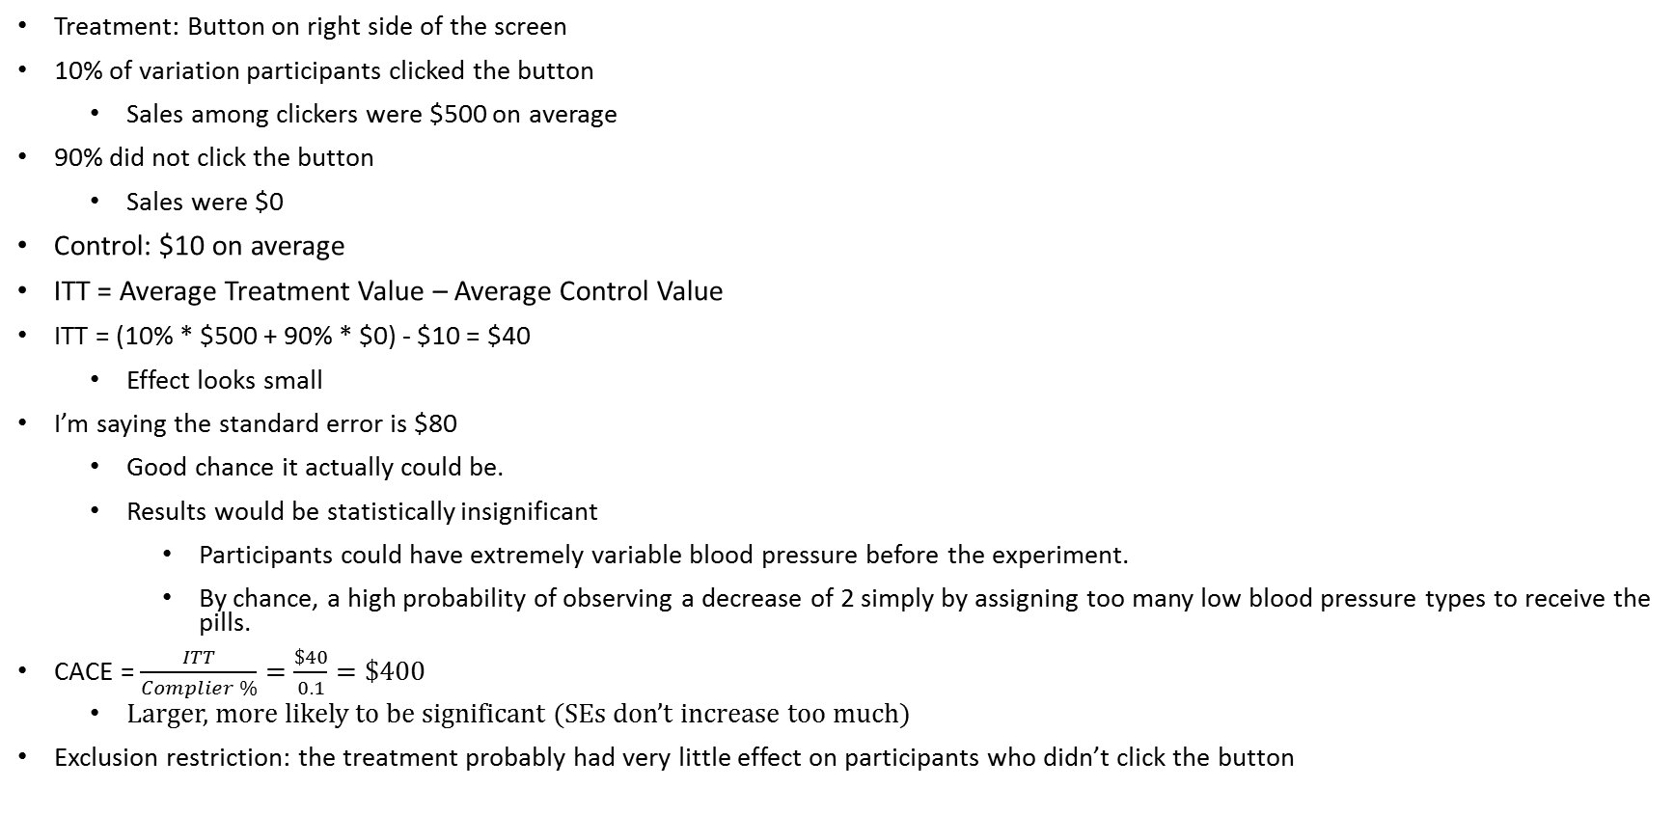
CACE: Example, cont’d
Treatment: Button on right side of the screen
10% of variation participants clicked the button
Sales among clickers were $500 on average
90% did not click the button
Sales were $0
Control: $10 on average
ITT = Average Treatment Value – Average Control Value
ITT = (10% * $500 + 90% * $0) - $10 = $40
Effect looks small
I’m saying the standard error is $80
Good chance it actually could be.
Results would be statistically insignificant
Participants could have extremely variable blood pressure before the experiment.
By chance, a high probability of observing a decrease of 2 simply by assigning too many low blood pressure types to receive the pills.
CACE = $\frac{ITT}{Complier \%}=\frac{\$40}{0.1}=\$400$
Larger, more likely to be significant (SEs don’t increase too much)
Exclusion restriction: the treatment probably had very little effect on participants who didn’t click the button

Slide 9
Method 2: FACE
Filtered Average Treatment Effect (FACE) =
Treatment Avg among Treated – Control Avg among Would Have Been Treated
example: Participants who took an experimental medicine vs would have
FACE is my term, special case of Conditional Average Treatment Effect
Superior to CACE
Removes more noise
Higher-powered: more likely to detect effects if they exist
Use when: you can measure whether control users would have complied
Key assumption:
Treated were the same as the would have been treated.
Treated Avg would have been equal to the Would Have Been Treated if not treated.

Slide 10

FACE: Example
Top of Event pages
Real Libra Test
Event page trailing content
You can’t see the variation
content when the page loads.

Slide 11



FACE: Example, cont’d
Users have to scroll to the bottom of the
page to be exposed to the treatment.
I wrote tracking in Javascript to fire
when users reached the end of events.
A small majority do (53%)
Key Assumption
Treatment Page load is fast and all content until
the trailing content is identical, so we can
assume scrolling isn’t confounded w/
treatment status.
$≈$equal # of Scrollers in Treatment/Control
5% more in treatment
Control (top) vs Variation (bottom)

Slide 12
FACE: Example, cont’d
Results: Not Filtered (Scrollers and Non-scrollers):
Significant increase in Event Views: 1.72% (99% confidence)
Nothing else significant: PDP views (0.01% increase, not sign)
Often the final analysis
Don’t have more tracking, don’t do the analysis
Variation | Sessions | Orders_Count | PDP Views | PDP Views Beta | Event Views | Event Views Beta | ATC_Count | ATC_Beta | TotalRevenue | TotalProfit | TotalDSOrders | AOV
control | 288461 | 21243 | 2641498 | 214929 | 769131 | 189351 | 359150 | 48147 | 4902815 | 1210010 | 12056 | 230.7967
Variation | 289361 | 21477 | 2686227 | 215627 | 824232 | 193218 | 353978 | 48823 | 4937470 | 1215153 | 11995 | 229.8957
% diff |  | 0.79% | 1.38% | 0.01% | 6.83% | 1.72% | -1.75% | 1.09% | 0.39% | 0.11% | -0.82% | -0.70%
sig. |  | ns | ns | ns |  | 99% |  | ns |  |  | ns

Slide 13
FACE: Example, cont’d
Results: Filtered to Scrollers
Both PDP Views and Event views increased significantly (both 99% confidence)
Size of effects is larger
Filtered: 1.17% for PDP views and 5.9% for Event views
Unfiltered: 0.01% for PDP views and 1.72% for Event views
Sample size a PDP Effect w/o filtering: 274,203,760, per group (1800x)
Variation | Sessions | Orders | Orders Beta | PDP Views | PDP Views Beta | Event Views | Event Views Beta | ATC_Count | ATC_Beta | Revenue | Profit | DS Orders | AOV
control | 152124 | 9670 | 8435 | 1228837 | 94410 | 397014 | 89571 | 168568 | 22461 | 2193041 | 548139.6 | 5809 | 226.7881
Variation | 159403 | 10292 | 8947 | 1305887 | 100084 | 462406 | 99432 | 172468 | 23763 | 2264030 | 571183.8 | 5984 | 219.9796
% diff |  | 1.57% | 1.23% | 1.42% | 1.17% | 11.15% | 5.94% | -2.36% | 0.97% | -1.48% | -0.55% | -1.69% | -7.43%
sig. |  | ns | ns | ns | 99% |  | 99% |  | ns |  |  | ns

Slide 14
Conclusion
1) FACE
Best solution – Highest powered
Keys:
A) Can track compliance among Control
B) Treatment doesn’t influence compliance
2) CACE
Second-best solution
Key:
Exclusion Restriction
Non-compliers aren’t affected by treatment
Better differentiation between Good/Bad features

Slide 15
Sources
Introductions:
http://www.columbia.edu/~ajc2241/Instrumental%20Variables%20Estimation%20in%20Political%20Science.pdf
p.17, http://jee3.web.rice.edu/causal-inference.pdf
p. 551, http://sekhon.berkeley.edu/causalinf/causalinf.pres.pdf
Math-heavy
http://imai.princeton.edu/teaching/files/iv.pdf
http://www.stats.ox.ac.uk/~evans/Counterfactuals/LectureNotes.pdf
Books
https://www.amazon.com/Field-Experiments-Design-Analysis-Interpretation/dp/0393979954

