Slide 1
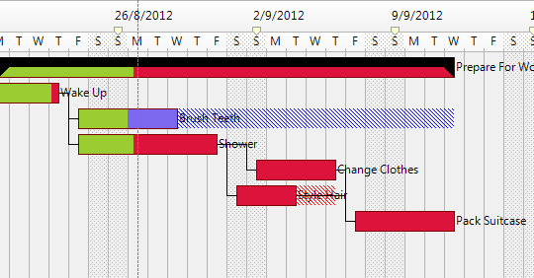
Task
Label
Group
Slack
Now
Header 1
Header 2
BarSpacing
BarHeight
1
1
Relation
2
2
3
3
4
4
5
5
Critical
Path
BarWidth
ForeFill
(% Complete)
BackFill
(Out)Line

