Slide 1
Travel Package Purchase Prediction By Jacob Siegel

Slide 2
Contents
Introduction and Business Context
Data Overview and Pre-Processing
EDA & Multi Variable Analysis
Ensemble Technique Models
Conclusion and Recommendations

Slide 3
Business Problem Overview and Solution Approach
Context: “Visit With Us” wants to expand its customer base and save costs with targeted marketing to customers more likely to purchase a travel package.
Goal: Understand if a customer are more likely to purchase a travel package based on the data set provided.
Implications: Use the insights from the analysis to create a competitive advantage and market to customers that are more likely to buy a travel package.

Slide 4
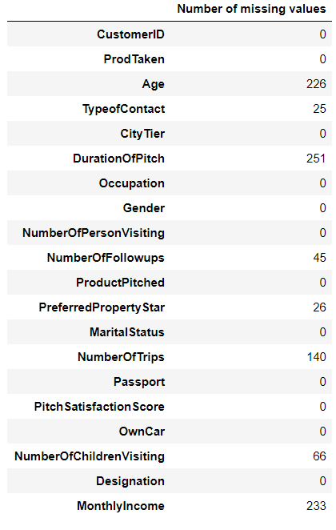
Data Overview & Pre-Processing
Travel Package Purchase:
920 people purchased the travel package
3968 did not purchase the package
The raw data set contains 4888 rows and 20 columns.
15% of the data contains rows with missing values, see table. Two approaches were taken to deal with the missing values:
Fill in missing values with averages.
Remove rows with missing values.
Gender category had a typo where several rows had ‘Fe Male’ instead of Female, this was corrected.
The type of contact category had several missing values that were filled in with “Unknown.”
Columns with Missing Data

Slide 5
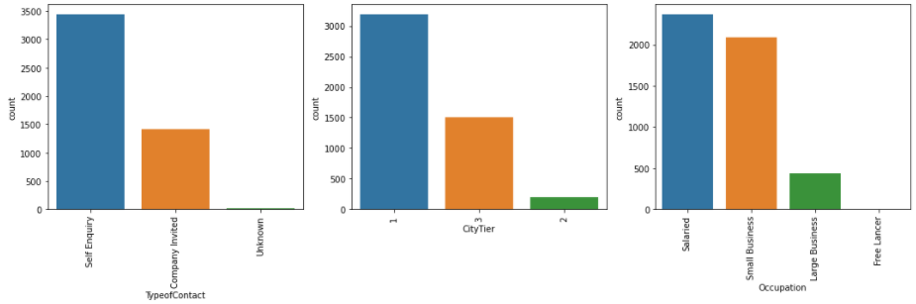
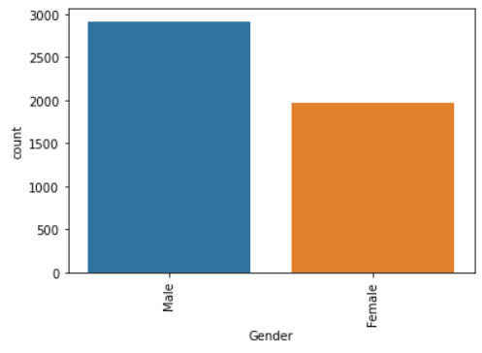
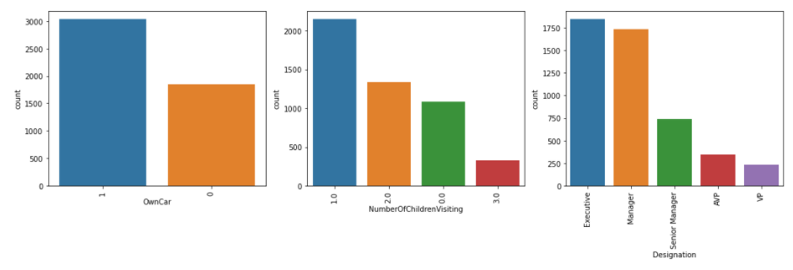
Data Overview: Categorical Variables
Type of Contract
City Tier
Occupation
The majority of the data set contains categorical variables, the distributions are shown over the next two slides.
Gender
Car
Children
Designation

Slide 6
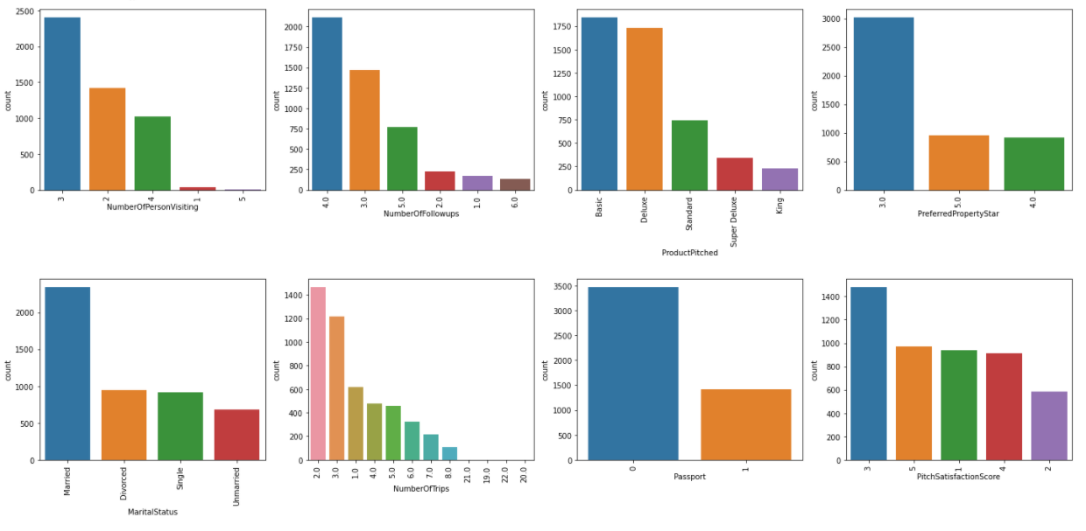
Data Overview: Categorical Variables (continued)
Number of Persons
Number of Follow Ups
Product Pitched
Preferred Property Star
Marital Status
Number of Trips
Passport
Pitch Satisfaction

Slide 7
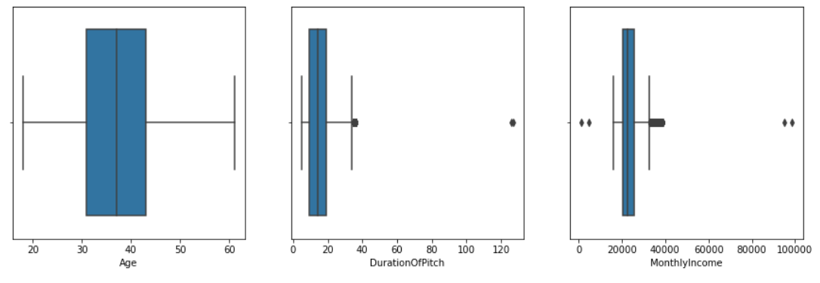
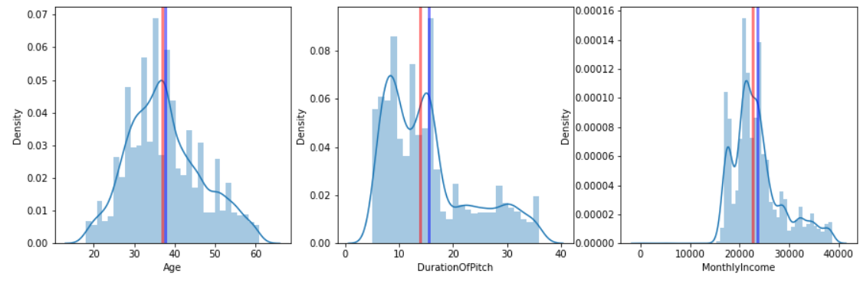
Data Overview: Continuous Variables & Pre-Processing
The continuous data showed several outliers in ‘DurationofPitch’ and ‘MonthlyIncome’ these outliers were removed from the dataset.
Age
Duration of Pitch
Monthly Income
outliers
Distribution plot after removing multiples

Slide 8
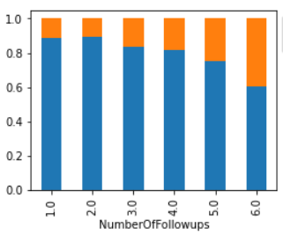
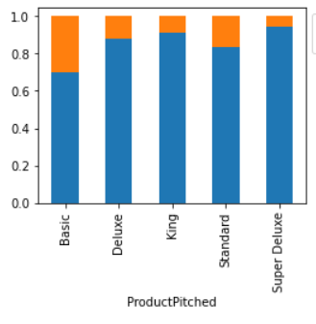
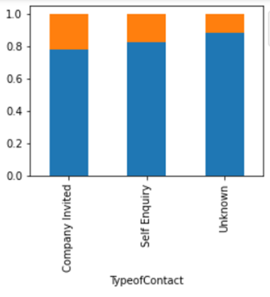
EDA: Product Purchased Ratio in Categorical Variables
Increasing the number of follow ups from the sales person increases the likelihood of purchasing a travel package.
The basic package has the highest ratio of sales.
Invited contracts have a higher success rate with purchased products.
Number of Follow-ups
Product Pitched
Type of Contract
Product Purchased Not Purchased

Slide 9
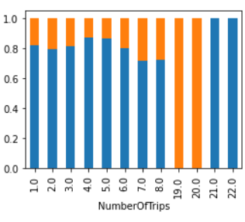
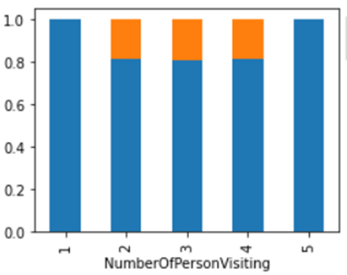
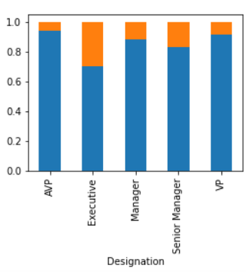
EDA: Product Purchased Ratio in Categorical Variables
Customers that take more trips (19/20) per year always by the travel package, however, customers who travel more than 20 trips a year don’t by the package at all.
Group size between 2 – 4 purchases the most travel packages.
Executives purchase the most amount of travel packages.
Number of Trips
People Visiting
Designation
Product Purchased Not Purchased

Slide 10
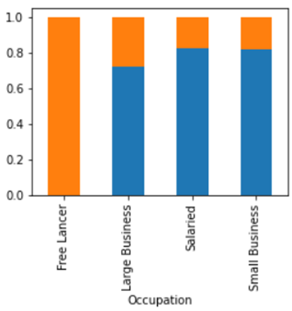
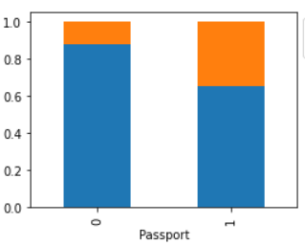
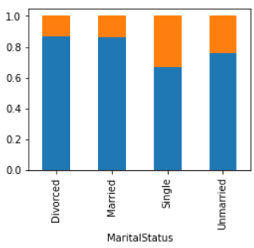
EDA: Product Purchased Ratio in Categorical Variables
Free Lancer Occupation purchases the most travel packages, as do people with passports.
Single people also purchase the most travel packages.
Other categories did not have a significant difference and are not shown in this presentation.
Occupation
Passport
Marital Status
Product Purchased Not Purchased

Slide 11
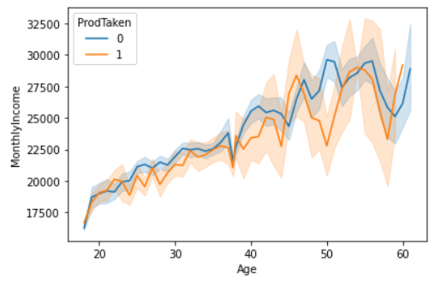
EDA: Income vs Age
Monthly income increase with age. It doesn’t have a clear distinction between people who purchased the product or not. However, surprisingly, people who did not purchase the travel package have a slightly higher income on average.
Slightly lower average income per age for people who purchased travel package

Slide 12
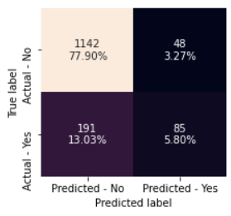
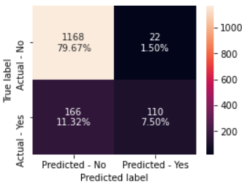
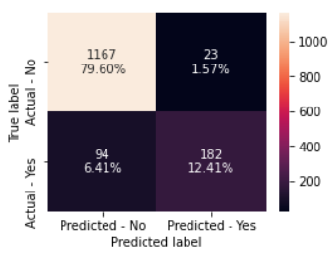
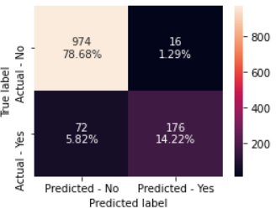
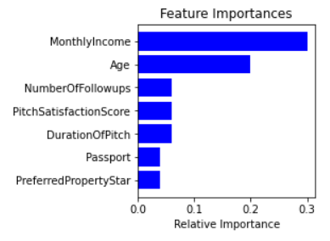
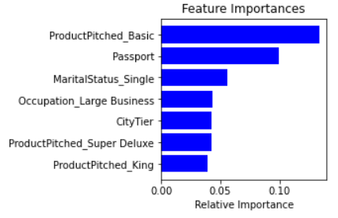
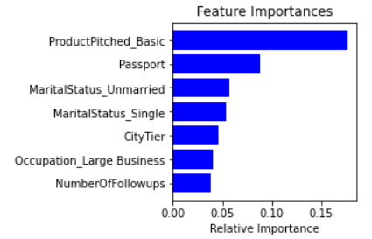
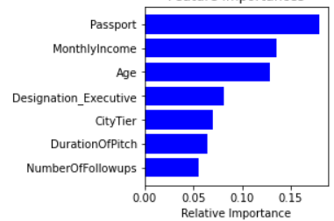
Model Results: Un-tuned Models
3 ensemble models with default hyper parameters were run.
XGBoost model identified the most amount of potential purchasers.
XGBoost V2 uses the data with all rows with missing values removed, this data will be used in the model tuning to follow.
AdaBoost is the only model that identified Monthly Income as an important feature.
AdaBoost
Gradient Boosting
XGBoost
XGBoost (v2)
Confusion Matrix
Feature Importance
(highest 7)

Slide 13
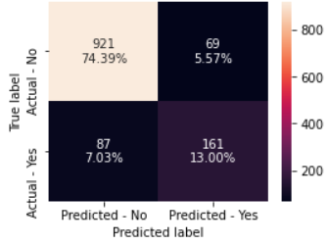
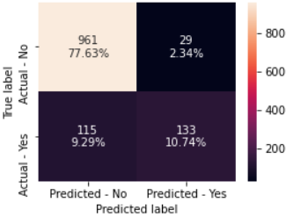
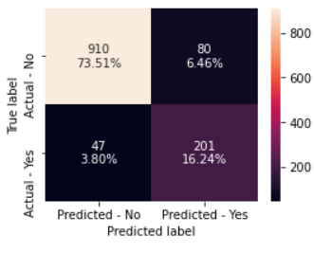
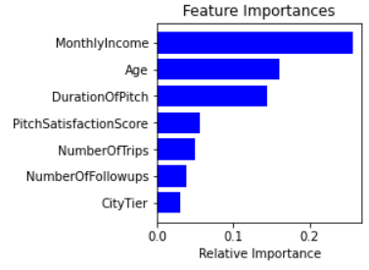
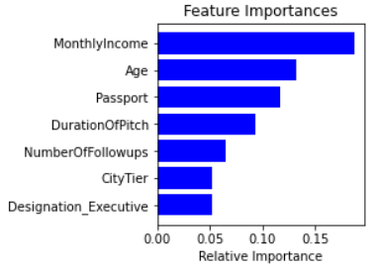
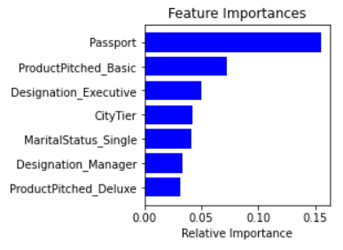
Model Results with Hyperparameter Tuning
XGBoost with hyperparameter tuning identified the most amount of people who purchased a travel package.
AdaBoost
Gradient Boosting
XGBoost
Confusion Matrix
Feature Importance
(highest 7)

Slide 14
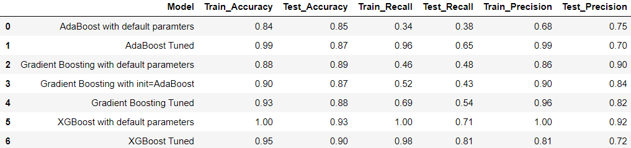
Model Review
The XGBoost model with default parameters, followed by the XGBoost hyperperparameter tuned model, performed the best in terms of test accuracy, recall, and precision.
This model suggests that the “Basic” product and having a passport are the two more important features, followed by marital status single, and occupation large business, see table.
Most Important Features (from models)
Product Pitched – Basic
Having A Passport
Marital Status – Single
Occupation Large Business
Designation – Executive
Designation – Manager
Product Pitched – super Deluxe
Product Pitched – Deluxe
City Tier
Model Results

Slide 15
Conclusion and Recommendations
Conclusions/Observations:
To assist with the marketing research for “Visit With Us” an analysis was conducted with EDA and Ensemble Model techniques on a dataset provided by the company to understand the demographics of people more likely to purchase a travel package.
From the EDA, the most important features are:
Having more follow ups from the sales person, Occupation Executive, Free Lancer, People with passports, and marital status single.
From the Ensemble Models, the most important features are:
Having a Passport, Single Marital Status, and the basic travel package.
Recommendations to Grow Business:
The ideal candidate for marketing is someone who: has a passport, is single, an executive and/or free lancer.
The sales people should do several follow ups and suggest the basic travel package to increase the likelihood of someone purchasing.

