Slide 1
Axis Insurance Analysis
Prepared by:
Jacob Siegel

Slide 2
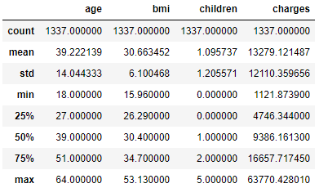
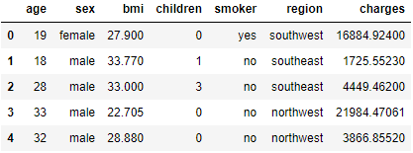
Introduction: Axis Insurance Data Analysis
Goal: understand data trends and insights.
Dataset: 1337 unique rows of data.
Columns (Data Dictionary):
Age - age of the primary beneficiary (excluding those above 64 years)
Sex - policy holder's gender, either male or female.
BMI - body mass index (BMI)
Children - number of children / dependents covered by the insurance plan.
Smoker - yes or no depending on whether the insured regularly smokes tobacco.
Region - This is the beneficiary's place of residence in the U.S., divided into four geographic regions - northeast, southeast, southwest, or northwest.
Charges​ - Individual medical costs billed to health insurance
Integer Data Description
Data Set (first 5 rows)

Slide 3
Part 1: Data Overview Categorical Variables
There are many more non-smokers than smokers.
Sex and Region have an even distribution of the data population.
Category | Variable | Count
Smoker | Yes | 274
 | No | 1063
Sex | Male | 675
 | Female | 662
Region | southwest | 325
 | southeast | 364
 | northwest | 324
 | northeast | 324
Children | 0 | 573
 | 1 | 324
 | 2 | 240
 | 3 | 157
 | 4 | 25
 | 5 | 18

Slide 4
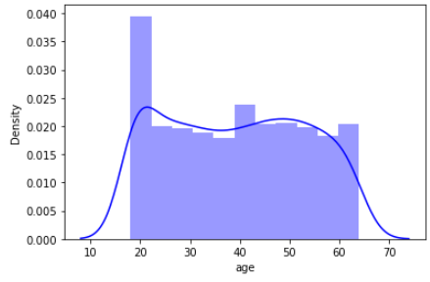
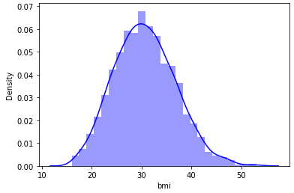
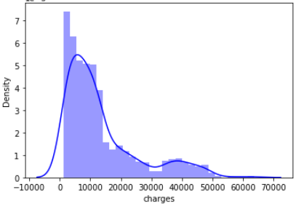
Part 1: Data Overview Continuous Variables
There are about twice as many 18 to 20 year olds as any other age group.
Charges has a positive skewness with some people having much higher than average charges.
BMI has a normal distribution.
Age
Mean: 39.22
std: 14.04
BMI
Charges
Mean: 30.66
std: 6.10
Mean: 13279
std: 12110

Slide 5
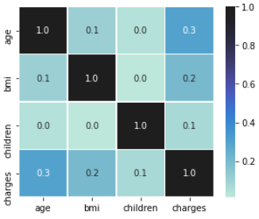
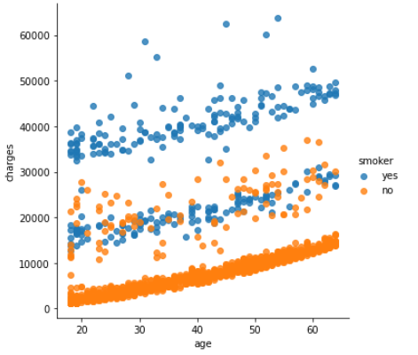
Part1 : EDA
There is no strong correlation in the raw data set.
Age vs Charges has the highest correlation coefficient of (0.3).
A plot of age vs. charges shows a general trend, however, smokers have higher charges. Smokers will be examined in more detail in the next section.
Correlation Plot
Age vs. Charges Correlation

Slide 6
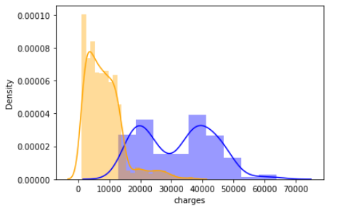
Part 2: Smoker vs. Non Smoker
Smokers have higher charges that are statistically significant, with a mean of ($32,000) for smokers and ($8400) for non smokers.
Smokers do not have a statistically significant difference in Age, BMI, or Children.
Charges Distribution Plot
Smoker
Non Smoker
Table: Smoker vs Non Smoker P-values for Categories
Category | Smoker (mean) | Non Smoker (mean) | P-Value
Age | 38.5 | 39.4 | 0.350
BMI | 30.7 | 30.7 | 0.891
Children | 1.1 | 1.1 | 0.789
Charges | 32050 | 8441 | 1.4e-282

Slide 7
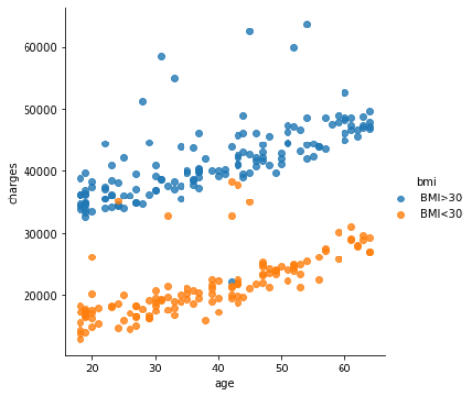
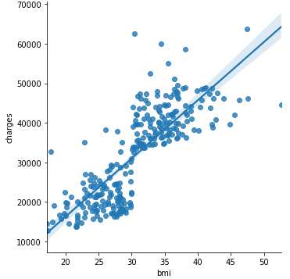
Part 2: Smoker EDA
Analysis of smoker data shows that smokers with higher BMI (bmi>30) have higher average charges then smokers with lower BMI (bmi<30).
There is also a stronger correlation of BMI vs. charges for smokers (correlation coefficient 0.8)
Age vs. Charges
BMI vs. Charges

Slide 8
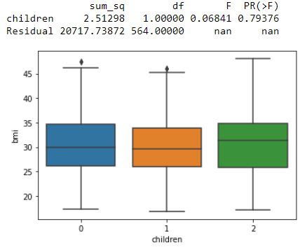
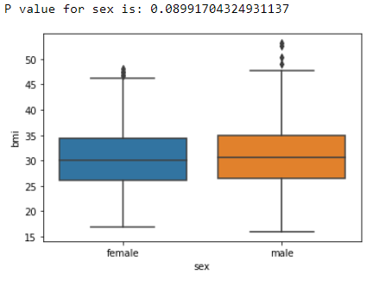
Part 3: BMI
There is not a statistically significant difference for BMI when comparing males to females (P-value = 0.090).
There is not a statistically significant difference for BMI when comparing females with 0, 1, and 2 kids (P-value = 0.079).
Children vs. BMI (Female)
Sex vs. BMI

Slide 9
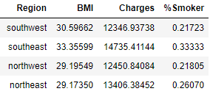
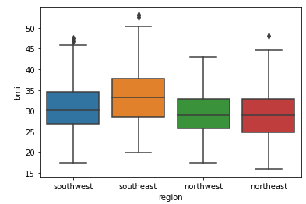
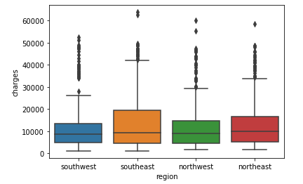
Part 4: Regional Perspective
The southeast region has the highest percentage of smokers, the highest average BMI and the highest average charges of the 4 regions.
The differences in BMI and Charges across the regions are statistically significant.
Table: Average BMI
BMI by Region
Charges by Region
P-value: ~0 thus significantly different
P-value: 0.033 thus significantly different

Slide 10
Conclusions
Medical claims made by smokers are significantly higher than those made by non-smokers.
smokers with BMI > 30 have the highest charges.
The BMI of females is not significantly different from males.
The BMI of women with 0, 1, and 2 children are not significantly different.
The Southeast has the highest proportion of smokers, the highest average charges, and the highest average BMI.
The strongest correlations in the data are for:
BMI vs Charges for smokers
Age vs. Charges for non-smokers.
Thus, for predicting charges:
for smokers BMI is the strongest indicator of charges.
for non-smokers, age is the strongest indicator of charges.

