Slide 1
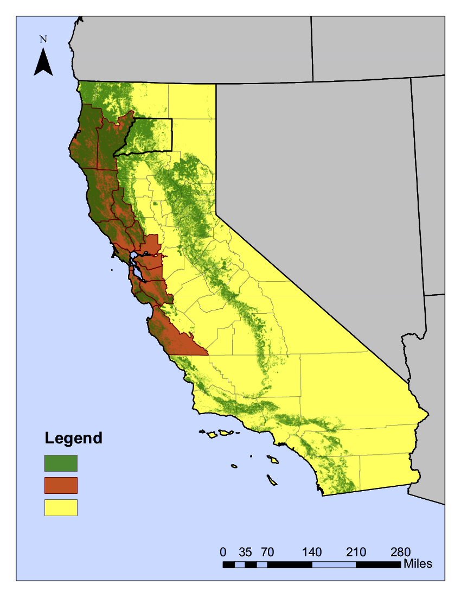



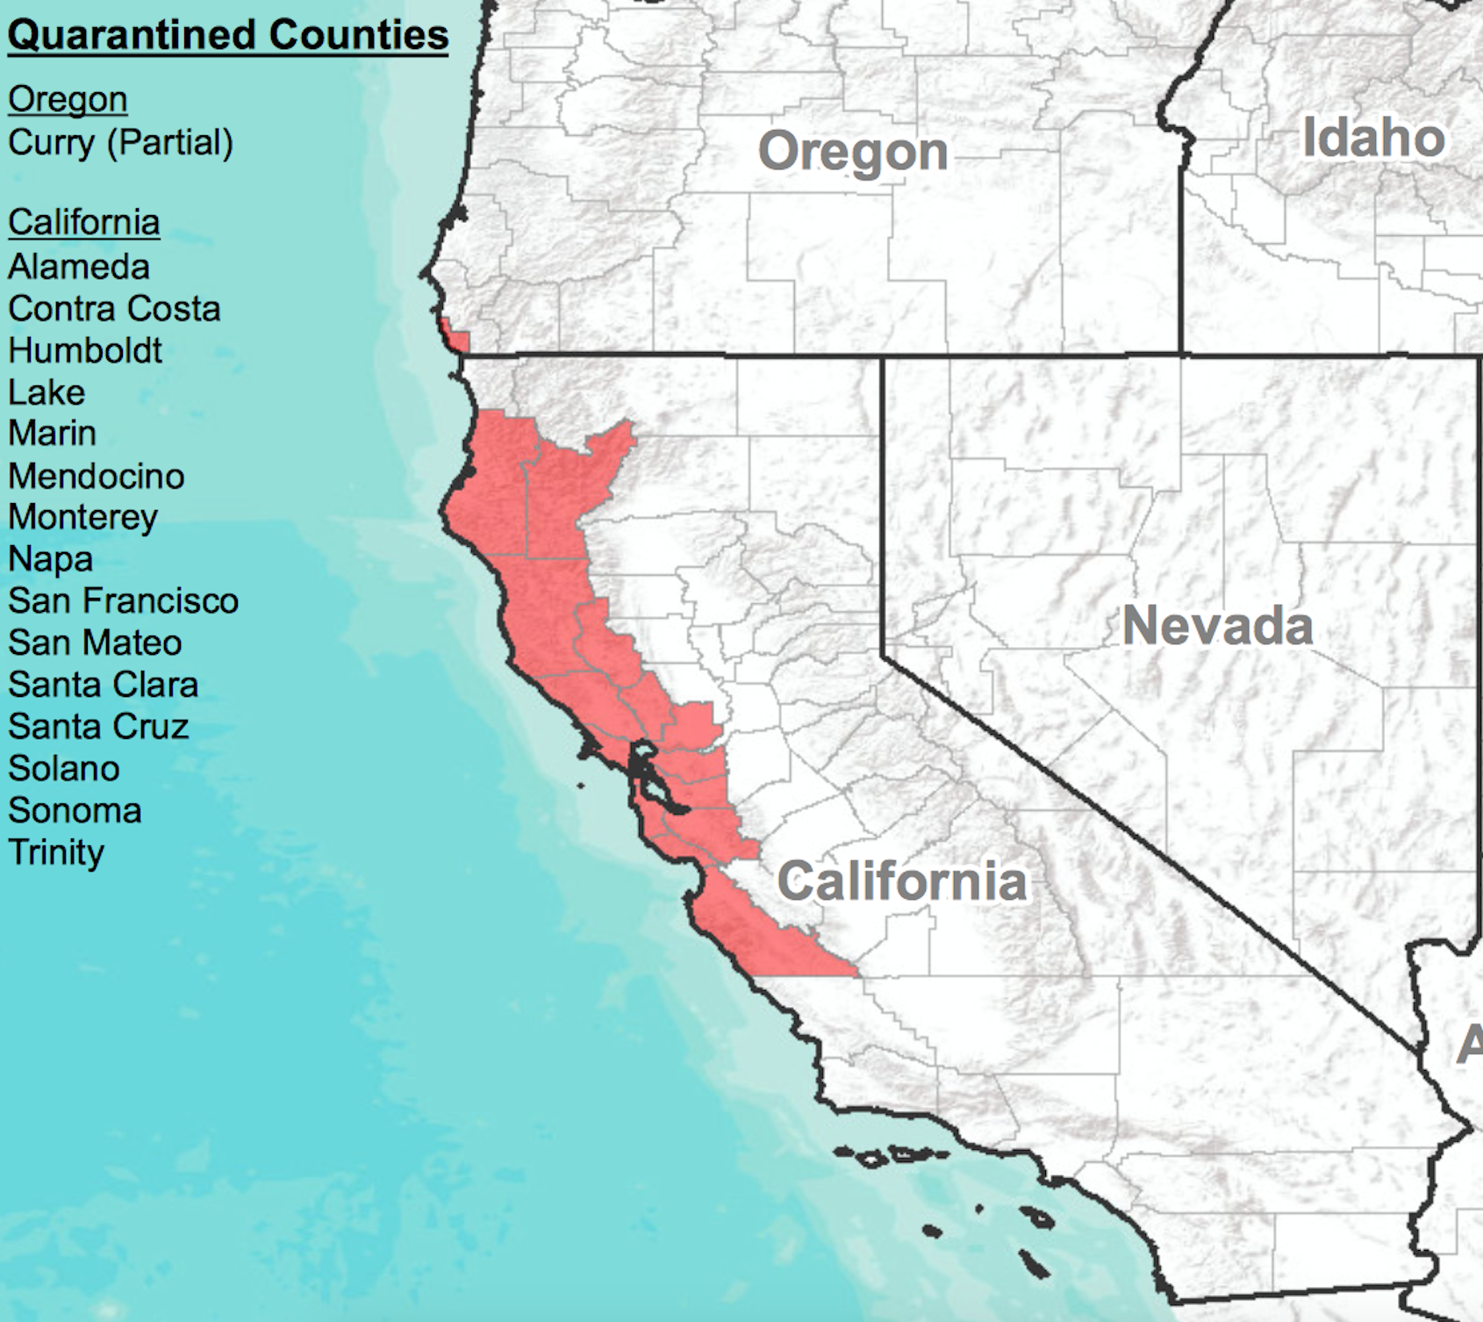
1. Initially, disease invades and spreads undetected
Primary
infection
Secondary
infection
Quarantined counties
Alameda Contra Costa
Humboldt Lake
Marin Mendocino
Monterey Napa
San Francisco San Mateo
Santa Clara Santa Cruz
Solano
Sonoma
Trinity
2. When disease is detected, quarantine is introduced
First detection
Quarantine zone
Free trade zone
3A. Underusing quarantine leads to disease escape
Secondary
infection
Trade
Quarantine zone
Free trade zone
3B. Overusing quarantine is expensive
Quarantined counties
Quarantine zone
Free trade zone
Locations
of P. ramorum susceptible hosts
3C. Optimal quarantine is most cost efficient
Quarantine zone
Free trade zone

