Slide 1
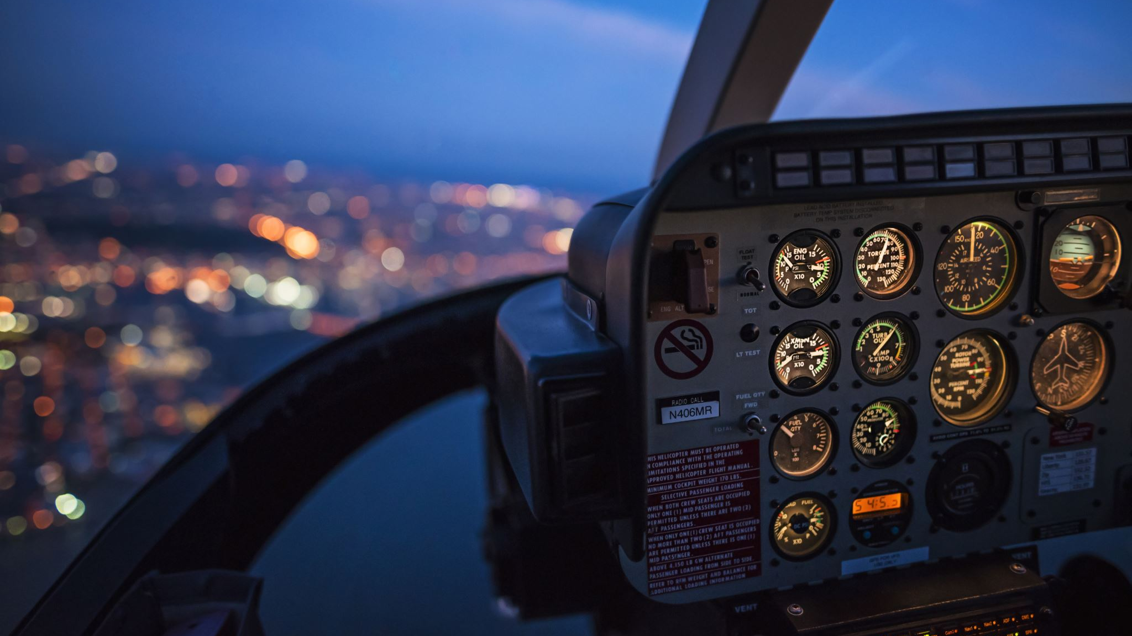
Pilot Readiness Assistant
NDIA Hackathon
Team Avengers

Slide 2
Use case and Design
Use Case: Develop a solution to predict pilot readiness and/or disqualifying events in the next 90 days based on current health and historic health conditions.
Design and solution: We developed a readiness assistant using machine learning and AI capabilities that predicts the likelihood of a pilot being ready to fly or disqualified from flying within 90 days of a given date.

Slide 3
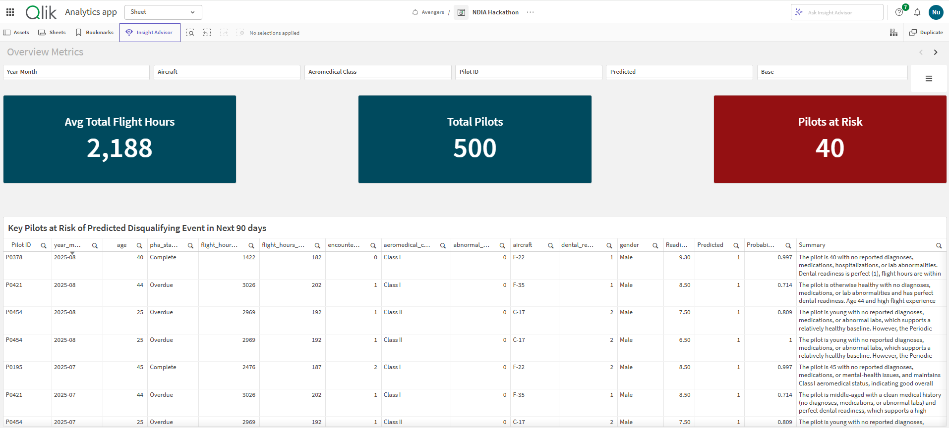
Application Demo
NDIA Hackathon

Slide 4
Development Limitations
Initial solution attempt utilized Pyspark, but environment didn’t support many Pyspark machine learning libraries.
Pivoted to Python-native packages for machine learning model training libraries.
Scalability concerns due to environment setup.
Adjusted programming to be as efficient as possible within these limitations.

Slide 5
Work With Us!
In coordination with your contracting office, log onto TSM at https://www.tradewindai.com/
Search for the company “KPMG LLP” to find one of our many solutions. Confirm the solution’s status is “Awardable”.
Contact KPMG to begin contract negotiations.

