Slide 1

Introduction to Android Development
Vogella.com Lars Vogel
Developer.android.com Google
https://www.raywenderlich.com/126528/android-recyclerview-tutorial
New Boston Videos thenewboston.org

Slide 2
MOOC Training
Developing Android Apps
Udacity.com
https://www.udacity.com/course/viewer#!/c-ud853/l-1395568821/m-1643858568

Slide 3
What is Android?
An operating system
Based on BSD
NDK – Native Development Kit
  C++ API
  Augment the operating system
SDK – Software Development Kit
  Java API
  Latest version 7.0 (Nougat)

Slide 4
Common Terms
Activity – Visual representation of an android application. Uses both views and fragments to create a user interface. There is normally one of these for each screen.
Fragment – Optional constructs inside activities to support display on different devices or provide reuse across multiple activities or to support swiping
View – interface widget like a button or text field

Slide 5
More terms
View Group – basically a layout manager to establish where the view will go on the actual screen
Intent – an async message that allows the application to request functionality from other components.
Service – a background task that does not require a UI component

Slide 6
Even more terms
Content Provider – an interface to shared application data. Usually the on-board SQLite database.
Broadcast Receiver – deliver events to the app outside of regular program flow

Slide 7
Android Studio
Google's “official” development platform
SDK and Gradle already integrated
Based on Intelli-J platform
http://developer.android.com/sdk/index.html

Slide 8
Packaging and Deployment
The compiled code you write along with resources and support are compiled into a .apk file.
The organization, permissions and instructions on how to run your program are in a file called:
AndroidManifest.xml

Slide 9
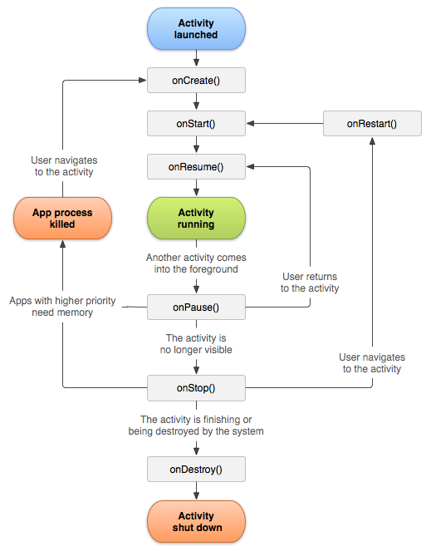
Activity Lifecycle

Slide 10
Activity Lifecycle
Once an activity is started it can be in one of three states: Paused, Resumed/Running and Stopped.
We have the following callbacks to determine what state we are in:
onCreate(), onStart(), onResume(), onPause(), onStop(), onRestart() and onDestroy()

Slide 11
Important Pairs
Entire lifetime is between create – destroy
Visible lifetime between start – stop
Foreground lifetime between resume - pause

Slide 12
Our first simple Android App
It just prints out the transitions from the different states of the activity.
Note the use of logging to show in eclipse things that are happening on the phone emulator.

Slide 13
Transition to new Activity
Create an Intent
Use Bundle with key-value pairs to pass data if necessary

