Slide 1
Analysis II Domain Models
CS2340

Slide 2
Now What?
We have identified the external users and systems
We have described the stories of use
Now we have to start to understand what is inside the box.
Step 1 is the domain model – understanding the customer concepts and terms.
AKA
Data Dictionary (in the old SASD days)
Ubiquitous Language (in Domain Driven Design)
Focus on what is important to the customer – NOT what is important to the programmer!

Slide 3
Domain Vocabulary
Blind men and the elephant
Stakeholders may use different terms in different parts of the company to mean the same thing.
Stakeholders may also use the same term to mean different things!!!!

Slide 4
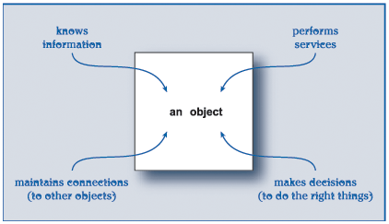
Digression – What is an object?
Nouns….
Identity, Encapsulation, Polymorphism
Picture from Rebecca Wirfs-Brock
Object Design Book

Slide 5
Ordering Flowers (Procedural)
What do I need to do?
What data do I need?
Chris
Robin

Slide 6
Ordering Flowers - OO
Role: Send Flowers to Robin
Arranger
Role: Turn Raw Flowers into an arrangement
Chris
Florist
Role: Create Flowers
Grower
Role: Satisfy Customer
Request
Wholesaler
Role: Provide Fresh Flowers
Robin
DeliveryPerson
Role: Deliver Flowers to Robin
Role: Receive Delivery
Adapted from Timothy Budd

Slide 7
Step 1 - Brainstorming
Team generates a lot of possible objects
Don’t think too hard
Record all ideas
Use multiple techniques:
Domain Analysis (Generic)
Noun Analysis (Specific to problem)

Slide 8
Step 2 - Filtering
We need to reduce this big list down to candidate objects that we think are in the customer domain
Remember : the customer should recognize every noun that we are selecting as a candidate object. Anything else is probably computer-speak and should be postponed to design
Look for (and get rid of):
Synonyms – nouns that mean the same thing in the customer domain
Attributes – nouns that are really just a simple number or string
Implementation – nouns that represent implementation/design decisions, not customer domain ideas (networking, servers, databases, etc.)
User interface –nouns representing UI ideas (windows, screens, dialogs, widgets, etc)

Slide 9
Step 3 – Draw the domain Model
Candidate classes with their attributes and methods
No visibility markings (public/private)
No parameters or return types
No types of instance data
Do provide:
Basic class boxes
Associations (regular but normally not aggregation or inheritence)
Cardinality Constraints (multiplicity)

