Slide 1
Software Architecture
CS2340
Spring 2017

Slide 2
Where are we now?
We understand at least part of what we have to build through the user stories.
We understand major concepts of the customer domain through the domain model.
We understand interactions with the system through the Robustness Diagrams and UI prototypes

Slide 3
Now it is time to move to design
First let’s step back and think at a System’s level.
A System is an integrated composite of:
People
Products (Hardware and Software)
Processes
To satisfy a stated need or objective
--(DoD Systems Engineering Guide)

Slide 4
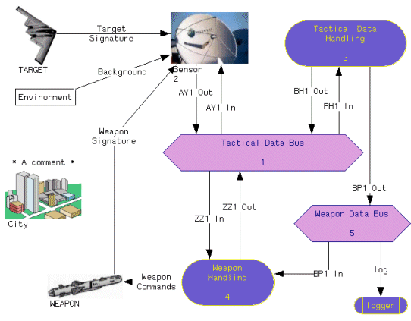
System’s Architecture

Slide 5
Software Architecture
A part of the overall System’s Architecture
A software architecture for a program or computing system consists of the structure or structures of that system, which comprise elements, the externally visible properties of those elements, and the relationships among them [Bass 03].
The quality attributes of a software system, such as performance, modifiability, and security, are bound up in its software architecture. A system with the wrong architecture will be a failure.
Software Engineering Institute (SEI)

Slide 6
Architectural Views
A view is a representation of a set of system elements and the relations associated with them. Views are representations of the many system structures present simultaneously in software systems.

Slide 7
Standard Views
Conceptual / Logical / Functional
Process / Runtime
Physical
Module / Implementation
User Interaction / Use Case
Security
Performance

Slide 8
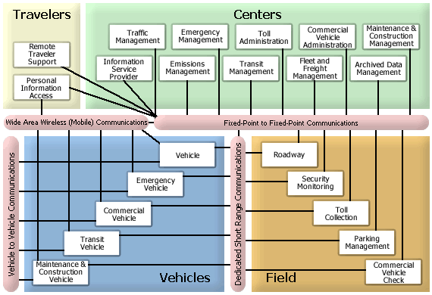

Slide 9
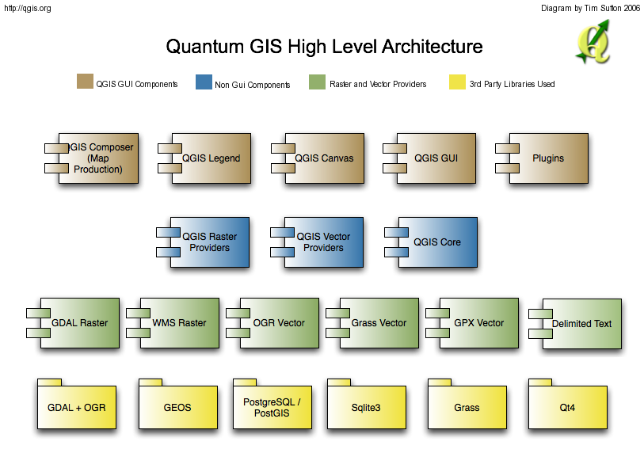

Slide 10
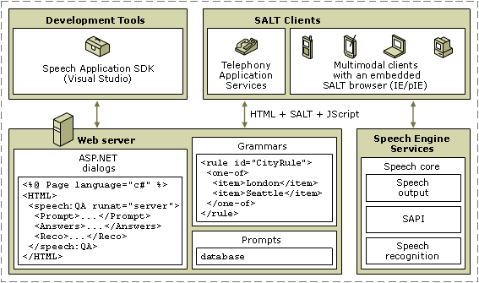

Slide 11
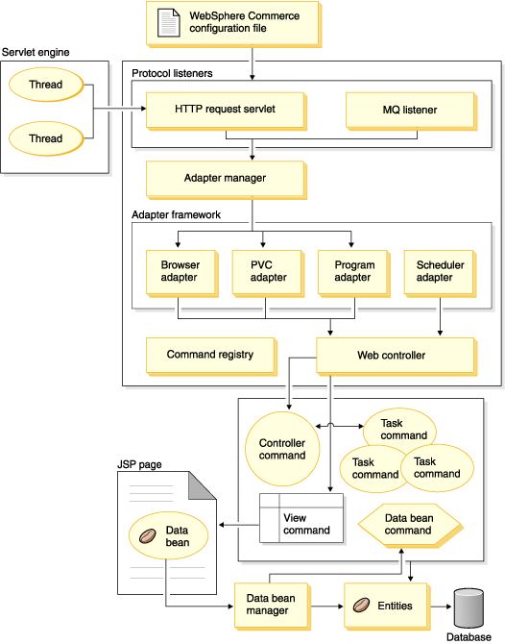
Runtime
Architecture
Example

Slide 12
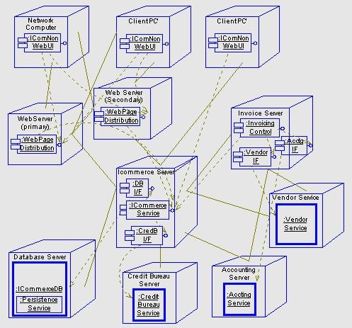
Physical
Architecture
Example

Slide 13
Architectural Styles
A style is a specialization of element types (e.g., “client,” “layer”) and relationship types (e.g., “is part of,” “request-reply connection,” “is allowed to use”), along with any restrictions (e.g., “clients interact with servers but not each other” or “all the software comprises layers arranged in a stack such that each layer can only use software in the next lower layer”).

Slide 14
Common Architectural Styles
Client – Server (thin/fat)
Peer-to-Peer
Blackboard/Shared Memory
Pipe and Filter
Model – View – Controller
n-tier
Layered
Implicit Invocation/Event-Driven

Slide 15
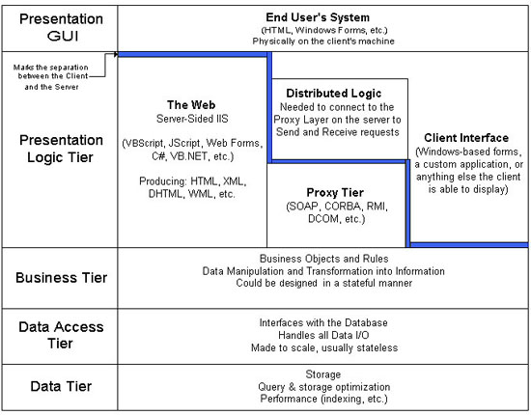
sample n-tier

Slide 16
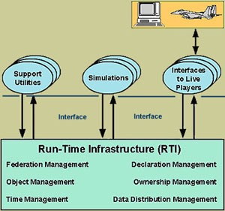
Sample Event-Driven

Slide 17
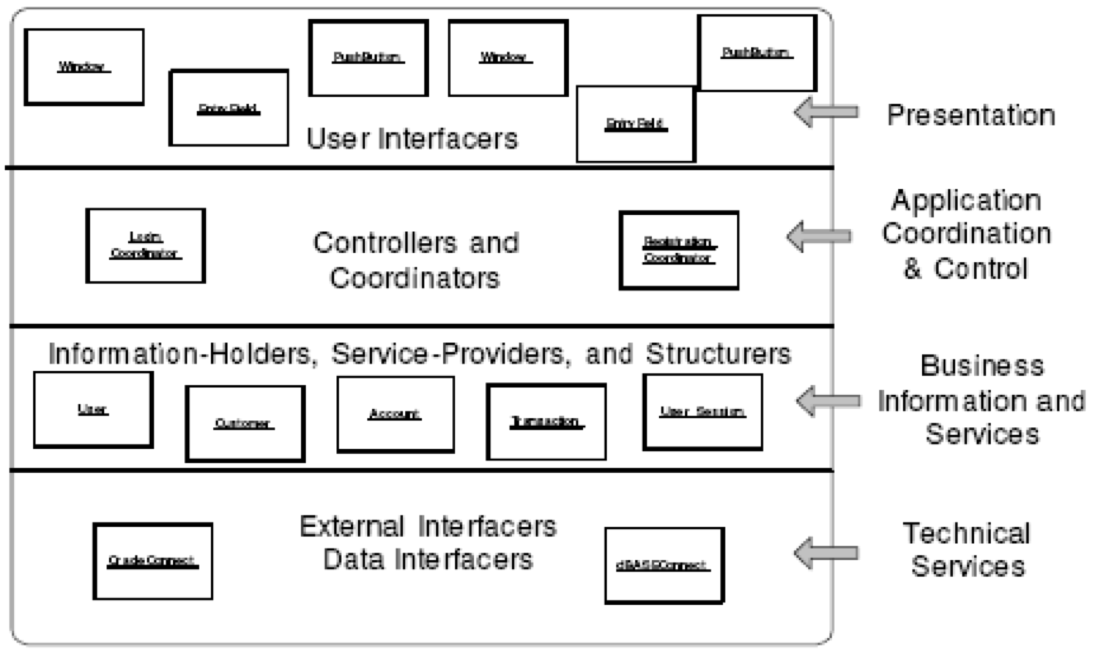
Layered Architecture Examples

Slide 18
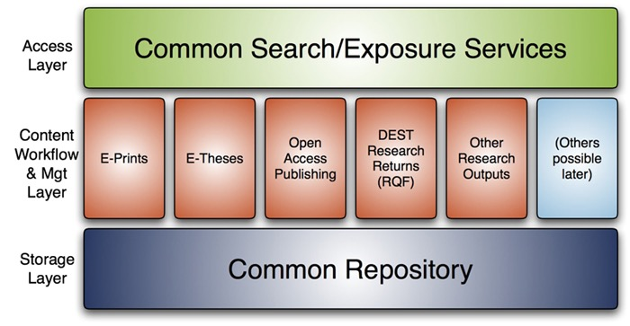

Slide 19
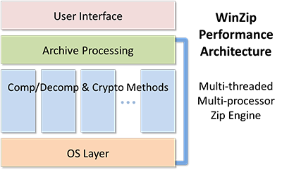

Slide 20
Enterprise Architectures
Service-Oriented Architecture
Microservices Architecture

Slide 23
Control Styles
Centralized – A few objects make all the decisions and direct other objects when to do specific tasks.
Delegated – There are several coordinator objects which locally direct a few objects.
Dispersed – Objects work without central direction to accomplish tasks

Slide 24
Architectural Evaluation (Validation)
How do we know if we have a good architecture? (Not primarily functionality)
SAAM (Software Architecture Analysis Method)
ATAM (Architectural Tradeoff Analysis Method)

Slide 25
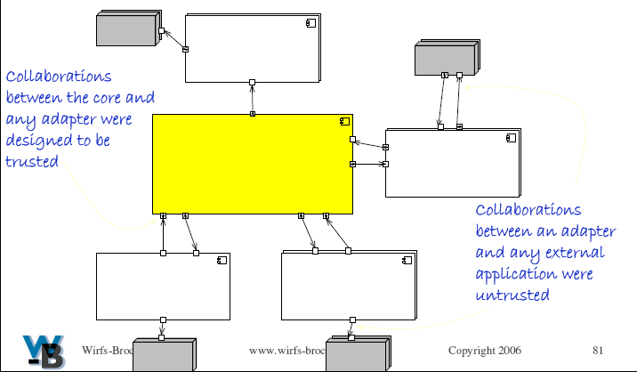
Trust Boundaries
Trusted and Untrusted

Slide 26
Untrusted Collaborations
If a collaborator can’t be trusted, it doesn’t mean it is inherently more unreliable. It may require extra precautions:
Pass along a copy of data instead of sharing it
Check on conditions after the request completes
Employ alternate strategies when a request fails
Check for timeliness, relevance and correctly formed data.
Make objects read-only to prevent modification

Slide 27
Representing the Architecture
UML Package Diagram
Each component is a “file folder” icon
There are several ways to show connections between packages, but for this class we will primarily use a “dependency” relation
Dependency means a package calls methods on or implements interfaces defined in a different package.
Chapter 13 in Larman book
Trust Boundary can be hand drawn on diagram

