Slide 1

Statistical analysis of Anxiety in wake of COVID-19
By Jacob Walter

Slide 2
Abstract
The advent of COVID-19 has left the world ravaged and individual’s mental health is no exception. Mental health is already a large issue; however, the COVID-19 related lockdown has amplified anxiety greatly across the United States. By understanding what groups are most affected by this anxiety, we could work to target specific programs towards these demographics. This research will use a dataset of United States inhabitants GAD-2 (an established psychiatric anxiety test) surveys taken to assess individuals self-reported anxiety. We begin by modelling and summarizing the general trends of three distinct groups and their differences: sex, education level, and age. We next use statistical tests to determine which specific groups have highest (or lowest) levels of self-reported anxiety and how they influence the national GAD-2 average. Finally, regression analysis will be used to determine if this self-reported anxiety is increasing at a statistically significant rate. We found that at a national level, age was the best predictive indicator of anxiety due to COVID-19, with younger audiences contributing to higher anxiety, and older audiences contributing to less anxiety. This research is limited by the time frame (April 23, 2020 – October 26, 2020) and the frequency of surveys (every two weeks as opposed to every week of every day), these could lead to imperfections and biases in analyzed data.

Slide 3
Subject of Interest and Data Source
The subject of interest is how anxiety has been altered by the COVID-19 lockdown, this topic is interesting seeing as how relevant it is to many people's lives, mine included.
Data Source Name: National Center for Health Statistics (NCHS)
Data Source Link: https://www.cdc.gov/nchs/covid19/pulse/mental-health.htm
Data Source Description: A pulse study updated every 2 weeks to outline participants mental health response to COVID-19 lockdown.

Slide 4
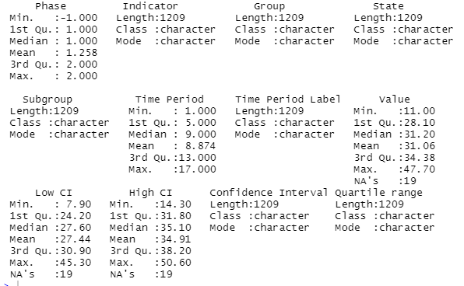
Codebook and Summaries
There is a handful of data here, particularly nominal and ordinal data. The most important data in this data set is the quantitative ‘Value’ data. The ‘Value’ data represents the scores on the GAD-2 test, which is a test with numerical answers determining General Anxiety Disorder within patients. The higher the score, the higher the reported anxiety.

Slide 5
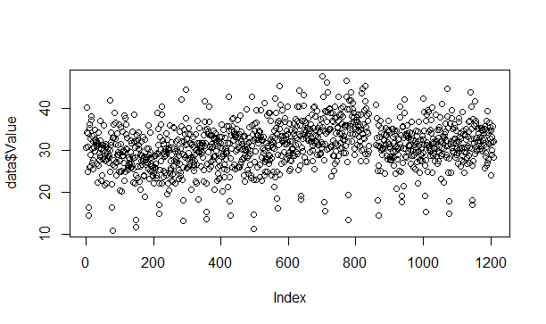
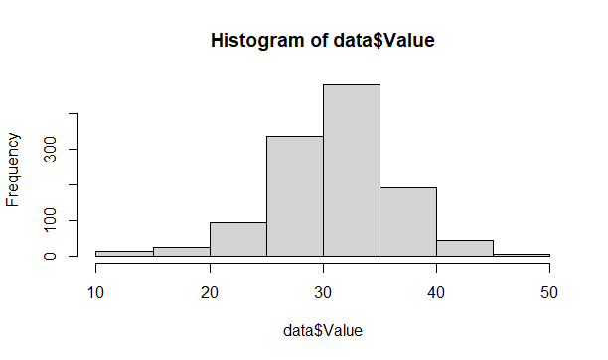
GAD-2 Scores Graphical Summaries
The data appears to be fairly evenly distributed, with a higher concentration of GAD-2 score between the 25 and 35 range.

Slide 6
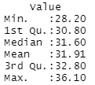
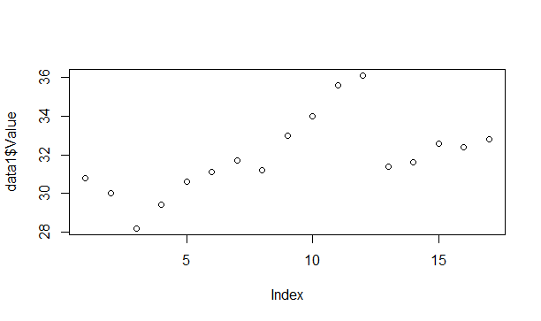
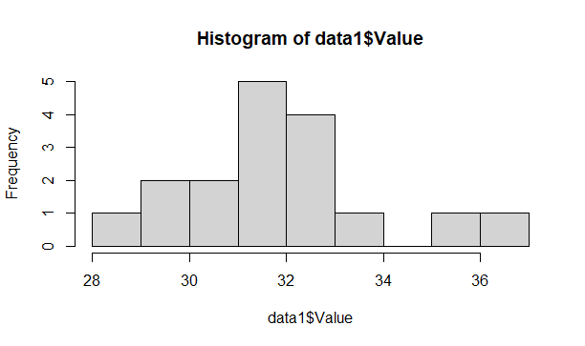
Data Graphics for National Value
After the data was cleaned and sorted
The data appears to be less random and has its highest GAD-2 scores between the 30 and 34 range.

Slide 7
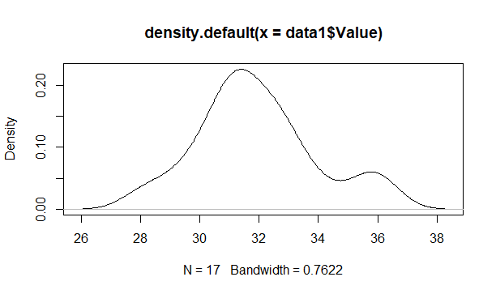
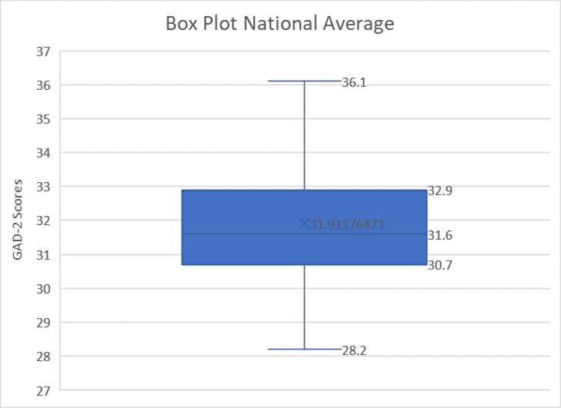
Data Graphics for National Value(cont.)
After the data was cleaned and sorted
The data appears to be fairly normally distributed with the exception of a small hump around the values 35-37.

Slide 8
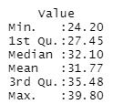
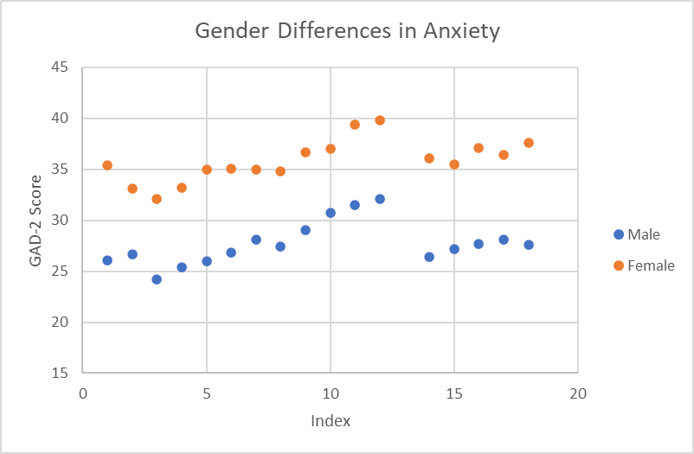
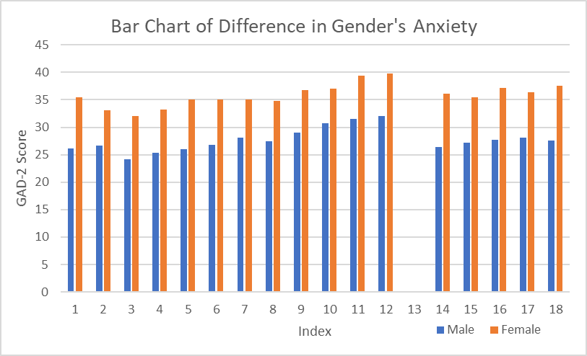
Summary Statistics for Gender
After the data was cleaned and sorted

Slide 9
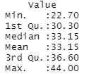
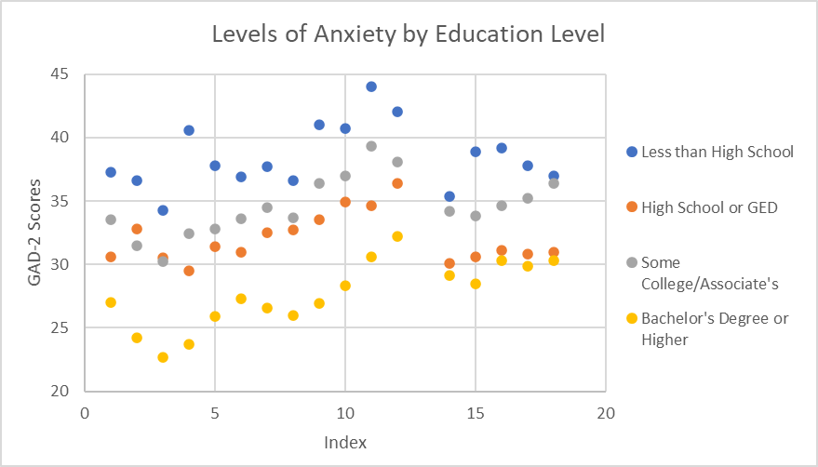
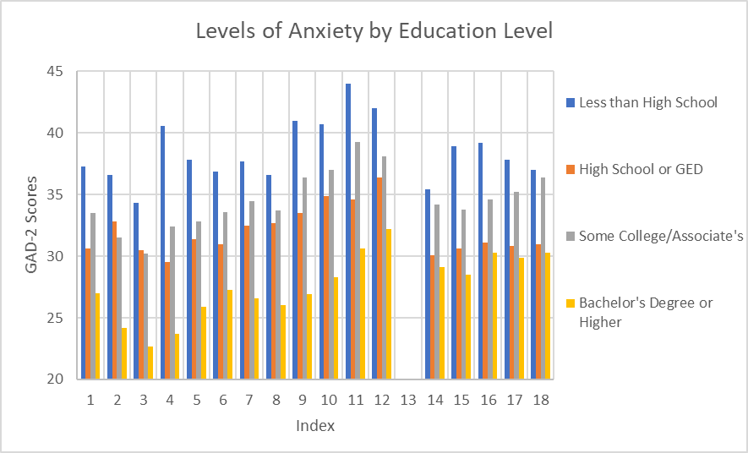
Summary Statistics for Education
After the data was cleaned and sorted

Slide 10
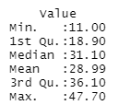
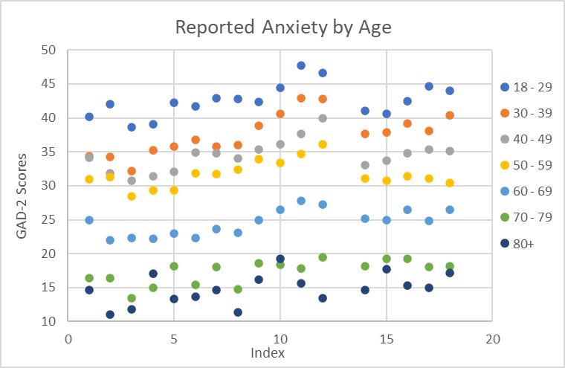
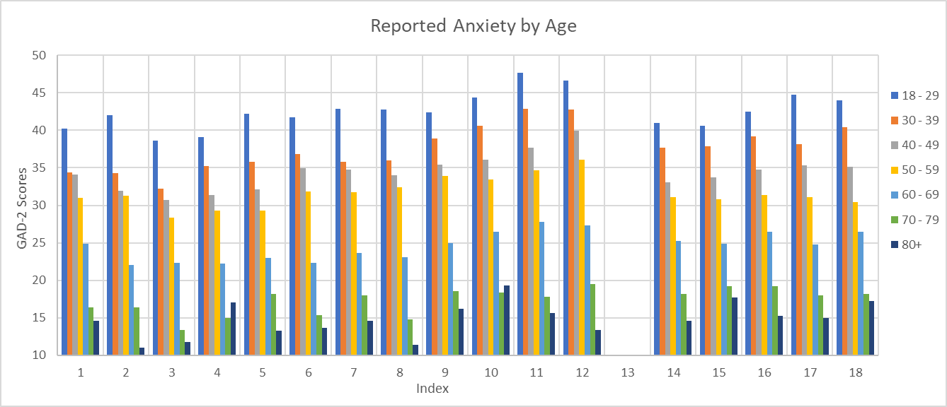
Summary Statistics for Age
After the data was cleaned and sorted

Slide 11
Research Questions
What group (sex, education, age) had the largest effect on anxiety due to COVID-19?
What subgroup (within sex, education, age) had the largest effect on anxiety due to COVID-19?
How have reported anxiety (GAD-2) scores changed over the course of time?

Slide 12
What group (sex, education, age) had the largest effect on anxiety due to COVID-19?
Hypothesis: Age and education level will have a significant affect on COVID-19 related anxiety, while sex will not.
Null Hypothesis: Age and education level will not have a significant affect on COVID-19 related anxiety, while sex will.
The variables are:
National GAD-2 Scores
Average Sex GAD-2 Scores
Average Education Level GAD-2 Scores
Average Age GAD-2 Scores
Statistical test that will be used are density plots, Q-Q graphs (including Q-Q plot lines), Shapiro Wilk test, F-test, t-test, and correlation and scatterplot matrices.

Slide 13
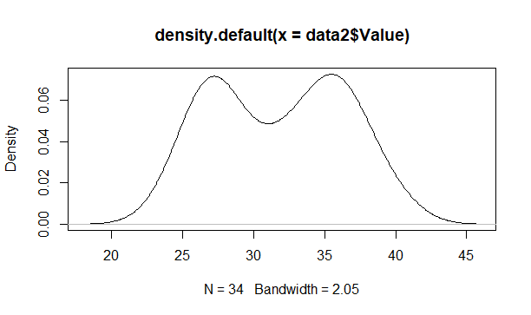
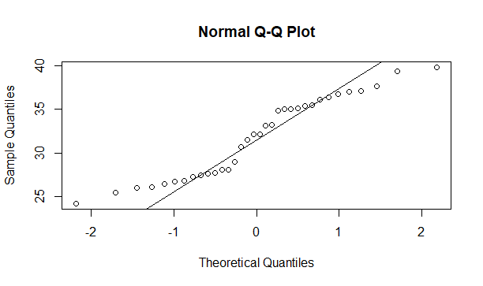
Gender Density and Q-Q Graphs
The distribution appears to be almost perfectly bimodal.

Slide 14
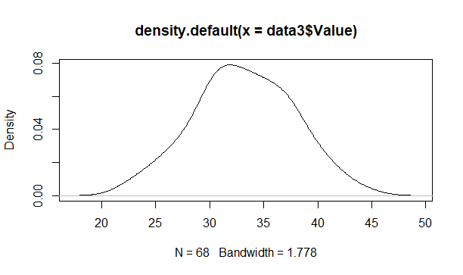
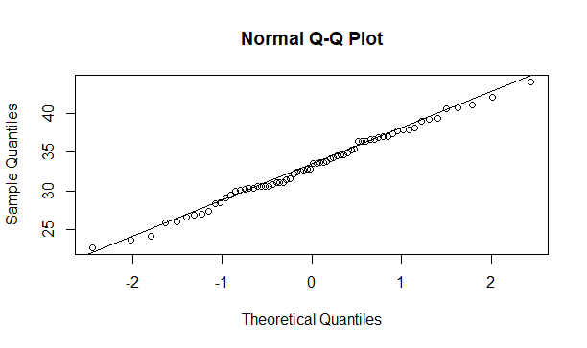
Education Density and Q-Q Graphs
The distribution appears to be fairly normally distributed.

Slide 15
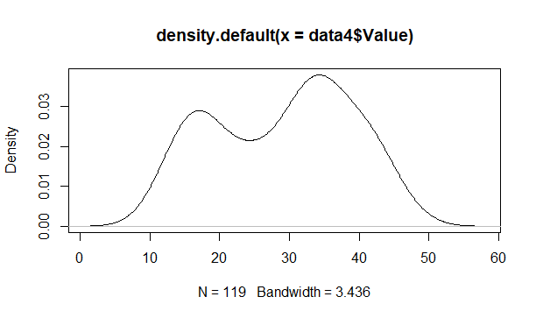
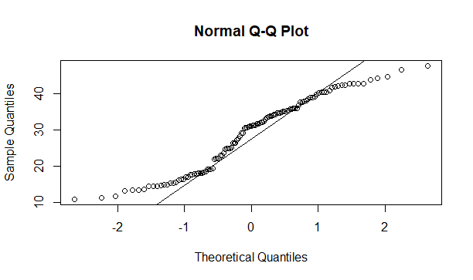
Age Density and Q-Q Graphs
The distribution appears to be bimodal, with a higher peak in the 30 – 40 range of values.

Slide 16




Shapiro-Wilk Test for Normality
For the entire sample
For the gender sample
For the education sample
For the age sample
The Shapiro-Wilk test showed that the entire sample, and the education sample were normally distributed (given a p-value above 0.05), and the gender and age samples were not normally distributed. This was predictable, given each samples density plot and q-q plot in the previous slides.
The average values across sex, education, and age were taken and each distribution was normally distributed.

Slide 17
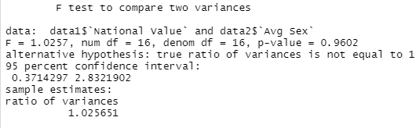
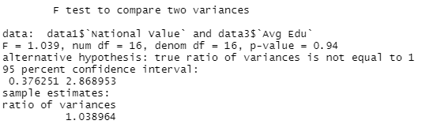
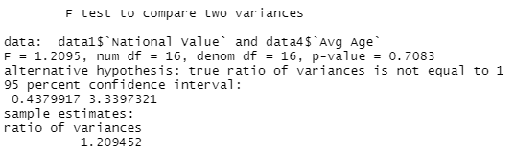
F-tests
Between National Value and Average Sex
Between National Value and Average Education
Between National Value and Average Age
Since none of the values are statistically significant, it can be determined that neither sex, education, or age, are statistically different from the national GAD-2 score values.

Slide 18
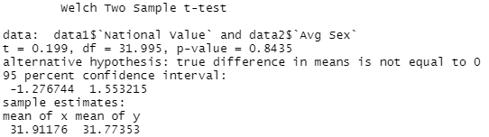
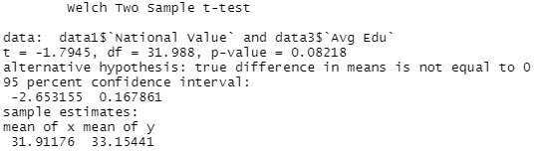
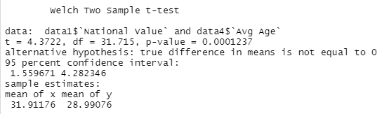
T-tests
Between National Value and Average Sex
Between National Value and Average Education
Between National Value and Average Age
Since sex and education did not yield statistically significant results, they are not a significant indicator of national GAD-2 scores. Age; however, yielded very statistically significant results, showing that the age of participants altered the national value of GAD-2 scores.

Slide 19
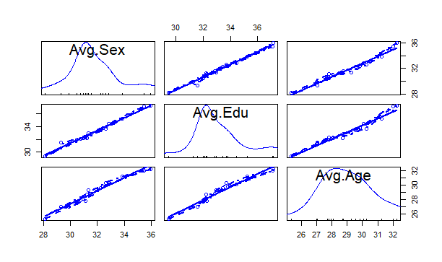
Correlation and Scatterplot Matrices for Average Sex, Education, and Age
All variables contained significantly normally distributions and strong linear regressions when any other variable was changed. This was especially apparent with sex and education. Because of this, it can be determined that there was little covariation of variables on one another.

Slide 20
What group (sex, education, age) had the largest effect on anxiety due to COVID-19? - Results
The null hypothesis cannot be rejected.
The analysis showed that sex and education level did not have a significant cause of higher or lower levels of COVID-19 lockdown related anxiety.
The analysis did show that age was a significant cause and suitable predictor of COVID-19 lockdown related anxiety.

Slide 21
What subgroup (within sex, education, age) had the largest effect on anxiety due to COVID-19?
Hypothesis: Females and those under age 70 will contribute to higher GAD-2 scores, there will be no difference between education levels.
Null Hypothesis: Females and those under age 70 will not contribute to higher GAD-2 scores, there will be significant difference between education levels and GAD-2 scores.
The variables are:
National GAD-2 Scores
Male GAD-2 Scores
Female GAD-2 Scores
No High School GAD-2 Scores
High School GAD-2 Scores
Statistical test that will be used are Chi-Squared tests, Confidence Interval Bootstrapping, and ANOVA tests
Associates GAD-2 Scores
Bachelor’s or more GAD-2 Scores
18 - 29 year GAD-2 Scores
30 - 39 year GAD-2 Scores
40 - 49 year GAD-2 Scores
50 - 59 year GAD-2 Scores
60 - 69 year GAD-2 Scores
70 - 79 year GAD-2 Scores
80+ year GAD-2 Scores

Slide 22


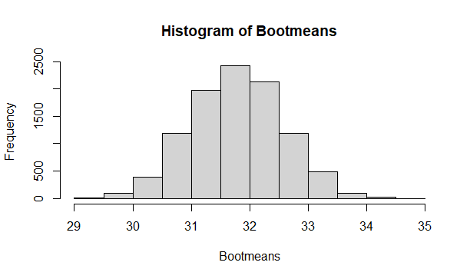
Chi-squared test and Bootsrapped CI for Sex
Between National Value and Male
Between National Value and Female
Since neither p-value was below the value of 0.05, it can be determined that neither being male, nor female had a significant effect on higher or lower anxiety levels in survey respondents.

Slide 23

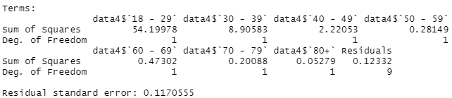
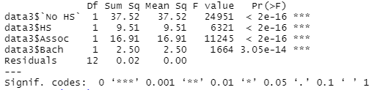
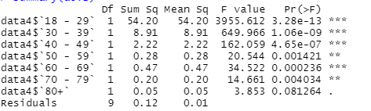
ANOVA tests for Education and Age
Between National Value and Education
Between National Value and Age
Since all results were statistically significant (besides over 80 years), it can be determined that all groups are different from the national values, besides being older than 80 years old.

Slide 24
What subgroup (within sex, education, age) had the largest effect on anxiety due to COVID-19? - Results
The null hypothesis cannot be rejected.
This means that being male (or female) was a not a significant cause of higher anxiety in anxiety due to COVID-19 lockdowns. Neither gender caused higher or lower anxiety.
This also means that separate education levels individually did not cause higher or lower levels of anxiety due to COVID-19 lockdowns.
Finally, it can be determined that only ages under 80 did not cause higher or lower levels of anxiety due to COVID-19 lockdowns, but ages 80 and over caused decreased levels of anxiety.

Slide 25
How have reported anxiety (GAD-2) scores changed over the course of time?
Hypothesis: Anxiety due to COVID-19 will increase over time.
Null Hypothesis: Anxiety due to COVID-19 will decrease or stay the same over time.
The variables are:
National GAD-2 Scores
Time
Statistical test that will be used are scatterplots, bar charts, Q-Q plots, Q-Q line graphs, and linear regression.

Slide 26
Data Graphics for National Value
After the data was cleaned and sorted
The data appears to be less random and has its highest GAD-2 scores between the 30 and 34 range.

Slide 27
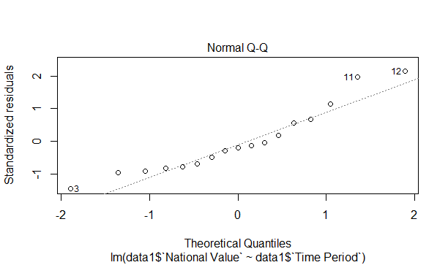
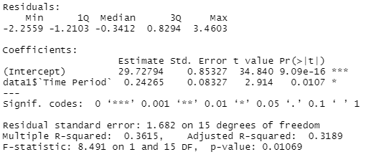
Graphical Analysis of GAD-2 Over Time
Overall, the values of GAD-2 scores seemed to increase over each time interval, the linear regression determined that this pattern was statistically significant.

Slide 28
How have reported anxiety (GAD-2) scores changed over the course of time? - Results
The null hypothesis can be rejected.
This means that as time passed (from April 23, 2020 to October 26, 2020), participants feelings of self-reported anxiety (via the GAD-2 test) has rising in a statistically significant manner during the COVID-19 lockdown.

