Slide 1
Non-binary ADC Switching Algorithm
YYK
2019 July 19

Slide 2
Non-binary ADC Switching Algorithm
Motivation: Binary search and its weakness
Considerations

Slide 3
An Idealized, SAR ADC Block Diagram
V_{input}
S&H
V_{x}
V_{ref}
DAC
FSM

Slide 4
An Idealized, SAR ADC Block Diagram
V_{input}
V_{DAC}
DAC
FSM

Slide 5
Binary SAR ADC search tree
> 4?
> 2?
> 6?
> 1?
> 3?
> 5?
> 7?
0
1
2
3
4
5
6
7

Slide 6
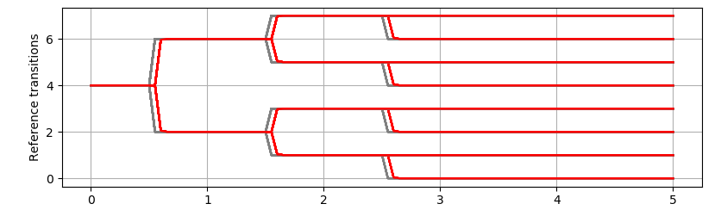
ADC decision tree for a 3 bit ADC
Case study for Vin = 2.5V

Slide 7
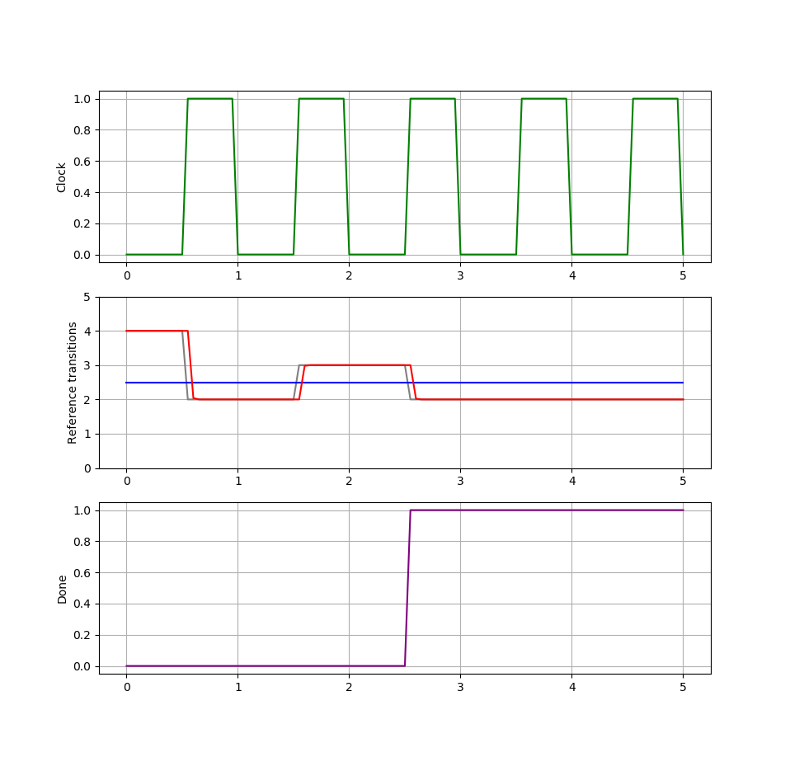
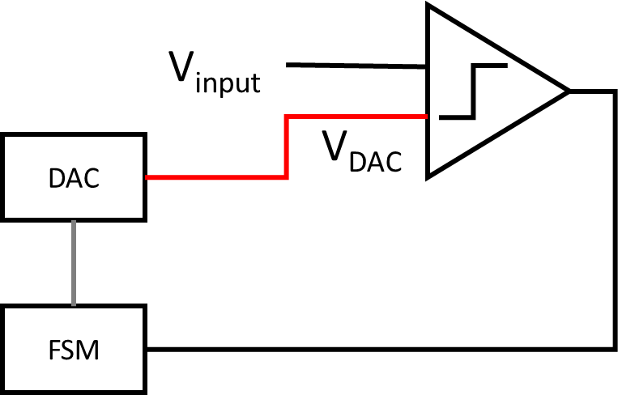
Waveforms when
Vin = 2.5V
Legend
Input voltage
FSM output
DAC output
ADC Done

Slide 8
Binary search tree example: 2.5V input
> 4?
> 2?
> 6?
> 1?
> 3?
> 5?
> 7?
0
1
2
3
4
5
6
7

Slide 9
Binary search tree example: 2.5V input
> 4?
> 2?
> 6?
> 1?
> 3?
> 5?
> 7?
0
1
2
3
4
5
6
7

Slide 10
Binary search tree example: 2.5V input
> 4?
> 2?
> 6?
> 1?
> 3?
> 5?
> 7?
0
1
2
3
4
5
6
7

Slide 11
Binary search tree example: 2.5V input
> 4?
> 2?
> 6?
> 1?
> 3?
> 5?
> 7?
0
1
2
3
4
5
6
7

Slide 12
Waveforms when
Vin = 2.5V
Legend
Input voltage
FSM output
DAC output
ADC Done
Comparator judges [V_{in} > V_{DAC}] decisions at these zones

Slide 13
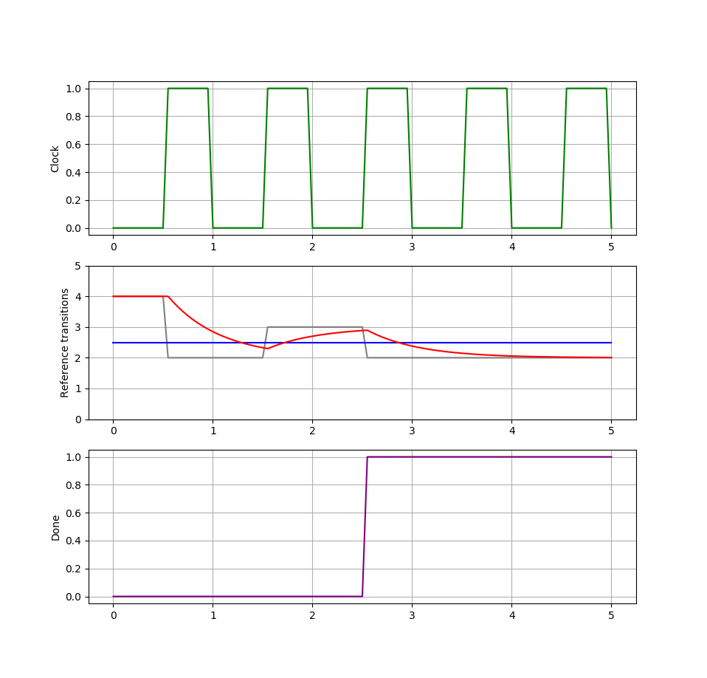
Waveforms when
DAC is somewhat slow
Legend
Input voltage
FSM output
DAC output
ADC Done

Slide 14
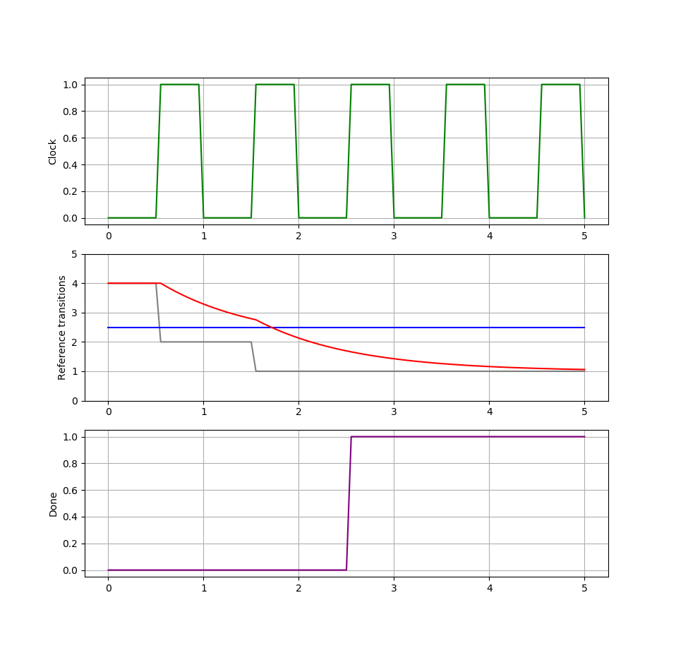
Waveforms when
DAC is too slow
Legend
Input voltage
FSM output
DAC output
ADC Done
Error in step 2

Slide 15
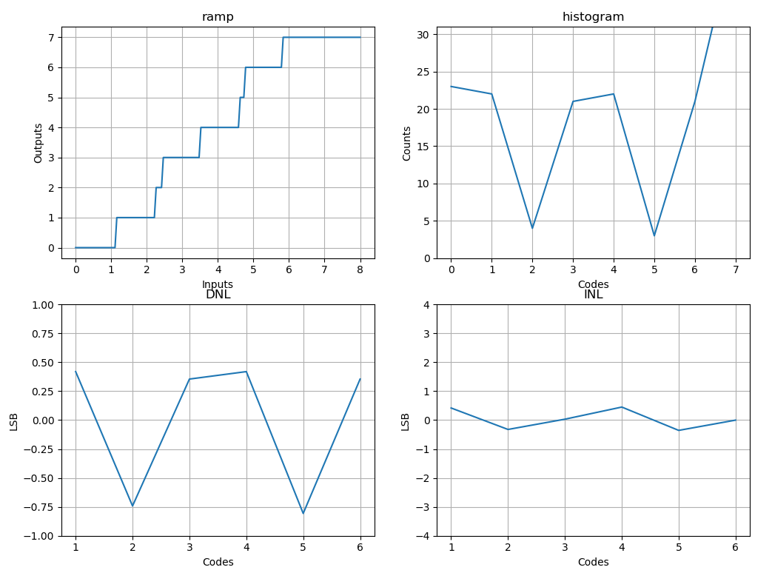

Slide 16
Mitigation Steps
Say sorry for potentially making a mistake
Look for the potential mistake range down your future search path

Slide 17
Mitigation step 1
Say sorry for potentially making a mistake
Legend
Input voltage
FSM output
DAC output
ADC Done
I may have made a ±1 LSB mistake in step 2

Slide 18
Original Search Tree
> 4?
> 2?
> 6?
Wrong path
Right path
> 1?
> 3?
> 5?
> 7?
0
1
2
3
4
5
6
7

Slide 19
Zoom into step 2’s sub Tree
Mitigation step 2
Look for the potential mistake down your future search path
I may make a ±1 LSB mistake in [ > 2 ? ]
> 2?
> 1?
> 3?
Wrong path
Right path
0
1
2
3

Slide 20
Zoom into step 2’s sub Tree
Mitigation step 2
Look for the potential mistake down your future search path
I may make a ±1 LSB mistake in [ > 2 ? ]
> 2?
> 1?
> 3?
-1
0
1
2
1
2
3
4
Keep an open mind, consider ±1 LSB into your conclusions

Slide 21
Zoom into step 2’s sub Tree
Mitigation step 2
Look for the potential mistake down your future search path
I may make a ±1 LSB mistake in [ > 2 ? ]
> 2?
> 1?
> 3?
> 0?
> 2?
> 2?
> 4?
Expand the ±1 LSB paths
Over
flow
0
1
2
1
2
3
4

Slide 22
Zoom into step 2’s sub Tree
Mitigation step 2
Look for the potential mistake down your future search path
I may make a ±1 LSB mistake in [ > 2 ? ]
> 2?
> 1?
> 3?
> 0?
> 2?
> 2?
> 4?
Notice the overlapping regions
Over
flow
0
1
2
1
2
3
4

Slide 23
Zoom into step 2’s sub Tree
Mitigation step 2
Look for the potential mistake down your future search path
I may make a ±1 LSB mistake in [ > 2 ? ]
> 2?
> 1?
> 3?
> 0?
> 2?
> 4?
Merge overlapping regions
Over
flow
0
1
2
3
4

Slide 24
Zoom into step 2’s sub Tree
Mitigation step 2
Look for the potential mistake down your future search path
I may make a ±1 LSB mistake in [ > 2 ? ]
> 2?
> 1?
> 3?
A 2nd chance to correct your mistake
> 0?
> 2?
> 4?
Over
flow
0
1
2
3
4

Slide 25
Mirror search trees
> 2?
> 6?
> 1?
> 3?
> 7?
> 5?
> 0?
> 2?
> 4?
> 8?
> 6?
> 4?
Over
flow
0
1
2
3
4
Over
flow
7
6
5
4
3

Slide 26
Merge search trees
> 4?
> 2?
> 6?
> 1?
> 3?
> 5?
> 7?
> 0?
> 2?
> 4?
> 6?
> 8?
Over
flow
0
1
2
3
4
5
6
7
Over
flow

Slide 27
Let’s try a 2.5V input
> 4?
V_{in} = 2.5V
> 2?
> 6?
> 1?
> 3?
> 5?
> 7?
> 0?
> 2?
> 4?
> 6?
> 8?
Over
flow
0
1
2
3
4
5
6
7
Over
flow

Slide 28
Step 1
> 4?
V_{in} = 2.5V
> 2?
> 6?
> 1?
> 3?
> 5?
> 7?
> 0?
> 2?
> 4?
> 6?
> 8?
Over
flow
0
1
2
3
4
5
6
7
Over
flow

Slide 29
Step 2
Want to make this comparison
V_{in} >? 2V ➔ 2.5V >? 2V
But! V_{DAC} hasn’t settled.
Actual computation:
2.5V >? 2.6V
> 4?
V_{in} = 2.5V
> 2?
> 6?
> 1?
> 3?
> 5?
> 7?
> 0?
> 2?
> 4?
> 6?
> 8?
Over
flow
0
1
2
3
4
5
6
7
Over
flow

Slide 30
Step 3
> 4?
V_{in} = 2.5V
Want to make this comparison
V_{in} >? 1V
Assuming V_{DAC} has settled,
computation
V_{in} >? 1V
> 2?
> 6?
> 1?
> 3?
> 5?
> 7?
> 0?
> 2?
> 4?
> 6?
> 8?
Over
flow
0
1
2
3
4
5
6
7
Over
flow

Slide 31
Step 4
> 4?
V_{in} = 2.5V
> 2?
> 6?
> 1?
> 3?
> 5?
> 7?
> 0?
> 2?
> 4?
> 6?
> 8?
Over
flow
0
1
2
3
4
5
6
7
Over
flow

Slide 32
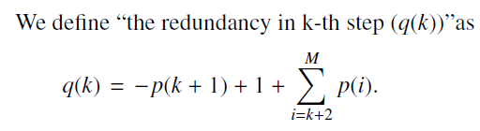

Tomohiko Ogawa et al.
Provides 2 equations and proves them
Use the equations to decide how to size the steps
Also contains some generic tables to copy from
To use equations, define how much settling you need at each conversion step
Next, calculate redundancy in LSBs at each conversion step
Equation 1 – a measure of redundancy or “overlapped-ness”
Equation 2 – constraint how many steps you need for a given level of redundancy

Slide 33
“Overlapped-ness”
The level of redundancy at this level is how much overlap there is in the leaf nodes.
q() = 1 (2 LSBs shared by 2 sides)
> 2?
> 1?
> 3?
-1
0
1
2
1
2
3
4

Slide 34
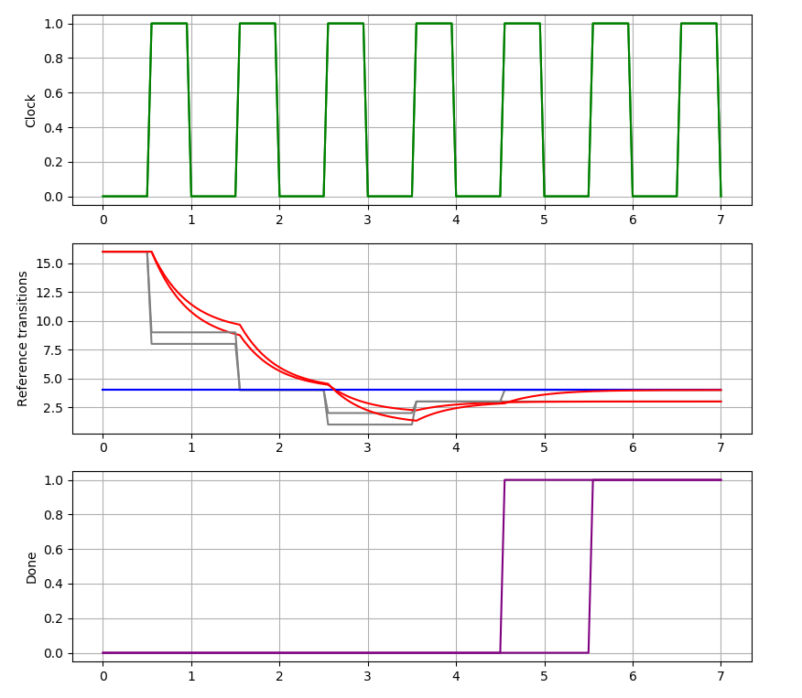
Simulations on a 5 bit ADC with 1st order reference settling
Red waveform shows DAC settling
5 steps vs 6 steps overlaid on same plot
Legend
Input voltage
FSM output
DAC output
ADC Done

Slide 35
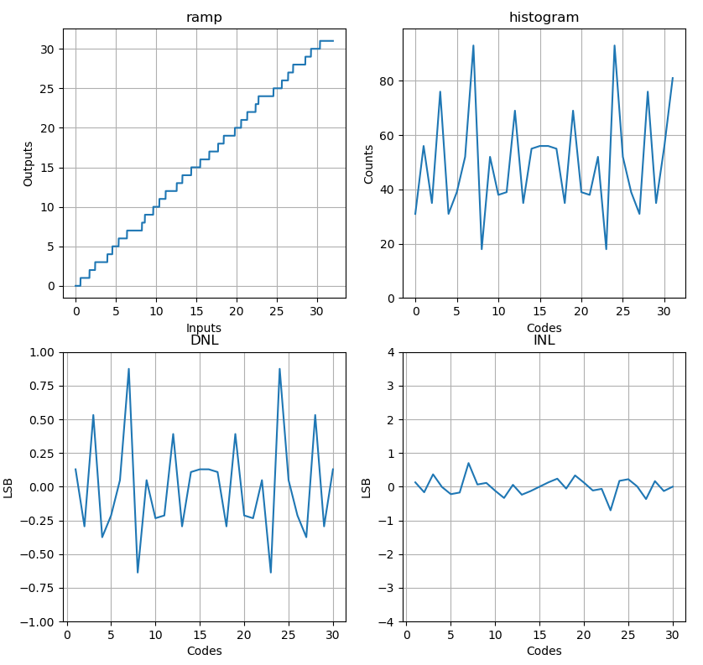
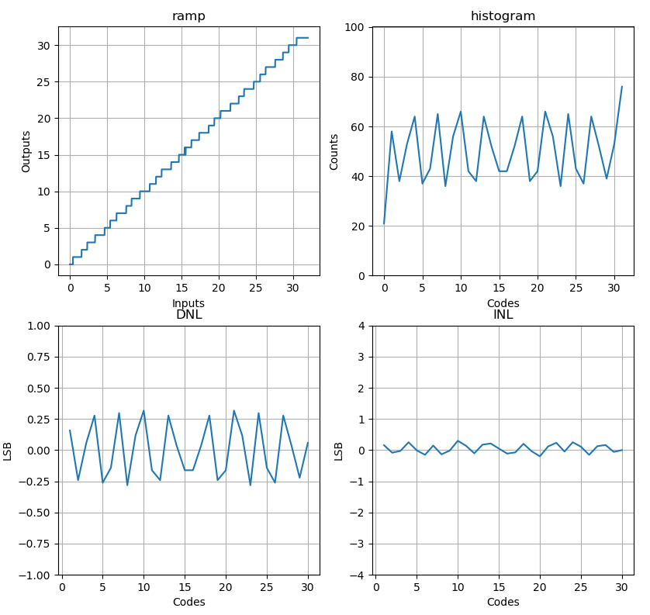
5 bit 5 steps
5 bit 6 steps

Slide 36
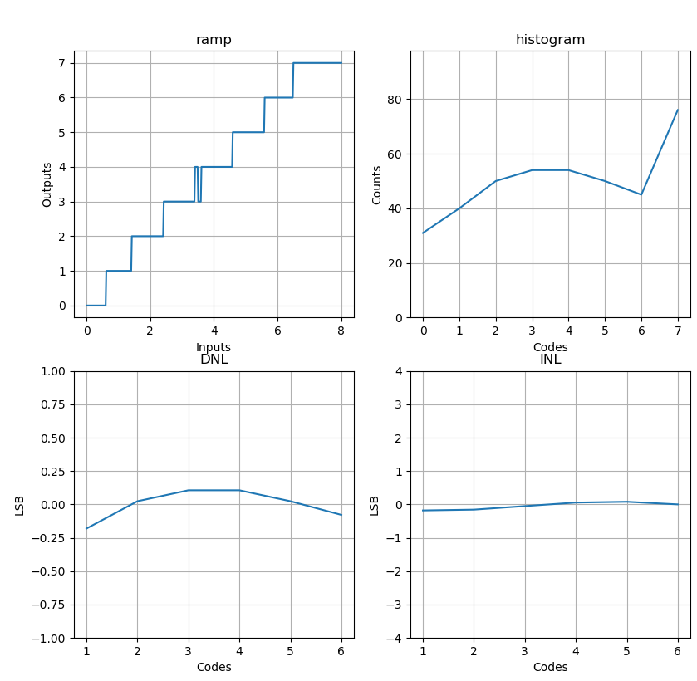
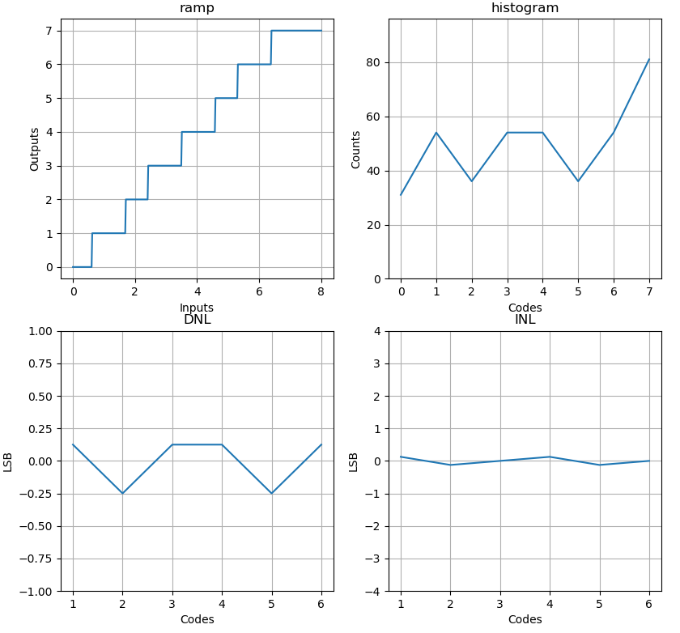
3 bit 3 steps
3 bit 4 steps

Slide 37
Thought Experiment
N = ADC number of bits
M = number of steps
What is the maximum M possible?
Equation 1 – a measure of redundancy or “overlapped-ness”
Equation 2 – constraint how many steps you need for a given level of redundancy

Slide 38
Reference
Ogawa, T., Kobayashi, H., Takahashi, Y., Takai, N., Hotta, M., San, H., … Mori, T. (2010). SAR ADC algorithm with redundancy and digital error correction. IEICE Transactions on Fundamentals of Electronics, Communications and Computer Sciences, E93-A(2), 415–423. https://doi.org/10.1587/transfun.E93.A.415

