Slide 1




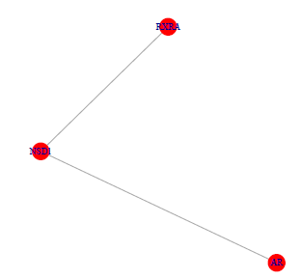
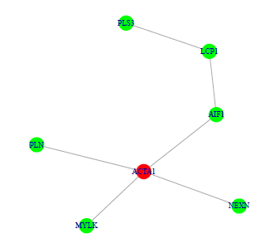
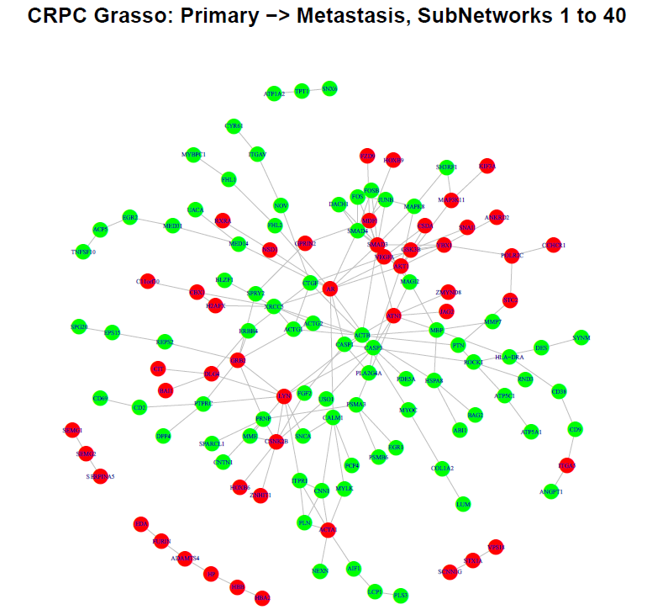
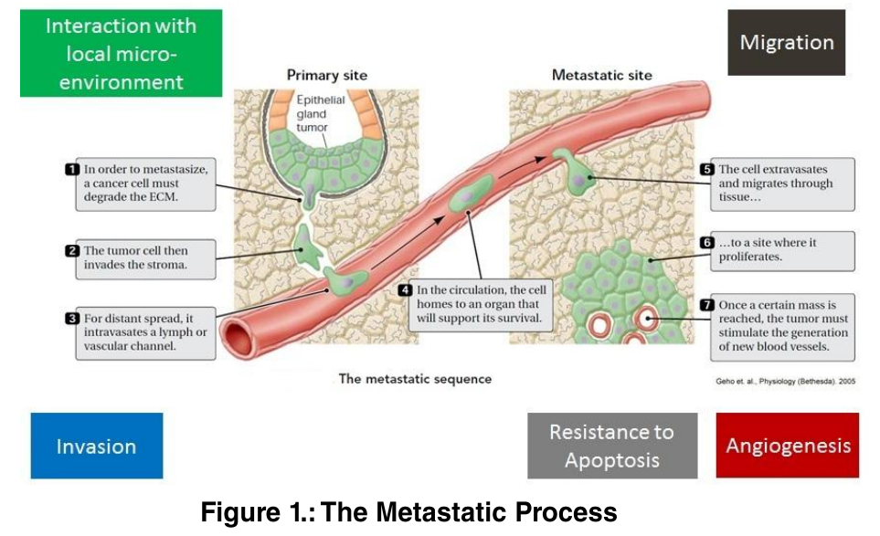
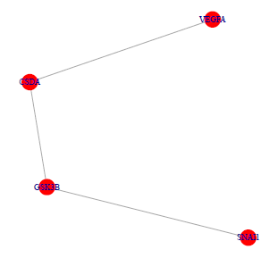
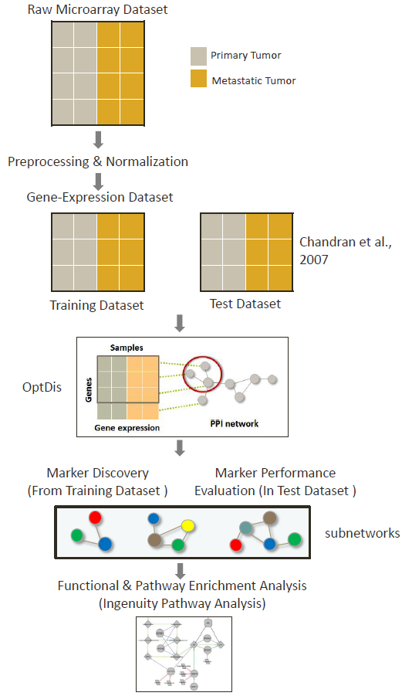
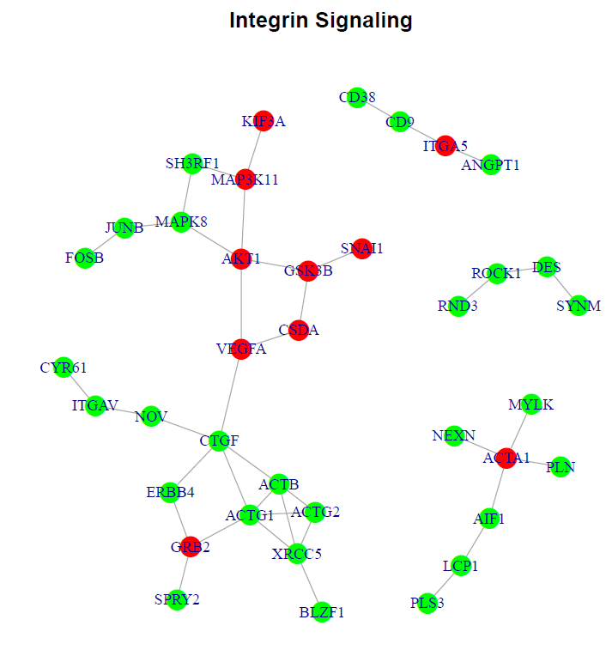
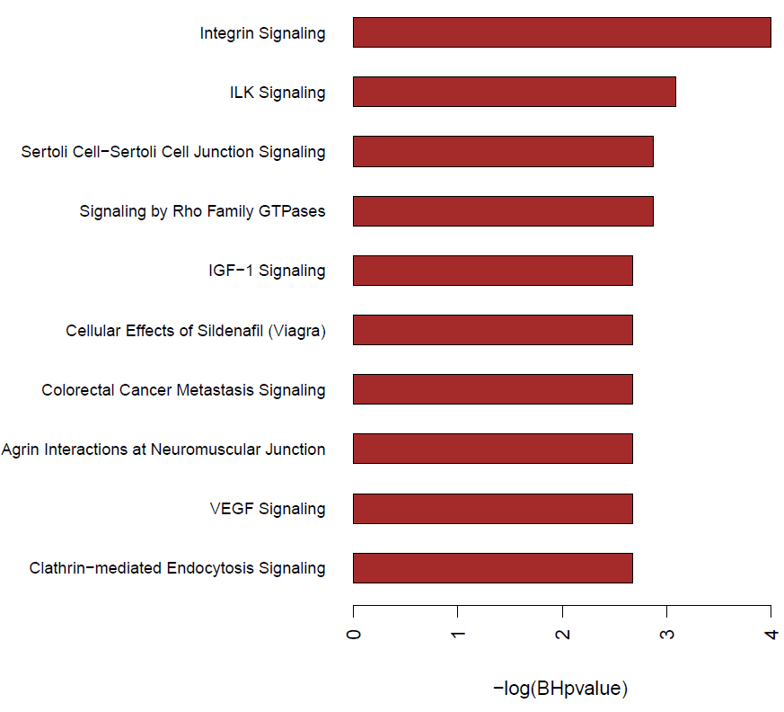
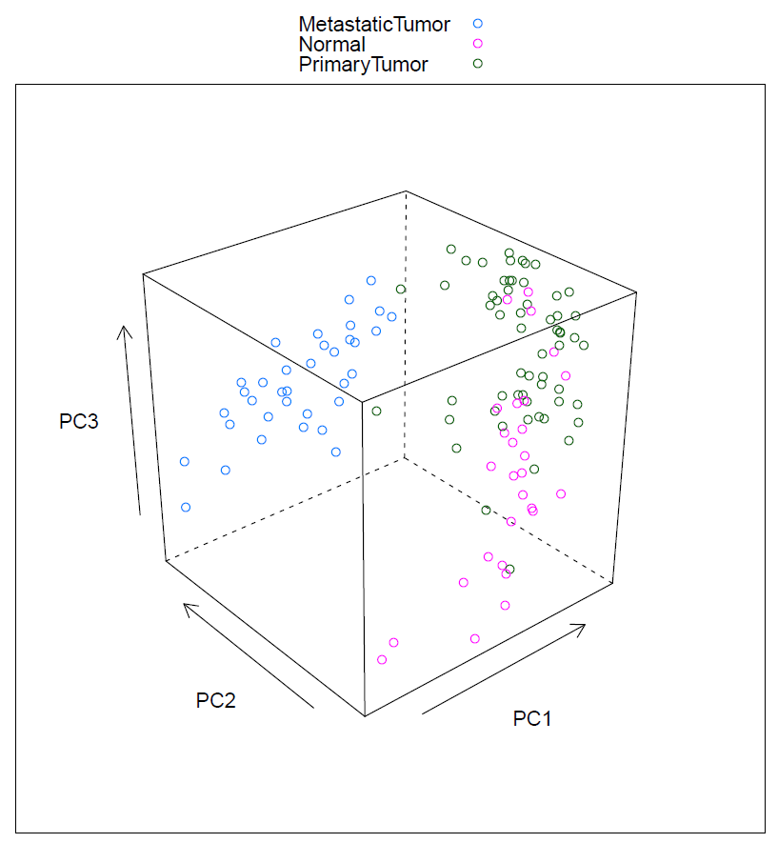
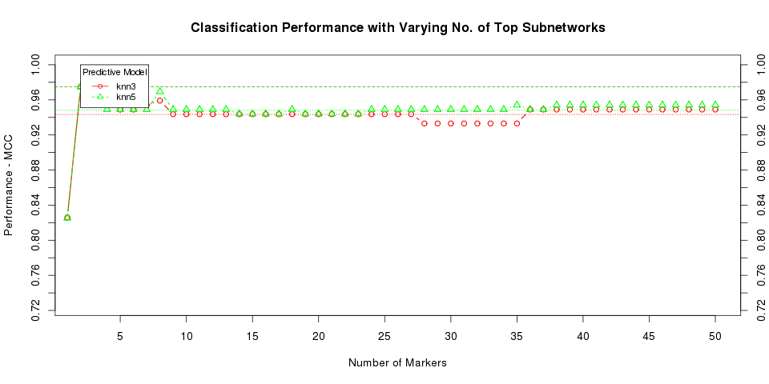
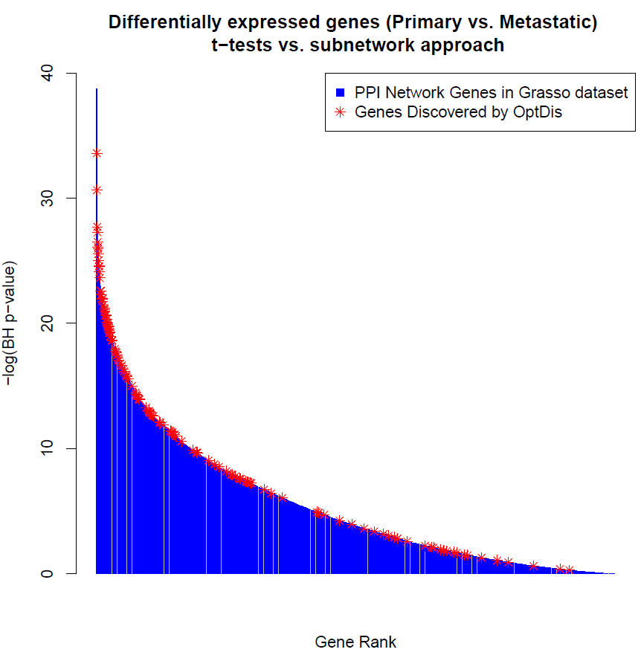
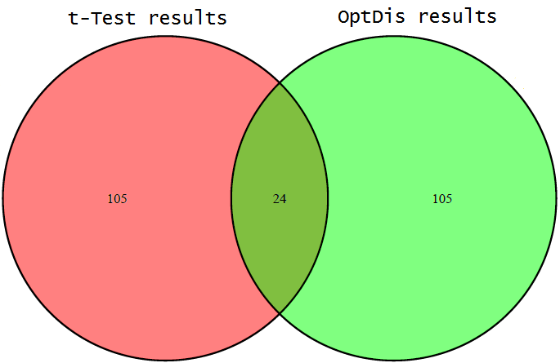
Exploring the Metastasis Process in Prostate Cancer using Interaction Networks
Raunak Shrestha¹, Josh Brown², Melissa Lee³, Dorji Pelzom³ and Jake Yeung⁴
¹ CIHR/MSFHR Bioinformatics Training Program, University of British Columbia, ² Department of Medical Genetics, University of British Columbia,
³ Department of Statistics, University of British Columbia, ⁴ Genome Science and Technology Gradate Program, University of British Columbia
Introduction
Results
Prostate cancer (PC) remains to be one of the leading causes of cancer death in North American men¹. Metastatic events indicate the advanced stage of cancer and poor patient survival. Deeper insights in the pathways that cause a primary tumor to metastasize into distant sites are critical for development of new biomarkers and therapies and are clinically significant towards improving patient outcomes.
D. Sub-Network Analysis
Conventional strategies use a single-gene approach where aberrant genes are considered independently from other genes. However, understanding the function of genes in a complex disease like PC requires investigation of genes within the context of their interaction networks (collectively called interactome)². This idea is based on the observation that disease condition is characterized by aberrant networks of genes (subnetworks), which interact at the protein level or at the protein-DNA level.
OptDis algorithm³ has been reported to efficiently identify subnetworks with the best possible discrimination between tumor classes and provide better insights into the biological mechanisms. Our project aims to investigate differences in the transcriptome between primary tumors and metastatic tumors and biological pathways/function that could shed more light in the biology behind the metastasis process using OptDis.
Genes upregulated in metastatic tumor as compared to primary
Dataset
Methods
Genes downregulated in metastatic tumor as compared to primary
We used a publically available gene-expression prostate cancer dataset representing primary and metastasis tumors from various metastatic sites – Grasso et al, 2012⁴ (GSE35988). All the metastatic tumor samples are from patients with castrate resistant prostate cancer (CRPC), an aggressive type of PC which is hormone therapy or chemotherapy resistant. Changes in expression identified using this study design could be dependent upon differences between prostate adenocarcinoma and CRPC or between primary PC and metastatic PC.
Figure 2.: Workflow of the Project.
Figure 7.: Three examples of sub-networks discovered from OptDis (Out of Top-40 sub-networks).
Figure 8.: Genes from the top 40 sub-networks discovered using OptDis.
E. Pathway Enrichment
Table 1. : Description of the dataset
Platform | Disease State | Number of Samples | Remarks
Agilent Whole Human Genome Microarray | Benign Normal | 28
 | Primary Prostate Tumors | 59
 | Metastatic Tumors | 35 | All Metastatic tumors are CRPCs and are derived from various metastatic sites
Results
Figure 9.: Negative log BH p-values of top 10 pathways (out of 108 significant pathways with BH p-value <0.1) from IPA.
Figure 10.: Network showing the genes enriched in the Integrin Signaling pathway.
A. Exploratory Analysis
B. Classification Performance
Discussion
Among the subnetwork markers discovered by OptDis that discriminate between the primary and castration-resistant metastatic tumors, we chose the top 40 subnetworks to examine pathways underlying the metastasis process. Genes within these subnetworks include genes with previous links to prostate cancer metastasis, such as the growth factor VEGFA, CTGF, and genes without previous associations, such as the hemoglobin chain HBA2.
The 128 genes from OptDis showed significant enrichment in 108 pathways using a cutoff of BH p-value < 0.1 in IPA. In comparison, using the top 128 differentially expressed genes found using Student’s t-test yielded no significantly enriched pathways.
The most enriched pathways in analysis of OptDis results using the IPA tool have known links to metastasis and CRPC. Integrin and integrin-linked kinase (ILK) signalling pathways were most highly enriched. Integrins are transmembrane glycoproteins that mediate binding to components of the extracellular matrix (ECM), and influence signalling into and out of cells by activating kinases of the Ras/Rho GTPase pathways, which were also highly enriched in this analysis. The ability of primary tumor cells to invade the stroma before entering the bloodstream, and to establish and grow in secondary sites in metastasis, is facilitated by integrins and ILK signalling⁶.
Figure 3.: Plot of sample types with respect to the first three principal components.
Figure 4.: Classification performance of markers derived from Grasso cohort in Chandran cohort.
Conclusions
108 pathways were enriched in OptDis results, indicating that the sub-network approach could provide more insight on the biological mechanisms than traditional statistical methods.
Genes and pathways identified with OptDis frequently had previous links to metastasis and CRPC in the literature, supporting the validity of this approach.
The genes and pathways identified without previous links to metastatic CRPC present candidates for future study.
C. Method Comparison
Figure 6.: BH p-values of genes from t-test (primary vs. metastasis) with OptDis genes labelled.
References
Datta K, Muders M, Zhang H, T. D. Mechanism of lymph node metastasis in prostate cancer. Future Oncology 6, 823–836 (2010).
Achen, M. G. & Stacker, S. a Molecular control of lymphatic metastasis. Annals of the New York Academy of Sciences 1131, 225–34 (2008).
Dao, P. et al. Optimally discriminative subnetwork markers predict response to chemotherapy. Bioinformatics (Oxford, England) 27, i205–13 (2011).
Grasso, C. S. et al. The mutational landscape of lethal castration-resistant prostate cancer. Nature 487, 239–43 (2012).
Chandran, U. R. et al. Gene expression profiles of prostate cancer reveal involvement of multiple molecular pathways in the metastatic process. BMC cancer 7, 64 (2007).
Bendas, G., & Borsig, L. Cancer cell adhesion and metastasis: selectins, integrins, and the inhibitory potential of heparins. International journal of cell biology, 676731 (2012).
Figure 5.: Venn diagram of genes discovered from t-test and OptDis.

