Slide 1
Food Truck Management
Noah Levine
Jordan Itzkovitz
Spiro Mavroidakos
Jake Zhu

Slide 2
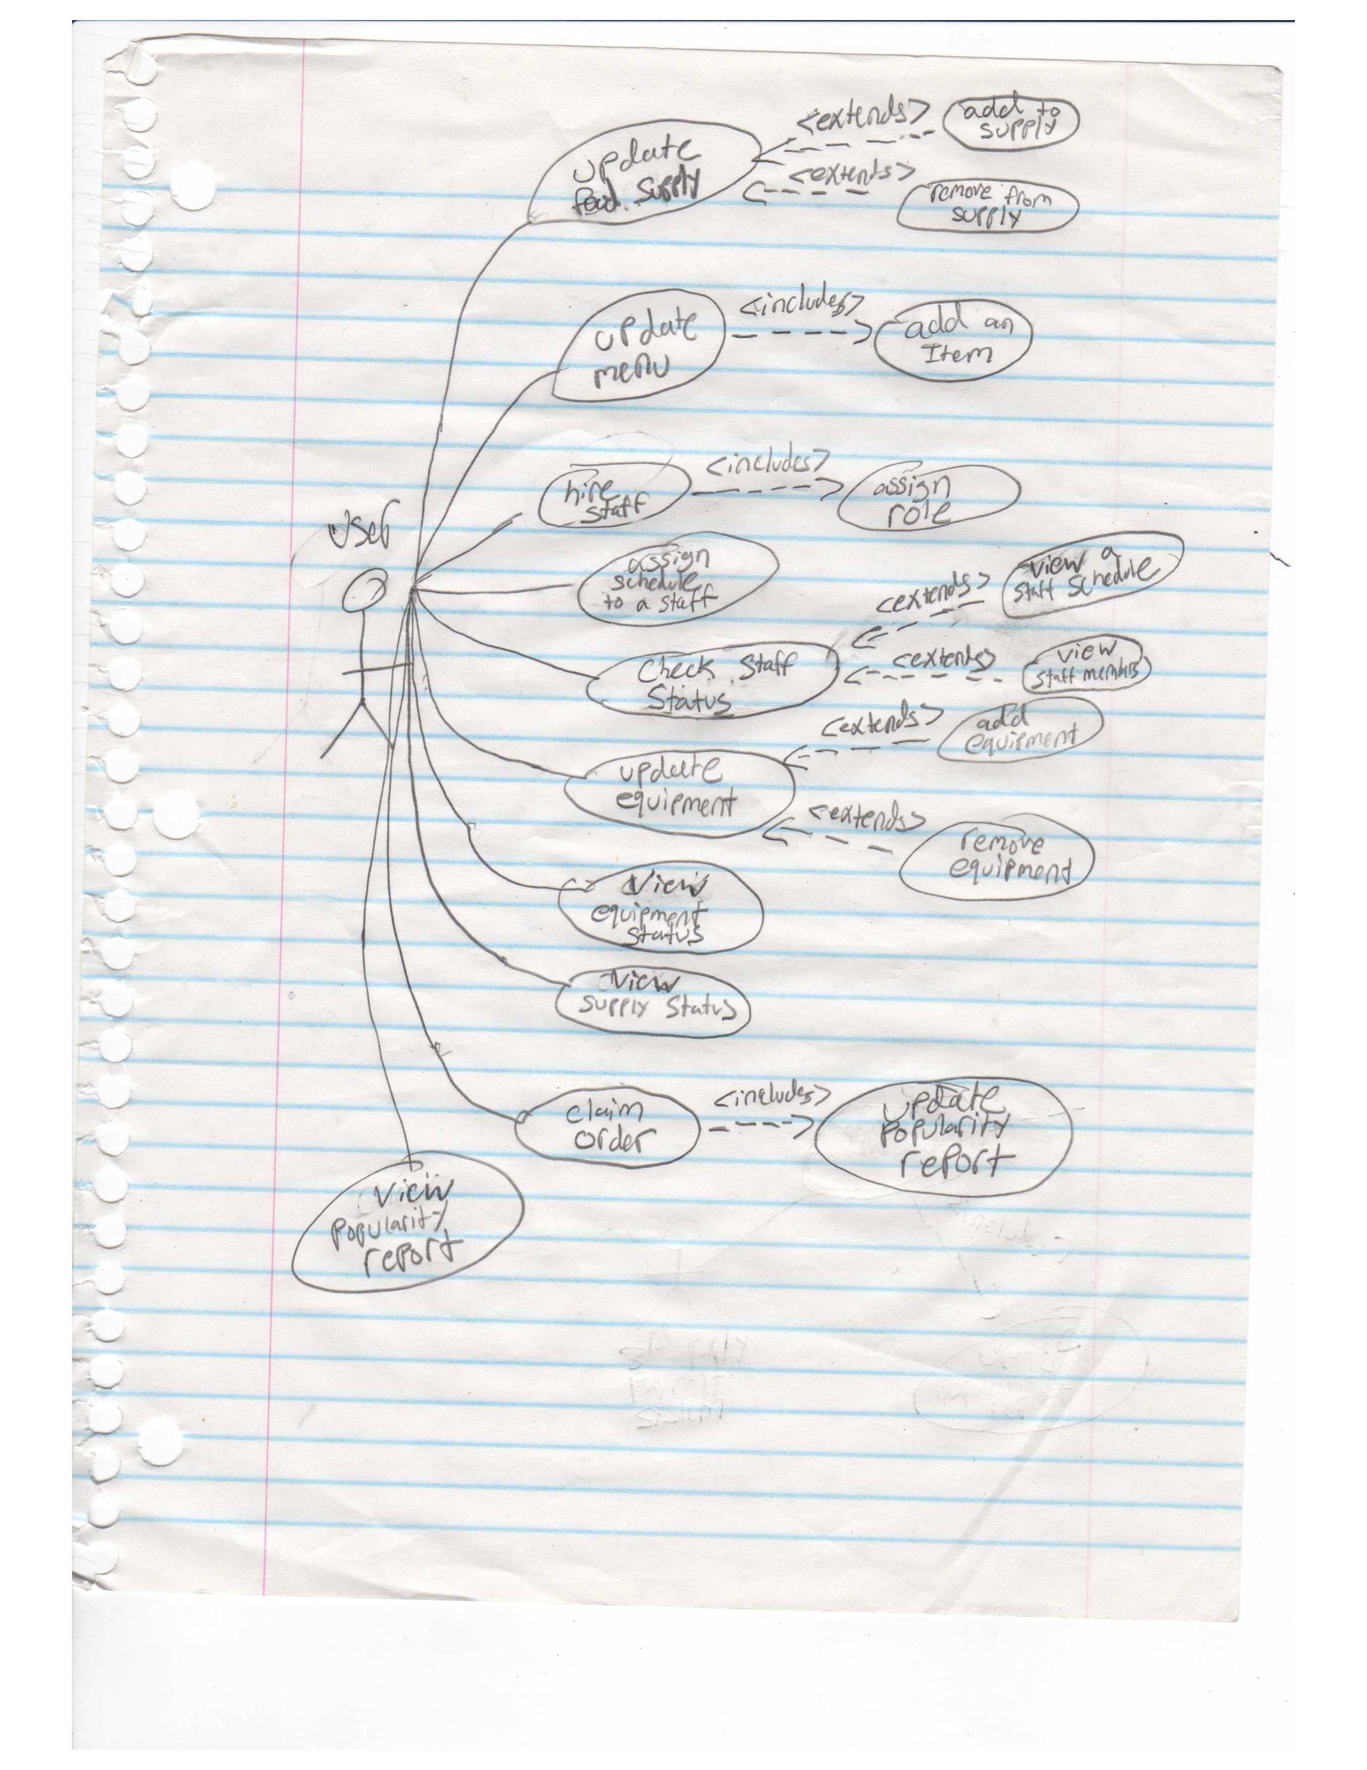

Slide 3
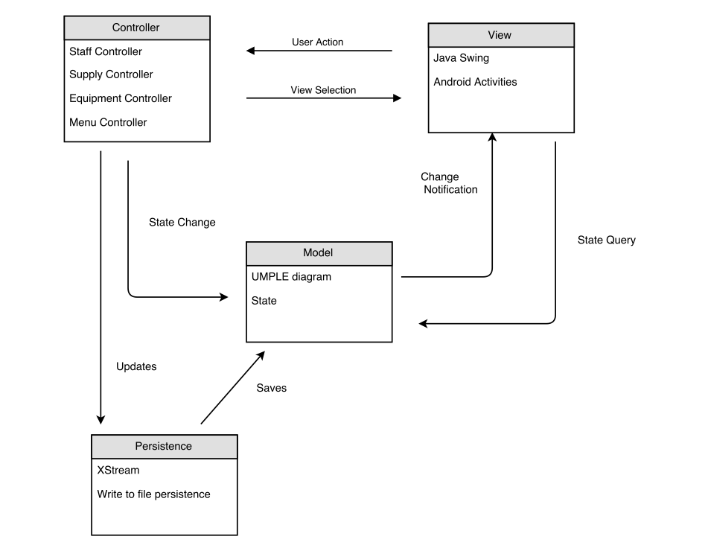
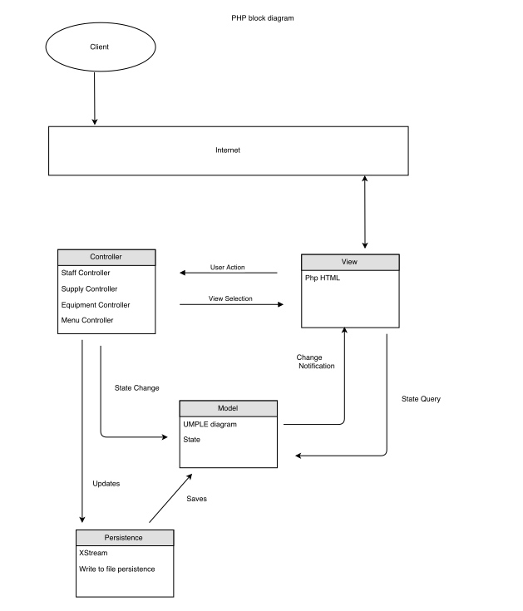
Architecture - MVC

Slide 4
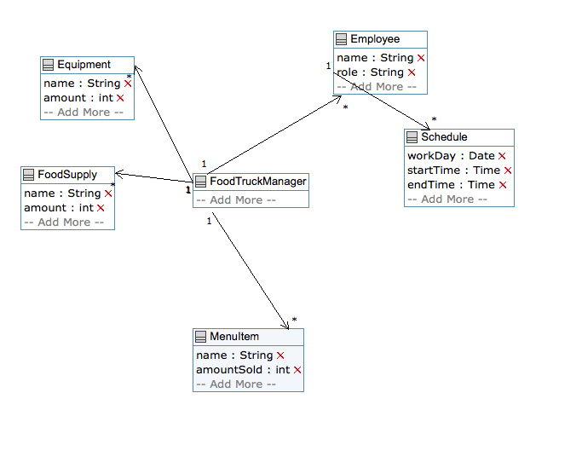
Domain Model

Slide 5

Controllers
Abstract Supply Controller
Equipment Controller
MenuItem Controller

Slide 6
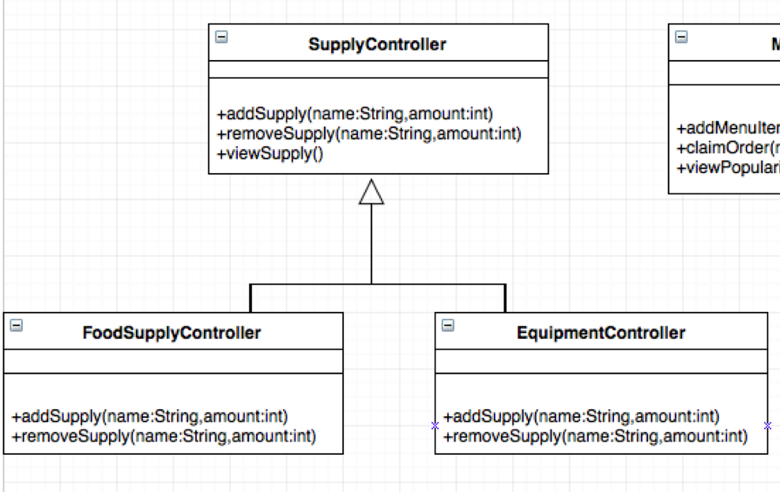
Supply Controller – Template Design Pattern

Slide 7
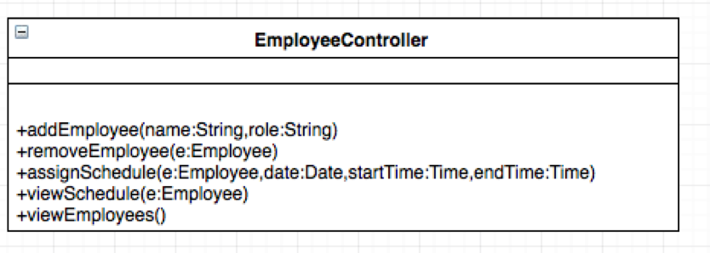
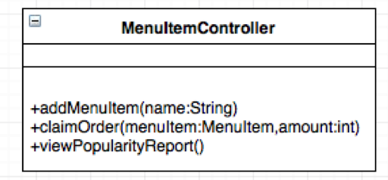
Employee + MenuItem Controllers

Slide 8
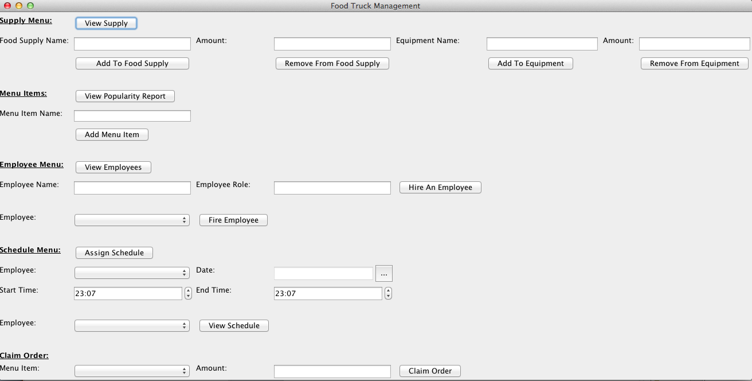
Desktop View

Slide 9
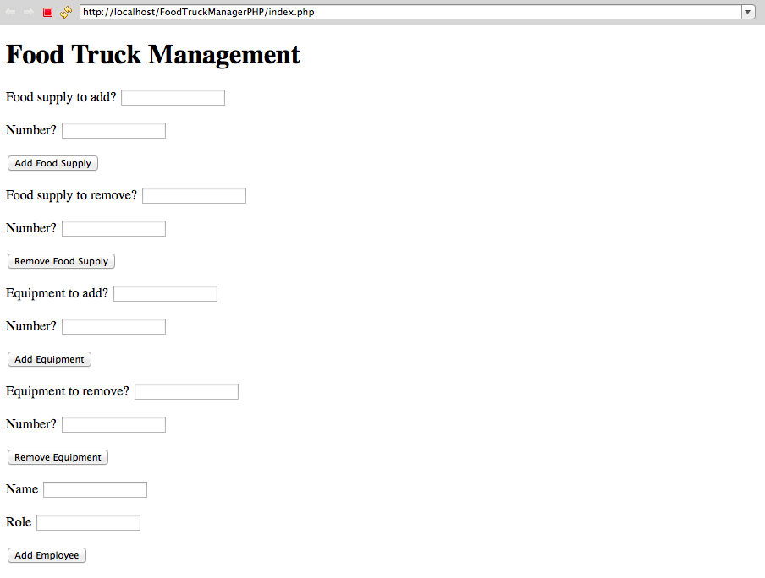
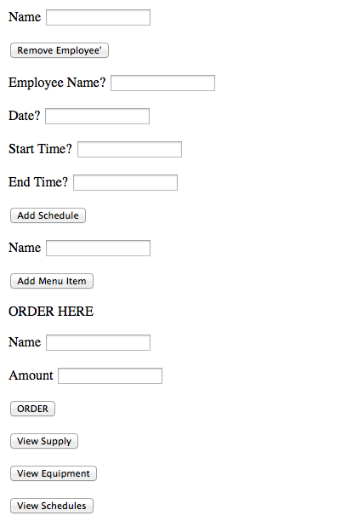
Browser View

Slide 10

Testing
Unit Testing
Tested Edge Cases
Equivalence Partitioning
No Views
None for Android

Slide 11
Testing
Add Food Supply:
No name
Name with Spaces
0 supply
Negative Supply

Slide 12
Release Pipeline
TBD TOMORROW

Slide 13

Cool Features

Slide 14
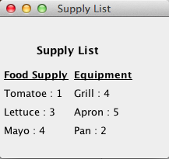
View Supply

Slide 15
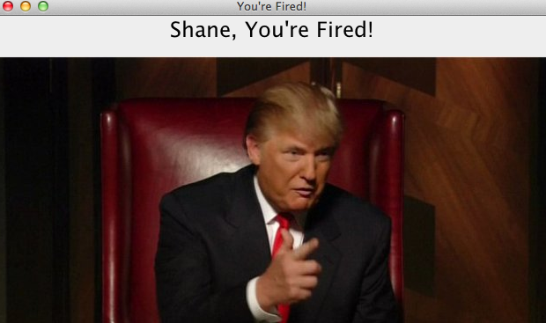
Fire an Employee

Slide 16
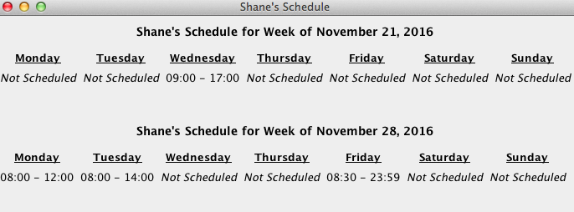
View Weekly Schedule

Slide 17
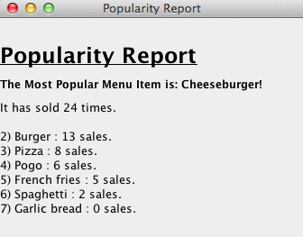
View Popularity Report

