Slide 1
Food Truck Management
Noah Levine
Jordan Itzkovitz
Spiro Mavroidakos
Jake Zhu

Slide 2
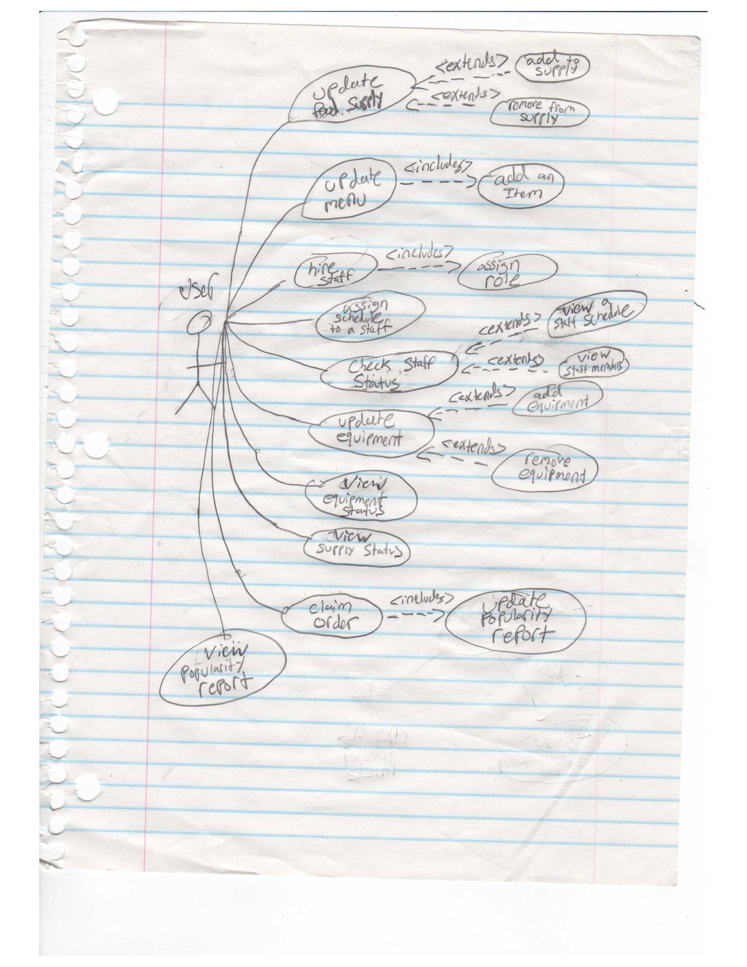

Slide 3
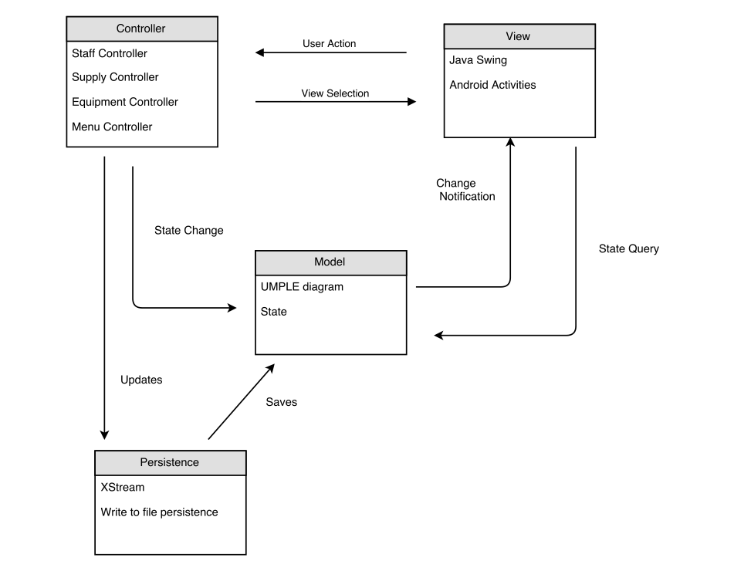
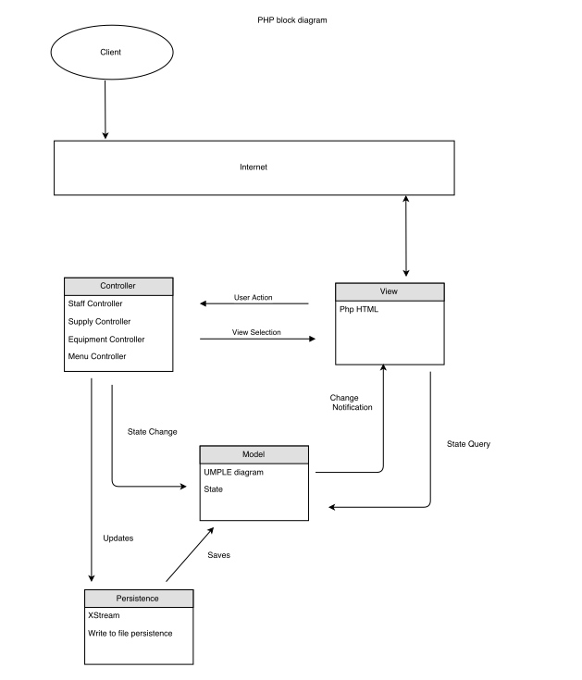
Architecture - MVC

Slide 4
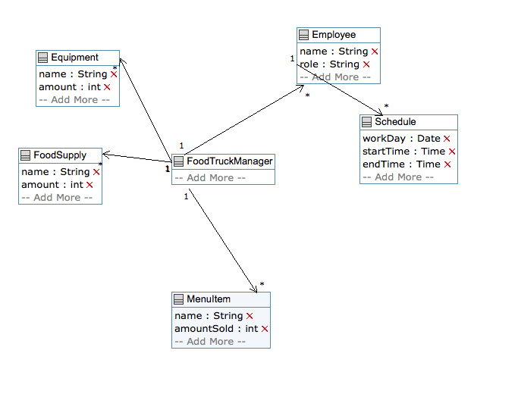
Domain Model

Slide 5

Controllers
Abstract Supply Controller
Equipment Controller
MenuItem Controller

Slide 6
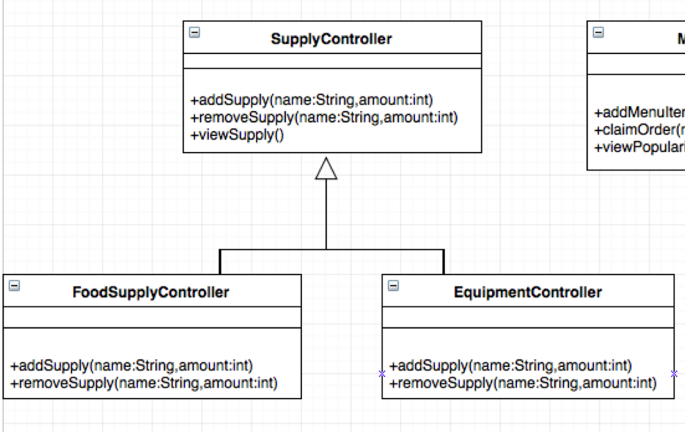
Supply Controller – Template Design Pattern

Slide 7
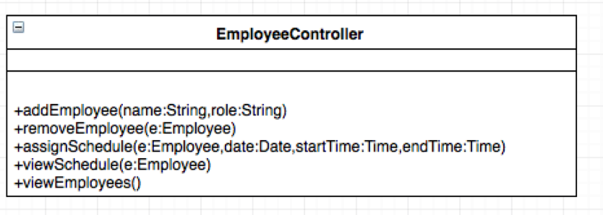
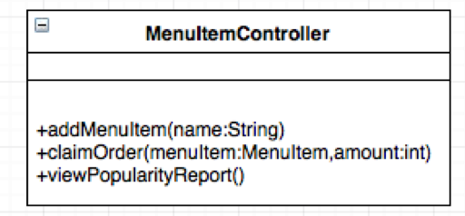
Employee + MenuItem Controllers

Slide 8
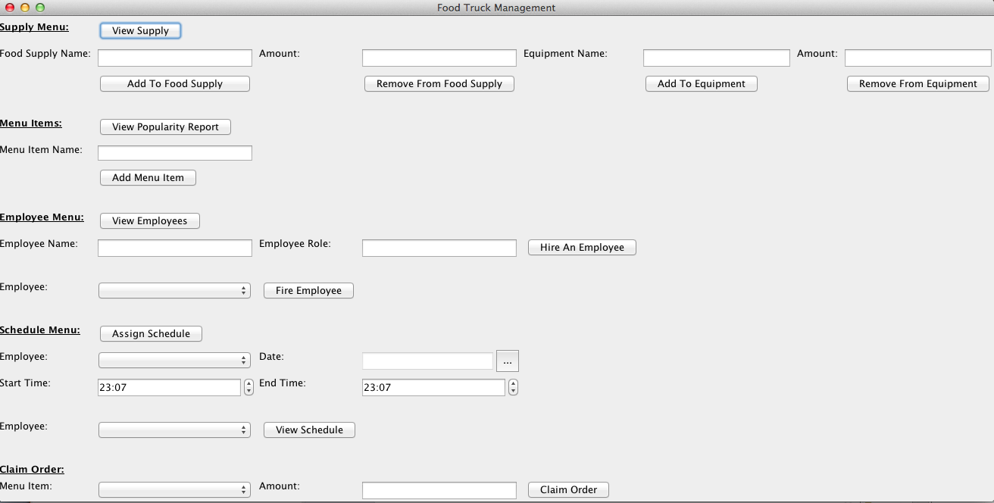
Desktop View

Slide 9
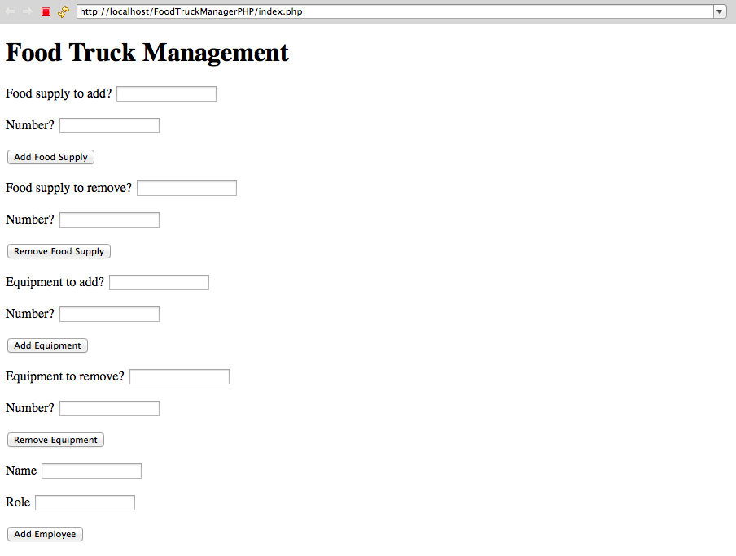
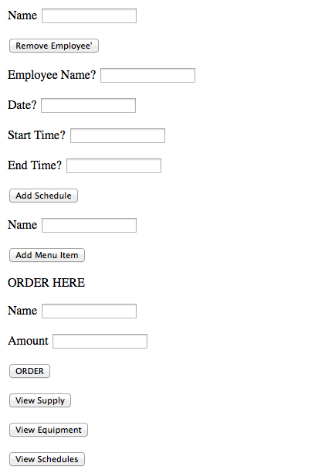
Browser View

Slide 10

Testing
TO BE DONE TOMORROW

Slide 11
Release Pipeline
TBD TOMORROW

Slide 12

Cool Features

Slide 13
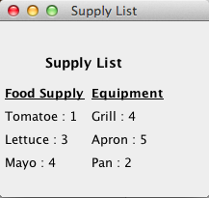
View Supply

Slide 14
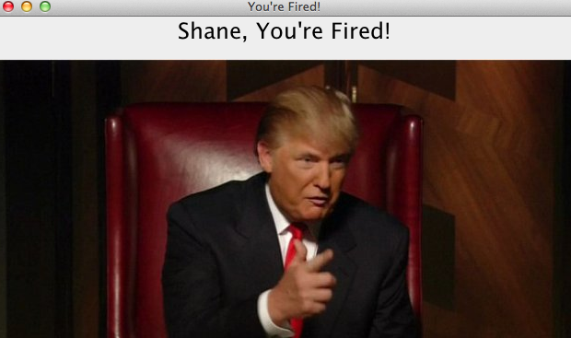
Fire an Employee

Slide 15
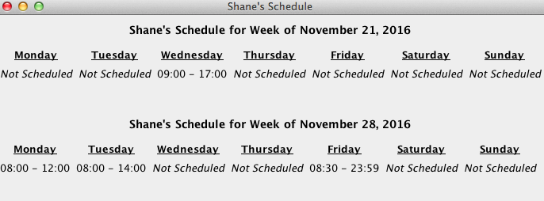
View Weekly Schedule

Slide 16
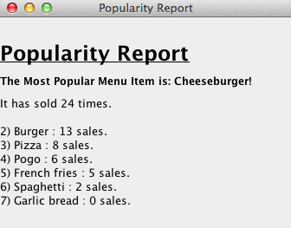
View Popularity Report

