Slide 1
Food Truck Management
Team 12
Noah Levine
Jordan Itzkovitz
Spiro Mavroidakos
Jake Zhu

Slide 2
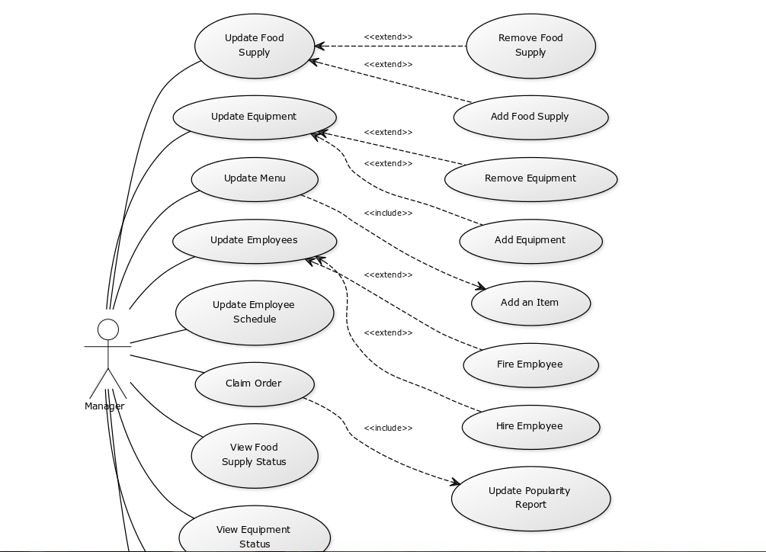
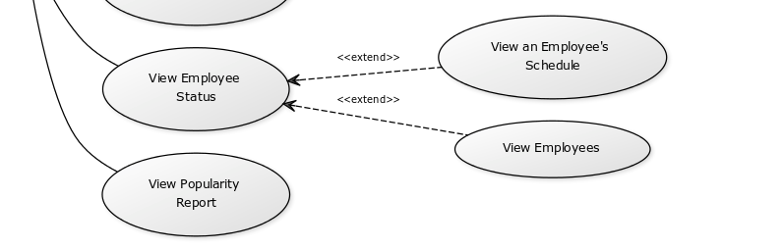
Use Case Diagram

Slide 3
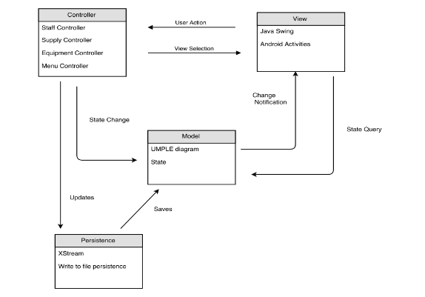
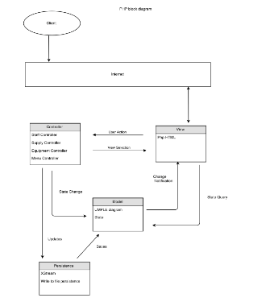
Architecture - MVC

Slide 4
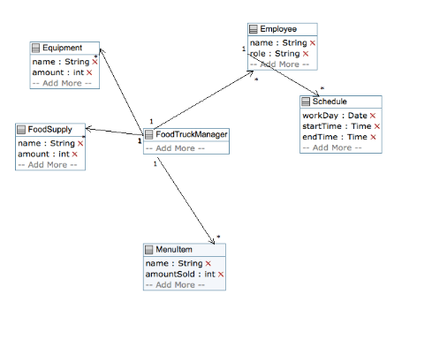
Domain Model

Slide 5

Controllers
Abstract Supply Controller
Equipment Controller
MenuItem Controller

Slide 6
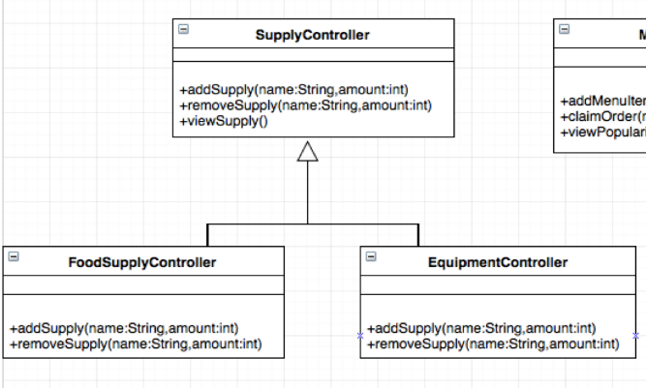
Supply Controller – Template Design Pattern

Slide 7
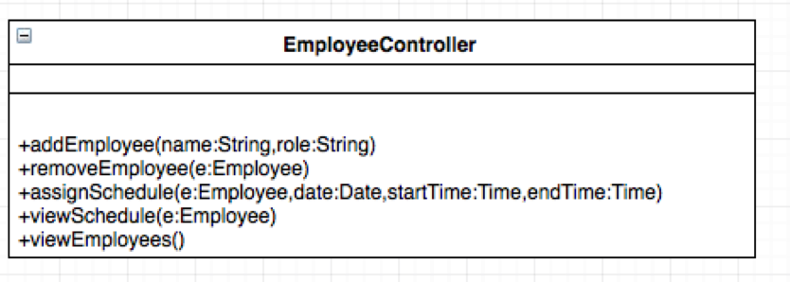
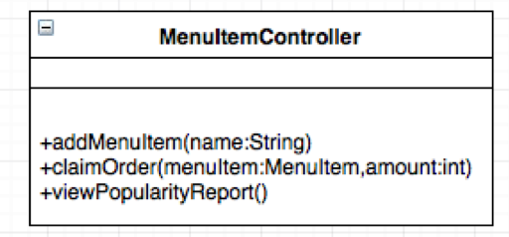
Employee + MenuItem Controllers

Slide 8
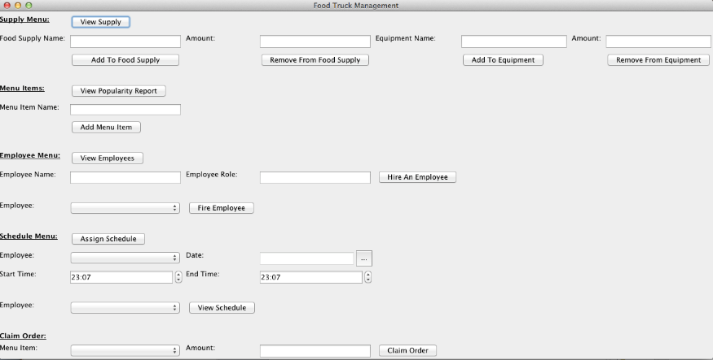
Desktop View

Slide 9
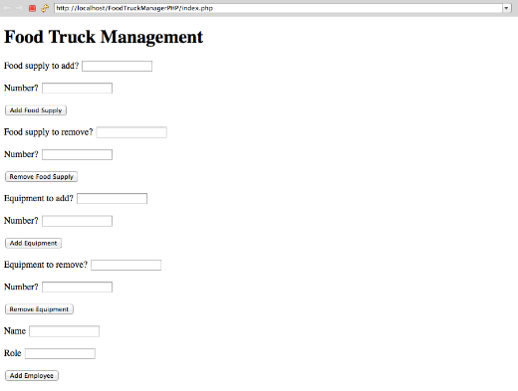
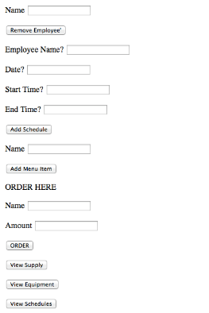
Browser View

Slide 10

Testing
Unit Testing
Tested Edge Cases
Equivalence Partitioning
No Views
None for Android

Slide 11
Testing
Equivalence Partitioning
Add Food Supply:
Partition Around 0
No name
Name with Spaces

Slide 12
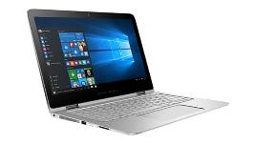

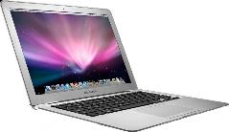
Release Pipeline
Available for :
Android
Desktop Computers
Web Browsers

Slide 13

Release Pipeline
3 Phases:
Integration
Build
Deployment

Slide 14
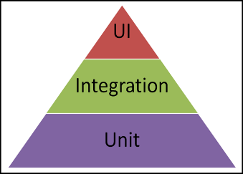

Integration
Unit Testing
Integration Testing
Code reviews

Slide 15

Build
No Build system

Slide 16

Deployment
New iteration Delivery
Rework

Slide 17

Cool Features

Slide 18
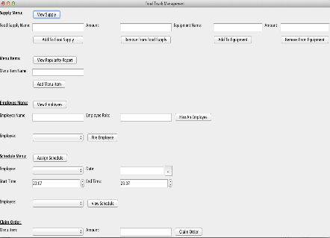
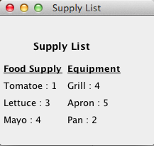
View Supply

Slide 19

Fire an Employee

Slide 20
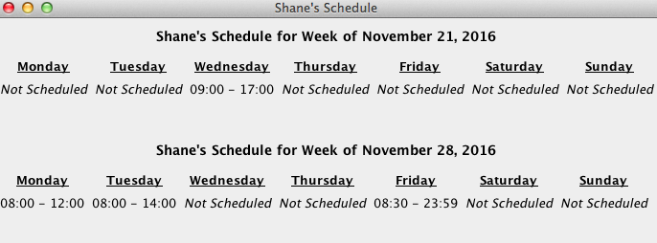
View Weekly Schedule

Slide 21
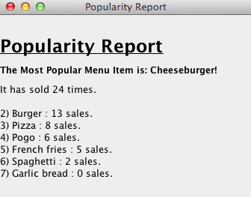
View Popularity Report

Slide 22
The Great Showcase

Slide 23
Conclusion
Group Organisation
Testing
UI

