Slide 1
SpikeProp

Slide 2
SpikeProp
Spiking neurons can simulate feedforward sigmoidal neural nets and approximate continuous functions.
SpikeProp is a learning rule to allow error-backpropagation in temporally encoded networks of spiking neurons.
It can be used to train multi-layered networks, a solution to non-linear classification for SNN.
Rate-Coded Neuron
Temporal-Coded Neuron
=
“3”
=

Slide 3
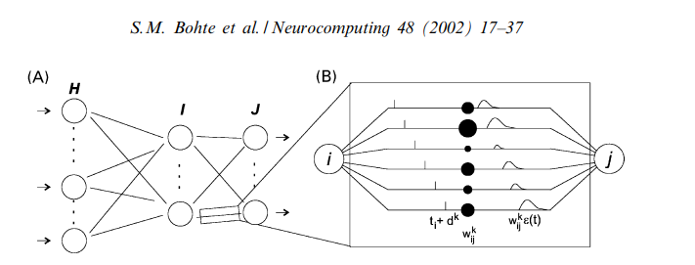


SpikeProp
1)
2)

Slide 4
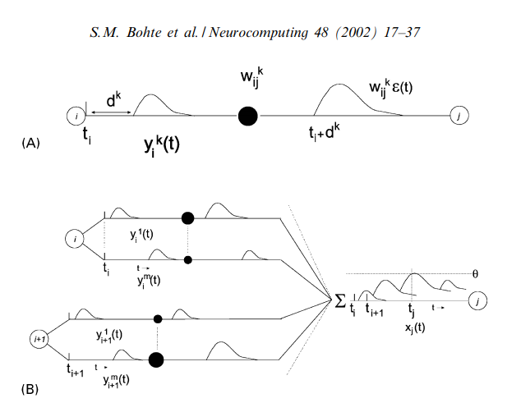


SpikeProp
3)
4)

Slide 5
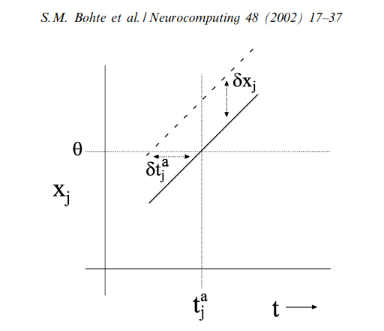



SpikeProp
5)
6)
7)

