Slide 1
Subversion and Mercurial
Submitted by – Samarth Jakhar
500108268
B.Tech CSE CCVT B6
Submitted to – Dr. Prateek Raj Gautam

Slide 2
Subversion
Subversion (SVN) is a centralized version control system (CVCS) where all versions are stored on a central server.
Many large organizations (e.g., Apache, Google Code, NASA) still use SVN for maintaining critical software.
Useful when teams need strict version control and access restrictions.

Slide 3
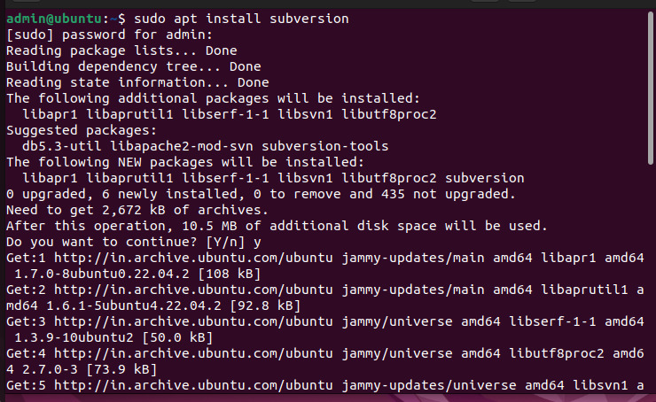
Subversion
Install SVN

Slide 4
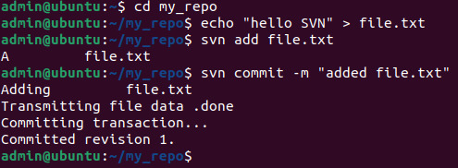
SVN create repository
Perform commands for adding a text file

Slide 5
Mercurial
Mercurial is a distributed version control system (DVCS) similar to Git. It is designed for speed, simplicity, and scalability.
Used by companies like Mozilla (Firefox) and Facebook for handling massive projects.
Used by companies like Mozilla (Firefox) and Facebook for handling massive projects.

Slide 6
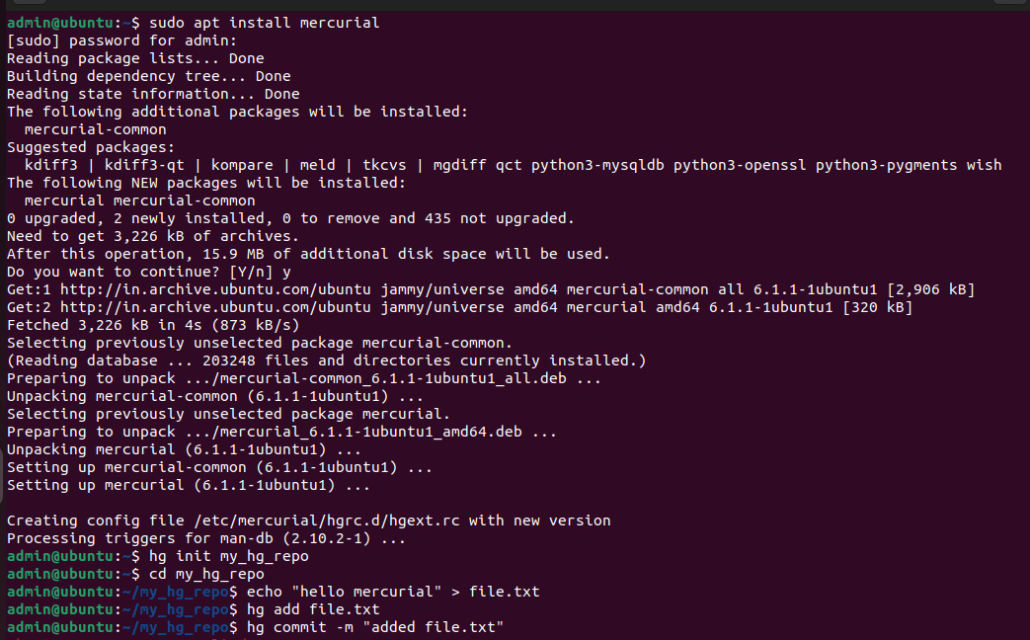
Mercurial
Install and perform commands

Slide 7
GitHub Link
https://jakharsamarth.github.io/SVN_MERCURIAL/SVN_MERCURIAL.pptx

