Slide 1
MINI-PROJECT
Fundamental Optimization Course

Slide 2
TABLE OF CONTENTS
01
02
03
Introduction
Problem description
Methodology
04
05
06
Results
Discussion
Conclusion

Slide 3
INTRODUCTION
This is a mini project of Fundamental optimization course for problem 8.

Slide 4
MEMBERS
Nguyễn Phương Thảo – 20214973
Cao Gia Khánh -20214962
Nhữ Đức Minh - 20214966

Slide 5
02
DESCRIPTION
Problem detail

Slide 6
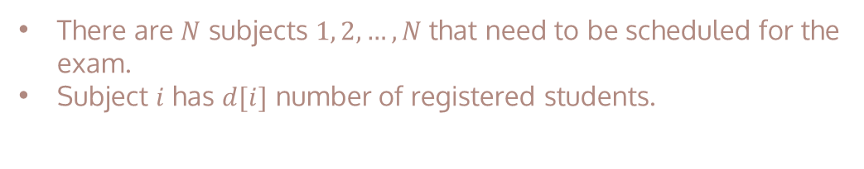
DESCRIPTION
There are $N$ subjects $1, 2, …, N$that need to be scheduled for the exam.
Subject $i$ has $d[i]$ number of registered students.
i | 1 | 2 | 3 | 4 | 5 | 6 | 7
d[i] | 15 | 20 | 12 | 10 | 20 | 10 | 15
There’re 15 students register in the 1st subject

Slide 7
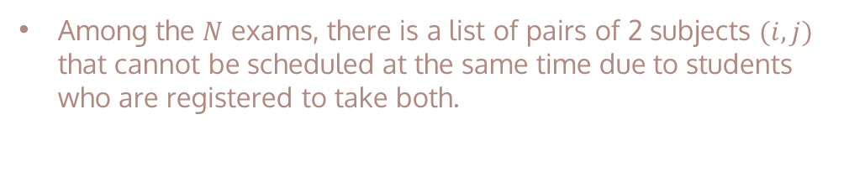
DESCRIPTION
Among the $N$ exams, there is a list of pairs of 2 subjects $(i,j)$ that cannot be scheduled at the same time due to students who are registered to take both.
i | j
1 | 2
2 | 7
3 | 4
The 1st and the 2nd subject can not be scheduled at the same time

Slide 8
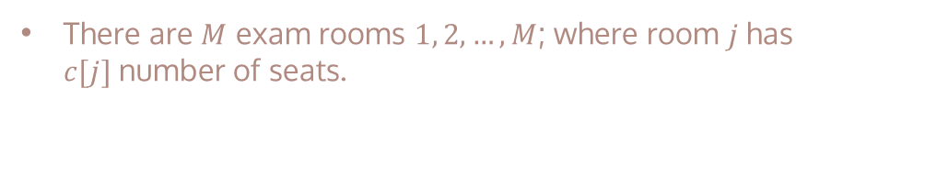
DESCRIPTION
There are $M$ exam rooms $1, 2, …, M$; where room $j$has $c[j]$number of seats.
j | 1 | 2 | 3
C[j] | 20 | 15 | 20
The 1st room has 20 seats

Slide 9

DESCRIPTION
Each day is divided into 4 periods.
Plan a schedule for the exams so that the total number of days for the N exams is minimum.
Subject | 1 | 2 | 3 | 4 | 5 | 6 | 7
Room | 3 | 3 | 2 | 1 | 3 | 1 | 1
Shift | 1 | 2 | 1 | 2 | 3 | 1 | 3
Max shift: 3 $→$ total number of days: 1

Slide 10
03
METHODOLOGY
modelling and algorithms

Slide 11
3 METHODS
HEURISTIC
CONSTRAINT PROGRAMMNG
INTEGER PROGRAMMING
Using CP-SAT solver from module OR-Tools
Using SCIP solver from module OR-Tools
Using Greedy algorithm

Slide 12
modelling

Slide 13

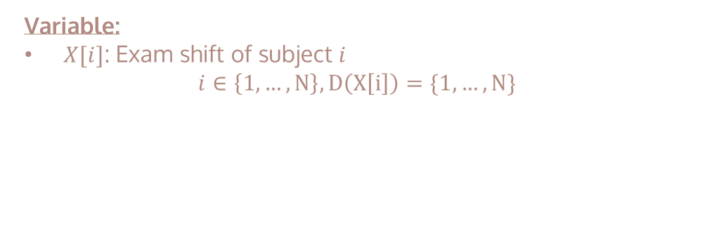
CONSTRAINT PROGRAMMING
Variable:
$X[i]$: Exam shift of subject $i$
$$i∈\left\{1, …, N\right\}, D\left(X\left[i\right]\right)=\{1, …, N\}$$
$X\left[3\right]=$1 $→Subject 3 is assigned to shift 1$

Slide 14
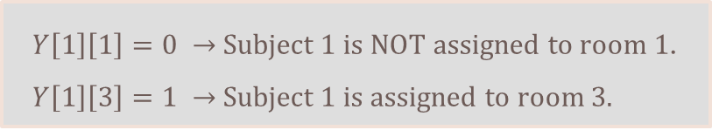
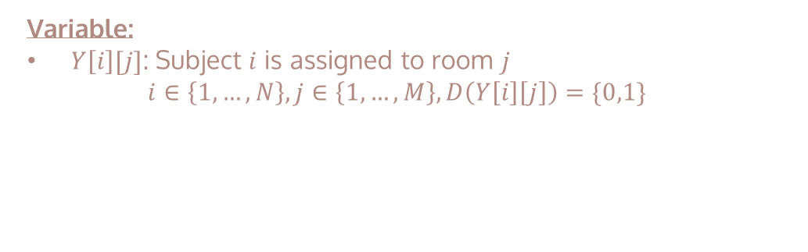
CONSTRAINT PROGRAMMING
Variable:
$Y\left[i\right][j]$: Subject $i$ is assigned to room $j$
$$i∈\left\{1,…,N\right\}, j∈\left\{1,…,M\right\}, D\left(Y\left[i\right]\left[j\right]\right)=\{0,1\}$$
$Y\left[1\right]\left[1\right]=0 →$Subject 1 is NOT assigned to room 1.
$Y\left[1\right]\left[3\right]=1 →$Subject 1 is assigned to room 3.

Slide 15
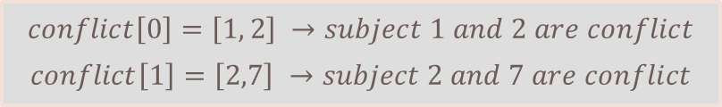
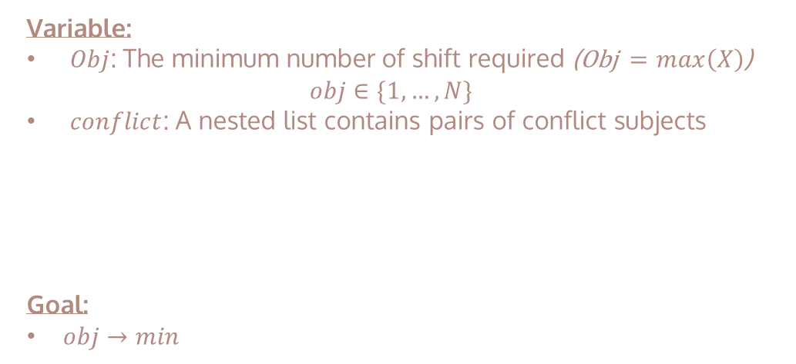
CONSTRAINT PROGRAMMING
Variable:
$Obj$: The minimum number of shift required (Obj $=\max\left(X\right)$)
$$obj∈\{1,…,N\}$$
$conflict$: A nested list contains pairs of conflict subjects
Goal:
$obj→min$
$$conflict\left[0\right]=\left[1, 2\right] →subject 1 and 2 are conflict$$
$$conflict\left[1\right]=\left[2,7\right] →subject 2 and 7 are conflict$$

Slide 16

CONSTRAINT PROGRAMMING
Constraints:
Constraint 01
One subject is assigned to only one room
$$\sum_{i=1}^{N}{Y\left[i\right]\left[j\right]=1, ∀j∈\{1,…,M\}}$$
$$Y\left[1\right]\left[3\right]=1 →Y\left[1\right]\left[j\right]=0 ∀ j≠3$$

Slide 17
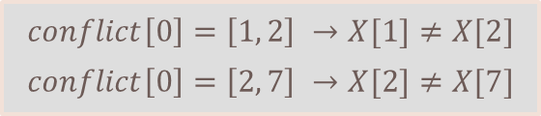

CONSTRAINT PROGRAMMING
Constraints:
Constraint 02
Two conflict subject are not assigned to the same shift
$$∀\left(i,j\right)∈conflict⇒X\left[i\right]≠X\left[j\right]$$
$$conflict\left[0\right]=\left[1, 2\right] →X[1]≠X[2]$$
$$conflict\left[0\right]=\left[2, 7\right] →X[2]≠X[7]$$

Slide 18
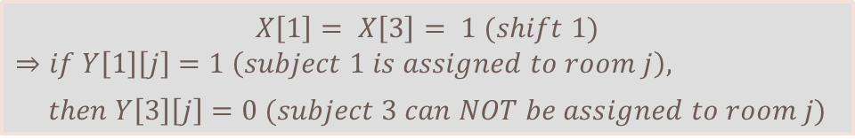
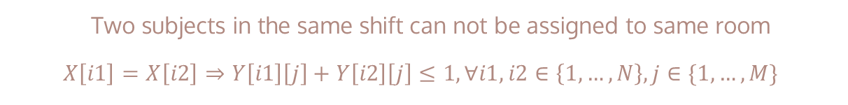
CONSTRAINT PROGRAMMING
Constraints:
Constraint 03
Two subjects in the same shift can not be assigned to same room
$$X\left[i1\right]=X\left[i2\right]⇒Y\left[i1\right]\left[j\right]+Y\left[i2\right]\left[j\right]≤1, ∀i1,i2∈\left\{1,…,N\right\}, j∈\{1,…,M\}$$
$$X\left[1\right]= X\left[3\right]= 1 (shift 1)$$
$$⇒if Y\left[1\right]\left[j\right]=1 \left(subject 1 is assigned to room j\right),$$
$then Y\left[3\right]\left[j\right]=0 (subject 3 can NOT be assigned to room j)$

Slide 19




CONSTRAINT PROGRAMMING
Constraints:
Constraint 04
Put subjects in the room with suitable capacity
$$\sum_{i=1}^{N}{Y\left[i\right]\left[j\right]×c\left[j\right]≥d\left[i\right], ∀j∈\{1,…,M\}}$$
$$Y\left[i\right]\left[j\right]=1 or 0$$
$$c\left[j\right]:capacity of room j$$
$$d\left[i\right]:number of students$$
$$register subject i$$

Slide 20
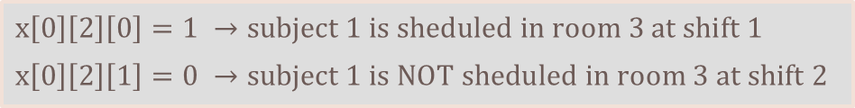
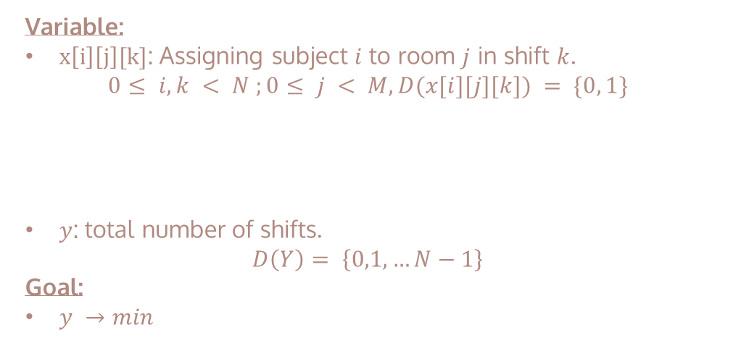
MIXED INTEGER PROGRAMMING
Variable:
$x\left[i\right]\left[j\right][k]$: Assigning subject $i$ to room $j$ in shift $k$.
$$0≤ i, k < N ;0≤ j < M, D(x[i][j][k]) = \{0, 1\}$$
$y$: total number of shifts.
$$D\left(Y\right)= \left\{0,1,…N−1\right\}$$
Goal:
$y →min$
$$x\left[0\right]\left[2\right]\left[0\right]=1 →subject 1 is sheduled in room 3 at shift 1$$
$$x\left[0\right]\left[2\right]\left[1\right]=0 →subject 1 is NOT sheduled in room 3 at shift 2$$

Slide 21

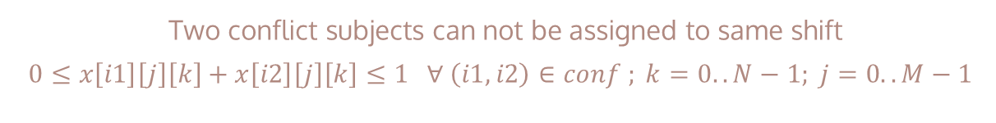
MIXED INTEGER PROGRAMMING
Constraints:
Constraint 01
Two conflict subjects can not be assigned to same shift
$$0≤x\left[i1\right]\left[j\right]\left[k\right]+x\left[i2\right]\left[j\right]\left[k\right]≤1 ∀ \left(i1, i2\right)∈conf ; k=0..N−1; j=0..M−1$$
Constraint 02
One subject can be assigned once
$$1≤ \sum_{k=0}^{N−1}{\sum_{j=0}^{M−1}{x\left[i\right]\left[j\right]\left[k\right]}}≤1 ∀ i=0..N−1$$

Slide 22
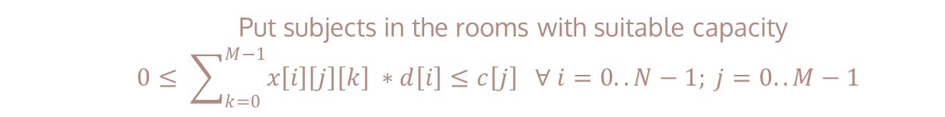

MIXED INTEGER PROGRAMMING
Constraints:
Constraint 03
In any shift, one room can contain only one subject
$$0≤ \sum_{i=0}^{N−1}{x\left[i\right]\left[j\right]\left[k\right]}≤1 ∀ k=0..N−1; j=0..M−1$$
Constraint 04
Put subjects in the rooms with suitable capacity
$$0≤ \sum_{k=0}^{M−1}{x\left[i\right]\left[j\right]\left[k\right] ∗d\left[i\right]}≤c\left[j\right] ∀ i=0..N−1; j=0..M−1$$

Slide 23
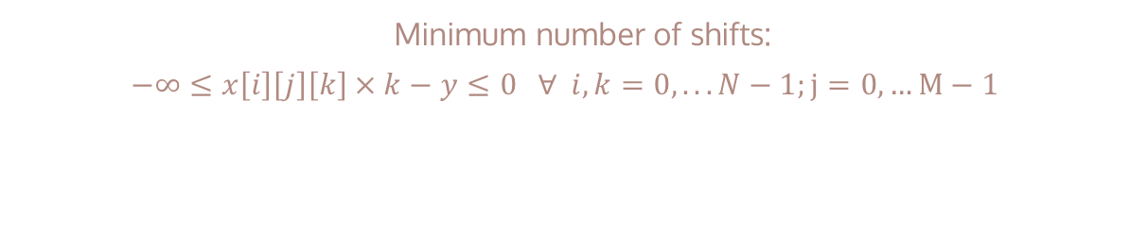
MIXED INTEGER PROGRAMMING
Constraints:
Constraint 05
Minimum number of shifts:
$$−∞≤x\left[i\right]\left[j\right]\left[k\right]×k−y≤0 ∀ i,k=0, ...N−1;j=0,…M−1$$
$$x\left[i\right]\left[j\right]\left[k\right]×k≤y →y=\max\left(k\right)∀ x\left[i\right]\left[j\right]\left[k\right]=1$$
Objective
Minimize y

Slide 24
algorithms

Slide 25
READING DATA
def input_(filename):
with open(filename) as f:
input_list = f.readlines()
N = int(input_list[0]) # number of students
d = [int(x) for x in input_list[1].strip().split()] # number of students registered for each subject
M = int(input_list[2]) # number of rooms
c = [int(x) for x in input_list[3].strip().split()] # the capacity of room
K = int(input_list[4]) # number of conflicting pairs
conflicts = [list(map(lambda x: int(x) - 1, ij.split())) for ij in input_list[5:]] # conflicting pairs
return N,d,M,c,K,conflicts

Slide 26
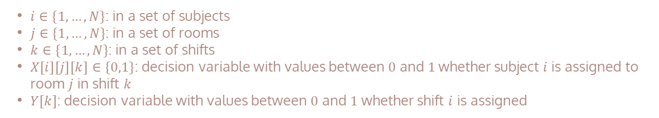
MIXED INTEGER PROGRAMMING
Initializing variables:
#Decision Variable
X = [[[solver.IntVar(0,1, 'X({i}, {j}, {k})'.format(i=i, j=j, k=k)) for k in range(N)] for j in range(M)] for i in range(N)]
Y = solver.IntVar(0,N-1, 'Y')
$i∈\{1, …, N\}$: in a set of subjects
$j∈\{1, …, N\}$: in a set of rooms
$k∈\{1, …, N\}$: in a set of shifts
$X\left[i\right]\left[j\right]\left[k\right]∈\{0,1\}$: decision variable with values between $0$ and$1$whether subject $i$ is assigned to room $j$ in shift $k$
$Y[k]$: decision variable with values between $0$ and $1$ whether shift $i$ is assigned

Slide 27
MIXED INTEGER PROGRAMMING
Constraints:
Constraint 01
for conf in conflict:
c1,c2 = conf
for k in range(N):
schedule = solver.Constraint(0, 1)
for j in range(M):
schedule.SetCoefficient(X[c1-1][j][k], 1)
schedule.SetCoefficient(X[c2-1][j][k], 1)
Pair of conflicting subject not in the same shift

Slide 28
MIXED INTEGER PROGRAMMING
Constraints:
Constraint 02
for i in range(N):
schedule = solver.Constraint(1,1)
for j in range(M):
for k in range(N):
schedule.SetCoefficient(X[i][j][k], 1)
A subject is assigned only once

Slide 29
MIXED INTEGER PROGRAMMING
Constraints:
Constraint 03
for j in range(M):
for k in range(N):
schedule = solver.Constraint(0,1)
for i in range(N):
schedule.SetCoefficient(X[i][j][k],1)
A subject can only be assigned a room and a shift

Slide 30
MIXED INTEGER PROGRAMMING
Constraints:
Constraint 04
for i in range(N):
for j in range(M):
for k in range(N):
schedule = solver.Constraint(0, c[j])
schedule.SetCoefficient(X[i][j][k],d[i])
Assigning the subject in a room with appropriate capacity

Slide 31
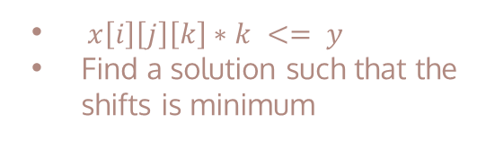
MIXED INTEGER PROGRAMMING
Constraints:
Constraint 05
for i in range(N):
for j in range(M):
for k in range(N):
schedule = solver.Constraint(-solver.infinity(),0)
schedule.SetCoefficient(Y,-1)
schedule.SetCoefficient(X[i][j][k],k)
$x\left[i\right]\left[j\right]\left[k\right]∗k <= y$
Find a solution such that the shifts is minimum

Slide 32
MIXED INTEGER PROGRAMMING
Defining object:
obj = solver.Objective()
obj.SetCoefficient(Y,1)
obj.SetMinimization()

Slide 33
MIXED INTEGER PROGRAMMING
Solving problem:
result_status = solver.Solve()
if result_status == pywraplp.Solver.OPTIMAL:
y = 1
for i in range(N):
for j in range(M):
for k in range(N):
if X[i][j][k].solution_value() == 1:
print('Xếp môn {i} vào phòng {j} trong kíp {k}'.format(i=i+1, j=j+1,k=k+1))
y = max(y,k)
print('tổng số ngày diễn ra kì thi là {t}'.format(t=y//4+1))
else:
print("No Solution")

Slide 34
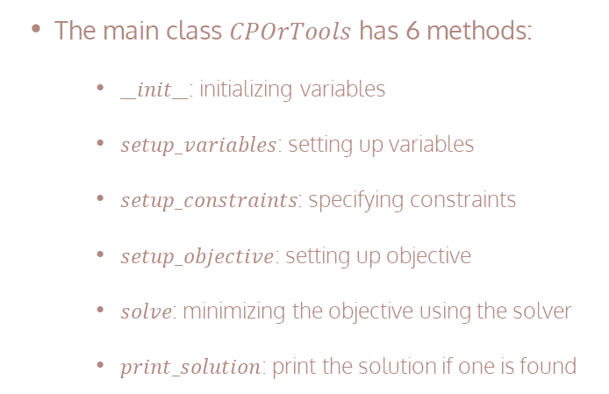
CONSTRAINT PROGRAMMING
Main class and functions:
The main class $CPOrTools$ has 6 methods:
$__init__$: initializing variables
$setup_variables$: setting up variables
$setup_constraints$: specifying constraints
$setup_objective$: setting up objective
$solve$: minimizing the objective using the solver
$print_solution$: print the solution if one is found
class CPOrTools:
def __init__(self): …
def setup_variables(self): …
def setup_constraints(self): …
def setup_objective(self): …
def solve(self): …
def print_solution(self): …

Slide 35
CONSTRAINT PROGRAMMING
def __init__(self):
self.cp_model = cp_model.CpModel()
self.N = N
self.d = d
self.M = M
self.c = c
self.K = K
self.conflict = conflict
Initializing varialbes:

Slide 36
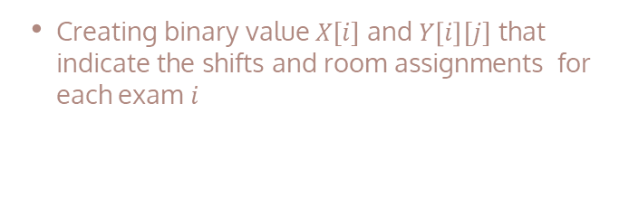
CONSTRAINT PROGRAMMING
Setting up variables:
Creating binary value $X[i]$ and $Y\left[i\right][j]$ that indicate the shifts and room assignments for each exam $i$
def setup_variables(self):
self.X = [self.cp_model.NewIntVar(1, self.N, "X[%d]" % i) for i in range(self.N)]
self.Y = [[self.cp_model.NewIntVar(0, 1, "Y[%d][%d]" % (i, j)) for j in range(self.M)] for i in range(self.N)]

Slide 37
CONSTRAINT PROGRAMMING
Constraints:
Constraint 01
Each subject is assigned to exactly one room.
for i in range(self.N):
self.cp_model.Add(sum(self.Y[i]) == 1)

Slide 38
CONSTRAINT PROGRAMMING
Constraints:
Constraint 02
No two subjects are assigned in a shift
for i in range(self.K):
self.cp_model.Add(self.X[self.conflict[i][0]] != self.X[self.conflict[i][1]])

Slide 39
CONSTRAINT PROGRAMMING
Constraints:
Constraint 03
No two subjects assigned to the same shift are assigned to the same room.
for j in range(self.M):
for i1 in range(self.N - 1):
for i2 in range(i1 + 1, self.N):
boolvar = self.cp_model.NewBoolVar("boolvar[%d][%d][%d]" % (j, i1, i2))
self.cp_model.Add(self.Y[i1][j] + self.Y[i2][j] < 2).OnlyEnforceIf(boolvar)
self.cp_model.Add(self.X[i1] == self.X[i2]).OnlyEnforceIf(boolvar)
self.cp_model.Add(self.X[i1] != self.X[i2]).OnlyEnforceIf(boolvar.Not())

Slide 40
CONSTRAINT PROGRAMMING
Constraints:
Constraint 04
The number of students in each room does not exceed its capacity.
for i in range(self.N):
self.cp_model.Add(sum([self.Y[i][j] * self.c[j] for j in range(len(self.Y[i]))]) >= self.d[i])

Slide 41
CONSTRAINT PROGRAMMING
Objective:
Setting up objective
def setup_objective(self):
self.obj = self.cp_model.NewIntVar(1,self.N, "objective")
self.cp_model.AddMaxEquality(self.obj, self.X)

Slide 42
CONSTRAINT PROGRAMMING
Solving problem:
def solve(self):
self.setup_variables()
self.setup_constraints()
self.setup_objective()
self.cp_model.Minimize(self.obj)
self.solver = cp_model.CpSolver()
self.status = self.solver.Solve(self.cp_model)

Slide 43
CONSTRAINT PROGRAMMING
Printing solution:
def print_solution(self):
if self.status == cp_model.cp_model_pb2.OPTIMAL:
for i in range(self.N):
room = 0
for j in range(self.M):
if self.solver.Value(self.Y[i][j]) == 1:
room = j + 1
break
print("Môn thi %d: Kíp %d, Phòng %d" % (i + 1, self.solver.Value(self.X[i]), room))
print("Số kíp tối thiểu:", self.solver.Value(self.obj))

Slide 44
HEURISTIC
Algorithm:
Sorting number of students registered for each subject in decreasing order.
Sorting capacity of rooms in decreasing order
$→$ maximize the utilization of available rooms and shifts
Looping through each subject and assigning it to the earliest available shift in the first available room with enough capacity.
If there is no room left in the last period, increasing the current day by 1
The function returns the minimum number of days and the schedule with format (day, room, shift)

Slide 45

HEURISTIC
Initializing variables:
Function $greedy$ implement the greedy algorithm to schedule exam
$time_table$: storing information of day, room and shift for each subject. The format for each element in array is tuple (day, room, shift)
$scheduled$: the element $scheduled[i]$tracking whether the subject(i) is assigned or not enough capacity. The format for each element in array is tuple (day, room, shift, capacity)
def greedy(N, D, M, C, conflicts):
time_table = np.array([(0,0,0) for _ in range(N)])
scheduled = np.zeros((N, M, 4), dtype=int)

Slide 46
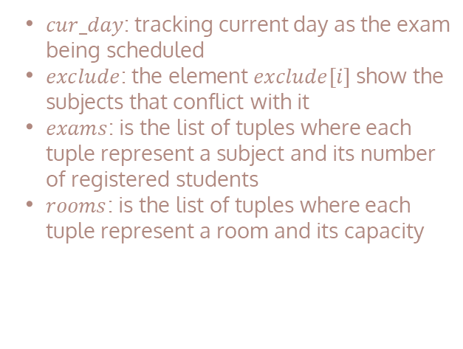
HEURISTIC
Initializing variables:
$cur_day$: tracking current day as the exam being scheduled
$exclude$: the element $exclude[i]$ show the subjects that conflict with it
$exams$: is the list of tuples where each tuple represent a subject and its number of registered students
$rooms$: is the list of tuples where each tuple represent a room and its capacity
cur_day = 0
exclude = {}
for i,j in conflicts:
exclude[i] = exclude.get(i, []) + [j]
exclude[j] = exclude.get(j, []) + [i]
exams = [(d, i) for i, d in enumerate(D)]
rooms = [(c, j) for j, c in enumerate(C)]

Slide 47
HEURISTIC
Handling variables:
# sort number of students registered for each subject in decreasing order
exams.sort(reverse=True, key=lambda x: x[0])
# sort capacity of rooms in decreasing order
rooms.sort(reverse=True, key=lambda x: x[0])

Slide 48
# looping through each subject and assigning it to the earliest available shift in the first available room with enough capacity.
scheduled_subs = 0
while scheduled_subs < len(exams):
exam = exams[scheduled_subs]
d, i = exam
for room in rooms:
c, j = room
for k in range(4):
if (scheduled[cur_day][j][k] + d <= c) and (scheduled[cur_day][j][k] == 0):
# check if there is another subject registered or full of capacity of room
conflict = False
for ii in range(i):
if (time_table[ii][0] == cur_day and time_table[ii][2] == k) and ((ii in exclude.get(i, [])) or time_table[ii][1] == j ): # check if there is another subject registered or conflict
conflict = True
break
if conflict:
continue
scheduled[cur_day][j][k] += d
time_table[i] = (cur_day, j, k)
break
else:
continue
break
else:
#If there is no room left in the last period, increasing the current day by 1
cur_day += 1
scheduled_subs -=1
scheduled_subs += 1
# return the minimum days for the exam
return cur_day + 1, time_table
HEURISTIC
Handling variables:

Slide 49
HEURISTIC
Printing solution:
def main():
n,d,m,c,k,conflicts = input_(input())
num_days, time_table = greedy(n,d,m,c, conflicts)
for exam, (i,j,k) in enumerate(time_table):
print(f"Subject {exam+1} is assigned at day {i+1}, room {j+1}, and shift {k+1}")
print(f"Minimum days for the exams: {num_days}")

Slide 50
RESULTS

Slide 51
RESULTS

Slide 52
05
DISCUSSION

Slide 53
RUNNING TIME

Slide 54
OPTIMIZATION

Slide 55
06
CONCLUSION

Slide 56
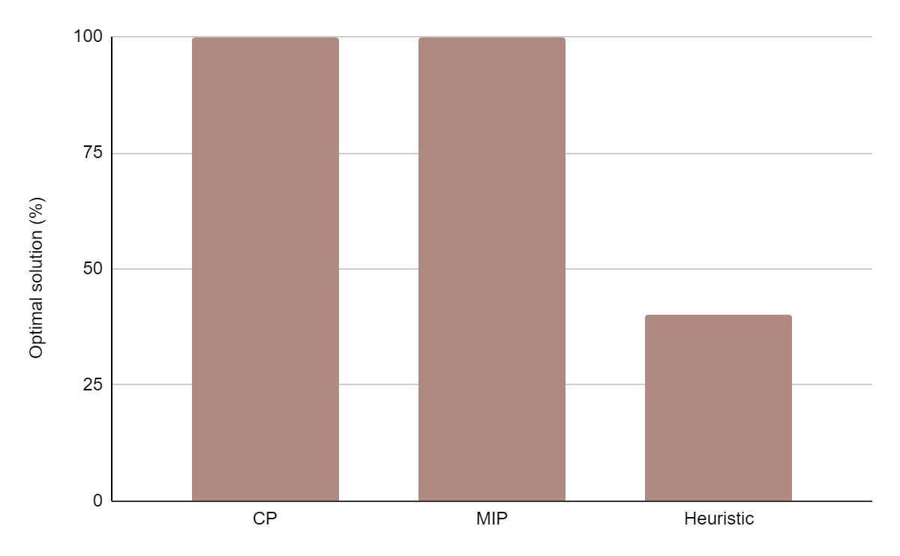
SOLUTION
Optimal
Optimal
Non - optimal

Slide 57
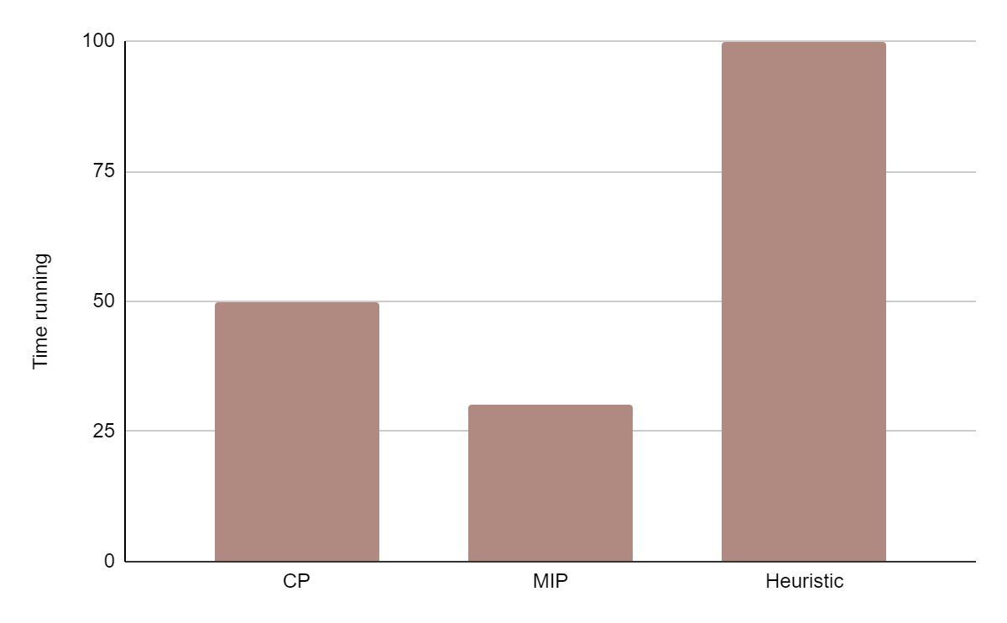
RUNTIME
Fast
Slow
Very slow

Slide 58
THANKS

