Slide 1

Software Quality Metrics to Identify Risk
Department of Homeland Security
Software Assurance Working Group
Thomas McCabe Jr.
tmccabe@mccabe.com
Presented on January 31, 2008
(Last edited for content in Nov. 2008)

Slide 2
Topics Covered
Topic #1: Software Complexity: The Enemy of Software Security
Topic #2: McCabe Complexity Metrics
Topic #3: Measuring Control Flow Integrity
Topic #4: Code Coverage on Modules with High Attack Surface
Topic #5: Using Basis Paths & Subtrees for Sneak Path Analysis
Topic #6: Code Slicing
Topic #7: Finding Code Patterns, Styles and Similarities Using Metrics
Topic #8: Measuring & Monitoring Code Changes
Topic #9: Opinions
Topic #10: SAMATE Complexity Analysis Examples

Slide 3
Topic #1:
Software Complexity: The Enemy of Software Security

Slide 4
Complexity: The Enemy of Software Security
“The Future of digital systems is complexity, and complexity is the worst enemy of security.”
Bruce Schneier
Crypto-Gram Newsletter, March 2000

Slide 5
Software Complexity – The Enemy of Security
“Cyberspace is becoming less secure even as security technologies improve. There are many reasons for this seemingly paradoxical phenomenon, but they can all be traced back to the problem of complexity.
As I have said elsewhere, complexity is the worst enemy of security. The reasons are complex and can get very technical, but I can give you a flavor of the rationale:
  Complex systems have more lines of code and therefore security bugs.
  Complex systems have more interactions and therefore more security bugs. Complex systems are harder to test and therefore are more likely to have untested portions.
  Complex systems are harder to design securely, implement securely, configure securely and use securely.
  Complex systems are harder for users to understand.
Everything about complexity leads towards lower security. As our computers and networks become more complex, they inherently become less secure.”
Testimony of Bruce Schneier, Founder and CTO Counterpane Internet Security, Inc
Subcommittee on Cybersecurity, Science & Research and Development
Committee of Homeland Security
U.S. House of Representatives - Jun 25, 2003

Slide 6
Security Debuggers vs. Security Testing
Tools that search for known exploits are analogous to debuggers in our opinion and are employed using a reactive model rather than a proactive one. The reason why cyclomatic complexity and subtree analysis is so important relates to the fact that many expoits deal with interactions: interactions between code statements, interactions between data and control flow, interactions between modules, interactions between your codebase and library routines, and interactions between your code and attack surface modules. Being cognizant of paths and subtrees within code is crucial for determining sneak paths, impact analysis, and testing to verify control flow integrity.
It is crucial that both security debuggers and security control flow integrity test tools are included in your arsenal

Slide 7
Source Analysis vs. Binary Analysis
As is the case with static analysis and dynamic analysis the two approaches are complementary. Source analysis is platform (architecture and operating system) independent, but language-specific; binary analysis is language-independent but platform-specific. Source code analysis has access to high-level information, which can make it more powerful; dually, binary analysis has access to low-level information (such as the results of register allocation) that is required for some tasks.
Bottom line is: The binary approach effectively analyzes what the compiler produces, whereas the source approach effectively analyzes what the developer produces.
It is true that binary (compiled) code represents the actual attack surface for a malicious hacker exploiting software from the outside. It is also true that source code analysis has differentiated itself in a complementary way by finding the enemy within software development shops. There have been studies indicating that exploits from within are far more costly than those from the outside.
Source code analysis can be employed much earlier in the software development lifecycle (SDLC). Libraries and APIs can be tested early and independently of the rest of the system. Binary Analysis requires that at least an entire executable, if not an entire subsystem or system is completed.
In binary analysis it is true that white box analysis reporting can be generated. However, these reports are indirect, and do not always correlate exactly back to the source code logic; therefore, detailed analysis may be more difficult than humans analyzing source code analysis reporting. Furthermore, compilers and their options (such as optimization) can cause the correlation between binary analysis reporting and source code to be even more different.

Slide 8
Simple Code is Secure Code Expert Says
When it comes to writing secure code, less is more.
SAN FRANCISCO -- As software grows more complex, it contains many more flaws for hackers to exploit, programmers are warned.
That was the advice passed down Thursday by security expert Paul Kocher, president of Cryptography Research, who told the Usenix Security Symposium here that more powerful computer systems and increasingly complex code will be a growing cause of insecure networks.
"The problem that we have is that we are getting these great performance improvements, which leads to increases in complexity, and I am not getting any smarter," Kocher said. "But it's not just me. I don't think you guys are getting smarter, either.“
The overall problem of increased complexity poses challenges that Kocher is not sure can be overcome.
"Today, nobody has any clue what is running on their computer," he said. "The complexity curve has passed us.”
Ashlee Vance, IDG News Service
Friday, August 09, 2002 6:00 AM PDT

Slide 9
Mission Impact of Foreign Influence on DOD Software
Final Report of the Defense Science Board Task Force on Mission Impact of Foreign Influence DOD Software - November 2007
  The complexity of software itself can make corruption hard to detect
  Software has been growing in the dimensions of size, complexity and interconnectedness, each of which exacerbates the difficulties of assurance
  Software complexity is growing rapidly and offers increasing challenges to those who must understand it, so it comes to no surprise that software occasionally behaves in unexpected, sometimes undesirable ways
  The vast complexity of much commercial software is such that it could take months or even years to understand
  The Nation's defense is dependent upon software that is growing exponentially in size and complexity
  Finding: The enormous functionality and complexity of IT makes it easy to exploit and hard to defend, resulting in a target that can be expected to be exploited by sophisticated nation-state adversaries.
  Finding: The growing complexity to the microelectronics and software within its critical systems and networks makes DoDs current test and evaluation capabilities unequal to the task of discovering unintentional vulnerabilities, let alone malicious constructs.

Slide 10
Center for Education Research and Information Assurance and Security
One of the key properties that works against strong security is complexity.
Complex systems can have backdoors and Trojan code implanted that is more difficult to find because of complexity.
Complex operations tend to have more failure modes.
Complex operations may also have longer windows where race conditions can be exploited.
Complex code also tends to be bigger than simple code, and that means more opportunity for accidents, omissions and manifestation of code errors.
- June 18th, 2007 by Prof. Eugene Spafford
Eugene H. Spafford is one of the most senior and recognized leaders in the field of computing. He has an on-going record of accomplishment as an advisor and consultant on issues of security, cybercrime and policy to a number of major companies, law enforcement organizations, and government agencies, including Microsoft, Intel, Unisys, the US Air Force, the National Security Agency, the Federal Bureau of Investigation, the Department of Energy, and two Presidents of the United States

Slide 11
Security as a Function of Agility and Complexity
January 23, 2007 - Veracode
In any inherently insecure medium, such as the moving parts of software, security naturally erodes as requirements shift.
There’s a common misconception that security follows the rules of superposition. That something that has been secured (A), combined with something else that has been secured (B) will also be secure. The physical analogy with locks breaks down with more complex mediums, such as software, due to the intrinsic interdependencies between modules. A might call procedures in B that call back into procedures in A. The interfaces between modules may add arbitrary amounts of code complexity when pieced together.
Before founding Veracode, Rioux founded @stake, a security consultancy, as well as L0pht Heavy Industries, a renowned security think tank. Rioux was a research scientist at @stake, where he was responsible for developing new software analysis techniques and for applying cutting edge research to solve difficult security problems. He also led and managed the development for a new enterprise security product in 2000 known as the SmartRisk Analyzer (SRA), a binary analysis tool and its patented algorithms, and has been responsible for its growth and development for the past five years.

Slide 12
Complexity as the Enemy of Security
Complexity as the Enemy of Security Position Paper for W3C Workshop on Next Steps for XML Signature and XML Encryption
The XML Signature and XML Encryption specifications present very complex interfaces suitable for general purpose use in almost any situation requiring privacy or integrity. These technologies are quickly becoming the foundation for security in the service-oriented software world. They must be robust, predictable and trustworthy. As specified, they are not. It is possible to create and operate these technologies with a secure subset of the defined functionality, but many implementing vendors are not.
- September 2007 by Brad Hill
About the submitter:
Brad Hill is a principal security consultant with iSEC Partners, where he assists companies in the health care, financial services and software development industries in developing and deploying secure software. He has discovered vulnerabilities, written whitepapers, created tools and spoken on attacking the XML security standards at Syscan, Black Hat and to private audiences at OWASP chapters and major corporations.

Slide 13
Software Complexity: Open Source vs. Microsoft
“Over the years, Microsoft has deliberately added more features into its operating system in such a way that no end user could easily remove them. Yet, in so doing, the world’s PC operating system monopoly has created unacceptable levels of complexity to its software, in direct contradiction of the most basic tenets of computer security.”
“Microsoft’s operating systems are notable for their incredible complexity and complexity is the first enemy of security.”
“The central enemy of reliability is complexity. Complex systems tend to not be entirely understood by anyone. If no one can understand more than a fraction of a complex system, then, no one can predict all the ways that system could be compromised by an attacker. Prevention of insecure operating modes in complex systems is difficult to do well and impossible to do cheaply. The defender has to counter all possible attacks; the attacker only has to find one unblocked means of attack. As complexity grows, it becomes ever more natural to simply assert that a system or product is secure as it becomes less and less possible to actually provide security in the face of complexity.”
CyberInsecurity Report
The Cost of Monopoly: How the Dominance of Microsoft Products Poses a Risk to Security
Computer & Communications Association
September 24, 2003

Slide 14
Complexity is a Hackers Best Friend
Wireless cards make notebooks easy targets for hackers
LAS VEGAS -- Security experts have spent the last couple years warning laptop users to take care when accessing wireless Internet hotspots in cafes, airports and elsewhere. At Black Hat USA 2006 Wednesday, two researchers demonstrated just how easy it is for malicious attackers to compromise the wireless cards within those laptops.
Ellch said 802.11 is an example of a wireless standard ripe for the picking by malicious hackers. "It's too big, too ambitious and too complicated," he said. Complexity is a hacker's best friend, he added, "and 802.11 is not lacking in complexity."
By Bill Brenner, Senior News Writer
02 Aug 2006 | SearchSecurity.com

Slide 15
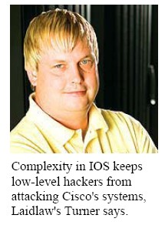
Contrarian Viewpoint or the Next Big Target?
The Next Big Target
Cisco Routers are everywhere. That makes them your next security concern
“Because IOS controls the routers that underpin most business networks as well as the Internet, anyone exploiting its flaws stands to wreak havoc on those networks and maybe even reach into the computer systems and databases connected to them. IOS is a highly sophisticated piece of software, but--as with Microsoft’s Windows--that's a double-edged proposition. Software complexity can be a hacker's best friend.”
"The more complex you make something in the security world, the better it is, so you don't have the script kiddies, or low-level hackers, out there trying to hack Cisco equipment," says Stan Turner, director of infrastructure for Laidlaw Transit Services Inc., an operator of public bus-transportation systems. Building layers of security into networks using firewalls, intrusion-prevention systems, antivirus software, and other components, and rigorous patch management and upgrading, are the price companies pay.”
Information week
The Next Big Target
By Larry Greenemeier
Nov. 7, 2005
This particular problem first came to light in July when information-security researcher Michael Lynn took the podium at the Black Hat conference with a presentation that proved hackers actually could take over IOS, not just shut down Cisco routers.
Lynn went out on a limb to share what he knew, resigning from his job at ISS to make the Black Hat presentation, rather than quiet down. Cisco later obtained a court order to shut him up

Slide 16
Forbes.com: Saving Software from Itself
“Critical parts are typed up by hand and, despite a wealth of testing tools that claim to catch bugs, the complexity of software makes security flaws and errors nearly unavoidable and increasingly common.”
“The complexity will only increase as more business is automated and shifted onto the Internet and more software production is assigned to India, Russia and China.”
Forbes Technology
Saving Software From Itself
Quentin Hardy, 03.14.05

Slide 17
Real-Time Embedded Software Safety
Developers of Real-Time Embedded Software Take Aim at Code Complexity
“The complexity explosion in software is exponential,” says David Kleidermacher, Chief Technology Officer at Green Hills Software in Santa Barbara, CA, which specializes in real-time embedded operating systems and software-development tools.
“The challenges of rising system complexity for software developers cannot be overstated. There is a movement to more complex systems, and the operating system is forced to take on a larger role in managing that complexity, says Green Hills’s Kleidermacher.”
“We have passed a critical juncture where a new paradigm is required, Kleidermacher continues. You get to a certain size of the software where your odds of getting a really serious error are too high. We have to change the whole rules of engagement.”
“In the 1970s the average car had 100,000 lines of source code, Kleidermacher explains. Today it’s more than a million lines, and it will be 100 million lines of code by 2010. The difference between a million lines of code and 100 million lines of code definitely changes your life.”
Military & Aerospace Electronics - April, 2007
By John Keller

Slide 18
Spire Security Viewpoint
Software Security Labels: Should we throw in the towel?
So the question is - what is it about software that makes it more- or less- vulnerable? One easy hypothesis that has been made in the past is that complexity drives insecurity.
“Cyclomatic complexity is the most widely used member of a class of static software metrics. Cyclomatic complexity may be considered a broad measure of soundness and confidence for a program. Introduced by Thomas McCabe in 1976, it measures the number of linearly-independent paths through a program module. This measure provides a single ordinal number that can be compared to the complexity of other programs.
Cyclomatic complexity is often referred to simply as program complexity, or as McCabe's complexity. It is often used in concert with other software metrics. As one of the more widely-accepted software metrics, it is intended to be independent of language and language format.”
Pete Lindstrom, CISSP
Research Director
Spire Security, LLC
October 24, 2005

Slide 19
Topic #2:
McCabe Complexity Metrics

Slide 20
Get to Know Your Code
A certain number of “complexity bugs” can be found through programmer vigilance.
Get to know your code. Get to know how the pieces work and how they talk to each other. The more broad a view you have of the system being programmed, the more likely you will catch those pieces of the puzzle that don’t quite fit together, or spot the place a method on some object is being called for some purpose it might not be fully suited.
Bruce Schneier makes a good case for the absolute need to examine code for security flaws from this position of knowledge. When considering security-related bugs, we have to ensure the system is proof against someone who knows how it works, and is deliberately trying to break it, again an order of magnitude harder to protect against than a user who might only occasionally stumble across the “wrong way to do things”.

Slide 21
How Do McCabe Unit Level Metrics Pertain to Security Analysis?
Cyclomatic Complexity v(g)
  Comprehensibility
  Testing effort
  Reliability
Essential Complexity ev(g)
  Structuredness
  Maintainability
  Re-engineering effort
Module Design Complexity iv(g)
  Integration effort
Global Data Complexity gdv(g)
  External Data Coupling
  Structure as related to global data
Specified Data Complexity sdv(g)
  Structure as related to specific data

Slide 22
Cyclomatic Complexity
Definition: Cyclomatic complexity is a measure of the logical complexity of a module and the minimum effort necessary to qualify a module. Cyclomatic is the number of linearly independent paths and, consequently, the minimum number of paths that one should (theoretically) test.
Advantages
  Quantifies the logical complexity
  Measures the minimum effort for testing
  Guides the testing process
  Useful for finding sneak paths within the logic
  Aids in verifying the integrity of control flow
  Used to test the interactions between code constructs

Slide 23
Source Code Analysis Flowgraph Notation
If .. then
If .. then .. else
If .. and .. then
If .. or .. then
Do .. While
While .. Do
Switch

Slide 24
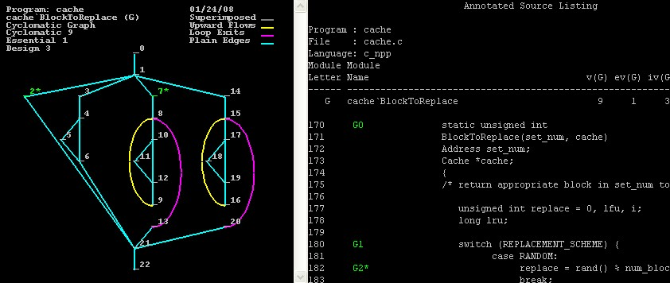
Understand the Control Flow of Code Under Security Review
Some security flaws are deeply hidden within the complexity

Slide 25
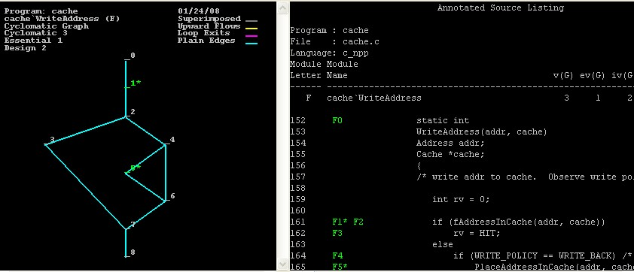
Something Simple

Slide 26
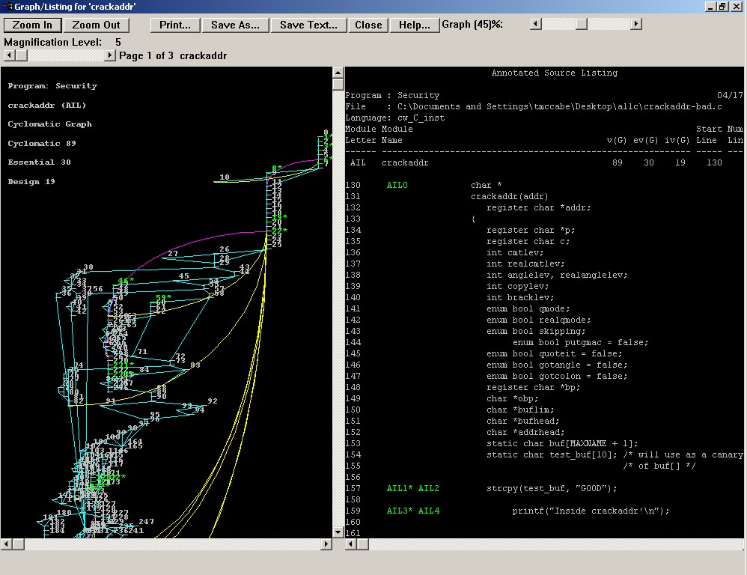
Something Not So Simple

Slide 27
Module Design Complexity
Modules do not exist in isolation
Modules call child modules
Modules depend on services provided by other modules
Quantify interaction of modules with subordinates under security review.
How much security testing is required to integrate this module into the rest of the system?

Slide 28
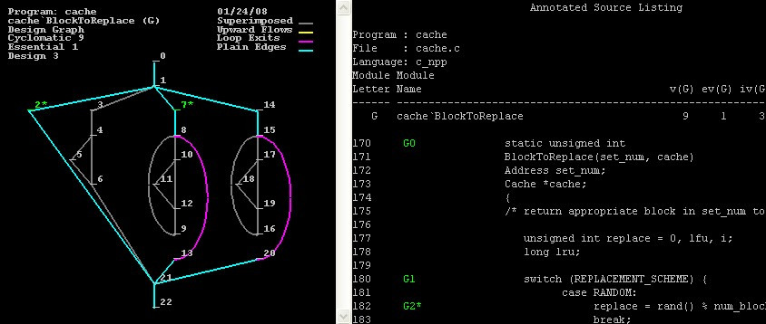
Module Design Complexity

Slide 29
Module Design Complexity
Definition: module design complexity of a module is a measure of the decision structure which controls the invocation of the module’s immediate subordinate modules. It is a quantification of the testing effort of a module as it calls its subordinates.
The module design complexity is calculated as the cyclomatic complexity of the reduced graph. Reduction is completed by removing decisions and nodes that do not impact the calling control of the module over its subordinates.

Slide 30
Module Global Data Complexity
Definition: Global data complexity quantifies the complexity of a module's structure as it relates to global and parameter data. Global data is data that can be accessed by multiple modules. This metric can show how dependent a module is on external data and is a measure of the testing effort with respect to global data. Global data complexity also measures the contribution of each module to the system's data coupling, which can pinpoint potential maintenance problems.
Isolates the modules with highest external data coupling.
Combines control flow and data analysis to give a more comprehensive view of software than either measure would give individually.

Slide 31
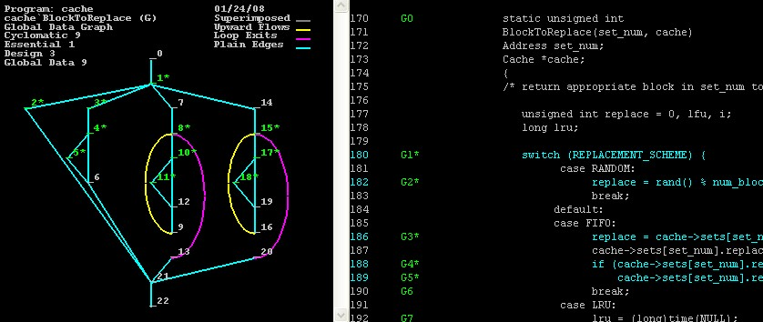
Global Data Flowgraph and Metrics

Slide 32
Module Specified Data Complexity
Specified data complexity quantifies the complexity of a module's structure as it relates to user-specified data. It is a measure of the testing effort with respect to specific data.
You can use the data dictionary to select a single data element, all elements with a specific data type, or a variety of other selection criteria. The specified data complexity then quantifies the interaction of that data set with each module's control structure.
Four Standard Windows Socket Routines Example: Which modules are using recv() (TCP, recvfrom() (UDP), WSARecv() (TCP) and WSARecvFrom() (UDP)

Slide 33
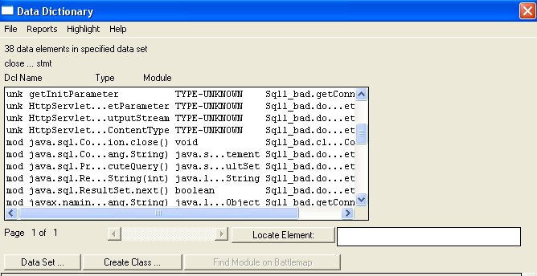
Module Specified Data Complexity
Indicates the data complexity of a module with respect to a specified set of data elements. Equals the number of basis paths that you need to run to test all uses of that specified set of data in a module. Allows users to customize complexity measurement for data-driven analyses

Slide 34
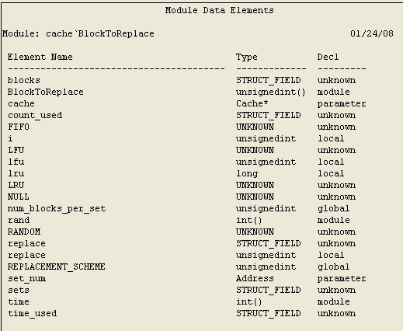
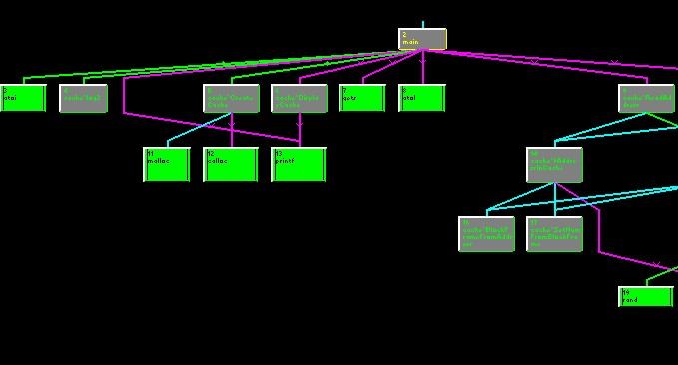
Specified Data Analysis

Slide 35
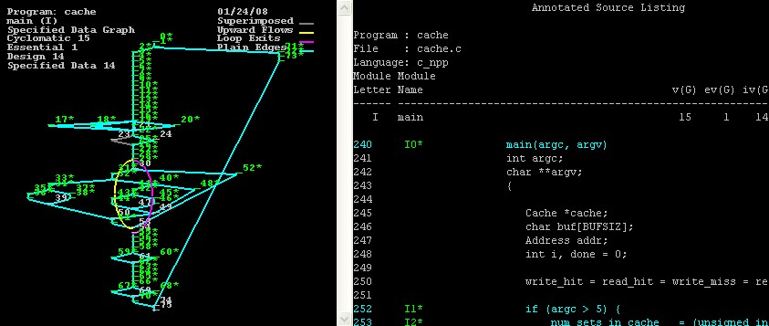
Specified Data Metric and Flowgraph

Slide 36
Structural Analysis
Structural Analysis … Providing Actionable Metrics
The higher the complexity the more bugs. The more bugs the more security flaws
Cyclomatic Complexity & Reliability Risk
  1 – 10 Simple procedure, little risk
  11- 20 More Complex, moderate risk
  21 – 50 Complex , high risk
  >50 Untestable, VERY HIGH RISK
Cyclomatic Complexity & Bad Fix Probability
  1 – 10 5%
  20 –30 20%
  > 50 40%
  Approaching 100 60%
Essential Complexity (Unstructuredness) & Maintainability (future Reliability) Risk
  1 – 4 Structured, little risk
  > 4 Unstructured, High Risk

Slide 37
Examine Code from a Position of Knowledge
IV. Structural Analysis … Visualizing The Big Picture
Component/Application - Functional Structure Chart
  - provides visualization of component design, with module calls and superimposed metrics coloring
  - is valuable for comprehension and topology map for Sneak Subtree and Path Analysis
  - Security exposure may be reduced by removing unnecessary libraries from the application
  Identify calls into legacy systems
  Uncovers entry points into the system
RED
Potentially unmaintainable code
GREEN
YELLOW
Potentially unreliable code
Library module
(Always green)
GREEN
GREEN
Small, well-structured code

Slide 38
Topic #3:
Measuring Control Flow Integrity

Slide 39
Verifying Control Flow Integrity
“In order to be trustworthy, mitigation techniques should -- given the ingenuity of would-be attackers and the wealth of current and undiscovered software vulnerabilities -- be simple to comprehend and to enforce, yet provide strong guarantees against powerful adversaries.”
This paper describes mitigation technique, the enforcement of Control-Flow Integrity, that aims to meet these standards for trustworthiness and deployability. The Control-Flow Integrity security policy dictates that software execution must follow a path of a Control-Flow Graph determined ahead of time. The Control Flow Graph in question can be defined by analysis ---source code analysis, binary analysis, or execution profiling.
“A security policy is of limited value without an attack model”
Microsoft Research
Control-Flow Integrity
Martín Abadi; Mihai Budiu; Ulfar Erlingsson; Jay Ligatti
February 2005

Slide 40
Software Security Analysis without Code Schematics
Software Security Analysis without a control and data flow diagram of logic and design, is like home security analysis without schematics, such as a flooring plan or circuitry diagram.
Simply scanning for known exploits without verifying control flow integrity is comparable to the same security expert explaining the obvious, such as windows are open and doors are unlocked, and being completely oblivious to the fact that there is a trap door in your basement.
Those known exploits, just like the insecure doors and windows, are only the low hanging fruit.
- McCabe Software

Slide 41
Use Module Flowgraphs Understand the Algorithm & Its Interactions
Flowgraphs Visualize Logic
Useful for:
  Comprehension
  Test Derivation
  Sneak Analysis
  Module Interaction

Slide 42
Path Coverage Effect
Analysis of the module control flow diagram identifies ways that sources could combine with targets to cause problems.
Complexity = 10
  Means that 10 Minimum Tests will:
    Cover All the Code
    Test Decision Logic
    Test the interaction between code constructs

Slide 43
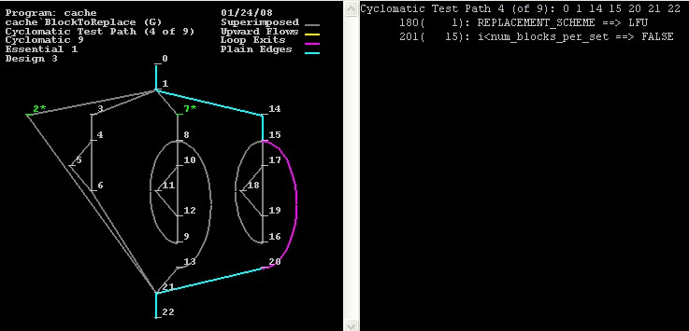
Cyclomatic Flowgraph and Test Condition

Slide 44
Topic #4:
Code Coverage on Modules with High Attack Surface

Slide 45
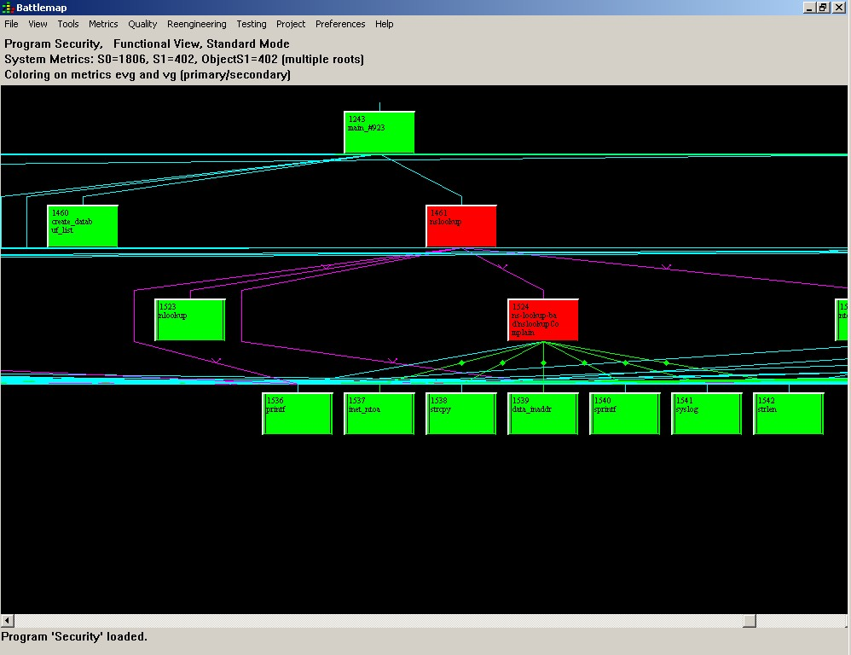
Structural & Attack Surface Analysis
Structural Analysis … Visualizing The Big Picture

Slide 46
And Nothing More
Many experts point out that security requirements resemble those for
any other computing task, with one seemingly insignificant difference ... whereas most requirements say "the system will do this," security
requirements add the phrase "and nothing more."
Not understanding code coverage limits the effectiveness of black-box software testing. If security teams don't exercise code in the application, they can't observe any bugs it might have.

Slide 47
White Box vs. Black Box Testing
Black Box Testing
Test Focus: Requirements
Validation Audience: User
Code Coverage: Supplemental
Positive Test: Testing things in your specs that you already know about
White Box Testing
Test Focus: Implementation
Validation Audience: Code
Code Coverage: Primary
Negative Test: Testing things that may not be in your specs but in the implementation

Slide 48
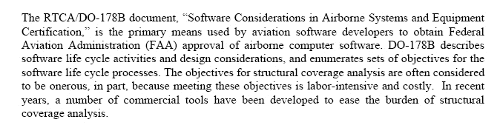
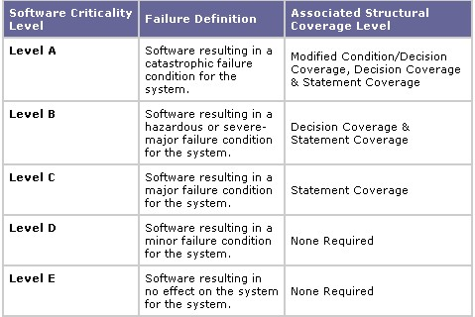
Are There Any Mandates for Measuring Code Coverage of Known Attack Surfaces?

Slide 49
Code Coverage: How Much of the Software That Was Attackable Was Verified?
RED
Module has never been verified during
testing and is vulnerable
GREEN
YELLOW
Partially Tested by security test
Library module
(Always green)
GREEN
GREEN
Completely Tested
Unconditional Call
Conditional Call
Iterative Call

Slide 50

Attack Surface Modules with Low Coverage Vulnerable
How much of code that is attackable has been exercised?
How effective are your security tests?
When is the security analysis testing complete?
What areas of the code did my penetration tests hit?
The Battlemap indicates the code coverage of each module, by superimposing test execution information on the structure of the system. This helps you locate attack surface areas of your
program that may require additional testing
The system defaults are set to a stoplight color scheme:
  Red modules that have never been tested
  Yellow modules have been partially tested
  Green modules have been fully tested

Slide 51
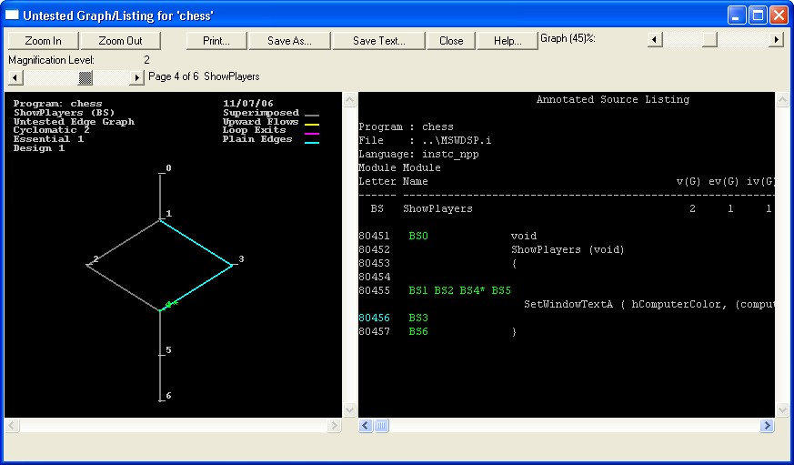
Untested Unit Level Flowgraphs & ASL

Slide 52
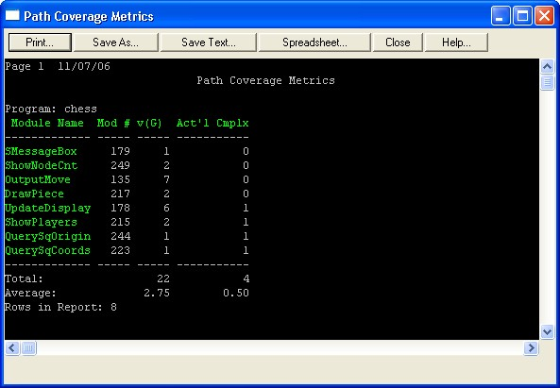
How Much Attack Surface Exercised by the Security Testing?

Slide 53
Topic #5:
Using Basis Paths & Subtrees for Sneak Path Analysis

Slide 54
Sneak Path Analysis/Cyclomatic and Subtree Path Analogy
Using Cyclomatic Basis Path Testing for software security analysis is analogous to using Sneak Path Analysis. The goal behind sneak path analysis, also called sneak circuit analysis (SCA), is to identify unexpected and unrecognized electrical paths or logic flows in electronics systems, called sneak circuits or paths, that under certain conditions produce undesired results or prevent systems from operating as intended. These paths come about in various ways.
Designers do not always have a complete view of the relationship between functions and components in complex systems, particularly those with many interfaces. System changes may falsely appear to be minor or of only local significance, and users may employ improper operating procedures. Historically, users discovered sneak paths when they observed an unintended effect during system operation. Sneak paths may lie in software, or user actions, or some combination thereof. They are latent conditions, inadvertently and unknowingly designed or engineered into the system, that do not cause system failure until triggered by unusual circumstances.
In Sneak path analysis a topology diagram is built of the various components
and interconnections. The system topology diagram is then analyzed
to identify ways that sources could combine with targets to cause problems. This is accomplished by examining flow paths through the diagram.

Slide 55
Source Code Complexity Can Mask Security Holes
“A typical hacker may use features in software which are not obvious security holes, in order to probe the system for useful information to form an attack. Source code complexity can mask potential security weaknesses, or seemingly innocuous software configuration changes may open up security gaps. An example would be a change to the permissions on a system directory. The implications of such changes may not be appreciated by a system administrator or software engineer, who may not be able to see the whole picture due to the complexity in any typical operating system. A reduction in this complexity may improve security.”
Internet armor: Internet security is like a layered suit of armor - breachable
in places.
By David Stevenson, PA Consulting Group
Conspectus, 01 July 1997

Slide 56
Attack Surface Software Sneak Path & Subtree Analysis
(For example: What functions are responsible for receiving packets on the network, and how is the resulting data is passed along the internal routines of the software.)
Step 1: Identify all modules with vulnerable attack surface
Step 2: Calculate McCabe Design Complexity, Integration Complexity
Step 3: Analyze visual and textual design invocation subtrees
Step 4: Calculate and analyze all cyclomatic, module design, and global data complexity metrics and complexity algorithm graphs for impact analysis, risk and sneak paths.
Step 5: Measure code coverage at point where the packet is received and is traversing memory into the program’s logic
*Interesting article in the SANS Institute Information Security Reading Room “Analyzing the Attack Surface Code Coverage”
By Justin Seitz
2007

Slide 57
Attack Surface Design Complexity
Definition: Design complexity, is a measure of the decision structure which controls the invocation of modules within the design. It is a quantification of the testing effort of all calls in the design, starting with the top module, trickling down through subordinates and exiting through the top.

Slide 58
System Design Complexity
Program Complexity

Slide 59
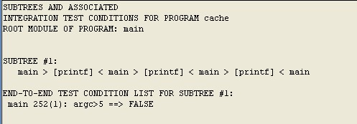

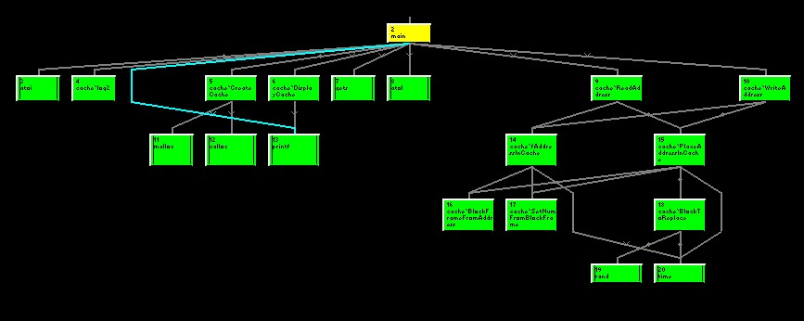
Design Complexity and Subtree Analysis

Slide 60

Example: Cyclomatic Used for Sneak Analysis

Slide 61
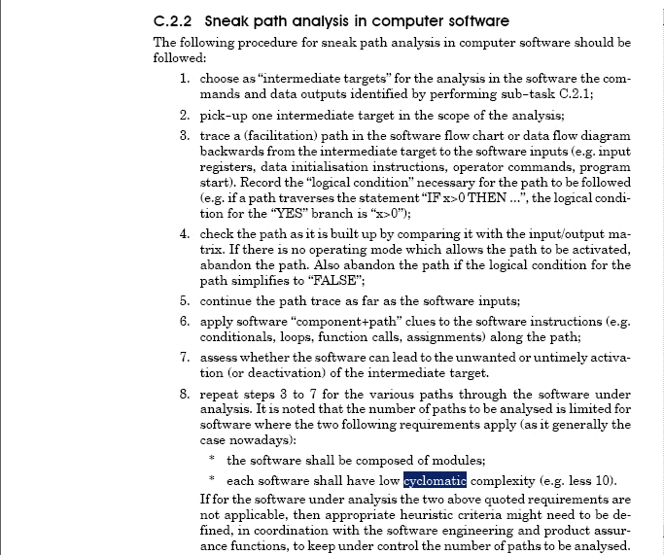
Sneak Analysis Using Cyclomatic Complexity

Slide 62
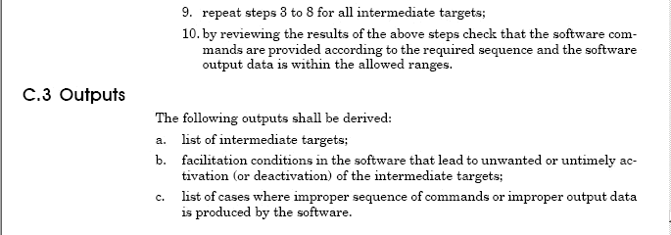
Using Cyclomatic Complexity for Sneak Analysis

Slide 63
Exception Handling in Code Can Be Very Sneaky
Error handling routines in software programs are typically sneak paths. Since error handling routines contribute to control flow, use flow graphs to decipher the programming logic and produce test conditions which will when executed test their logic.
The most neglected code paths during the testing process are error handling routines. Error handling may include exception handling, error recovery, and fault tolerance routines.
Functionality tests are normally geared towards validating requirements, which generally do not describe negative (or error) scenarios. Validating the error handling behavior of the system is critical during security testing

Slide 64
Topic #6:
Code Slicing

Slide 65
Measuring and Monitoring Execution Slices
Uncover your program’s internal architecture. By compiling and running an instrumented version of your program, then importing the resulting trace file, you can visualize which parts of your program’s code are associated with specific functionality. The slice concept is important to reengineering from several standpoints.
    Visualizing the software
    Tracing data through the system
    Decomposing a complex system
    Extracting business rules
    Tracing requirements
    Finding Sneak Paths
To gain understanding of code coverage before a fuzzing run, it is important to first pass the application a piece of data that is correctly formed. By sending the right packet and measuring the execution slice, the common path that a normal packet takes through the application logic is determined.
Some Intrusion detection systems based on anomaly detection use a set of training data to create a database of valid and legitimate execution patterns that are constantly compared to real execution patterns on a deployed system. This approach assumes that the attack pattern substantially differs from the legitimate pattern.

Slide 66

Tracing Data Through the Control Flow (Slice)

Slide 67
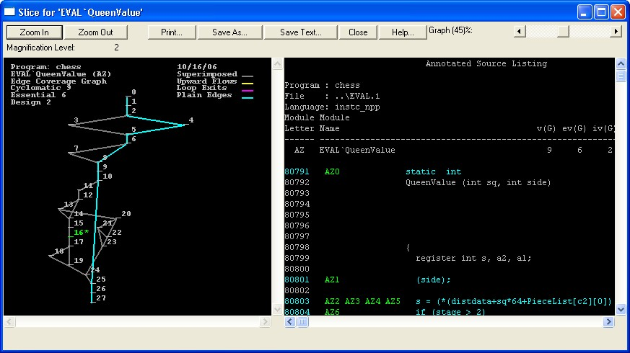
Slice @ Function Level

Slide 68
Topic #7:
Finding Code Patterns, Styles and Similarities Using Metrics

Slide 69
Using Metrics to Find Code Patterns
“People tend to work in patterns. They learn how to do some things well, then learn to carry that knowledge and those skills to other areas.”
Exploiting Chaos: Cashing in on the Realities of Software Development
Dave Olsen
Using a module comparison tool to locate redundant code. Select predefined search criteria or establish your own search criteria for finding similar modules. After you select the search criteria, select the modules you want to match, and specify which programs or repositories you want to search, the module comparison tool locates the modules that are similar to the ones you want to match based on the search criteria you selected.
Often times, the code associated with individual programmers can be identified by the code constructs they use.
Source code containing known security flaws can be analyzed and used as a baseline to compare against the codebase under security review.

Slide 70
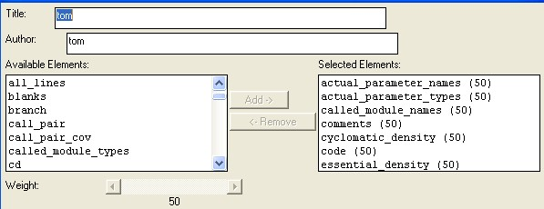
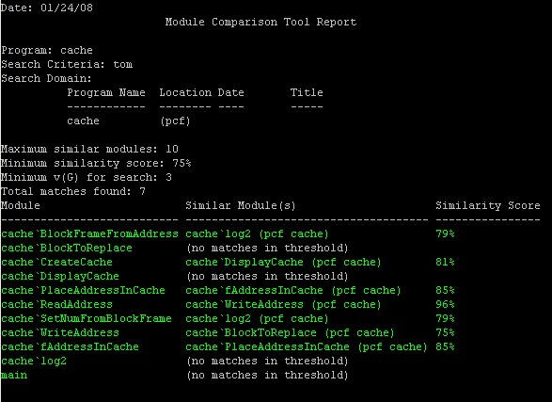
Where Else is That in My Codebase? What Else is Similar?

Slide 71
Topic #8:
Measuring & Monitoring Code Changes

Slide 72
Measuring and Monitoring Code Changes
At any point in the development cycle, reparse your source code and determine which modules have been modified. As you plan Security Analysis resources, you can allocate more resources to the areas that are both highly complex and contain changed code. Similarly, when you use a code coverage tool in conjunction, you can identify modules that changed and evaluate whether those modules are tested. You can then focus your testing on those changed modules and their interactions with the rest of your program.
Sections of code that have recently changed are often reviewed for security flaws.

Slide 73
Topic #9:
Opinions

Slide 74
Our Opinion
Use Software Complexity Metrics, Measure Control Flow Integrity and do Sneak Path Analysis for Better Security Analysis
There are no silver bullets when it comes to security metrics. Many of the issues surrounding Security Analysis are intertwined with fundamental software engineering principles. Metrics such as the Relative Attack Surface Quotient (RASQ) from Microsoft should be used in conjunction with traditional metrics that enable us to understand software and test it. Complexity, Object-Oriented Metrics and other metrics that help us understand the characteristics of our codebase are certainly relevant to software security. Software Testing and Code Coverage Metrics are also very relevant.
Basis cyclomatic test path and subtree analysis lends itself well in the area of Software Sneak Path Analysis. White box security testing following the methodology as presented in NIST Special Pub. 500-235 Structured Testing: A Testing Methodology Using the Cyclomatic Complexity Metric is a sound way to verify control flow integrity. Control Flow Integrity and Sneak Path Analysis should be a part of Security Analysis discussions.

Slide 75
NIST Special Publication 500-235: Structured Testing: A Testing Methodology Using the Cyclomatic Complexity Metric
Arthur H. Watson
Thomas J. McCabe
Prepared under NIST Contract 43NANB517266
Dolores R. Wallace, Editor Computer Systems Laboratory
National Institute of Standards and Technology
Gaithersburg, MD 20899-0001
August 1996
Abstract
The purpose of this document is to describe the structured testing methodology for software testing, also known as basis path testing. Based on the cyclomatic complexity measure of McCabe, structured testing uses the control flow structure of software to establish path coverage criteria. The resultant test sets provide more thorough testing than statement and branch coverage. Extensions of the fundamental structured testing techniques for integration testing and object-oriented systems are also presented. Several related software complexity metrics are described. Summaries of technical papers, case studies and empirical results are presented in the appendices.
Keywords
Basis path testing, cyclomatic complexity, McCabe, object oriented, software development, software diagnostic, software metrics, software testing, structured testing

Slide 76
Topic #10:
SAMATE Complexity Analysis Examples

Slide 77
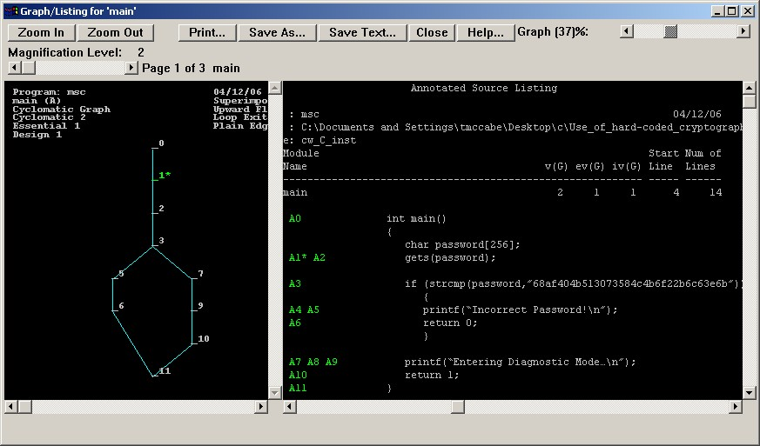
SAMATE Source Code Examples

Slide 78
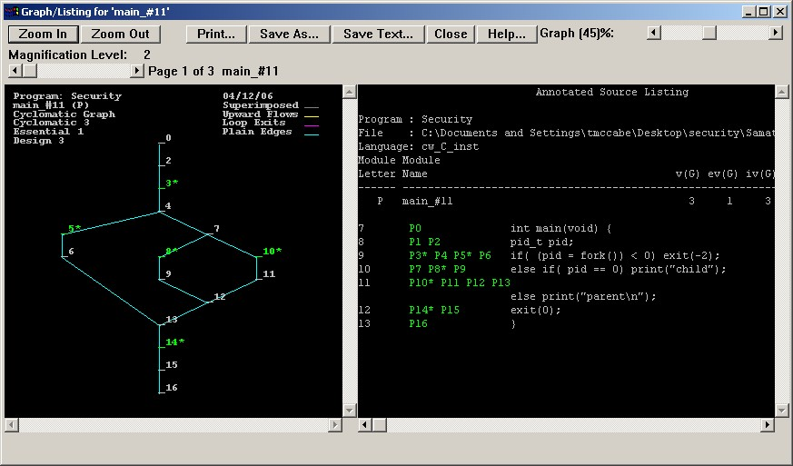
SAMATE Source Code Examples

Slide 79
SAMATE Source Code Examples

Slide 80
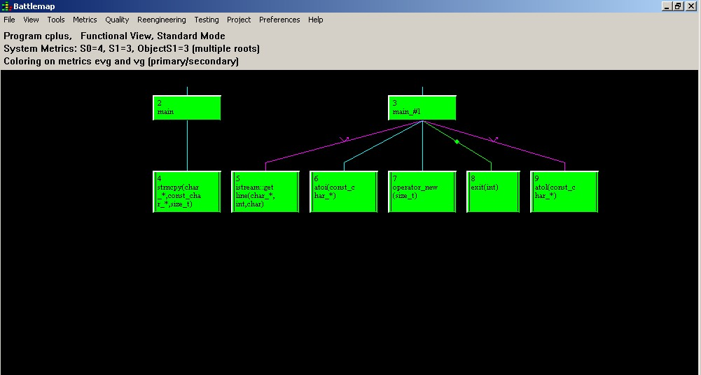
SAMATE Source Code Examples

Slide 81
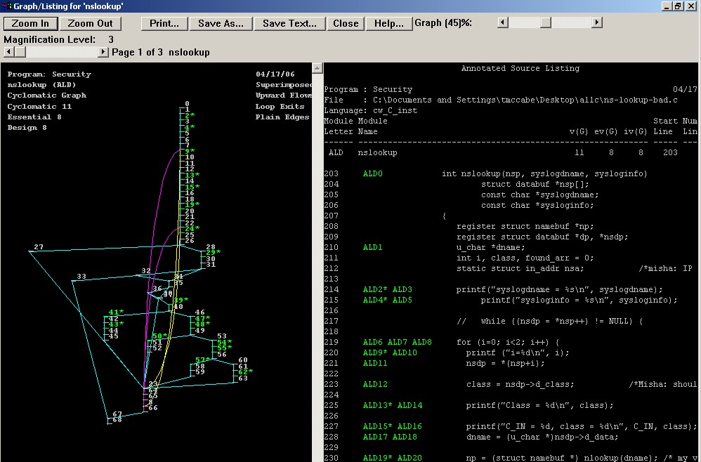
SAMATE Source Code Examples

Slide 82
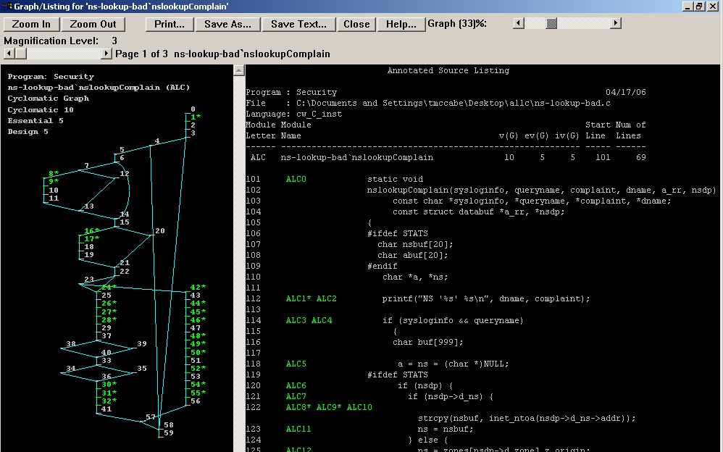
SAMATE Source Code Examples

Slide 83
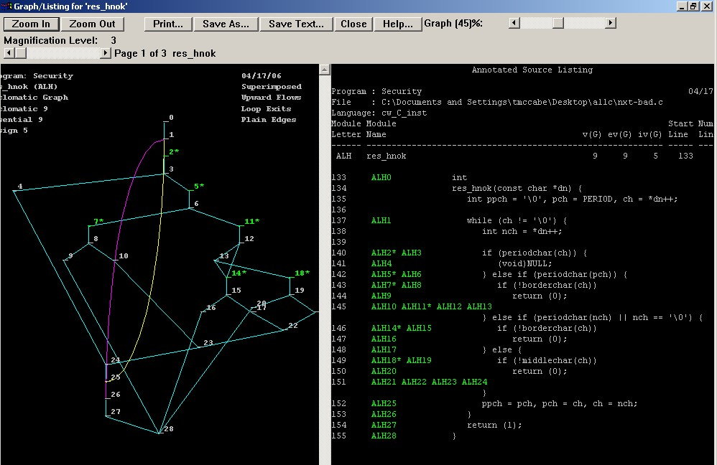
SAMATE Source Code Examples

Slide 84
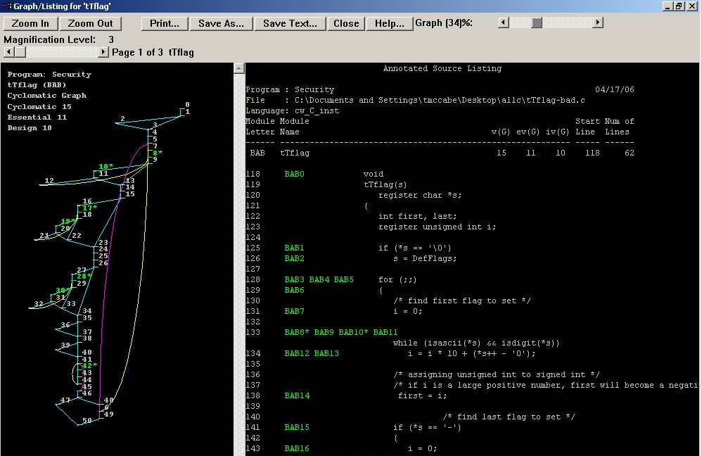
SAMATE Source Code Examples

Slide 85
SAMATE Source Code Examples

Slide 86
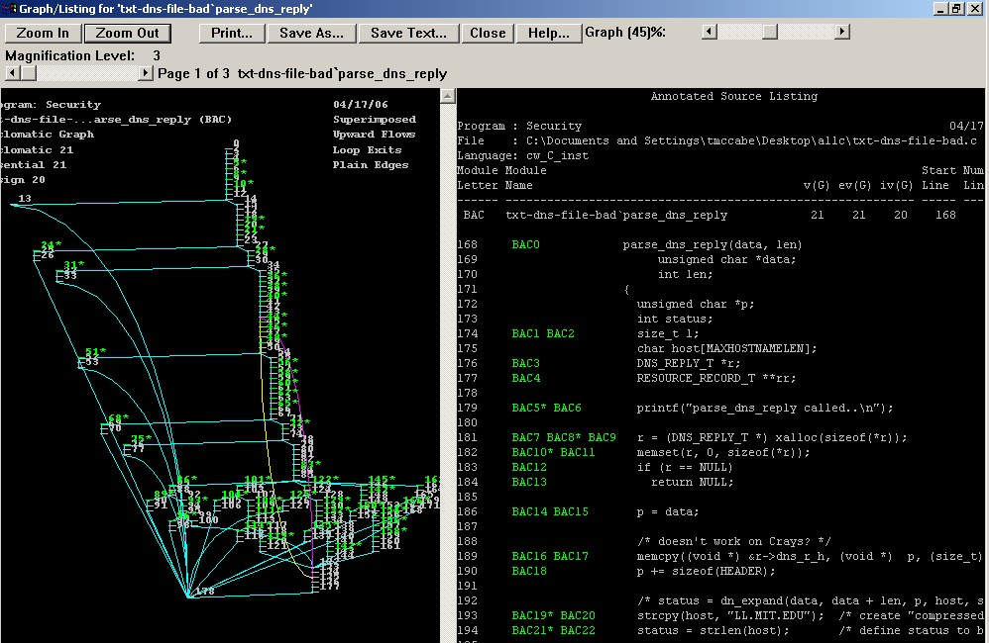
SAMATE Source Code Examples

Slide 87
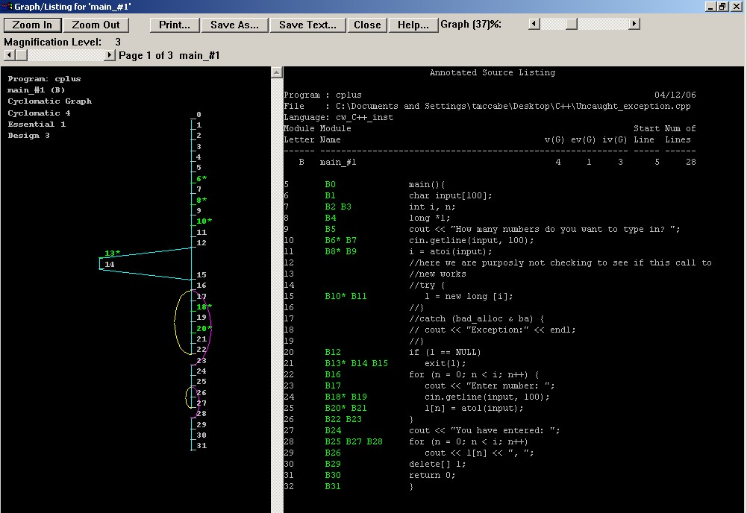
SAMATE Source Code Examples

Slide 88
Thank you
Presented by
Tom McCabe, Jr.
tmccabe@mccabe.com
McCabe Software, Inc
http://www.mccabe.com

