Slide 1
CS 2114: SOFTWARE DESIGN & DATA STRUCTURES | DELIVERABLE 4
The Pass: Building for Reuse
A defensible, generic linked architecture for restaurant order management and kitchen dispatch.
Project Team — Group 84
• Abigail — System Architecture, Diagrams & Quality Review
• Bryan — Validation Design, Drink Orders & Test Plan
• Jack — Data Invariants, Complexity & Storage Contracts
• Talal — API Architecture, Stretch Goal & Centralization
Public GitHub Repository
https://github.com/Talal288/cs2114-project2-group84
✔ Publicly accessible in private browsing
✔ Complete source code and 104 passing JUnit tests
✔ Comprehensive README with attribution and run steps
✔ Architecture diagrams and stretch goal documentation

Slide 2
PART 1: WHAT YOU BUILT (~2 MIN)
The Pass: Single-User Restaurant Order Workflow
Core Capabilities
Order Ingestion
Adds food to kitchen or drink to bar with auto-assigned unique sequential IDs.
Arrival Ordering
Preserves exact FIFO sequence across both production queues independently.
Dispatch & Logging
Completes oldest entry into shared sent-out log; cancels entries without logging.
Defensive Validations
Table Number Checks
Ensures positive integers; isolates errors to avoid queue corruption.
Menu Classification
Normalizes input; rejects non-menu or cross-category items with helpful re-prompts.
ID Range Protection
Detects Integer.MAX_VALUE and exhausts safely to prevent ID reuse.
Presentation & Inspection
Live Queue Views
Kitchen and bar views display item position, ID, table, and elapsed whole minutes.
Table-Specific Views
Parallel side-by-side columns show pending food and drinks for any table.
Sent-Out History
Permanent record of completed items in chronological completion order.

Slide 3
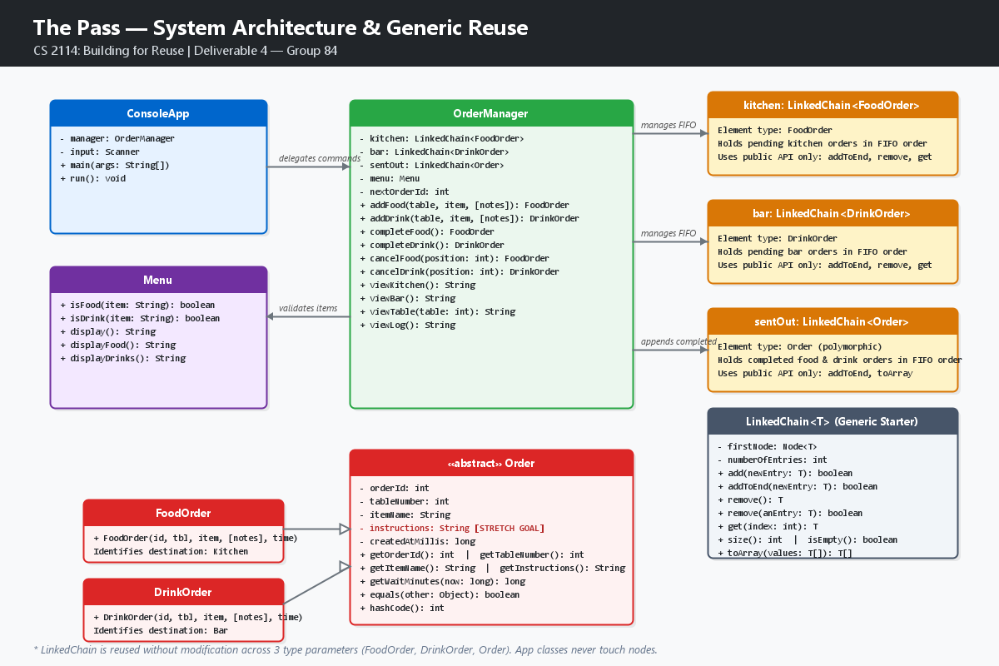
PART 1: WHAT YOU BUILT (~2 MIN)
Generic LinkedChain Reuse & Architectural Separation
Generic Contract & Layering
3 LinkedChain Instances
OrderManager holds kitchen (FoodOrder), bar (DrinkOrder), and sentOut (Order). One generic structure reused for 3 distinct type arguments.
Strict Public API
Uses only addToEnd, remove, get, size, and toArray. Zero application code accesses nodes or next pointers.
No Domain Infiltration
LinkedChain knows nothing about tables, food, or restaurant status; pure container with universal Object.equals comparison.
Polymorphic Log
sentOut: LinkedChain<Order> accepts both FoodOrder and DrinkOrder subtypes without type-casts.

Slide 4
PART 1: WHAT YOU BUILT (~2 MIN)
Evolution from Spec & Stretch Goal Implementation
Evolution: Deliverable 2 Spec → Deliverable 3 Prototype → Final Build
• LinkedChain Contract: Spec proposed modifying chain with tail pointer and removeFirst(). In Prototype & Final, we proved the unedited staff LinkedChain was sufficient using addToEnd and remove.
• Centralized Menu: Prototype duplicated strings in ConsoleApp. Final centralized all display strings in Menu.displayFood() and Menu.displayDrinks().
• Testing Harness: Spec proposed generic test plans. Final completed 104 unit tests under student.TestCase with 100% method coverage.
Stretch Goal Implemented: Item Customizations & Special Instructions [EXCEEDS]
• Data Structure Extension: Added immutable instructions field and hasInstructions() to Order, FoodOrder, and DrinkOrder.
• Backward Compatibility: Preserved existing 4-parameter constructors; added 5-parameter overloads across all order types.
• Input Validation: Null values safely default to empty string; leading/trailing whitespace trimmed; rejects > 100 characters.
• Multi-View Integration: Seamlessly appears in parentheses across kitchen/bar queues, table views, and sent-out history.
• Test Verification: Tested normal notes ('no onions'), empty/null notes, and boundary rejections in OrderTest, FoodOrderTest, and OrderManagerTest.

Slide 5
PART 2: DEMO (~2 MIN)
Demonstration Protocol & Execution Plan
DEMO 1
Step 1: Ingestion & Customization
Add food to Table 4 (burger, 'no onions') and drink to Table 4 (lemonade, 'extra ice').
Shows MVP creation and stretch goal customization working live.
DEMO 2
Step 2: Generic Queue Reuse
Command 3 (View kitchen) and Command 4 (View bar).
Demonstrates two distinct element types (FoodOrder & DrinkOrder) stored in separate LinkedChain instances.
DEMO 3
Step 3: Bad-Input Resilience
Enter invalid table ('abc' and '-3'), invalid item ('pizza'), and out-of-bounds cancel position ('99').
Proves application recovers gracefully without crashing.
DEMO 4
Step 4: Dispatch & Sent-Out Log
Complete oldest food and drink (Commands 5 & 6) and inspect Command 10 (View sent-out log).
Demonstrates FIFO order dispatch and polymorphic LinkedChain<Order> logging.

Slide 6
PART 3: WHAT WENT WELL AND WHAT DIDN'T (~2 MIN)
Engineering Insights & Project Retrospective
What Went Well
Clean Responsibility Layering
ConsoleApp manages I/O, OrderManager coordinates workflows, and Menu encapsulates classification. OrderManager is 100% testable without console mocks.
ID Invariance & Equality
Order.equals based strictly on orderId ensures duplicate orders (e.g., two burgers for table 4) can be canceled or removed independently.
104 Passing Tests
Comprehensive test coverage across all 7 test classes gives complete confidence in edge-case handling.
Challenges & Specific Bugs Overcome
The LIFO vs. FIFO Starter Bug
LinkedChain.add inserts at the head (LIFO). In early testing, newest orders completed first! We resolved this by standardizing on addToEnd() to preserve FIFO arrival sequence.
JUnit 5 Framework Collision
GenAI initially drafted OrderTest with JUnit 5 (@Test, assertThrows). The course CS2-Support setup required JUnit 4 / student.TestCase. The team manually refactored the suite.
Scanner Token Buffering
Entering an invalid item left pending newlines in the input stream, skipping prompts. Fixed by standardizing on readLine() across all console inputs.

Slide 7
PART 3: WHAT WENT WELL AND WHAT DIDN'T (~2 MIN)
Evolving Definitions: Reuse & Generics (Week 6 vs. Week 9)
Week 6 Understanding: Baseline
Generics as Type Syntax
Viewed generics simply as a way to avoid cast operations like (String) list.get(0). Did not appreciate generic contracts.
Reuse via Inheritance
Defaulted to deep inheritance trees or copy-pasting code structures to handle different data types.
Coupled Data Structures
Temptation to add domain methods (e.g., getOrderByTable()) directly inside the linked chain.
Week 9 Understanding: The Pass
Contract-Driven Generics
Generics define domain-agnostic contracts. An unbounded LinkedChain<T> safely holds FoodOrder, DrinkOrder, and Order using only Object contracts.
Composition Over Modification
True reuse means using the container through its public interface without altering node mechanics or internals.
Polymorphic Storage
A LinkedChain<Order> seamlessly manages completed items from both queues, combining generics and subtype polymorphism.

Slide 8
PART 4: ETHICS REFLECTION ON GENAI (~3-4 MIN) [CRITICAL]
Ethics Reflection: Delegation vs. Verification
What We Delegated to GenAI
Boilerplate Skeletons
Initial class headers, standard getter methods, and repetitive equals/hashCode implementations.
Formatting Ideation
Initial suggestions for aligning multi-column text in viewTable().
Test Skeletons
Drafting repetitive test assertion methods for boundary values across positive/negative numbers.
What the Team Verified & Corrected
Framework Compatibility
Replaced incompatible JUnit 5 annotations and lambda assertThrows with student.TestCase try-catch assertions.
Invariant Enforcement
Enforced that LinkedChain is never modified to fit restaurant needs; guaranteed node encapsulation.
Execution on Course Tooling
Compiled and ran all 104 tests against student.jar on Java 20 with security manager flags.
Algorithmic Correctness
Audited addToEnd vs add to ensure FIFO delivery sequence was preserved.

Slide 9
PART 4: ETHICS REFLECTION ON GENAI (~3-4 MIN) [EXCEEDS]
Concrete Evidence: Prompt, AI Output & Verification
Actual Prompt Submitted to GenAI:
"Write a JUnit test for Order that verifies invalid wait time throws an IllegalArgumentException."
Raw GenAI Output Received (Flawed):
@Test
void testInvalidWait() {
Order order = new TestOrder(1, 1, "Burger", 1000L);
assertThrows(IllegalArgumentException.class,
() -> order.getWaitMinutes(999L));
}
❌ FLAW IDENTIFIED: Used JUnit 5 Jupiter (@Test package-private, assertThrows with lambda). Incompatible with Virginia Tech CS2-Support / JUnit 4 test runner.
Team Verified & Hand-Corrected Code:
public void testInvalidWait() {
Order order = new ConcreteOrder(1, 1, "Burger", 1000L);
try {
order.getWaitMinutes(999L);
fail("Expected IllegalArgumentException");
} catch (IllegalArgumentException e) {
assertNotNull(e);
}
}
✔ TEAM CORRECTION: Extended student.TestCase, used public void naming convention, explicit try-catch-fail idiom, and verified on Eclipse JUnit runner.

Slide 10
PART 4: ETHICS REFLECTION ON GENAI (~3-4 MIN)
Risks of Over-Reliance & Future Engineering Commitments
Where Over-Reliance Could Hurt Learning
Loss of Pointer Tracing Mastery
Relying on AI to generate linked structures bypasses the crucial cognitive process of tracing head, tail, and next node reference assignments on paper.
Illusion of Correctness
Code can compile and look elegant while subtly violating business invariants (e.g., LIFO instead of FIFO, or breaking encapsulation by leaking nodes).
Teammate Skill Disparity
If one teammate delegates implementation entirely to AI without consensus, other teammates cannot defend the codebase during live lab grading.
What We Will Do Differently Next Time
Manual Specification Before Generation
Draft comprehensive method signatures, invariants, and test plans by hand before writing or consulting any automated tool.
Strict 'Verify First' Protocol
No code enters the repository without line-by-line manual code review and local execution on the official course classpath.
Pair Programming & Active Defense
Every teammate must be able to trace and defend any class live in lab, ensuring balanced learning and complete ownership.

Slide 11
CONCLUSION
Summary & Open Discussion
The Pass: Summary of Achievements
✔ Working, defensible MVP with clean CLI layer, domain manager, and data models.
✔ True generic reuse: LinkedChain<T> unchanged and reused for FoodOrder, DrinkOrder, and Order.
✔ Stretch Goal achieved: Item customizations and special instructions fully functional and tested.
✔ Robust resilience: Recovers gracefully from all bad inputs; 104 passing JUnit tests.
✔ Public GitHub repository with comprehensive README, attribution table, and run instructions.
Repository: https://github.com/Talal288/cs2114-project2-group84
Thank you! We welcome your questions.

