Slide 1

USA and criminality

Slide 2
Crime rates per 100,000 people
Homicide: 6.5 (vs 0.93 in Germany)
Rape: 38.4
Robbery: 73.9
Aggravated assault: 279.7
Burglary: 314.2
Larceny-theft: 1398
Motor vehicle theft: 246

Slide 3
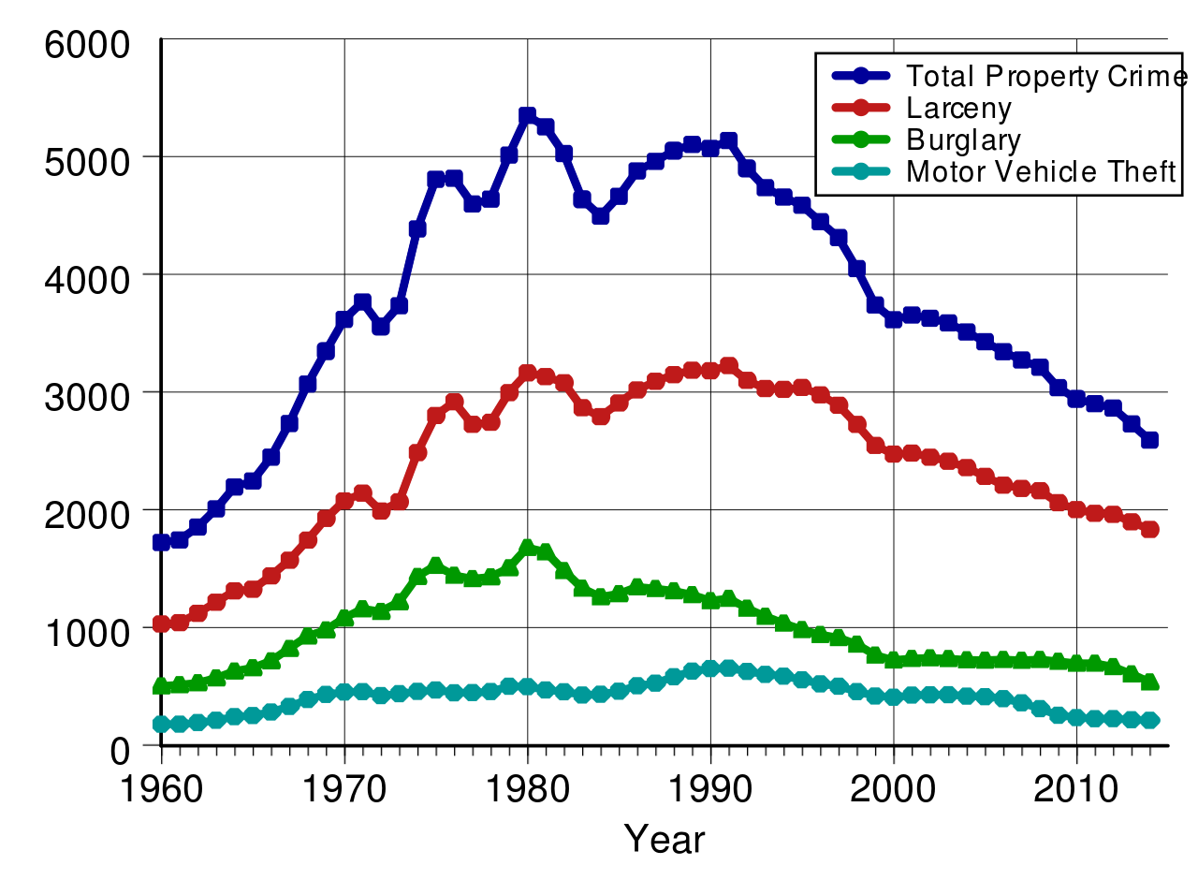
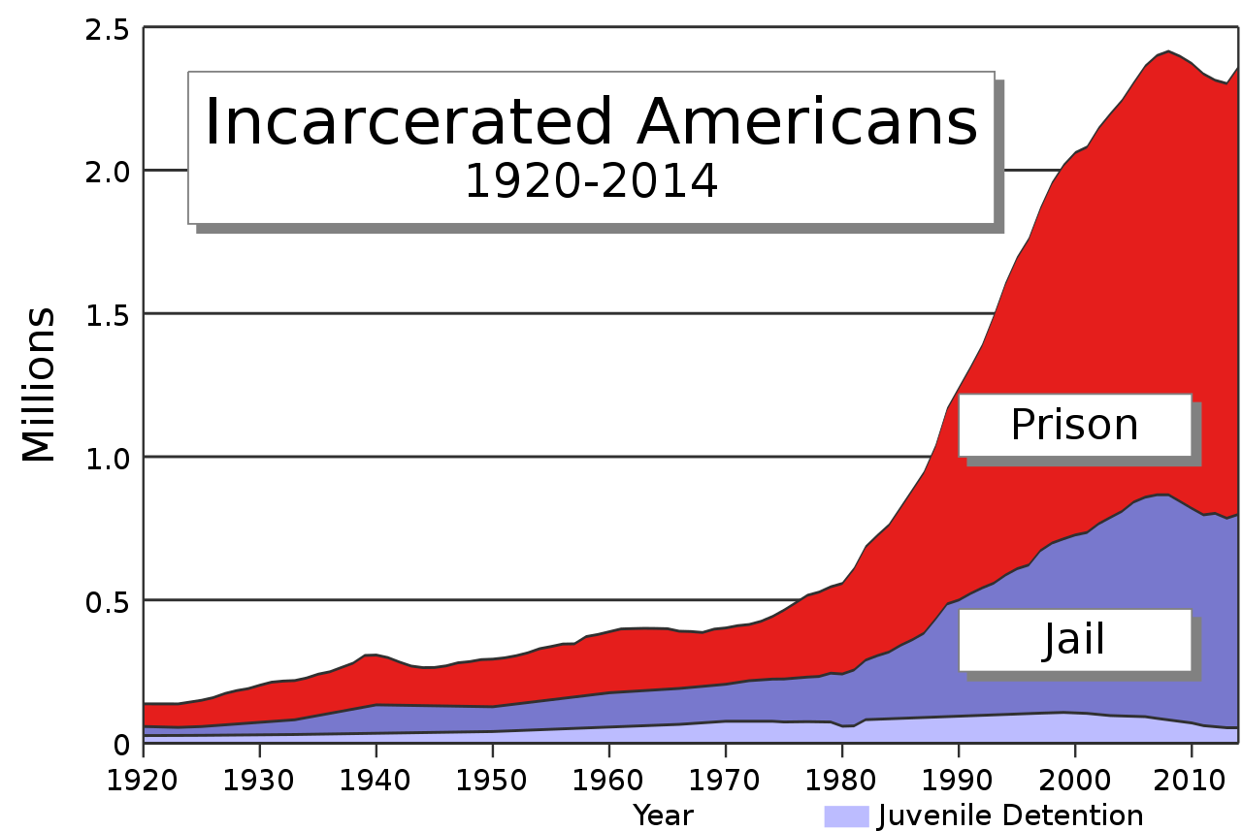
Development

Slide 4
Factors for development
Lead-crime hypothesis: lead poisoning = crime
More law enforcement of the years
Legalized abortion: less children in difficult circumstances
Changing age demographic

Slide 5
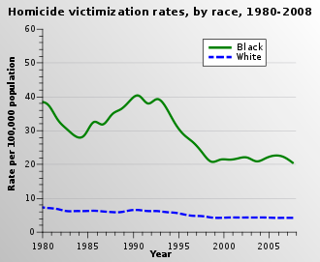
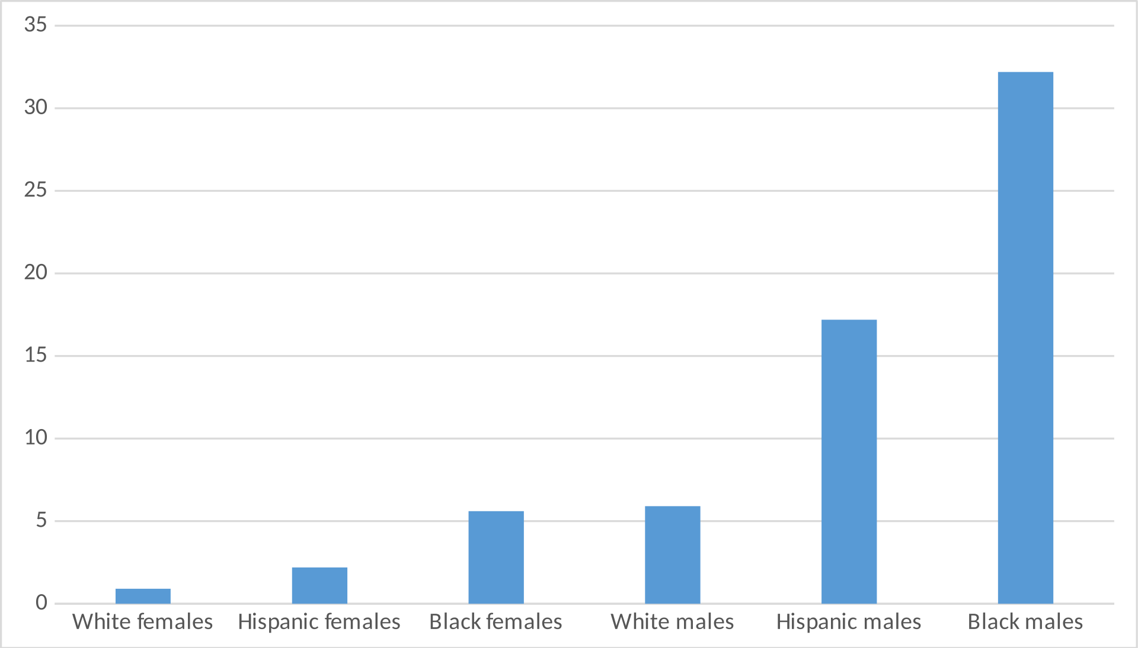
Discrimination
Women make up 89% of all rape victims while men make up 93% of all perpetrators of rape
Likeliness to be put in jail during your lifetime

Slide 6
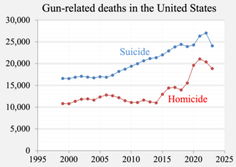
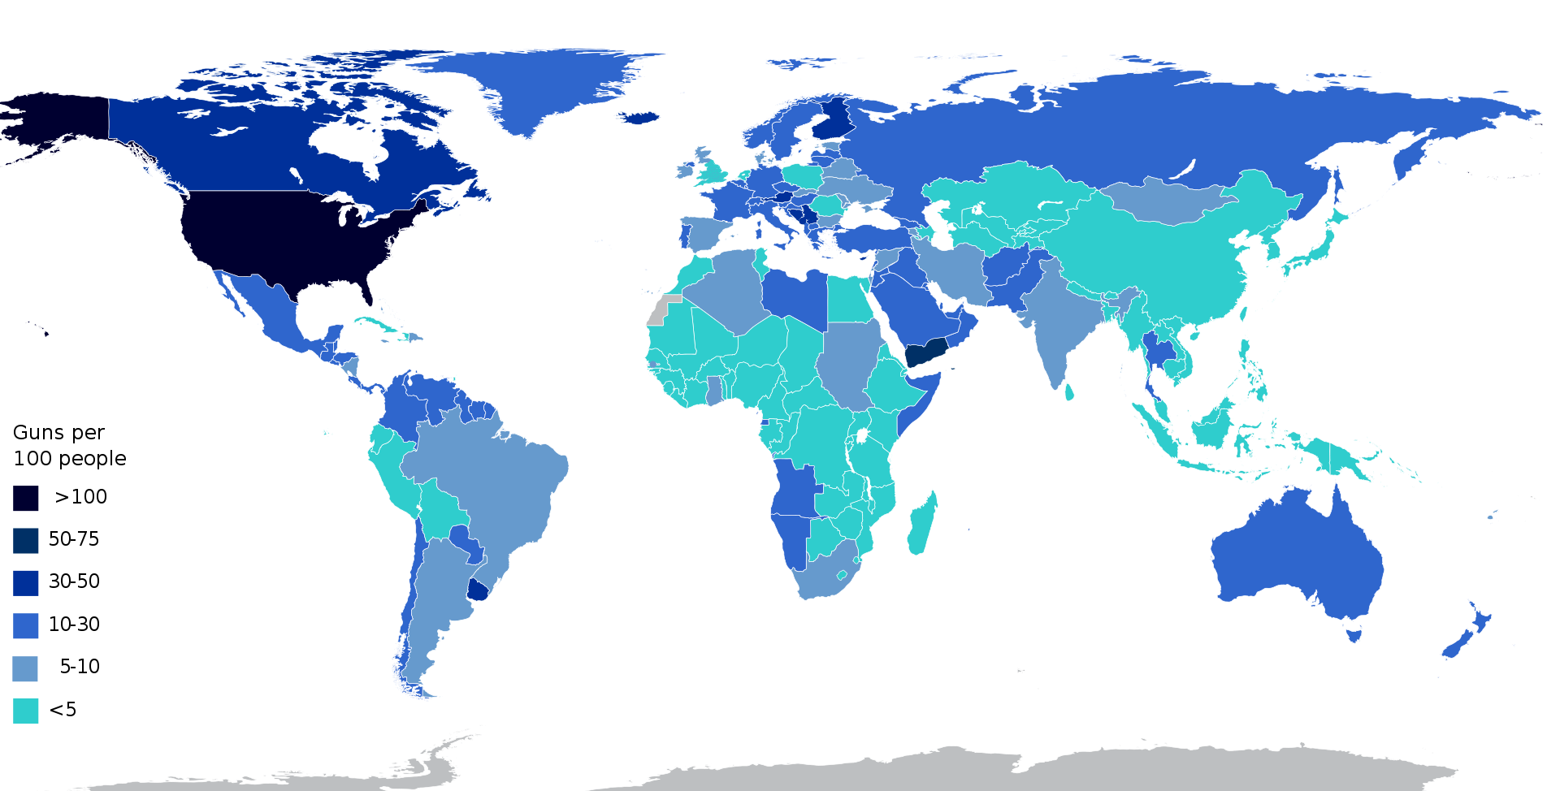
Guns
“The US accounts for 97% of all gun-related child deaths in a group of similar countries while making up only 46% of the group's population”
67.5% of all homicides are perpetrated using a firearm

Slide 7
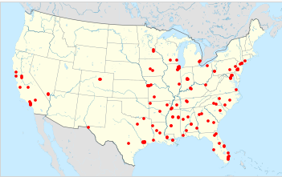
Mass shootings
Mass shootings this year

Slide 8


Slide 9
US crimes in other parts of the world
Too many
Seriously look it up

Slide 10
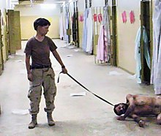
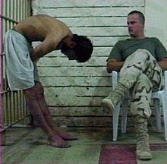
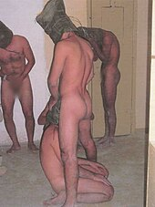
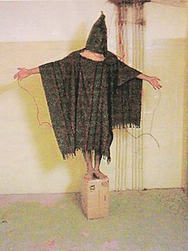
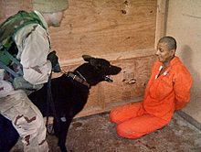

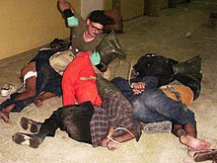
Abu Ghraib prison
Prison in Iraq used by the US military and the CIA to detain, abuse, torture and murder of detainees

Slide 11

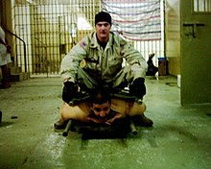
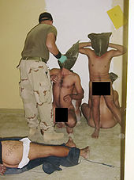

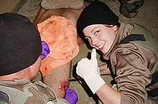
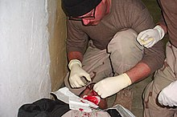
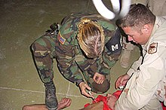
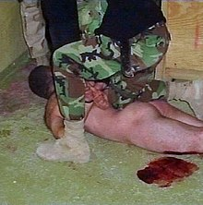
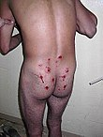

Slide 12
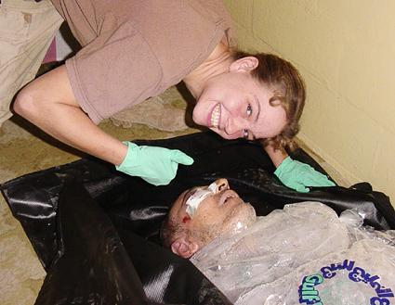



Slide 13
Persecution of the offenders?
Sabrina Harman: 6 months
Charles Graner: 10 years
Megan Ambuhl: dishonorable discharge
Ivan Frederick: 8 years
Lynndie England: 3 years

Slide 14
Foreign interventions by the US
400 since 1776
200 since 1950
100 since 1975
Most prominent wars: Vietnam, Iraq, Afghanistan

Slide 15
Total death toll: > 12 million people

Slide 16
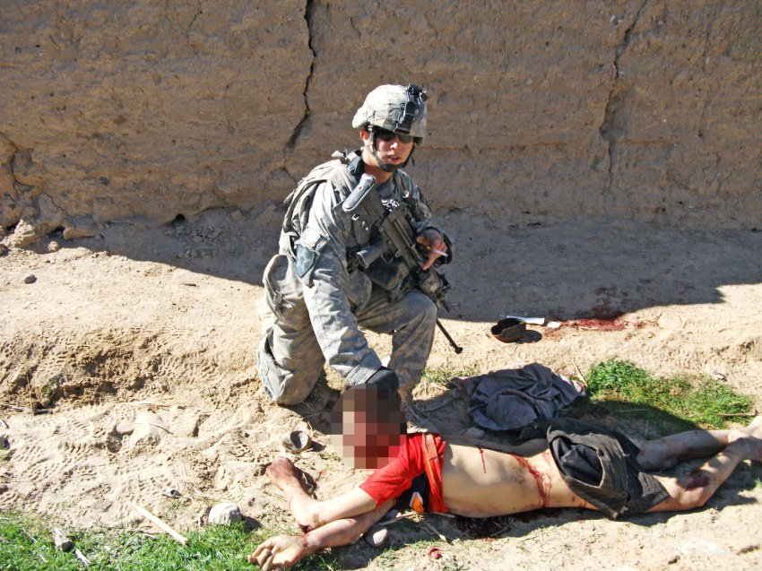
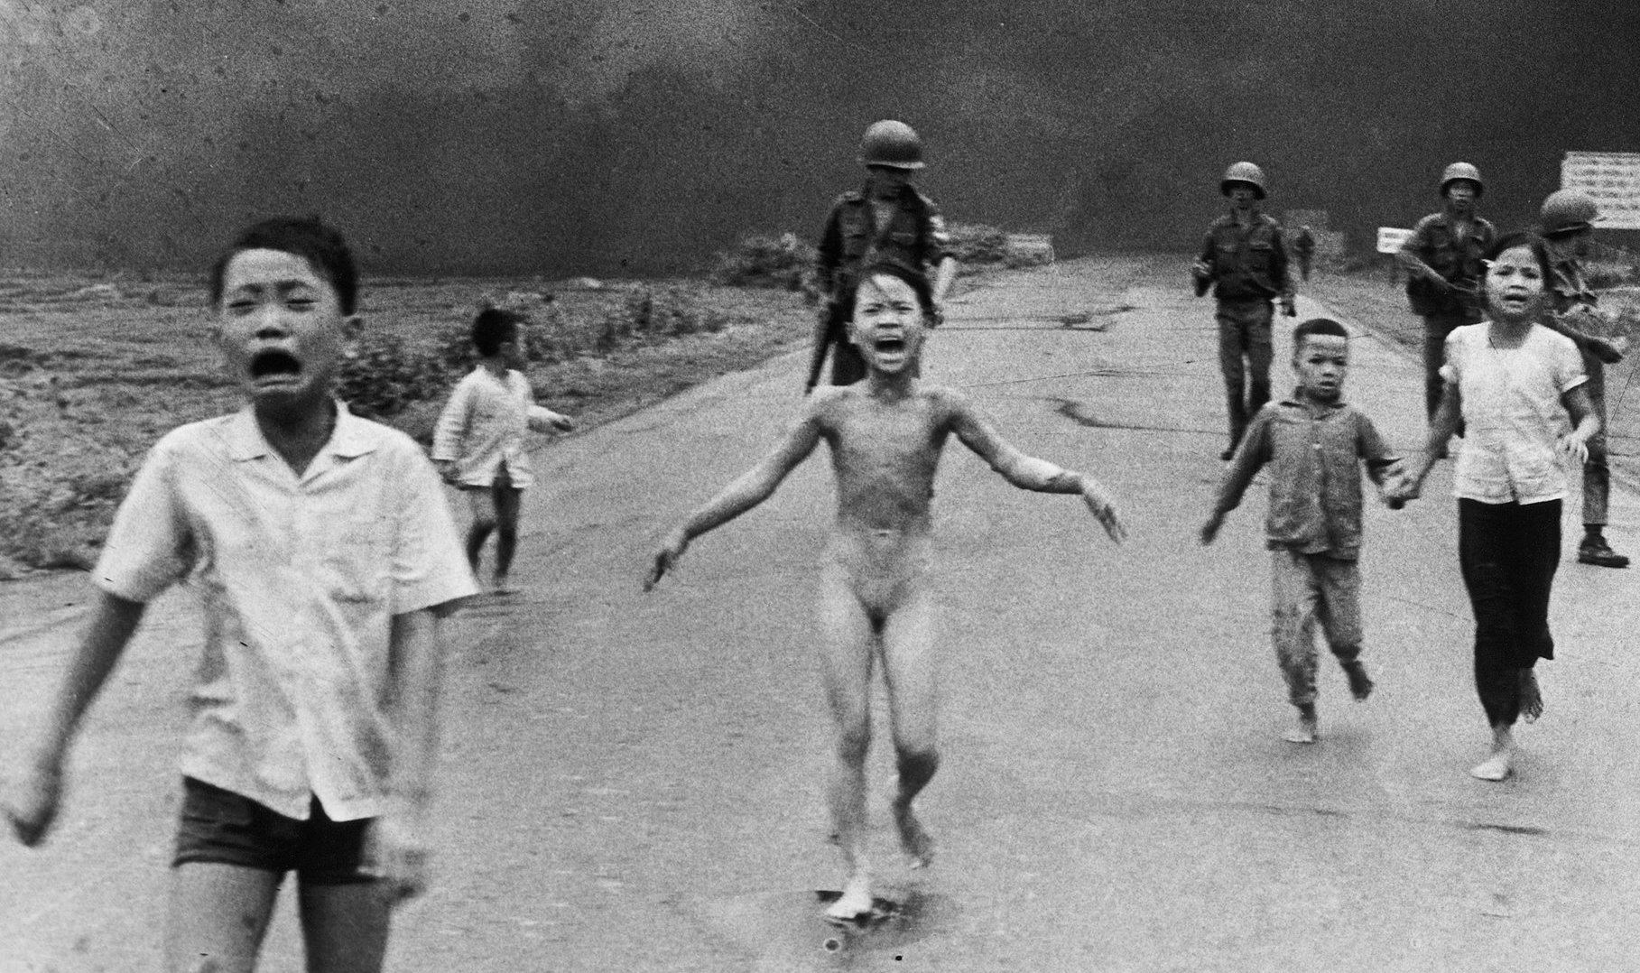
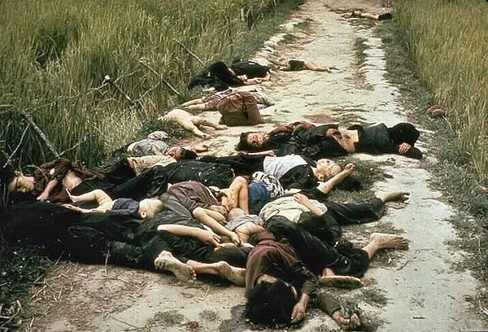

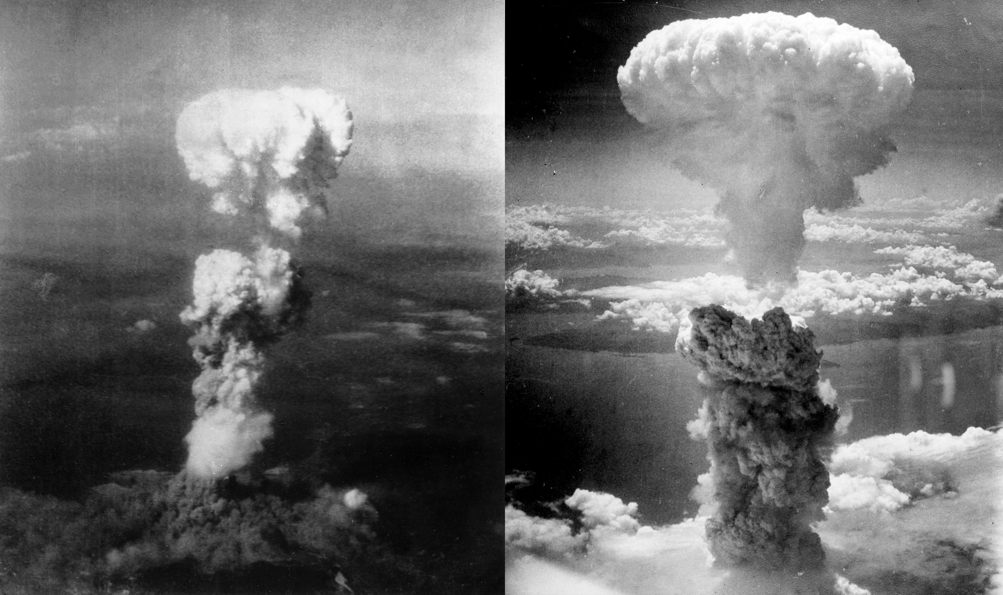
Some other “incidents”

Slide 17
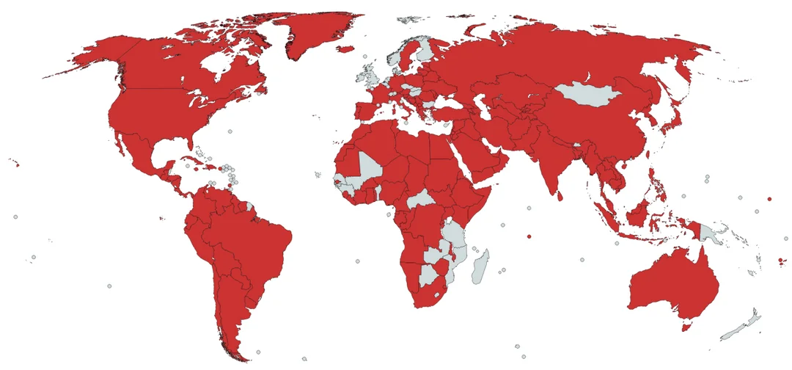
Map of Every Country that the USA has invaded, bombed, couped, supported dictators,
supported terrorists and/or interfered in elections since 1900.

