Slide 1
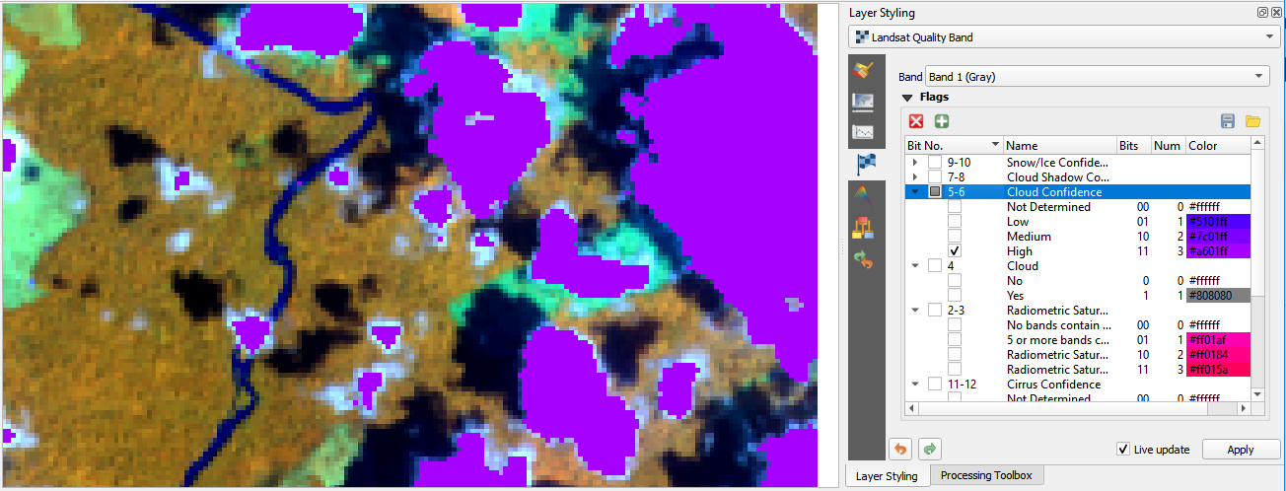
1. Select Bit Flag Renderer Panel
2. Add Bit Flag Parameters
3. Set bit range
(double click)
4. Set visibility, name and color (double click)

