Slide 1
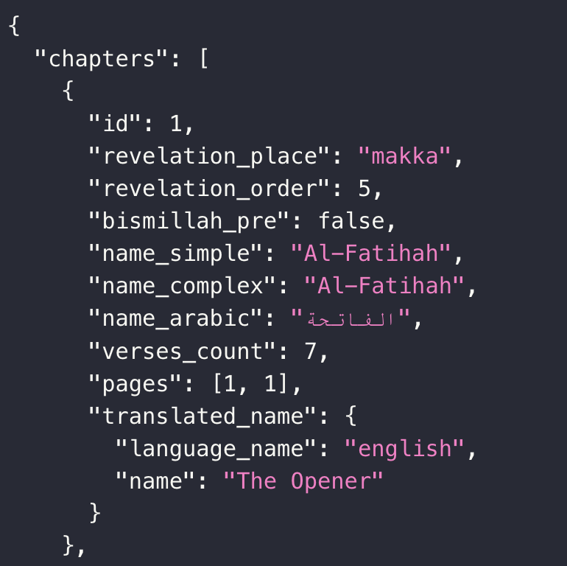
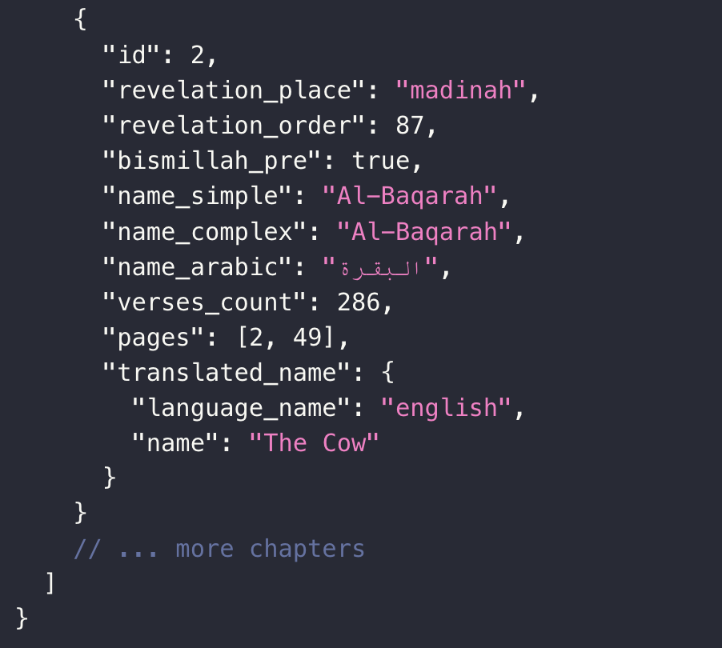

Slide 2



Al-Qur’an
Select a Surah to begin reading
Hover to list down chapters
Desktop
View

Slide 3
Select a Surah to begin reading
Mobile
View
Tap to list down chapters

Slide 4
Al-Qur’an
Al-Fatihah
الفاتحة
7 Verses
Desktop
View

Slide 5
Al-Fatihah
الفاتحة
7
Mobile
View

Slide 6
Al-Qur’an
Al-Fatihah الفاتحة
Al-Baqarah البقرة
Desktop
View

Slide 7
Al-Fatihah الفاتحة
Al-Baqarah البقرة
Mobile
View

Slide 8
Desktop View
Al-Fatihah
The Opener
Al-Fatihah
1
الفاتحة
7 Verses
1
الفاتحة
The Opener
7 Verses
Al-Fatihah
Al-Fatihah
The Opener
1
الفاتحة
The Opener
7 Verses
1
الفاتحة
7 Verses
Al-Fatihah
The Opener
Al-Fatihah
1
الفاتحة
7 Verses
1
الفاتحة
7 Verses
Mobile View
Al-Fatihah
The Opener
1
الفاتحة
7 Verses
Al-Fatihah الفاتحة
Al-Baqarah البقرة
The Opener
Al-Fatihah
1
الفاتحة
7 Verses
Al-Fatihah
1
الفاتحة
7 Verses

Slide 9
Verse Design: Desktop
1:1
بِسْمِ ٱللَّهِ ٱلرَّحْمَـٰنِ ٱلرَّحِيمِ
1
In the name of Allāh, the Entirely Merciful, the Especially Merciful.

Slide 10
Verse Design: Mobile
1:1
بِسْمِ ٱللَّهِ ٱلرَّحْمَـٰنِ ٱلرَّحِيمِ
1
In the name of Allāh, the Entirely Merciful, the Especially Merciful.

Slide 11
Night Sky
Heaven Light
Toggle Translation
Off
On
Font Size
A
A

Slide 12
Night Sky
Heaven Light
Night Sky
Heaven Light
Toggle Translation
Off
On
Toggle Translation
Off
On
Font Size
Font Size
A
A
A
A

Slide 13
Al-Qur’an
Al-Fatihah
الفاتحة
7 Verses
Al-Fatihah
الفاتحة
7
Stop Button

Slide 14
Al-Qur’an
Al-Fatihah
الفاتحة
7 Verses
Al-Fatihah
الفاتحة
7
1
2
3
4
5
6
7
Verse Dropdown

Slide 15
Surah Info Modal Design
Surah Name
Surah Name Arabic
X
Place of reveal
Number of verses
Title
Use regex to filter the text
<h2>Name</h2><p>This Surah is named Al-Fatihah because of its subject matter. Fatihah is that which opens a subject or a book or any other thing. In other words, Al-Fatihah is a sort of preface.</p><h2>Period of Revelation</h2><p>Surah Al-Fatihah is one of the very earliest Revelations to the Holy Prophet. As a matter of fact, we learn from authentic traditions that it was the first complete Surah that was revealed to Muhammad (Allah's peace be upon him). Before this, only a few miscellaneous verses were revealed which form parts of Alaq, Muzzammil, Muddaththir, etc.</p><h2>Theme</h2><p>This Surah is in fact a prayer that Allah has taught to all those who want to make a study of His book. It has been placed at the very beginning of the Quran to teach this lesson to the reader: if you sincerely want to benefit from the Quran, you should offer this prayer to the Lord of the Universe.</p><p>This preface is meant to create a strong desire in the heart of the reader to seek guidance from the Lord of the Universe Who alone can grant it. </p>
Source: Sayyid Abul Ala Maududi - Tafhim al-Qur'an - The Meaning of the Quran

Slide 16

Transparent Cursor
- Designed in MS PowerPoint

