Slide 1
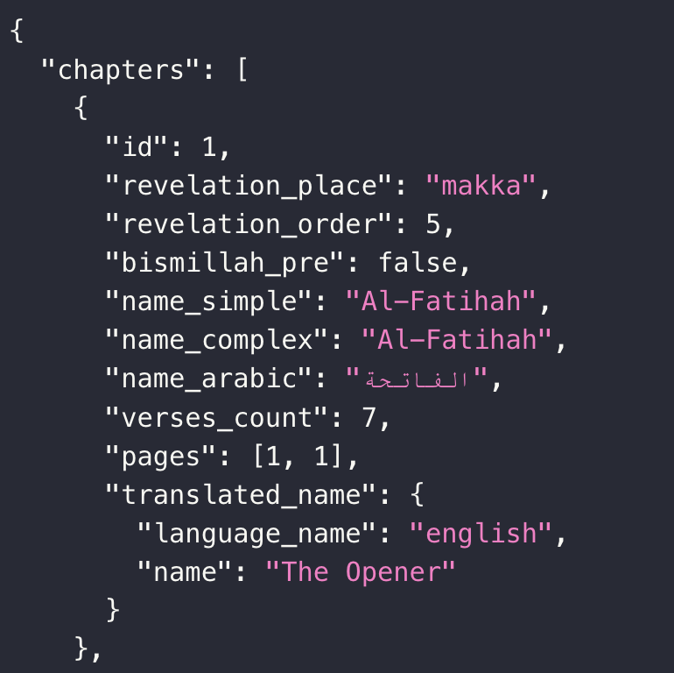
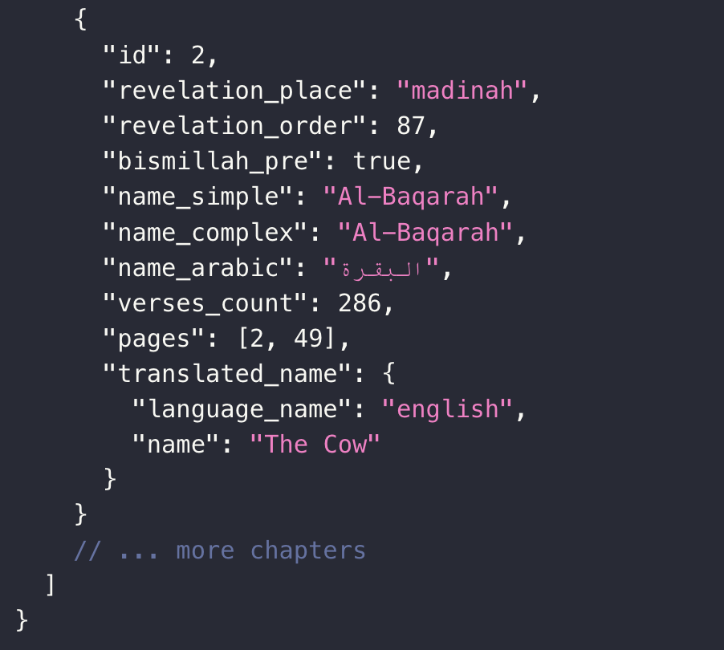

Slide 2



Al-Qur’an
Select a Surah to begin reading
Hover to list down chapters
Desktop
View

Slide 3
Select a Surah to begin reading
Mobile
View
Tap to list down chapters

Slide 4
Al-Qur’an
Al-Fatihah
الفاتحة
7 Verses
Desktop
View

Slide 5
Al-Fatihah
الفاتحة
7
Mobile
View

Slide 6
Al-Qur’an
Al-Fatihah الفاتحة
Al-Baqarah البقرة
Desktop
View

Slide 7
Al-Fatihah الفاتحة
Al-Baqarah البقرة
Mobile
View

Slide 8
Desktop View
Al-Fatihah
The Opener
Al-Fatihah
1
الفاتحة
7 Verses
1
الفاتحة
The Opener
7 Verses
Al-Fatihah
Al-Fatihah
The Opener
1
الفاتحة
The Opener
7 Verses
1
الفاتحة
7 Verses
Al-Fatihah
The Opener
Al-Fatihah
1
الفاتحة
7 Verses
1
الفاتحة
7 Verses
Mobile View
Al-Fatihah
The Opener
1
الفاتحة
7 Verses
Al-Fatihah الفاتحة
Al-Baqarah البقرة
The Opener
Al-Fatihah
1
الفاتحة
7 Verses
Al-Fatihah
1
الفاتحة
7 Verses

Slide 9
Verse Design: Desktop
1:1
بِسْمِ ٱللَّهِ ٱلرَّحْمَـٰنِ ٱلرَّحِيمِ
1
In the name of Allāh, the Entirely Merciful, the Especially Merciful.

Slide 10
Verse Design: Mobile
1:1
بِسْمِ ٱللَّهِ ٱلرَّحْمَـٰنِ ٱلرَّحِيمِ
1
In the name of Allāh, the Entirely Merciful, the Especially Merciful.

Slide 11
Night Sky
Heaven Light
Toggle Translation
Off
On
Font Size
A
A

Slide 12
Night Sky
Heaven Light
Night Sky
Heaven Light
Toggle Translation
Off
On
Toggle Translation
Off
On
Font Size
Font Size
A
A
A
A

Slide 13
Al-Qur’an
Al-Fatihah
الفاتحة
7 Verses
Al-Fatihah
الفاتحة
7
Stop Button

Slide 14
Al-Qur’an
Al-Fatihah
الفاتحة
Al-Fatihah
الفاتحة
7
1
2
3
4
5
6
7
Verse Dropdown

Slide 15

Mouse Pointer
-transparent

