Slide 1
Green University of Bangladesh
Department of Computer Science & Engineering
Subject: Computer Computer Architecture Course Code: CSE-211
Presentation topic : Arithmetic Microoperations
Submitted To:
Name : Syed Ahsanul Kabir
Designation : Associate Professor
Department : CSE
Green university of Bangladesh
Submitted by:
Name :Jakirul Islam
ID :193002101
Section :DB (193)
Department : CSE

Slide 2
Outline
Definition of Microoperation
Typical Arithmetic Microoperations
4 - bit Binary Adder Addition
4 – bit Binary Adder Subtractor
4 - bit Binary Adder Incrementor

Slide 3
Definition of Microoperation
The basic arithmetic micro operations are:-
Addition
Subtraction
Increment
Decrement

Slide 4

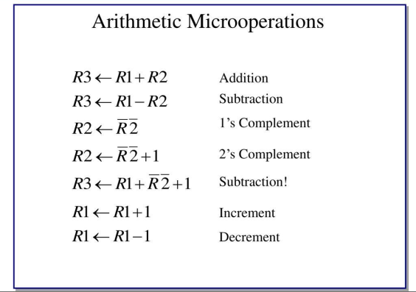

Slide 5
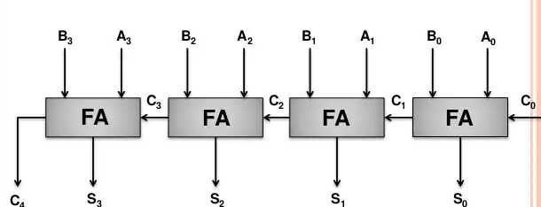
MICROOPERATION
Addition:
The arithmetic add micro operation is given by the statement.
R3 R1+ R2
Figure:2.1 4 - bit Binary Adder

Slide 6
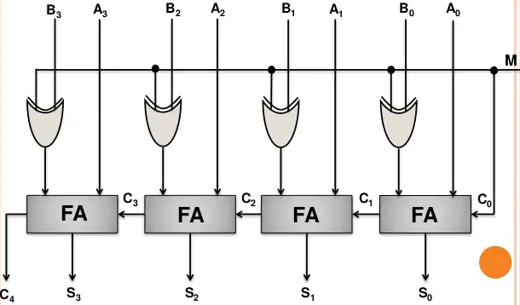
MICROOPERATION
Subtractor:
The subtract operation is specified by the following statement R3 R1 + R2ʹ + 1
Figure: 2.2 4 – bit Adder - Subtractor

Slide 7
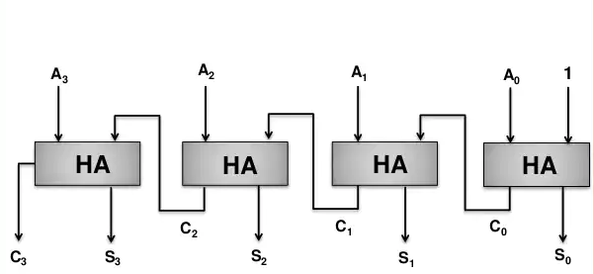
MICROOPERATION
Increment:
The increment micro operation is given by the statement
R1 R1 + 1
Figure:2.3 4 - bit Binary Incrementer

Slide 8
Thank you

