Slide 1
CourseListPlus Coding Standards
By Abdi Hassan

Slide 2
Topics
Why
Javadoc
Strings and hardcoding
Readability
General Tips

Slide 3
Why
Don’t want to redo work
Don’t want to waste developer time
Don’t want to stay up late nights
Do want to understand one another’s code
Do want good API documentation
Do want to meet our deadlines
Do want to turn FAANG into FAANGC (for CourseListPlus)

Slide 4
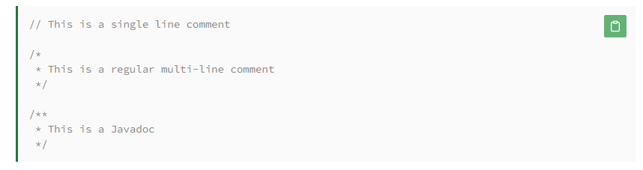
Javadoc
Javadoc comments may be placed above any class, method, or field which we want to document. Two parts: Description (what does it do) and block tags (@author, @param, etc.)
Source: https://www.baeldung.com/javadoc

Slide 5

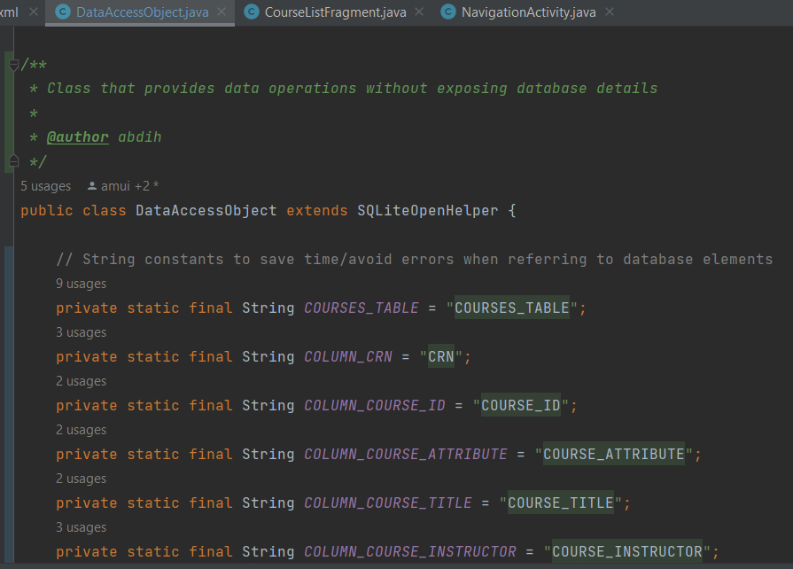
Javadoc cont.
Javadoc = classes and methods
Comment = everything else

Slide 6

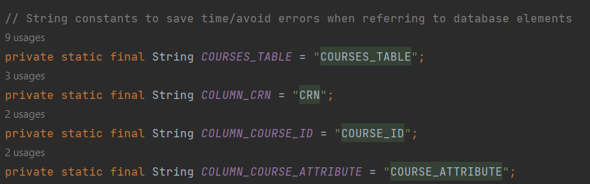
Strings & Hardcoding
Central takeaway = Keep future you in mind
Constants =👍 hardcoded strings =👎
Use a string resource for xml

Slide 7
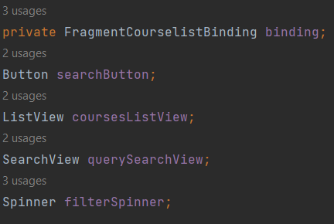
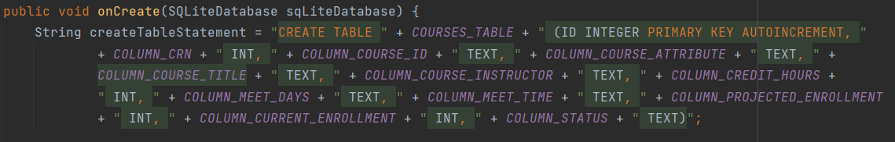
Readability
Central takeaway = you can != you should
Mnemonic variable names > esoteric variable names
Lower camel case
Except constants which are all caps + snake case
Upper = class names
Lower = method, variable and parameter names
Line break if > ~100 characters

Slide 8
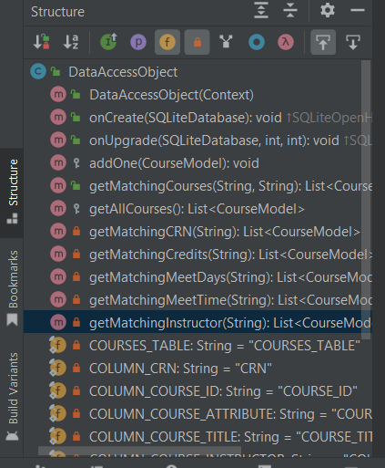
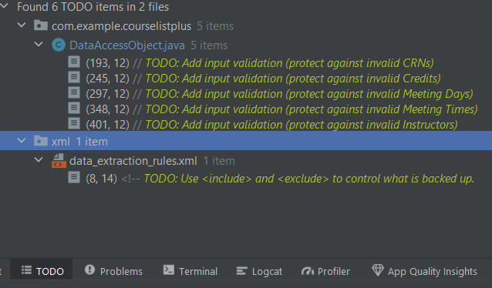
General Tips
Use the TODO tab in Android Studio
@ someone when you leave a TODO if possible
Use structure panel in android studio
Remember Software Dev rules and best practices (e.g. give use most restrictive access specifiers possible to still get the job done)

