Slide 1
CourseListPlus Git Standards
By Abdi Hassan

Slide 2
Topics
Why
Work in progress workflow
What is a branch?
Making code changes
Work complete workflow
Preparing changes for submission
What is a merge request?

Slide 3
Why
Don’t want to redo work
Don’t want to waste developer time
Don’t want to block, overwrite, or conflict with one another
Do want a low stakes area to experiment and rollback if things don’t work
Do want to have one central repository
Do want version control (releases, track commits/evolution of solution)

Slide 4

Work in progress workflow
Ready to add a feature, improve something, fix a bug, etc.? Create your own branch and switch to it!
A branch represents an independent line of development.
Branches allow you to develop features, fix bugs, or safely experiment with new ideas in a contained area of your repository
When you want to start a new feature, you create a new branch and switch to it with one command: off main using “git checkout -b [nameOfNewBranch]”
NOTE: If you want to just create a new branch, but not switch to it, use “git branch [nameOfNewBranch]” Read more here
Tip: If you’re ever unsure, use the command “git branch” to check what branch you’re in!

Slide 5
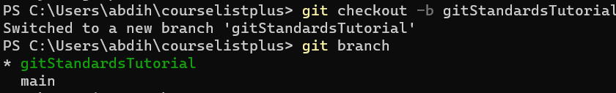
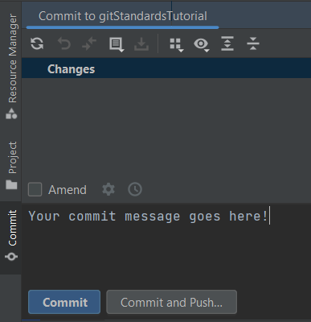
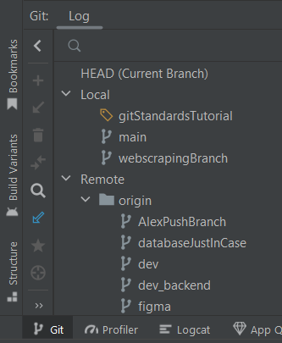
Examples
How it looks in Android Studio
How it looks in Android Studio
Use the git tab in Android Studio
Use the git tab in Android Studio

Slide 6
Work complete workflow
Done with your feature, improvement, bug fix, etc.? Run through this checklist before creating a merge request!
Abides by style guide and courselistplus coding standards?
Removed unused imports and added all needed ones (ctrl + alt + o will do this automatically for you on a file)?
Passes tests?
Logs, print statements, and commented out code removed?
Runs on your machine and is demonstrably working?

Slide 7
Work complete workflow cont.
Passed the checklist? Push your changes
Commands:
use “git branch” to ensure you are in the correct branch to commit/push to!
“git add .” to add all changed files to this commit
“git commit -m ‘[commit message goes here]’” to commit
Now git push (or git push --set-upstream origin [nameOfTheBranch] if you get the following error)
fatal: The current branch [nameOfTheBranch] has no upstream branch.

Slide 8
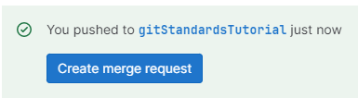
Work complete workflow cont.
Pushed your changes successfully (check gitlab)? Create a merge request!
A merge request is simply a request from a user to merge their code from one branch to another, typically to the master branch
Gitlab should now have a “Create merge request” button, click it and
Set a title for your merge request
A description of the changes you’ve made (think of your commit message but a little more detailed)
Set assignee and reviewer
Set milestone
Create merge request!

