Slide 1

Topic:-
RAIN SENSING AUTOMATIC CAR WIPER
Guide:-
Y.Sharvani
Assistant Professor
Presented by:-
G.Girija(246Y1A0421)
J.Abitha(246Y1A0423)
K.Rakshitha(246Y1A0426)
K.srija(246Y1A0429)

Slide 2
Abstract:-
Rain sensing automatic car wiper is a smart system that automatically detects rainfall on the windshield and activates the wipers without driver intervention. The system uses a rain sensor to detect water droplets and sends signals to a microcontroller such as Arduino Uno, which processes the signal and controls the wiper motor. According to the intensity of rain, the system adjusts the speed of the wiper automatically. This technology improves driving safety by maintaining clear visibility during rainfall and reducing driver distraction.

Slide 3
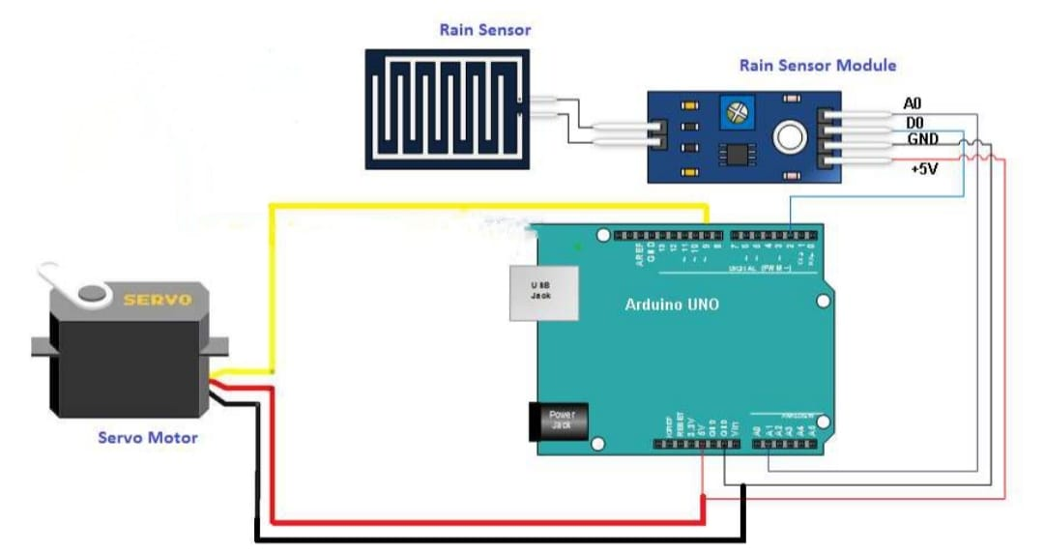
Block Diagram Flow:-

Slide 4
Working:-
The rain sensor detects water droplets on its surface.
It converts rainfall into an electrical signal.
The microcontroller reads this sensor signal.
It compares the value with preset thresholds.
Light rain triggers slow wiper speed.
Moderate rain triggers medium wiper speed.
Heavy rain triggers fast wiper speed.
The microcontroller sends signals to the motor driver.
- The motor driver powers the wiper motor accordingly.
Wiper blades move automatically, adjusting speed with rain intensity.

Slide 5
Components Used:-
Rain SensorModule
Arduino Uno
L298N Motor Driver Module
DC Motor (Wiper Motor)
Jumper Wires
Power Supply
Wiper Mechanism

Slide 6
Advantages:-
Improves driving safety
Automatic operation
Reduces driver distraction
Adjusts wiper
speed according to rain intensity
Saves time and effort

Slide 7
Applications:-
Modern automobiles and smart vehicles
Automatic windshield cleaning systems
Advanced driver assistance systems (ADAS)
Smart transportation systems

Slide 8
Conclusion:-
The rain sensing automatic car wiper system provides an efficient solution for maintaining windshield visibility during rainfall. By automatically detecting rain and controlling the wiper speed, the system enhances driver comfort and safety. This technology is widely used in modern vehicles and represents an important step toward intelligent automotive systems.

