Slide 1
Php final project
Mr.Jakkapat Chaikaeo
No.6108111001

Slide 2
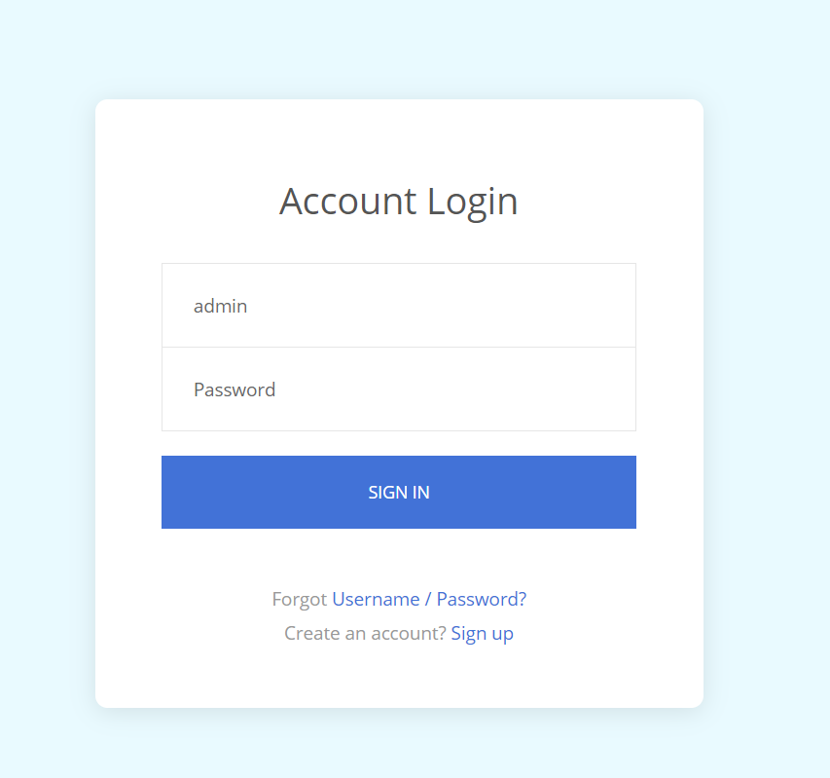
Login page

Slide 3
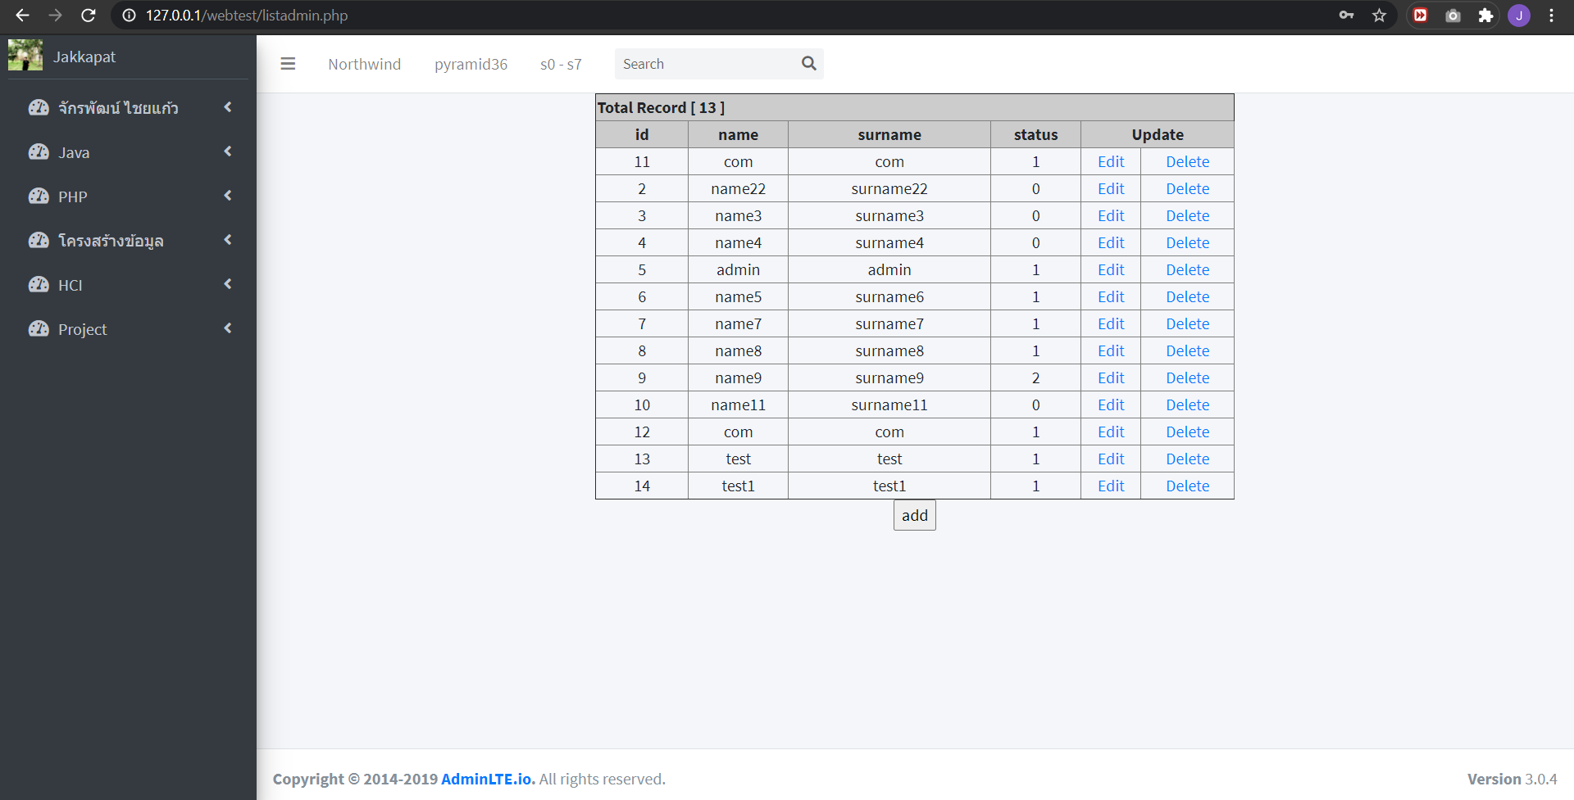
Admin page

Slide 4
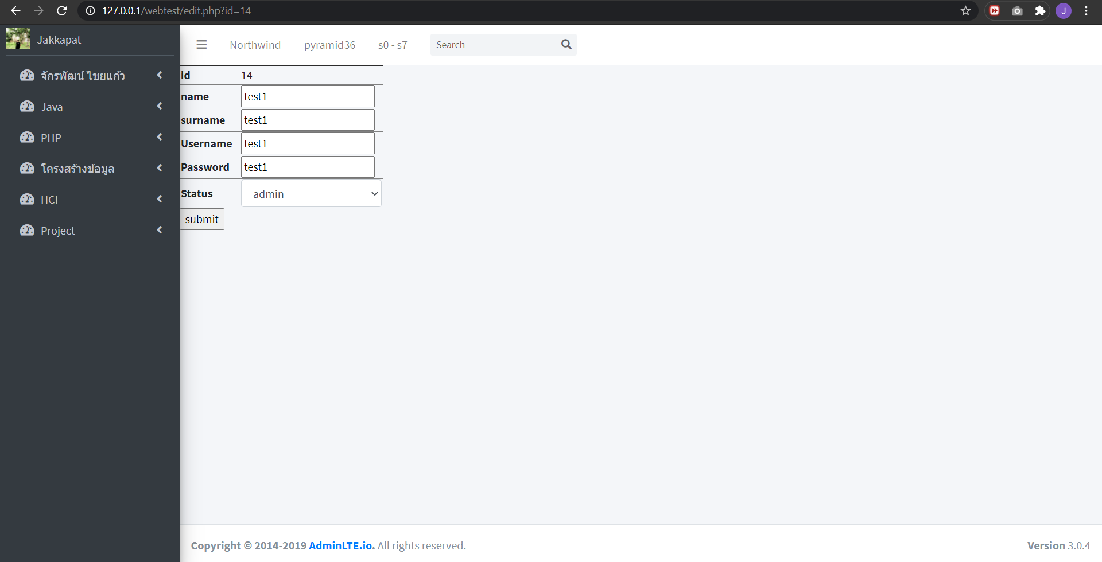
edit

Slide 5

delete

Slide 6
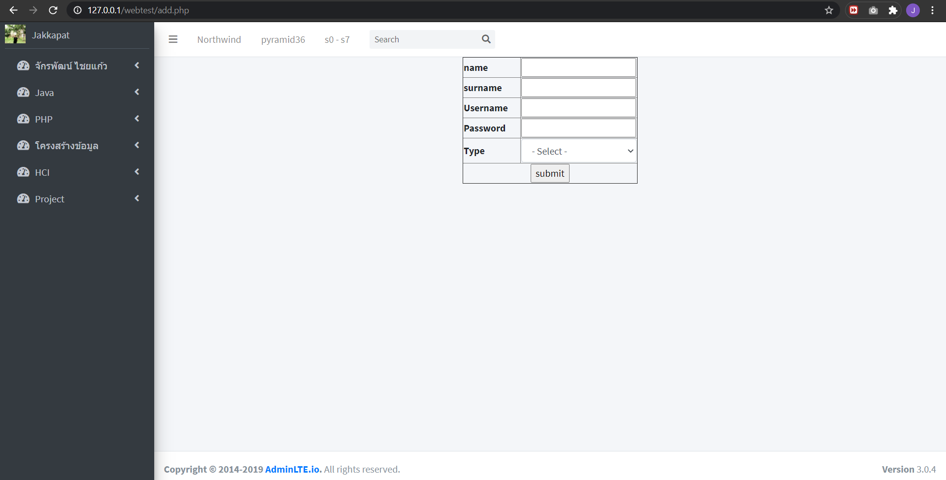
add

Slide 7
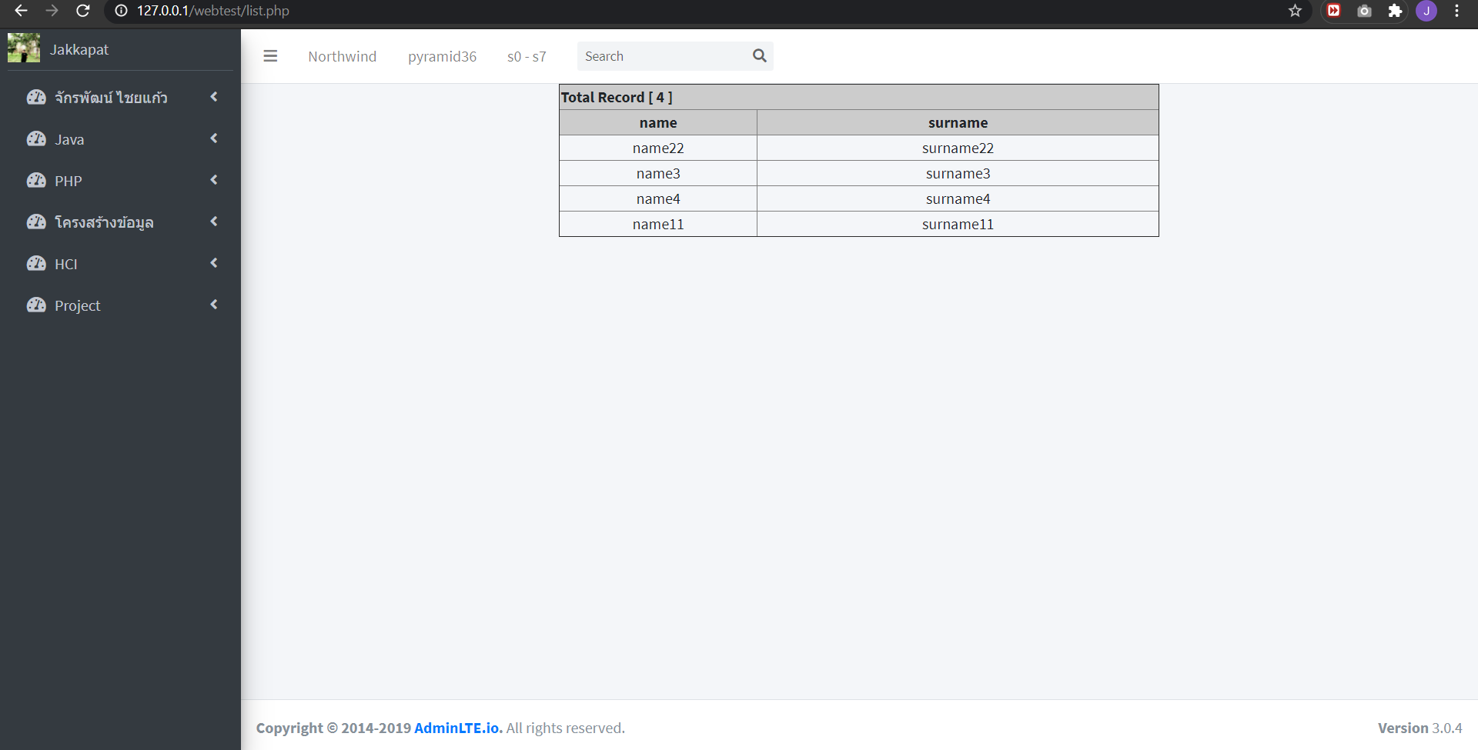
User page

Slide 8
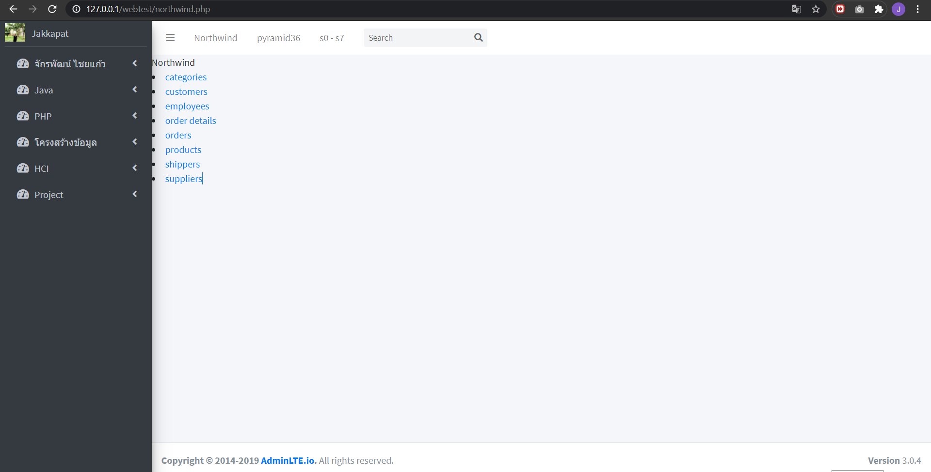
Nortwind

Slide 9
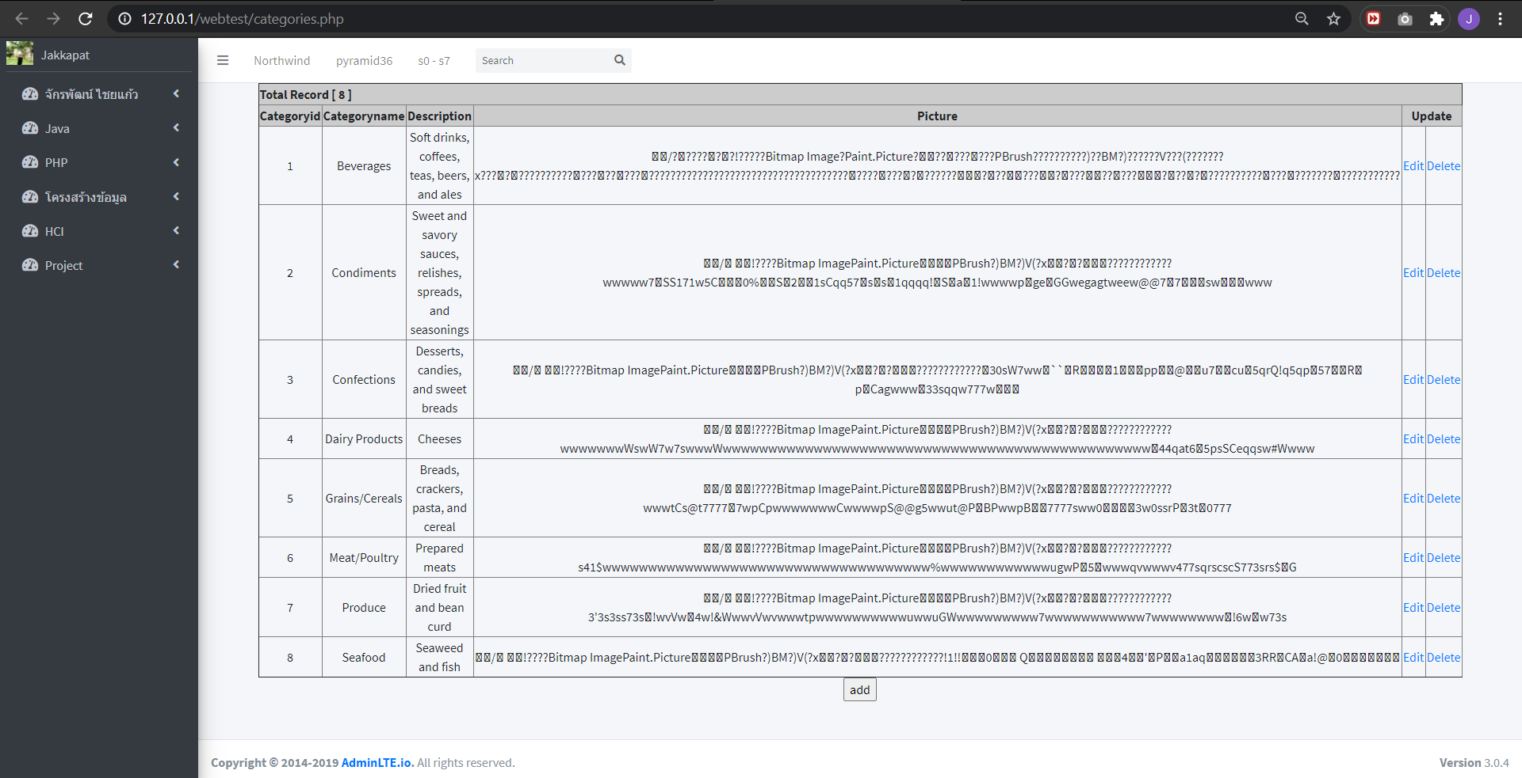
Ex.Northwind

Slide 10
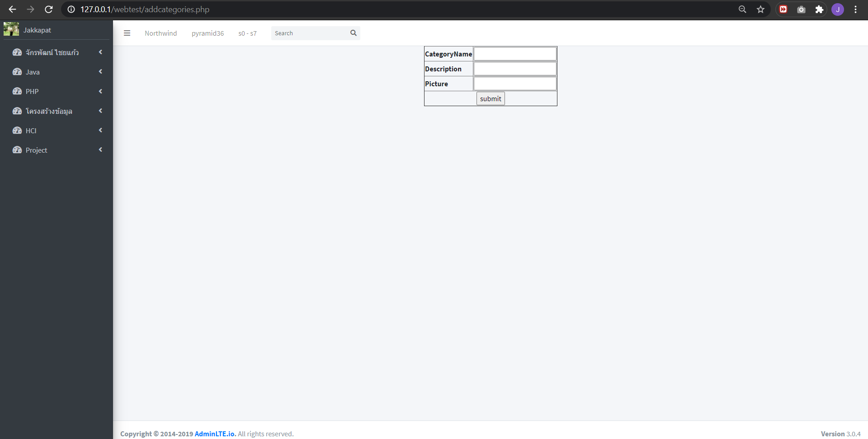
Ex.Northwind

Slide 11
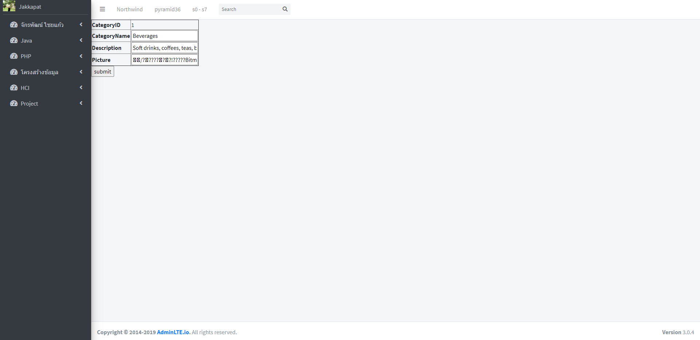
Ex.Northwind

Slide 12
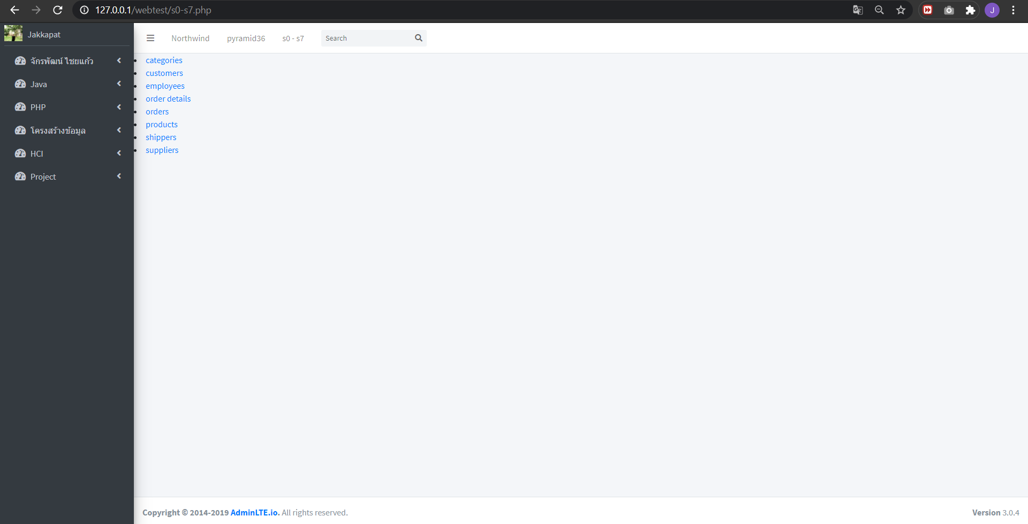
S0-s7

Slide 13
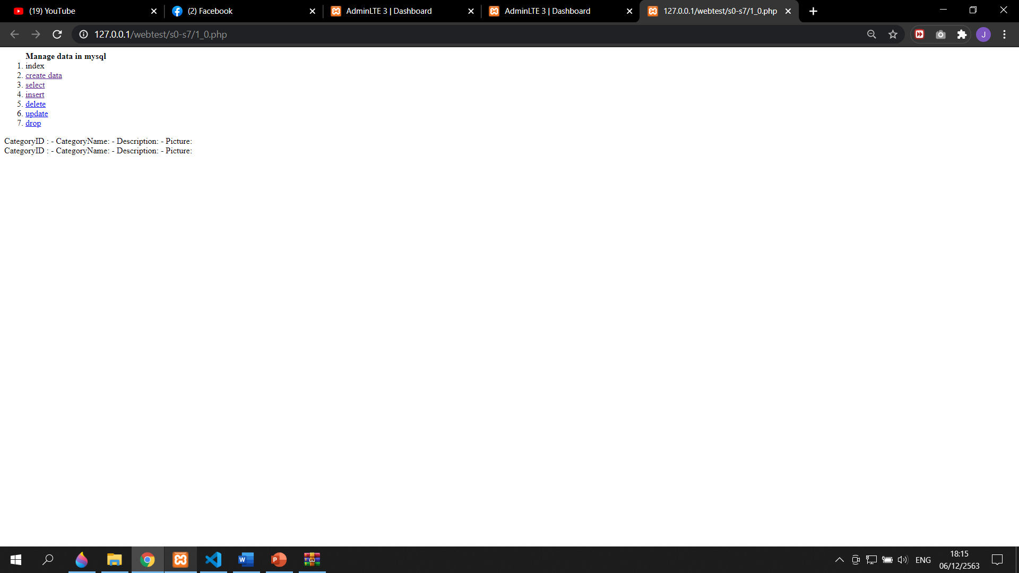
Ex.s0-s7

Slide 14
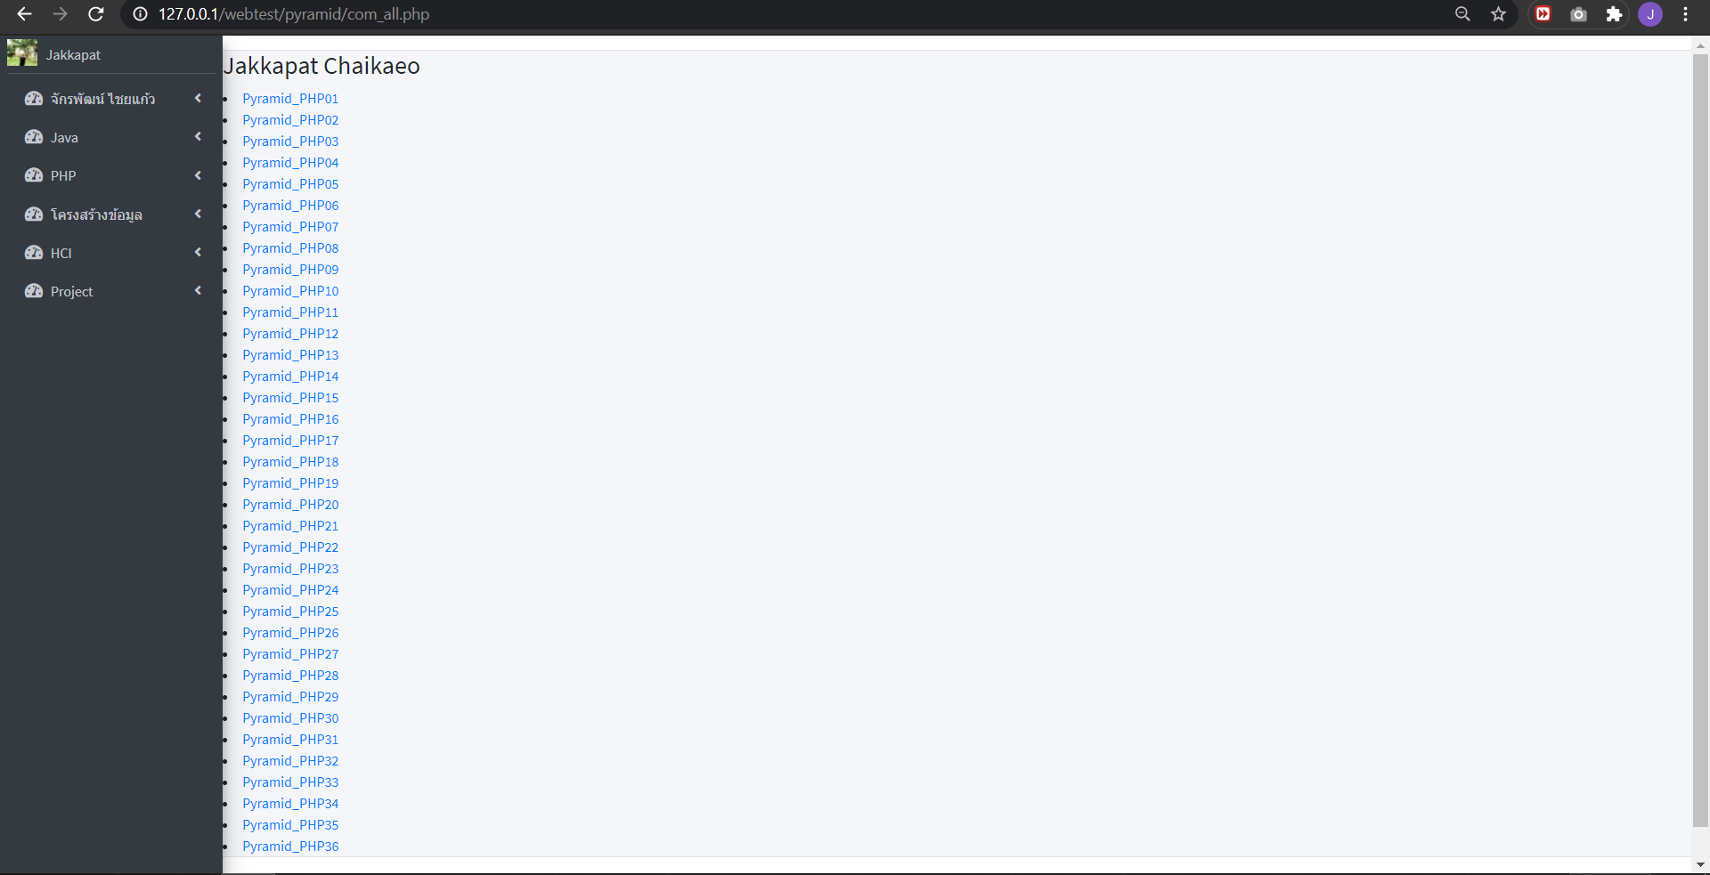
pyramid

Slide 15
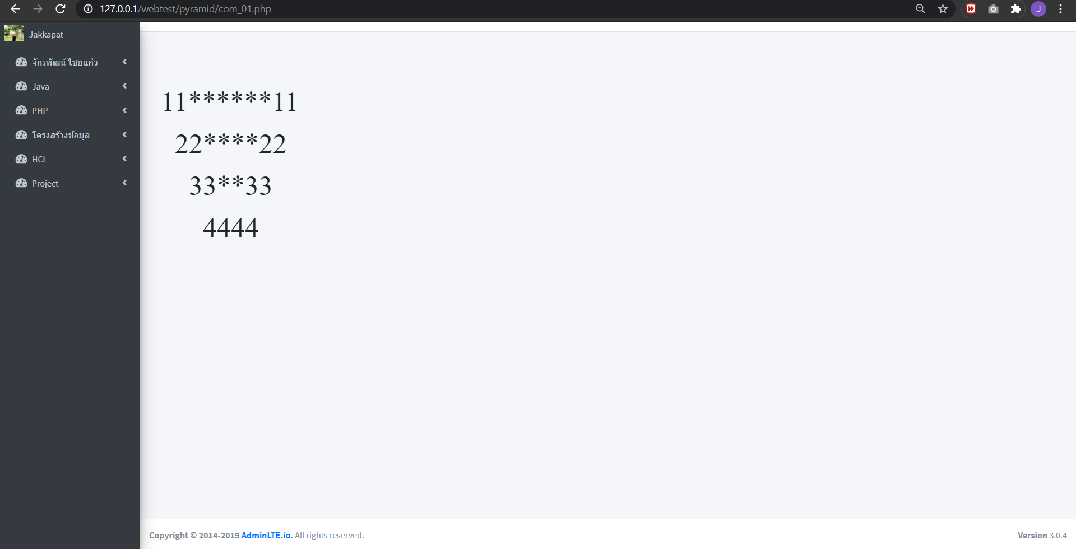
Ex.pyramid

