Slide 1
Lecture 2
Process and Process APIs

Slide 2
Previously …
What’s OS?
Learning in 3 modules: Virtualization, Concurrency, and Persistence
Virtualization
  Processor (2) and memory (3) virtualization
Concurrency
  Concurrency (4) of the many resource virtualizations
Persistence
  I/O device (2)

Slide 3
From Program to Process
code
static data
heap
stack
CPU
Memory
Process
Create
code
static data
Disk
Program

Slide 4
What is a Process?
A Process is an entity with 4 components: Process = (P, D, C, S)
  P is a program or a piece of code that the process is associated with
  D is a processing data, defined by a set of data variables that hold user data
  C is a control state, defined by a set of control variables that indicate where to execute next
  S is a process state – ready, suspended, running, etc.
Notes:
A program has control variables and data variables
Control variables indicate where to execute next – the control variables (e.g. program counter) are not explicitly declared in user’s code
The variables together with their values define the control state of a process
Data variables are used to hold user’s data – the data variables can be explicitly or implicitly declared (stdin, stdout, stderr)
Data variables together with their values define the data state of a process
At any given time of execution, each process has a status, which can be ready, suspended, or running

Slide 5
A Process Space
A memory that the process uses to reference its instructions and data
  Code Segment containing instructions
  Data Segment containing heap data (malloc)
  Stack containing parameters, local variables, return address, etc. of functions
  Process Descriptor (keep Process Control Block) – stored in the kernel space and can only be accessed in kernel mode execution
1
2
3
4
Text (code)
Segment
Process
Descriptor
Data Segment
Stack
User space
Kernel space
Notes:
The address space of a process is a set of locations than can refer to refer to any program instruction, object or data
Each process has a kernel space that is used only by the kernel when it is doing things on behalf of a process
The Process Descriptor (sometimes called Process Control Block or PCB) is stored in the kernel space – can only be accessed in system mode
Information contained in Process Descriptor is used by the kernel to manage processes, such as process status and context (program counter, stack pointer, etc.)

Slide 6
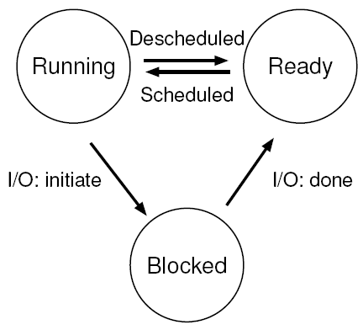
Process State
Ready: a process is ready to run
Running: a process is running on a processor
Blocked: a process has performed some operation that means it not ready to run, it is then suspended
Notes:
A process can be moved between the ready and running states at the discretion of the OS
Being moved from ready to running means the process has been scheduled
Being moved from running to ready means the process has been descheduled
Once a process has become blocked (e.g. by initiating an I/O operation), the OS will keep it as such until some event occurs (e.g. I/O completion) – at that point, the process moves to the ready state again (and potentially immediately to running again, if the OS so decides)
A process may have more than three states as shown here – it depends on the OS, e.g. initial, final, or zombie states exist in Unix

Slide 7
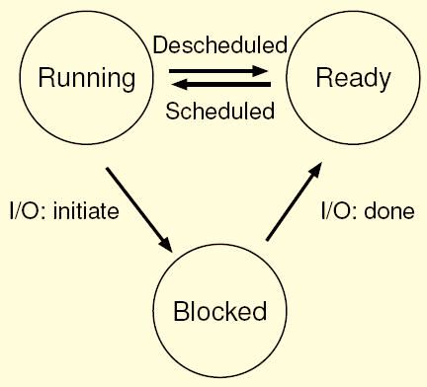
Process State – CPU only
Time | Process₀ | Process₁ | Notes
1 | Running | Ready
2 | Running | Ready
3 | Running | Ready
4 | Running | Ready | Process₀ now done
5 | – | Running
6 | – | Running
7 | – | Running
8 | – | Running | Process₁ now done
Notes:
First, imagine two processes running, each of which only uses the CPU (they do no I/O)

Slide 8
Process State – CPU and I/O
Time | Process₀ | Process₁ | Notes
1 | Running | Ready
2 | Running | Ready
3 | Running | Ready | Process₀ initiates I/O
4 | Blocked | Running | Process₀ is blocked,
5 | Blocked | Running | so Process₁ runs
6 | Blocked | Running
7 | Ready | Running | I/O done
8 | Ready | Running | Process₁ now done
9 | Running | –
10 | Running | – | Process₀ now done
Notes:
In this example, the first process issues an I/O after running for some time
At that point, the process is blocked, giving the other process a chance to run
There are many decisions the OS must make
The system decides to run Process₁ while Process₀ issues an I/O – doing so improves CPU utilization
The system decides not to switch back to Process₀ when its I/O is completed – is this a good decision or not?
These types of decisions are made by the OS Scheduler, which we will discuss in the next lecture

Slide 9
Typical Process APIs
Create: when double-click an application icon, an OS routine is invoked to create a process to run the program
Destroy: user may wish to kill a process
Wait: sometimes useful to wait for a process to stop running
Misc control: e.g. suspend or resume a process
State: get status information (how long a process has run for, what state it is in)

Slide 10
OS Data Structure
The OS is a program, and like any program, it has some key data structures that track various relevant pieces of information
The OS will
  keep process lists for all processes that are ready and running
  keep track of blocked processes – when the I/O event completes, wake up the right process
  keep track of register context (registers’ states) and save it to memory if a process is blocked
The individual structure that stores information about a process is called the Process Control Block (PCB)
Notes:
The register context will hold, for a stopped process, the contents of its register state
When a process is stopped, its register state will be saved to this memory – by restoring these registers (i.e. placing their values back into the actual physical registers), the OS can resume running the process

Slide 11
Process Control Block (PCB)
The Process Control Block stores information associated with each process:
  Process identity
  Process state
  Program counter
  CPU registers
  CPU scheduling information
  Memory-management information
  Accounting information
  I/O status information

Slide 12
Process and OS
Process is a running program, there are many and many of them running when a machine is turned on
CPU virtualization
  The OS creates an illusion that there is an infinite supply of CPUs for processes
  Multiprogramming/Time-sharing –> taking turns to use the CPU
To do this, the OS needs:
  Low-level mechanisms – a context switch (to stop/pause and start processes)
  High-level scheduling policies – algorithms for making decisions
    e.g. with many programs to run, who goes first and for how long?
  Mechanisms and policies should be separated
Notes:
The mechanism provides the answer to a how question, e.g. how does an operating system perform a context switch?
The policy provides the answer to a which question, e.g. which process should the operating system run next?
Separating the two allows one easily to change policies without having to rethink the mechanism and is thus a form of modularity

Slide 13
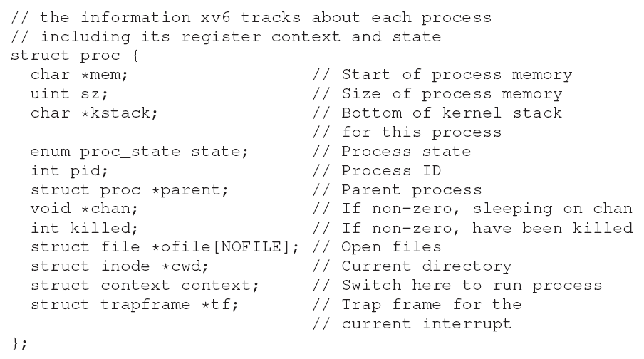
An Example of OS Data Structure
Notes:
xv6 is a simple Unix-like teaching operating system

Slide 14
MECHANISM

Slide 15
Challenges of Virtualization
Attaining performance while maintaining control is one of the central challenges in building an operating system
  Performance: how can we implement virtualization without adding excessive overhead
  Control: how can we run processes efficiently while retaining control over the CPU
Notes:
Control is particularly important to the OS, as it is in charge of resources – without it, a process could simply run forever and take over the machine, or access information that it shouldn’t be allowed to access

Slide 16
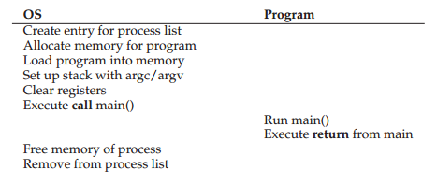
Direct Execution Mechanism
Sample Problems
If we just run a program, how can the OS make sure the program
doesn’t do things that we don’t want, while still running it
efficiently?
When a process is running, how does the operating system stop it
from running and switch to another process.
Notes:
Direct execution has the obvious advantage of being fast; the program runs natively on the hardware CPU and thus executes as quickly .

Slide 17
Suggested Mechanism
Limited Direct Execution Mechanism
  Restricted Operation
  Switch Between Processes
  Timer Interrupt

Slide 18
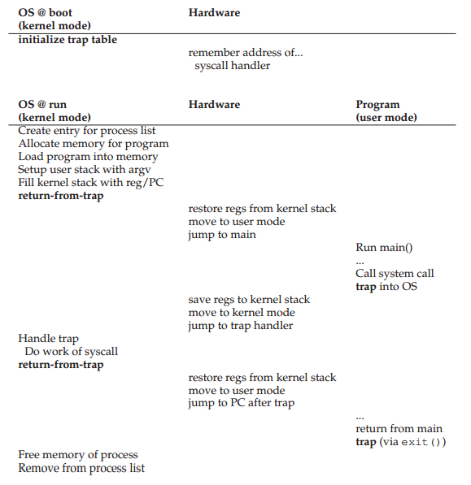
Limited Direct Execution
Notes:
One approach would simply be to let any process do whatever it wants in terms of I/O and other related operations. However, doing so would prevent the construction of many kinds of systems that are desirable. For example, if we wish to build a file system that checks permissions before granting access to a file, we can’t simply let any user process issue I/Os to the disk.
The “limited” part of the name arises from; without limits on running programs, the OS wouldn’t be in control of anything and thus would be “just a library” — a very sad state of affairs for an aspiring operating system!

Slide 19
1) Restricted Operation
Kernel mode: code that runs can do what it likes
User mode: any code that runs in user mode is restricted in what it can do. EX Can’t request I/O
EX: If a user process wants to access disk, hardware provides the ability for user programs to perform a system call.
  To execute a system call, a program must execute a special instruction to jumps into the kernel, called trap
  Raises the privilege level to kernel mode
  Perform privileged operations
  When finished, the OS calls a return-from-trap instruction to return into the calling user program and reduce the privilege level back.
Notes:
Modern architectures are interrupt driven. This means that if the CPU requests data from a disk, for example, it does not need to busy-wait until the read is over; it can issue the request and continue with some other execution. When the read is over, the CPU can be interrupted and presented with the read. For interrupts, a program called an interrupt handler is installed, and it is the interrupt handler that handles the interrupt from the disk.

Slide 20

User Mode and Kernel Mode
Mode bit provided by hardware
  Provides ability to distinguish whether system is running user code or kernel code
  Privileged instructions only executable in kernel mode
  System call changes mode to kernel, return resets it to user

Slide 21
System Call
A system call, such as fopen() or read(), looks like a typical function call in C. How does the system know it’s a system call?
  When you call fopen(), you are executing a function call into the C library.
  The library uses an agreed-upon calling convention with the kernel, which include calling the trap instruction
  Note that the parts of the C library that make system calls are hand-coded in assembly
Notes:
The function call in C needs to carefully follow convention in order to process arguments and return values correctly, as well as execute the hardware-specific trap instruction.
And now you know why you personally don’t have to write assembly code to trap into an OS; somebody has already written that assembly for you.

Slide 22
How does the trap know which code to run inside the OS ?
OS tells the hardware what code to run when certain exceptional events occur through the trap table.
For example, what code should run when a hard-disk interrupt takes place
The kernel does so by setting up a trap table at boot time
what types of horrible things could you do to a system if you could install your own trap table?
Notes:
Obviously the calling process can’t specify an address to jump to (as you would when making a procedure call); this would allow programs to jump anywhere into the kernel which clearly is a bad idea (imagine jumping into code to access a file, but just after a permission check).
The OS informs the hardware of the locations of these trap handlers, usually with some kind of special instruction. Once the hardware is informed, it remembers the location of these handlers until the machine is next rebooted, and thus the hardware knows what to do (i.e., what code to jump to) when system calls and other exceptional events take place.

Slide 23
2) The Switch Between The Processes
This switch decision is made by a part of the OS known as the scheduler.
If the decision is made to switch, the OS then executes a low-level piece of code which we refer to as the context switch.
Context switch is the step of storing and restoring the state of a process
so that execution can be resumed from the same point at a later time.

Slide 24

Saving and Restoring Context

Slide 25
Context Switch
Saving and Restoring Context
  OS saves the current context by executing some low-level assembly code to save the general purpose registers, PC, as well as the kernel stack pointer. (save PCB)
  Then restore the PCB context of the soon-to-be-executing process. New processes are chosen from a ‘ready’ queue
  When the OS executes a return-from-trap instruction, context switch is completed
Notes:
chosen by who?

Slide 26
Cooperative Level with OS
Challenge
  if a process is running on the CPU, this means the OS is not running.
  If the OS is not running, how can it do anything at all ?
How can the OS regain control of the CPU so that it can switch between processes?
  A cooperative approach: Wait for system calls
  A non-cooperative approach: The OS takes control

Slide 27
A Cooperative Approach (1)
OS trusts the users’ processes to behave reasonably
Processes that run for too long are assumed to periodically give in the CPU for the OS, so it can run some other process
There is an explicit yield system call, which does nothing except to transfer control to the OS
Most processes transfer control of the CPU to the OS quite frequently by making system calls or performing illegal instructions
– Calls to open a file
and subsequently read it
– Calls to send a message
to another machine
– Calls to create a new process
– Calls to yield CPU
– Divide by zero
– Access memory illegally
Notes:
Early versions of the Macintosh operating system did this
However, OS often have to deal with misbehaving processes, those that either through design (maliciousness) or accident (bugs) attempt to do something that they shouldn’t
In modern systems, the way the OS tries to handle such malfeasance is to simply terminate the offender

Slide 28
A Cooperative Approach (2)
In a cooperative system, the OS regains control of the CPU by waiting for a system call or an illegal operation of some kind to take place
What happens, if a process ends up in an infinite loop (buggy), and never makes a system call?
What can the OS do?
  Nothing really, must reboot the machine

Slide 29
A Non-cooperative Approach
A timer interrupt can be used (a timer device, programmed to raise an interrupt periodically)
When the interrupt is raised:
  the currently running process is halted
  a preconfigured interrupt handler in the OS runs
  OS has regained control of the CPU, and can do what it pleases, e.g. stop the current process
Note that
  Hardware must save enough states of the running program
  A subsequent return-from-trap instruction should be able to resume
  Similar to explicit system-call trap
Notes:
Just like system call handler, the OS must inform the hardware of which code to run when the timer interrupt occurs
At boot time, the OS does exactly that
Then, during the boot sequence, the OS must start the timer, which is of course a privileged operation – once the timer has begun, the OS can thus feel safe in that control will eventually be returned to it
Note that the hardware has some responsibility when an interrupt occurs, in particular to save enough of the state of the program that was running when the interrupt occurred such that a subsequent return-from-trap instruction will be able to resume

Slide 30
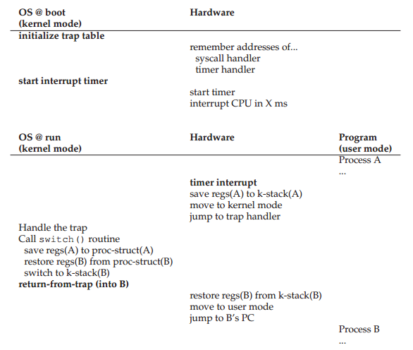
(3) Timer Interrupt

Slide 31
Heart of LDE Mechanism
  Restricted Operation (Execution Mode)
  Switch Between Processes (Context Switch)
  Timer Interrupt (Hardware Support)

Slide 32
Guess how long does something like a context switch take?
  sub-microsecond on systems with 2- or 3-GHz processors
Notes:
Many OS operations are memory intensive, buying the latest and greatest processor may not speed up your OS as much as you might hope

Slide 33
Summary
The OS, first (during boot time), sets up the trap handlers and starts an interrupt timer
Then runs processes in a restricted operation
The OS can feel quite assured that processes can run efficiently, only requiring OS intervention to perform privileged operations
When a process monopolizes the CPU for too long, it is switched out on an interrupt
This is the basic mechanism for virtualizing the CPU
Question: Which process should be executed at a given time?
  Answer: The scheduler with rules and protocols will decide

Slide 34
Process APIs of UNIX
Some important system calls

Slide 35
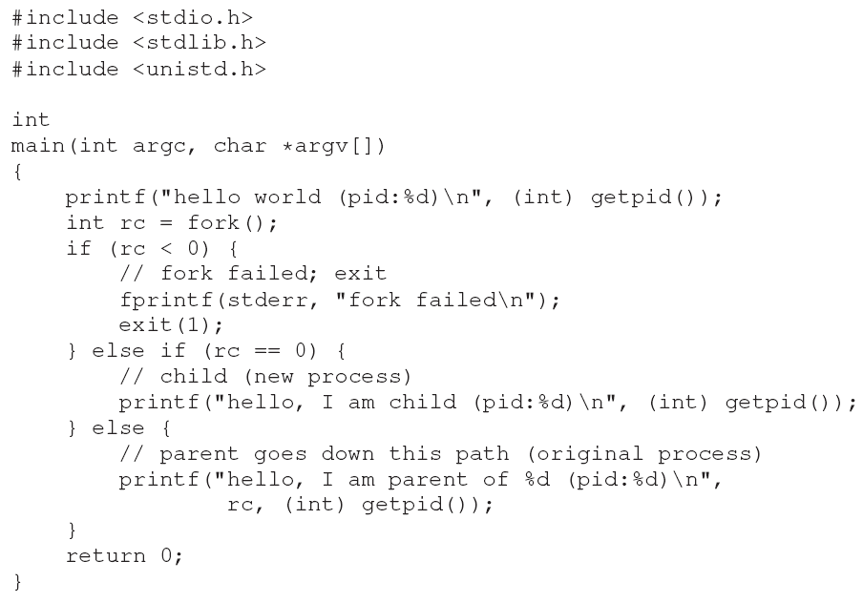
fork(): Hello World
The fork() system call is used to create a new process

Slide 36
fork(): Execution Result
When you run this program, what you see is the following:
  hello world (pid:29146)
  hello, I am parent of 29147 (pid:29146)
  hello, I am child (pid:29147)
Look at the first line under main()
  The process prints out a hello world message, with its process identifier, also known as a PID
  In Unix systems, the PID is used to name the process
Note that the process created by fork() is an (almost) exact copy of the calling process
However, the new process has its own address space (i.e. its own private memory, its own registers, its own PC, etc.)
So…OS will see there are now two processes in the system

Slide 37
fork(): Some Notes
The newly-created process is called the child, the creating process is called the parent
The child doesn’t start running at main(); rather, it just comes into life as if it had called fork() itself
If a computer has a single CPU, either the child or the parent might run at any particular point in time
Notice that
  The first “hello world” just got printed once.
  The output is not deterministic, i.e. different executions may give output in a different order
Notes:
Below, the parent printed out its message first
hello world (pid:29146)
hello, I am parent of 29147 (pid:29146)
hello, I am child (pid:29147)
Result could be
hello world (pid:29146)
hello, I am child (pid:29147)
hello, I am parent of 29147 (pid:29146)

Slide 38
wait(): Example Usage
Sometimes, it is quite useful for a parent to wait for a child process to finish before moving on
Using wait() or waitpid() will force the parent to wait
Let’s modify the last printf() of the previous code:
The parent calls wait() to delay its execution until the child finishes executing – when the child is done, wait() returns to the parent
// parent goes down this path (original process)
{
int wc = wait(NULL);
printf("hello, I am parent of %d (wc:%d) (pid:%d)\n",
rc, wc, (int) getpid());
}

Slide 39
wait(): Result and Notes
With this code, we now know that the child will always print first!
  hello world (pid:29266)
  hello, I am child (pid:29267)
  hello, I am parent of 29267 (wc:29267) (pid:29266)
More generally:
  wait(int *status) suspends execution of the current process until one of its children terminates
  waitpid(pid pid, int *status, int options) suspends execution of the current process until specified child terminates
  Both return PID as result and exit status in status argument
Notes:
This system call won’t return until the child has run and exited
Thus, even when the parent runs first, it waits for the child to finish running, then wait() returns, and then the parent prints its message

Slide 40
exec(): Family of Functions
  There is a family of exec() system calls, e.g. execvp()
  These are useful when you want to run a child program that is different from the parent program
  What it does: given the name of an executable (e.g. word_count), and some arguments (e.g. p.txt)
A successful call to an exec() function never returns
// child (new process)
char *myargs[3];
myargs[0] = strdup("word_count"); // program: "word_count”
myargs[1] = strdup(“p.txt"); // argument: file to count
myargs[2] = NULL; // marks end of array
execvp(myargs[0], myargs); // runs the word count code
printf("this shouldn’t print out");
Notes:
Behavior: OS does not create a new process – rather, it transforms the currently running program into a different running program (word_count)
After the exec() in the child, it is almost as if the original code (created by fork()) never ran
The functions differ in the way they take their arguments and the way they search for the file name
e.g. The execvp() function takes an array of strings and searches the directories listed in the PATH environment variable

Slide 41
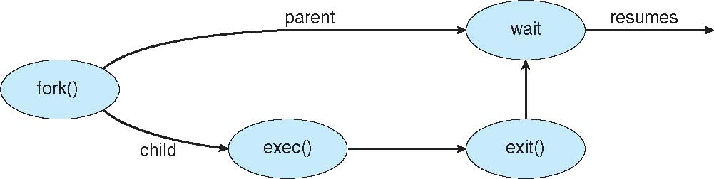
Termination
A process terminates its execution by:
  making an exit system call, e.g. exit(status)
  or abnormally due to a fatal error or signal
The exit status can be retrieved by the parent process via the wait() system call
On termination, the process resources are deallocated by OS

Slide 42
Other APIs
kill(): send signal to a process, including directives to go to sleep, die, etc.
Signals subsystem
  delivers external events to processes
  Provides ways for processes to receive and process those signals
Command line tools
  ‘ps’ – lists the running processes
  ‘top’ - displays the processes and how much CPU and other resources they are using
Notes:
Beyond fork(), exec(), and wait(), there are a lot of other interfaces for interacting with processes in Unix systems

Slide 43
Why fork() and exec()? (1)
  The separation of fork() and exec() is essential in building a Unix shell (command-line-interpreter) because it lets the shell run code after the call to fork() but before the call to exec()
With the name of an executable program, plus any arguments passed to the Unix shell, it:
  figures out where the executable is
  calls fork() to create a new child process
  alters the environment of the about-to-be-run program, if necessary
  calls some variant of exec() to run the command
  waits for the command to complete by calling wait()
  when the child completes, the shell returns from the wait() and prints out a prompt again, ready for the next command
Notes:
A Unix shell is a command-line interpreter that provides a traditional Unix-like command line interface

Slide 44
Why fork() and exec()? (2)
The separation of fork() and exec() allows the shell to do many useful things rather easily
  Suppose the command is: prompt> wc p.txt > newfile.txt
  Before calling exec(), the shell redirects the output by closing the standard output and opening the file newfile.txt
Unix pipes are implemented in a similar way but with the pipe() system call
  The output of one process is connected to the write-end of the pipe, and the input of another process is connected to the read-end of that same pipe

Slide 45
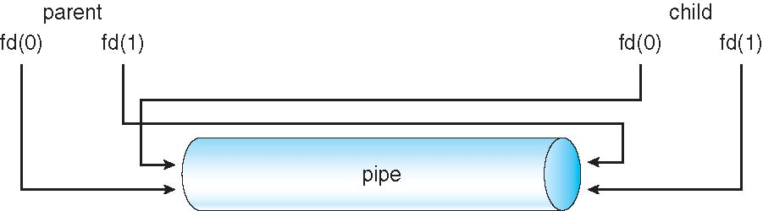
Pipes
Pipes allow communication in a producer/consumer style
  Producer writes to one end (the write-end of the pipe)
  Consumer reads from the other end (the read-end of the pipe)
  If the parent wants to receive data from the child, it should close fd[1] and read from fd[0], and the child should close fd[0] and write to fd[1]
  int pipe(int fd[2]); fd[0] is set up for reading, fd[1] for writing

