Slide 1
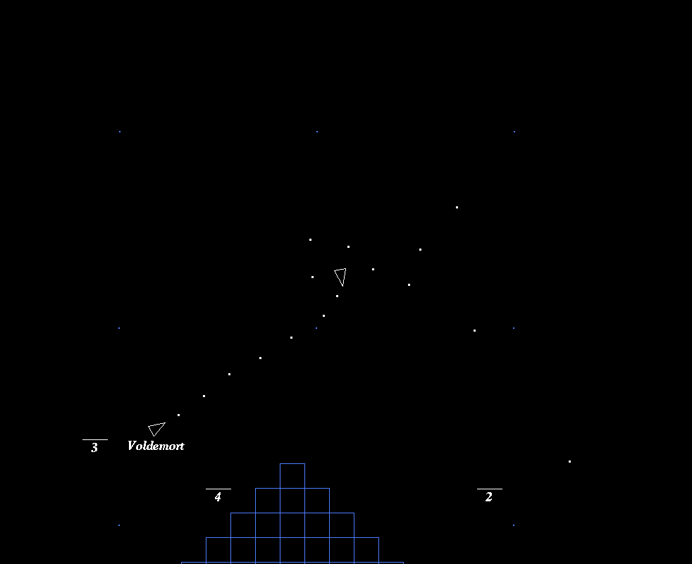
XPilot-AI
John Litborn, Magnus Karlsson, Christoffer Karlborg

Slide 2
Goal
An AI that can:
scan its surroundings and react accordingly
act agressively or defensively based on need
identify enemy ships, track them down and shoot them

Slide 3
Features
Identifies enemy ship(s)
  Flies to it
  Shoots it
Dodges incoming shots
Avoids obstacles

Slide 4
Control flow
start
krasching?
yes
no
turn
Being shot?
yes
no
dodge
Target nearby?
yes
no
thrust
shoot
flyTo
loop

Slide 5
Uses
As a practice partner
For cheating!
Entertainment

