Slide 1
Email Spam Filter based on Machine learning Methods
Naïve Bayes, SVM, KNN, CNN, RNN

Slide 2
1
PART ONE
Intro & Overview

Slide 3
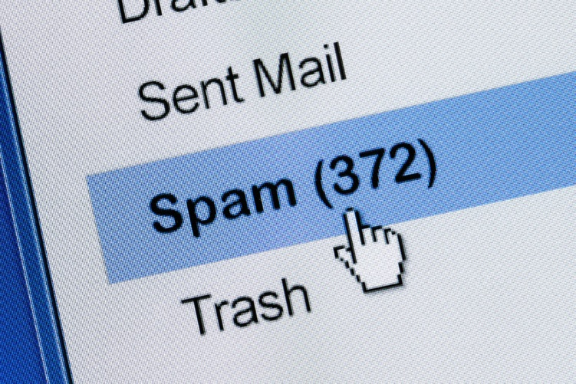
Intro & Overview
Unsolicited Commercial E-mail (UCE)
product advertisements, pornography, illegitimate contents
Spam emails
irrelevant or inappropriate messages sent on the internet to a large number of recipients’
handcrafted rules, blacklists
Optimal solution?
Both of little use
machine learning methods
Naïve Bayes, SVM, KNN, CNN, RNN
Key words:
email classification, spam, machine learning, text processing
Notes:
In recent years, the increasing popularity of the individual utilization of emails and the low-cost advertising through this way, have attract the commercial marketers to send massive amount unsolicited messages to mailboxes of users, for which include product advertisements, pornography, illegitimate contents or unwanted information of any kinds, preventing us from making full and good use of time, these messages are usually referred to as ‘Spam’ mails, or more formally, Unsolicited Commercial E-mail (UCE),
on to the spam problem is really important. Several counter-measures were proposed, for example, handcrafted rules, blacklists, both of them seem to be of little use as the rules need to be tuned manually which has very low efficiency while blacklists are also ineffective due to the forged sending address.

Slide 4

Intro & Overview
Limitation of each method?
Feasibility, generalizability, accuracy>?
Dataset selection
How many required?
What is the content? Which lead to
Distribution of ‘spam’ and ‘ham’
Pre-processing
average global spam volume as percentage of total e-mail traffic over the past 5 years (45% : 55%)
Remove noisy/redundant information
Tokenizer, vectorization of words
Word representation
Key words:
email classification, spam, machine learning, text processing
Notes:
Before we can do any exploration on our problem, it is crucial to find datasets for our models, we use the data from Enron Spam Dataset, which include six datasets in .tar.gz format, any other options…
We then have to consider how to convert the literal email contents to numerical representation that is trainable data, as features in machine learning is numbers that we can perform mathematical operations on. Before that, we need to first remove the noisy/redundant data in each sentence, revealed in our code. …
choose the average global spam volume as percentage of total e-mail traffic over the past 5 years, from 2015-2019,
pre-processing by removing the addresses of the sender and owner, for example, the information after the tag ‘To:’, ‘Cc’ and ‘Bcc’, and some other headers, hyperlinks (strings start with ‘http’), punctuations (from string library), whitespace, numbers (\d+ -> [0-9]) and etc

Slide 5
2
PART TWO
3 Models with Bagging

Slide 6
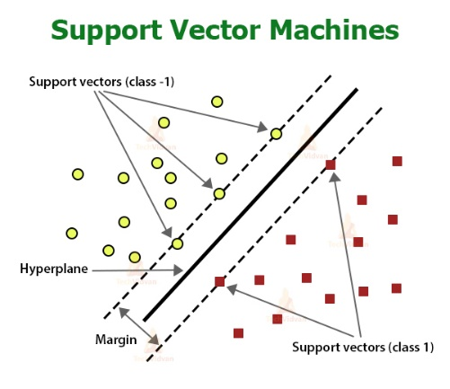
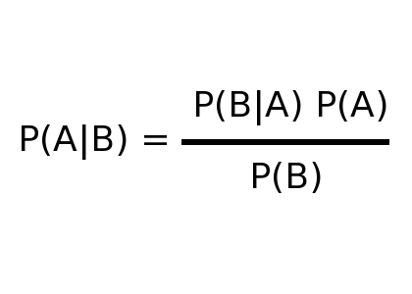
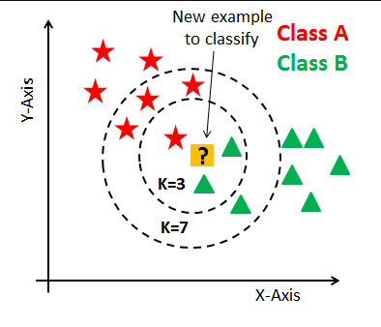
Intro & Overview
Three Instance Based Learning Models
Naïve Bayes Method
K- Nearest Neighbor Method
Support Vector Machine
Naïve Bayes
K-Nearest Neighbor
Support Vector Machine
Word Representation
Bag Of Words: Way of extracting features from text
TF-IDF: Term Frequency- Inverse document frequency (weight of words/features)
Notes:
Based on Bayesian Theorem, we treat x as features and Y as target labels, we get P (Belongs to Label L| Given Features) = P (Given Features| Belongs to Label L) * P(Belongs to Label L) over P(Given Features).
Based on Euclidean distance, find the first Kth smallest training data points are selected and the most frequent label in the first Kth smallest data points
Based on a hyperplane generated by the training process for SVM, Support vector machine predicts the label of new input data based on the sign of dot product of vectorized data point and the hyperplane.
BOW: A bag-of-words is a representation of text that describes the occurrence of words within a document. It involves two things:
A vocabulary of known words.
A measure of the presence of known words.
TFIDF evaluates how relevant a word is to a document in a collection of documents, This is done by multiplying two metrics: how many times a word appears in a document, and the inverse document frequency of the word across a set of documents.
Bag of Words just creates a set of vectors containing the count of word occurrences in the document (reviews), while the TF-IDF model contains information on the more important words and the less important ones

Slide 7
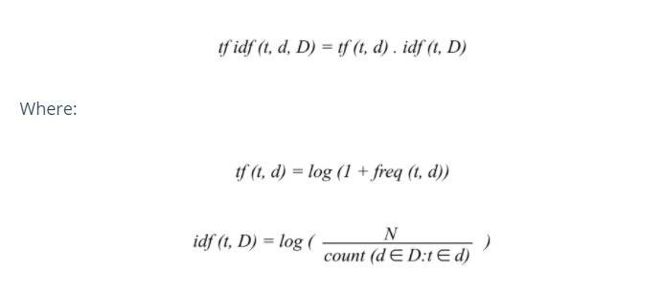
Math Work
Mathematic Expression Of TF-IDF
Notes:
Explain tf idf format

Slide 8
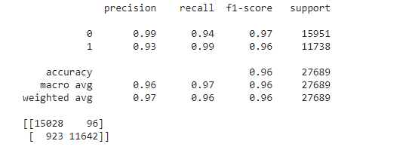
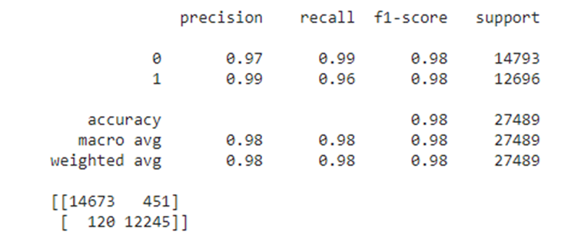
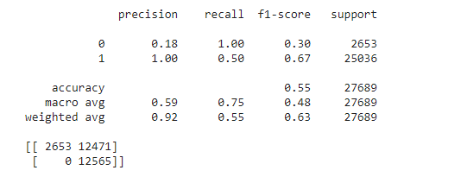
Results
Precision and Confusion Matrix for The Three Models
Naïve Bayesian
SVM
KNN
KNN has a very poor performance!
Notes:
While Naïve Bayes and SVM model has a fairly good performance on the test dat. The accuracy on testing set for KNN model is rather low, that is because of following possible reason: The training data set is way too large so that the data is randomly spread and the data points are jumbled thus when the algorithm tries to find the K nearest neighbors, the frequency of the two labels might be about 1:1. Then the accuracy will become rather poor.

Slide 9
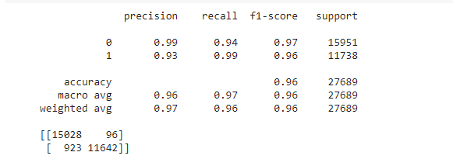
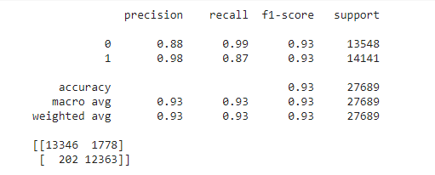
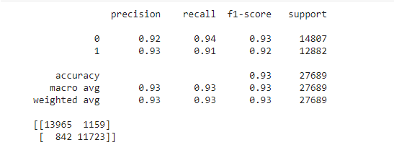
How To Improve Performance
1.Vary the size of data sets
Naïve Bayesian
SVM
KNN
Performance of KNN has improved a lot!
Notes:
Thus, we tried to shrink the train data into a much smaller size to see if there would be any change in the performance of each model, we want to know if the size of the training data would have a huge impact to models. In this case the new train data size is about 500

Slide 10
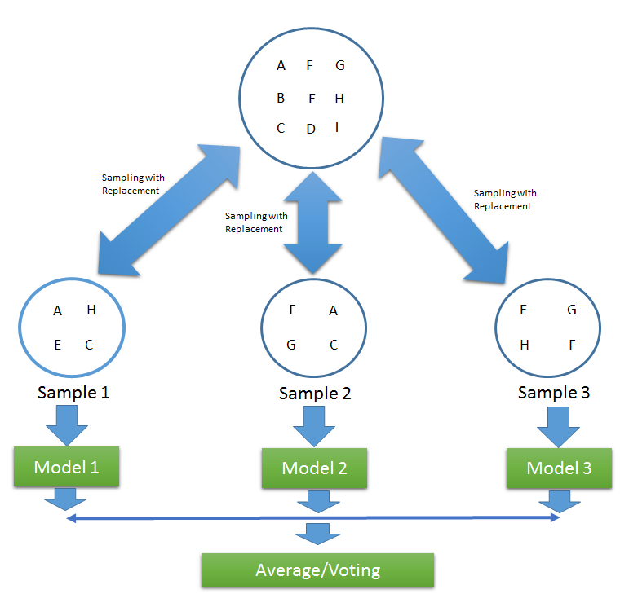
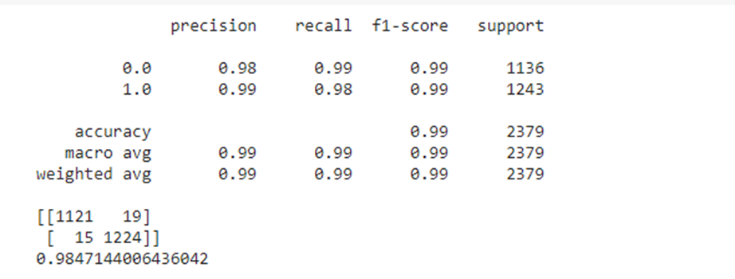
How To Improve Performance
2. Bagging (Aggregating Three Models)
To lower the bias of these 3 models, the concept of aggregating three of them is introduced
Precision and Confusion Matrix for Bagging Model
Aggregated Model has the best performance
Notes:
To lower the bias of these 3 models, the concept of aggregating three of them is introduced and let the final prediction be the hard voting result of the three models, means the result is derived based on the label with more votes. The performance of the model is very good, the test accuracy reach to 0.985, very impressive.

Slide 11
Conclusion
To Summarize…
The feasibility of KNN model is very poor
KNN models only has a fair performance on small training size but very poor performance once the training data gets large, KNN would not be a reliable classifier alone.
The feasibility of Naïve Bayes and SVM are good
The models are very easy to implement, and the generalizability for these two models are good, so they can be used for both by personal and public needs.
Bagging
Since Bagging method combines the result of all three methods by a hard voting process, it is highly reliable
Notes:
performance of NB and SVM model has no significant change with vary of train data size, the models are very easy to implement, and the generalizability for these two models are good, so they can be used for both by personal and public needs. However, the feasibility of KNN model is very poor. In the real world, the amount and style of spam emails will increase over time and so does the training process, KNN models only has a fair performance on small training size but very poor performance once the training data gets large, KNN would not be a reliable classifier alone.
See that Naïve Bayes has a very high accuracy of predicting unknown data. Thus, Naïve Bayes model has the best performance with a good generalizability. By combining the result of the three models, the overall accuracy score on the test data set is 0.984 which is very well performed.

Slide 12
3
PART THREE
Neural Network Models

Slide 13
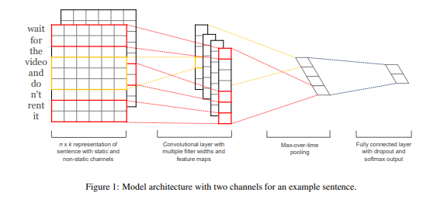
CNN
CNN usually for image processing
2D convolutional neural network layers + pooling layers
How to process text data?
Multiple 1D convolutional layers
Simulation to n-gram scanning
Different kernel size
Height refer to length of phrase
Rarer forms
Symptoms
Find pattern of phrases, 4 is long enough
Juvenile form
A tasty banana – totally 3 words
After about eight month
Notes:
Here we tried to use CNN to build the classifier. This may sound weird as CNN is usually used for visual image processing, and what we learned on the course was 2D-CNN, instead of 2-dimensional, texts have a one-dimensional structure where words sequence matter. Based on finding of 'Yoon Kim'[6], 1D CNN would simulate the process of n-gram model, in this case, the kernel would have the same size as the ‘embed_size’, e.g., same size as the word embedding vector, in our code, this number is 100, means the kernel has a width of 100,
he upper bound is 4 is because words that are farther away than 4 would be less relevant to identify the patterns, for example, a phrase usually has the length around 4, for example, the phrase ‘a delicious pie’.

Slide 14
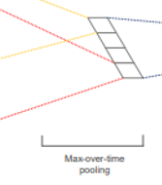
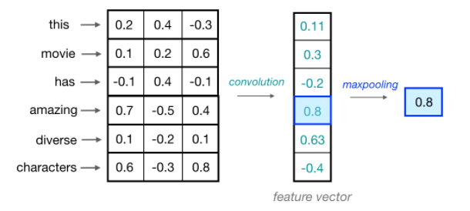
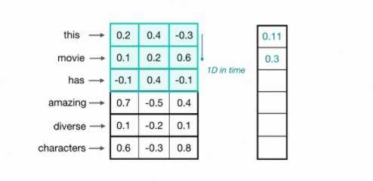
CNN
Convolution layers with 100 filters
Max Pooling over time?
But different kernel size
Aggregate the output of max-pooling
layers
MaxPooling1d?
Input of dense layer
Select largest among the output vectors
Output layer, sigmoid
Rarer forms
Symptoms
Juvenile form
After about eight month
Notes:
, while for the height, Kim provides a use of different size simultaneously, namely, in our model, we simulates 2/3/4-gram with the corresponding heights of 2,3,4, the kernel sizes therefore, are 2/3/4 x 100, and output a number for each scanning procss, the kernel would move one-by-one down a list of input embeddings, each time cover a window with the shape of 2/3/4 x 100 and produce one number based on the weight within the kernel, here the neural network architecture performs the simulation of 2/3/4-gram by scanning multiple words in a row, and eventually form a vector, the vector is then pooled with the largest number with GlobalMaxPooling1D(), each convolutional layer has 100 kernels means 100 such vectors would be produced for each layer,

Slide 15
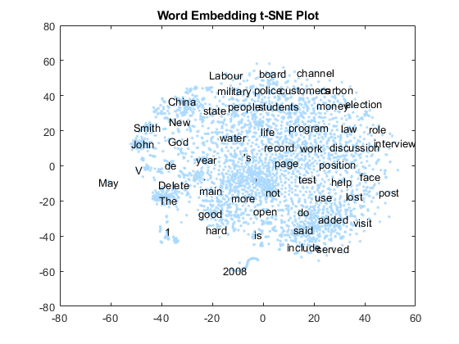
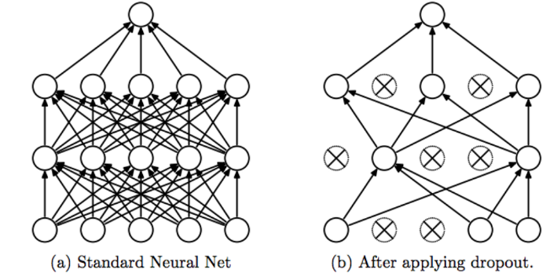
CNN
Drop out some portion, why?
The model is complicated, avoid overfitting
Embedding layers trained, updated
Embedding layers
[1xN]*[NxM] = [1xM]
Rarer forms
Symptoms
Juvenile form
Represents subtle relation between words
After about eight month
‘King’, ‘male’, ‘Queen’ , ‘female’ are closed
Notes:
I dropped 60% of the output to avoid overfitting, this would be useful. By implementing a CNN with this trend, we got a really high accuracy, according to the testing set, the complexity of the model did not lead to overfit which is so good for us, as mentioned before, the word embedding would also be trained and updated, means there are so many parameters, along with the weight in each kernel of the convolutional layer, the model has relatively high complexity which is able to extract and identify the pattern with the length of 2/3/4.
compare to the classical one-hot representation, embedding vectorization to a word would result a vector with much lower dimensionality, for example, in one-hot, the vector would have a size of 10000 (features) for a vocabulary of 10000 words, meanwhile most of the value within the vector is 0, namely, the word vector is really sparse with high dimensionality, this would lead to the phenomena named ‘Curse of dimensionality’ ^{[5]}, which lead great difficulty of extracting the relation and finding the

Slide 16



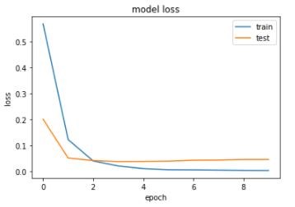
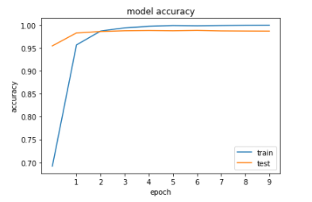
CNN
Confusion matrix and other statistics
Higher accuracy than any of the 3 classifiers
High generalizability
Symptoms
After about eight month
Notes:
The graphs shows the accuracy ascending and loss descending in each epoch.
The confusion matrix, precision, recall and the f1-score based on the former statistic are shown below. We can see the f1_score is 0.9855 which is better than all of the 3 models in the previous section. We conclude CNN as a feasible way of implementing effective email-spam filter.
explain the noticeable pattern of the graph

Slide 17
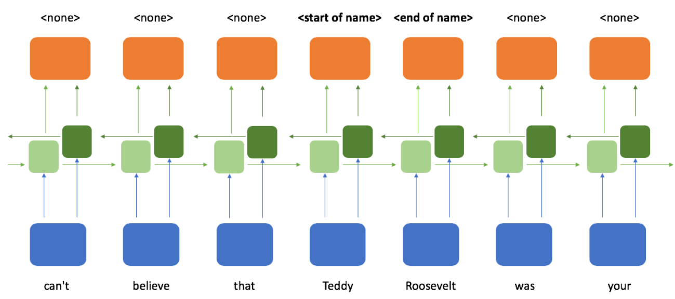
Introduction to RNN
Naive Bayes is regarded as the baseline for dealing with spam.
However, Google recently reported that by introducing Neural Network's to g-mail's spam filters. It took them from 99.5% to over 99.9% accuracy, suggesting that neural networks may be effective for enhancing spam filters.
Import Bidirectional layer to fix weakness
Benefits
Weakness
A Bidirectional RNN model sample
Its ability to handle arbitrary length inputs and outputs. This flexibility allows us to define a broad range of tasks.
we can only use the set of observations which we have already seen when making a prediction.
Rarer forms
Symptoms
Juvenile form
First noticeable signs of the condition is the appearance of a red dot at the back of their eyes.
After about eight month

Slide 18
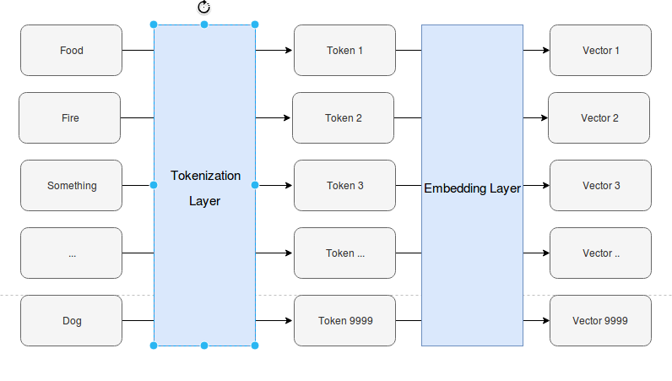
Embedding layers
Two RNN Models
Embedding from scratch
Embedding from Glove(pre-trained)
From scratch:
The tokenizer functions will maintain a dictionary of unique words that map each word to an index.
Then the Embedding layer will train and weight each word and refine itself.
From Glove(pre-trained):
Implementing the Glove pre-trained 300-dimensional word vectors from Glove official website.
enumerating all unique words from tokenization layer
locating the embedding weight vector from the loaded Glove embedding
The Embedding layer will train based on embedding matrix but it is unchangable.
Rarer forms
Symptoms
Here is the example of pre-trained word vectors:
#To show King- Man + Woman = Queen
w2v.most_similar(['king','woman'],negative=['man'],topn=1) # Output: [('queen', 0.6713277101516724)]
Juvenile form
First noticeable signs of the condition is the appearance of a red dot at the back of their eyes.
After about eight month

Slide 19
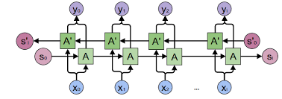
RNN layers
Bidirectional GRU layer
Bidirectional
for some of the sentences, the context information is at the end of the sentence. Without the context info, ambiguity might arise.
Eg. A: The experts project a 5% consumer price increase for the entire year.
B: He just hasn't been able to project himself as the strong leader.
While project in verb means something is planned or expected/someone tries to make people see them in that way
GRU
GRU solve the gradient vaninshing/explosion problem using a unique additive gradient structure that includes:
direct access to the forget gate’s activations,
enabling the network to encourage desired behaviour from the error gradient
using frequent gates update on every time step of the learning process.
Rarer forms
Symptoms
Juvenile form
First noticeable signs of the condition is the appearance of a red dot at the back of their eyes.
Figure: Bidirectional RNN
After about eight month

Slide 20
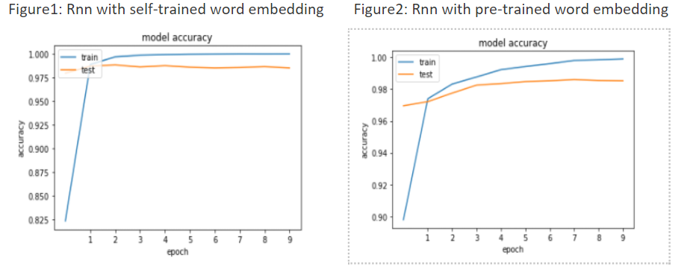
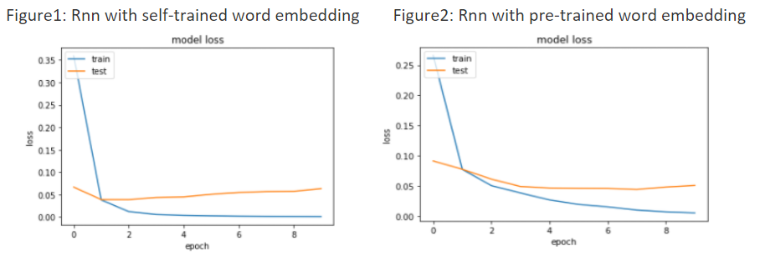
Results
Reach the same level of accuracy in the end but self-trained is faster.
Rarer forms
Symptoms
Juvenile form
First noticeable signs of the condition is the appearance of a red dot at the back of their eyes.
The loss graphs show that we might need to stop trainning after 1 epoch because the loss has been increasing instead of decreasing.
After about eight month

Slide 21
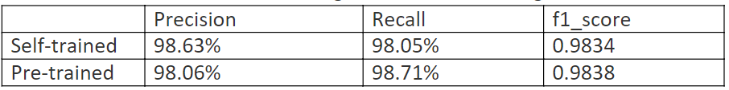
Conclusion
The precision and recall of the two models does not differ by a very great margin. Some of the reason might be due to:
Glove embedding is trained over sources that are very different from the data that we have in this problem, so the benefits we gain from the pre-trained embedding is not significantly helpful.
The text data in this spam filtering problem is not too complicated. RNN with self-trained word embedding is a good enough model to capture the pattern.
Rarer forms
Symptoms
Juvenile form
The accuracy and loss graphs prove that Glove embedding does not provide any helpful data. And self-trained word embedding is wonderful enough to handle the input dataset.
First noticeable signs of the condition is the appearance of a red dot at the back of their eyes.
After about eight month

Slide 22
Conclusion & Lesson learned
Conclusion
KNN is sensitive to input size, should be carefully used
Word embedding lower the dimensionality and sparsity, therefore yield better performance
CNN has the highest accuracy that we should focus on
Naïve bayes require less data but provide better accuracy – more generalizable
Bagging of multiple models should be considered
Pre-trained word embedding does not guarantee a better performance

Slide 23


THANKS FOR YOUR PATIENCE
Presenters:
ZHENGHAN TAI (17zt12@queensu.ca) – the nerd
SIZHE GUAN (17sg46@queensu.ca) – Gym aficionado
MINGJIA MAO (17mm78@queensu.ca) – AD carry
GitHub Repository:
https://github.com/jakki-Guan/CISC-372-Spam-Filtering

