Slide 1
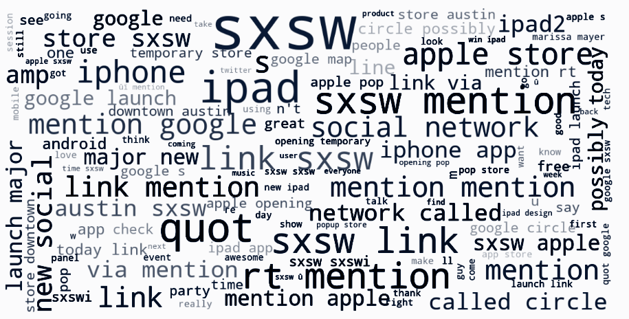
Natural Language Processing Project
Sentiment Analysis of Tweets Using NLP

Slide 2

Business Understanding
Overview
Role of social media in capturing user sentiments.
Use of machine learning and NLP to categorize sentiments.
Objective: Analyze sentiments towards Apple and Google products from Twitter data.

Slide 3

Business Understanding
Objective:
- Collect Twitter data related to Apple and Google product reviews.
- Preprocess and perform sentiment analysis.
- Derive insights to optimize product assortment and align with customer preferences.

Slide 4
Business Understanding
Challenges:
- Lack of systematic methods for sentiment analysis on platforms like Twitter.
- Need for data-driven stocking decisions.
Project aims:
Enhance understanding of customer opinions to improve stocking decisions and customer satisfaction.

Slide 5

Business Understanding
Business Problem:
- Ensure a positive customer experience by accurately predicting sentiment.
- Importance of correctly classifying sentiments to avoid misinterpreting customer feedback.

Slide 6
Data Preprocessing
Data Cleaning:
Removing Duplicates: Ensuring each tweet is unique.
Handling Missing Values: Strategies for dealing with incomplete data.
Text Preprocessing:
Tokenization: Breaking down text into individual words or tokens.
Stop-word Removal: Eliminating common words that do not contribute to sentiment (e.g., "and," "the").
Lemmatization/Stemming: Reducing words to their base or root form.
Data Transformation:
Converting text to lowercase.
Removing special characters and URLs.

Slide 7
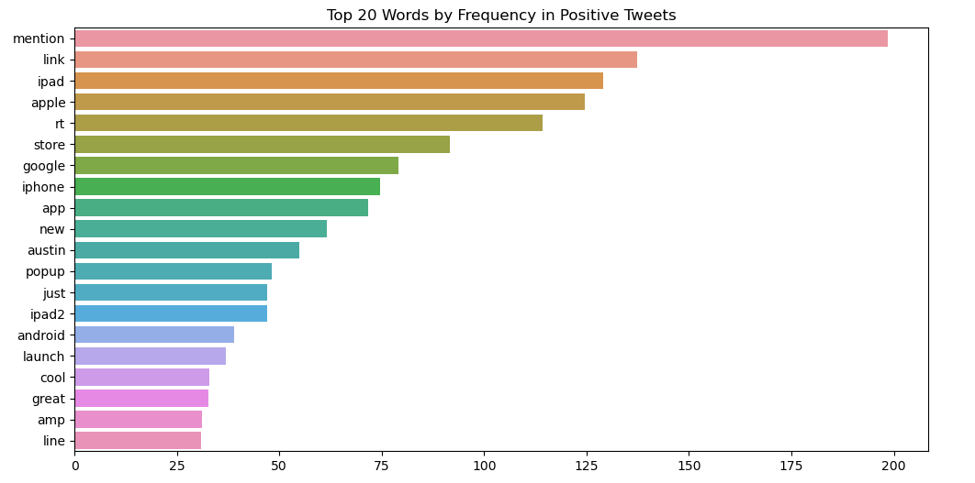

Slide 8
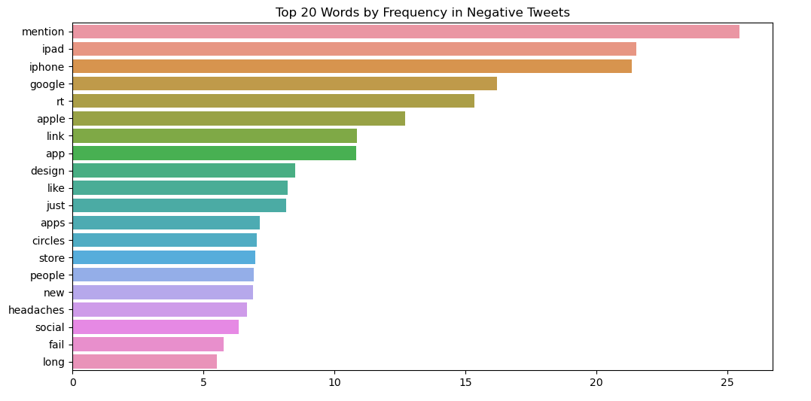

Slide 9
Model Training and Evaluation
Model Training:
Splitting Data: Dividing data into training and test sets.
Feature Extraction: Converting text into numerical features using techniques like TF-IDF or word embeddings.
Training Process: Details on model training, including parameters and iterations.

Slide 10
Cont …
Evaluation Metrics:
Accuracy: Proportion of correctly classified tweets.
Precision, Recall, F1-Score: Metrics to evaluate the performance of the model in detail.
Confusion Matrix: Visual representation of the model's performance.
Cross-Validation:
K-Fold Cross-Validation: Ensuring the model's robustness by training and validating on different data splits.

Slide 11
Insights and Recommendations
Actionable Insights:
Product Improvement: Areas where customers expressed dissatisfaction, suggesting potential improvements.
Marketing Strategy: Insights into how customers perceive marketing campaigns.
Customer Support: Identifying common customer concerns that can be addressed through better support.
Recommendations:
Tailoring advertising strategies based on sentiment analysis.
Enhancing product features that received positive feedback.
Addressing common issues to improve customer satisfaction.

Slide 12
The End
Thank You!

