Slide 1
SN
ServNex
LOCAL SERVICES PLATFORM
Connecting Users with Verified Local Professionals
Book • Chat • Track • Pay — All in One Place
1
2
3
4
Team Member 1
Team Member 2
Team Member 3
Team Member 4
Full Stack Developer
UI/UX Designer
Backend Developer
Project Manager
21CSE001
21CSE002
21CSE003
21CSE004
Department of Computer Science & Engineering | Academic Year 2024

Slide 2
02
Introduction
What is ServNex?
6+
Service Categories
ServNex is a full-stack web platform connecting users with skilled local service providers in real time.
Users can search, compare, book, chat, and pay — all inside one platform without switching apps.
Providers register their skills, set pricing, manage bookings, and grow their customer base digitally.
Covers 6 service categories: Electricians, Plumbers, Carpenters, Painters, Cleaners, and AC Technicians.
Built as a single-file HTML app — runs instantly by double-clicking in any modern browser.
8
Demo Providers
100%
Browser-Based
1
File to Run All
ServNex — Local Services Platform
2 / 11

Slide 3
03
Project Objectives
Easy Service Discovery
Seamless Booking System
Real-Time Chat
1
2
3
Search & filter verified providers by category, skill, rating, price, and distance in real time.
Book with date/time selection, address input, and live status updates from the provider.
In-app Socket.io messaging for instant communication between users and providers.
Secure Payment Gateway
Trust via Ratings
Admin Oversight
4
5
6
Razorpay integration supporting UPI, credit/debit cards, net banking, and wallets.
Review & star-rating system after job completion to build provider reputation.
Admin panel to verify providers, manage users, monitor all bookings & handle disputes.
ServNex — Local Services Platform
3 / 11

Slide 4
04
Stakeholders
End Users (Customers)
Service Providers
Platform Administrator
Search for local service providers
Filter by category, skill, price & rating
Book with preferred date, time, address
Chat with provider in real time
Pay securely via Razorpay
Leave star ratings and reviews
Register with skills & service location
Submit profile for admin verification
Accept or reject booking requests
Communicate with customers via chat
Mark job complete & set final price
Build reputation through reviews
Verify & approve provider profiles
Manage all registered users
Monitor all platform bookings
Enable or disable user accounts
View revenue and platform stats
Handle complaints and disputes
ServNex — Local Services Platform
4 / 11

Slide 5
05
Programming Languages, Tools & Software
Frontend Technologies
Backend Technologies
HTML5 — Structure & semantics
CSS3 — Animations, Grid, CSS Variables
Vanilla JavaScript ES6+ — Full app logic
Google Fonts (Clash Display + Cabinet Grotesk)
LocalStorage API — Client-side persistence
Node.js — Server-side runtime
Express.js — REST API framework
Socket.io — Real-time events
MongoDB + Mongoose — Database & ODM
JWT — Authentication | bcryptjs — Hashing
Payments & External APIs
AI & Development Tools
Razorpay — Payment gateway (India)
Google Maps JS API — Maps & geolocation
Browser Geolocation API — GPS detection
HMAC SHA256 — Payment signature verification
Claude AI (Anthropic) — Code generation
Visual Studio Code — IDE
Git & GitHub — Version control
Postman — API testing
npm — Package management
ServNex — Local Services Platform
5 / 11

Slide 6
06
AI Prompts Used to Generate Code — Part 1 of 2
Full System Architecture Prompt
1
"Build a complete local services platform called ServNex with user & provider registration (with skills/GPS location), search with filters, booking system, real-time chat via Socket.io, Razorpay payment integration, rating & reviews, live GPS tracking, and admin dashboard. Use React.js + Node.js + Express + MongoDB."
Backend Models & REST API Prompt
2
"Create MongoDB Mongoose models for User, Provider, Booking, Message, Payment, Review with validation and geospatial index. Build REST controllers for JWT auth, provider search with Haversine distance, booking CRUD with status history, and Razorpay order creation + HMAC signature verification."
Socket.io Real-Time Features Prompt
3
"Implement Socket.io to handle: user online/offline status, chat rooms by userId pair, message send/receive with optimistic updates, typing indicators, read receipts, provider live GPS location broadcasting to booking rooms, and booking status push notifications to users."
ServNex — Local Services Platform
6 / 11

Slide 7
06b
AI Prompts Used to Generate Code — Part 2 of 2
React Frontend Pages & Components Prompt
4
"Build React pages: Landing (hero, category grid, top providers), Search (sidebar filters, provider cards), Provider Detail (tabs: About/Skills/Reviews), Booking (date/time picker, address), User & Provider Dashboards, multi-step Provider Onboarding with GPS, real-time Chat, and Admin Panel with approval workflow."
Single-File HTML App (No Installation) Prompt
5
"Combine the entire ServNex app — all pages, routing, state management, 8 demo providers, full booking, real-time chat, payment simulation, reviews, admin dashboard — into a single index.html with no external dependencies, running purely in browser using localStorage."
Bug Fix, Packaging & GitHub Deployment Prompt
6
"Fix zip packaging so contents are at root level (no nested folder). Add missing frontend/public/index.html. Pre-fill backend/.env and frontend/.env with defaults. Add WINDOWS_QUICKSTART.md with terminal commands. Enable GitHub Pages so the site opens at jakkulasrivaishnavi.github.io/servnex."
ServNex — Local Services Platform
7 / 11

Slide 8
07
System Workflow Flowchart
USER FLOW
PROVIDER FLOW
1. Register / Login
1. Register + Add Skills & Location
2. Search Services + Apply Filters
2. Submit Profile for Admin Review
3. View Provider Profile & Reviews
3. Admin Approves — Goes Live in Search
4. Send Booking Request
4. Receive Booking Notification
5. Chat with Provider
5. Accept or Reject Request
6. Receive Confirmation
6. Start Job → Update Status
7. Complete Payment via Razorpay
7. Mark Complete & Set Final Price
8. Leave Star Rating & Review
8. Reply to Customer Reviews
ServNex — Local Services Platform
8 / 11

Slide 9
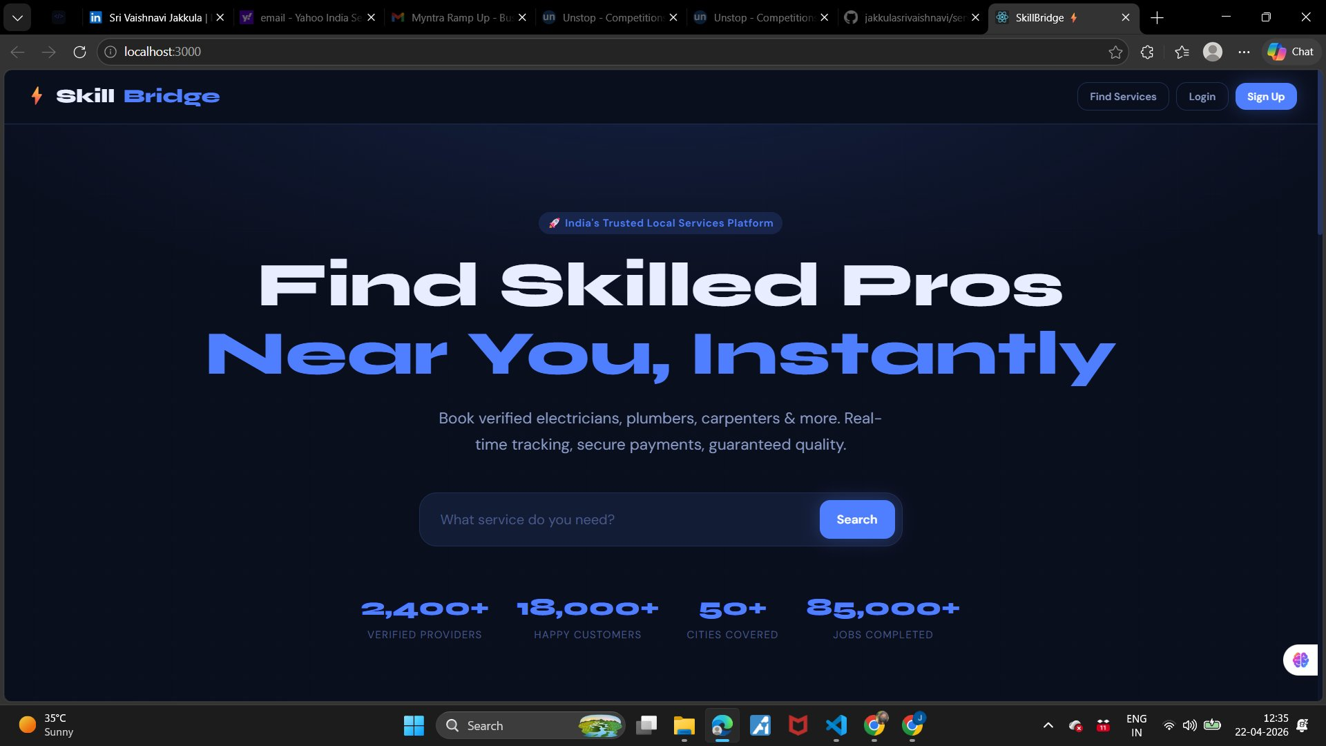
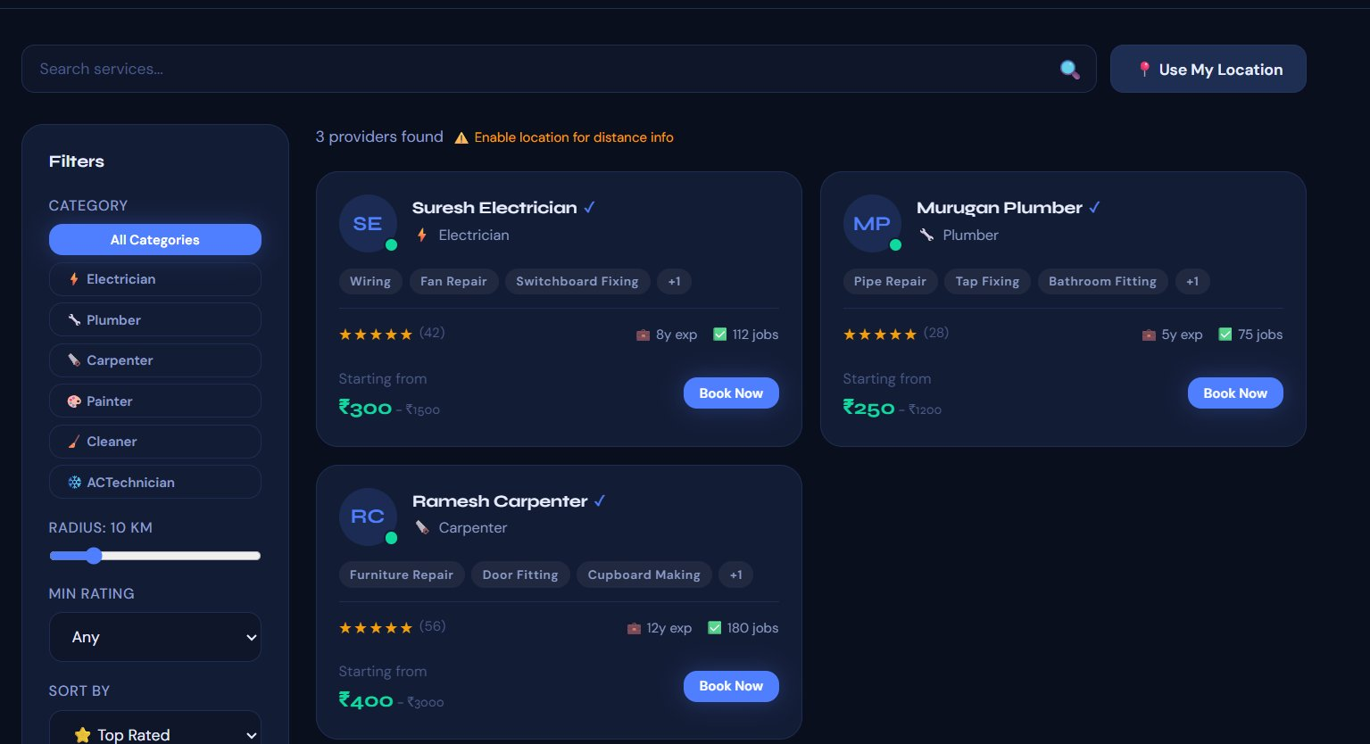
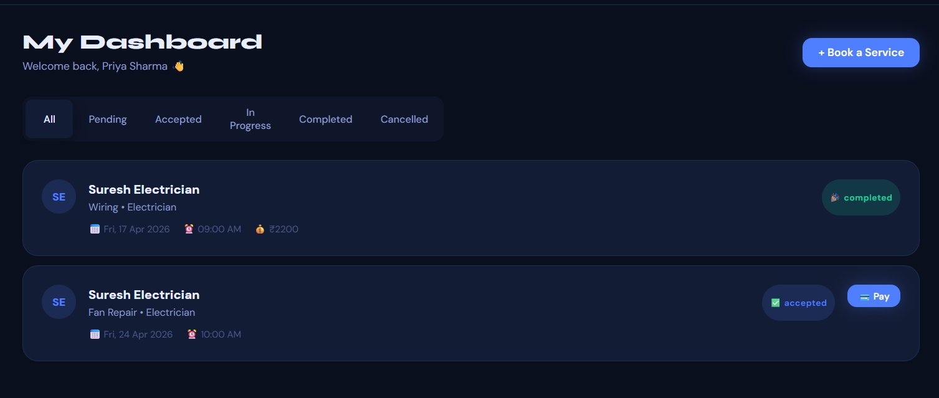
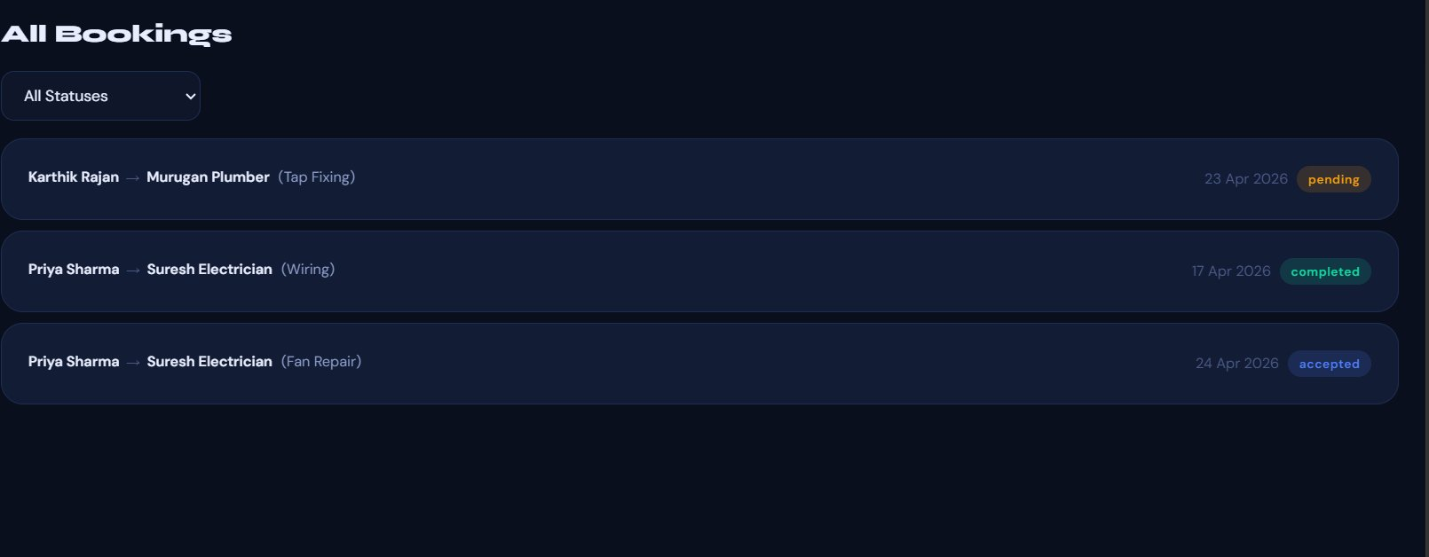
08
Frontend Views — Actual Application Screenshots
Landing Page
Search & Filter
User Dashboard
Admin Bookings
Live Website: https://jakkulasrivaishnavi.github.io/servnex | All screens captured from the working application
ServNex — Local Services Platform
9 / 11

Slide 10
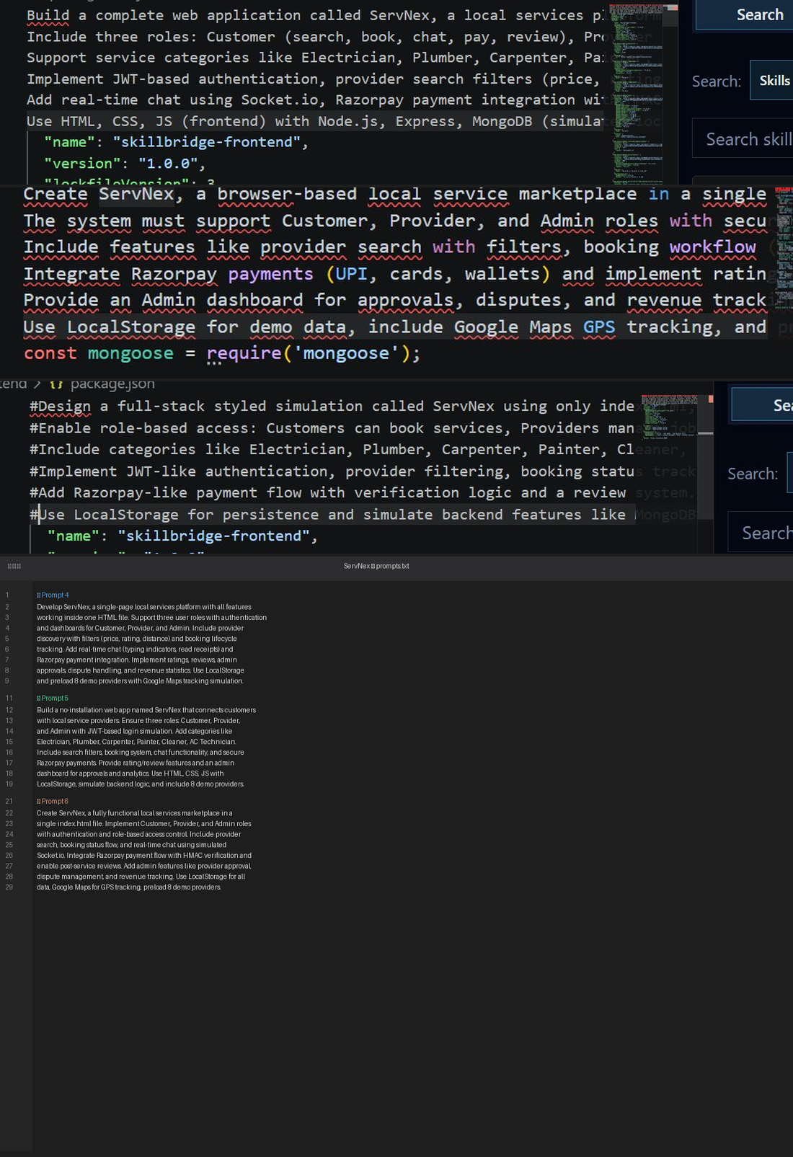
09
Proof of Prompts Generating Code
Actual Claude AI Conversation
51
Files Generated
6
Prompts Used
Tool: Claude AI (Anthropic) | Model: Claude Sonnet 4.6 | Conversation at: claude.ai
ServNex — Local Services Platform
10 / 11

Slide 11
10
References
AI Tool Used
Frontend & Styling
Backend Technologies
Claude AI by Anthropic — claude.ai
Model: Claude Sonnet 4.6 (claude-sonnet-4-6)
Used for: all code, architecture & documentation
MDN Web Docs — developer.mozilla.org
Google Fonts — fonts.google.com
CSS Tricks — css-tricks.com
Node.js — nodejs.org
Express.js — expressjs.com
Socket.io — socket.io
Mongoose — mongoosejs.com
JWT — jwt.io
Payments & Maps
Database
Dev Tools & Hosting
Razorpay Docs — razorpay.com/docs
Google Maps JS API — developers.google.com/maps
Razorpay Test Mode Guide
MongoDB Atlas — mongodb.com/atlas
MongoDB Compass — GUI tool
Mongoose ODM — mongoosejs.com/docs
VS Code — code.visualstudio.com
GitHub & GitHub Pages — github.com
Postman — postman.com | npm — npmjs.com
Live Website URL: https://jakkulasrivaishnavi.github.io/servnex | GitHub: https://github.com/jakkulasrivaishnavi/servnex
ServNex — Local Services Platform
11 / 11

