Slide 1
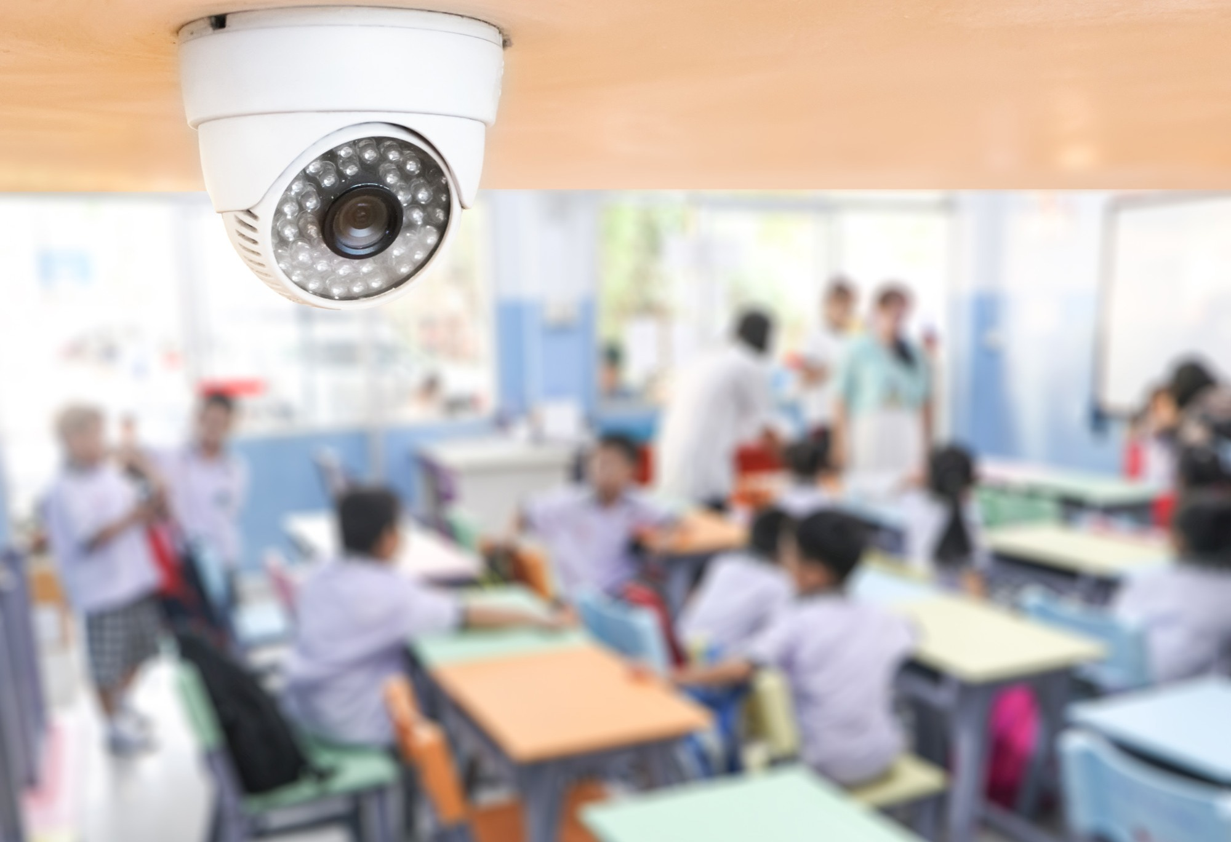
INTELLIGENT CLASSROOM MONITORING SYSTEM
AI-Powered CCTV Monitoring using Computer Vision
BVSR ENGINEERING COLLEGE
Department of CSE – Data Science
Visual reference: South China Morning Post
TEAM MEMBERS
Ch. Jahnavi
T. Sai Meghana
S. Adi Lakshmi
A. Prasanna
J. Thrisha
Computer Vision • Smart Monitoring • Real-Time Alerts
Y. Harika
O. Dhana Lakshmi
D. Shireesha
01

Slide 2
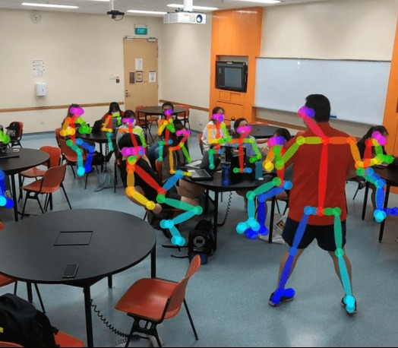
01 INTRODUCTION
From passive CCTV recording to intelligent monitoring
THE IDEA
Traditional CCTV records what happened. Our system adds computer vision to identify predefined suspicious events and immediately present evidence to faculty. The goal is to assist faculty with faster review — not replace human judgment.
Visual reference: Times Higher Education
02

Slide 3
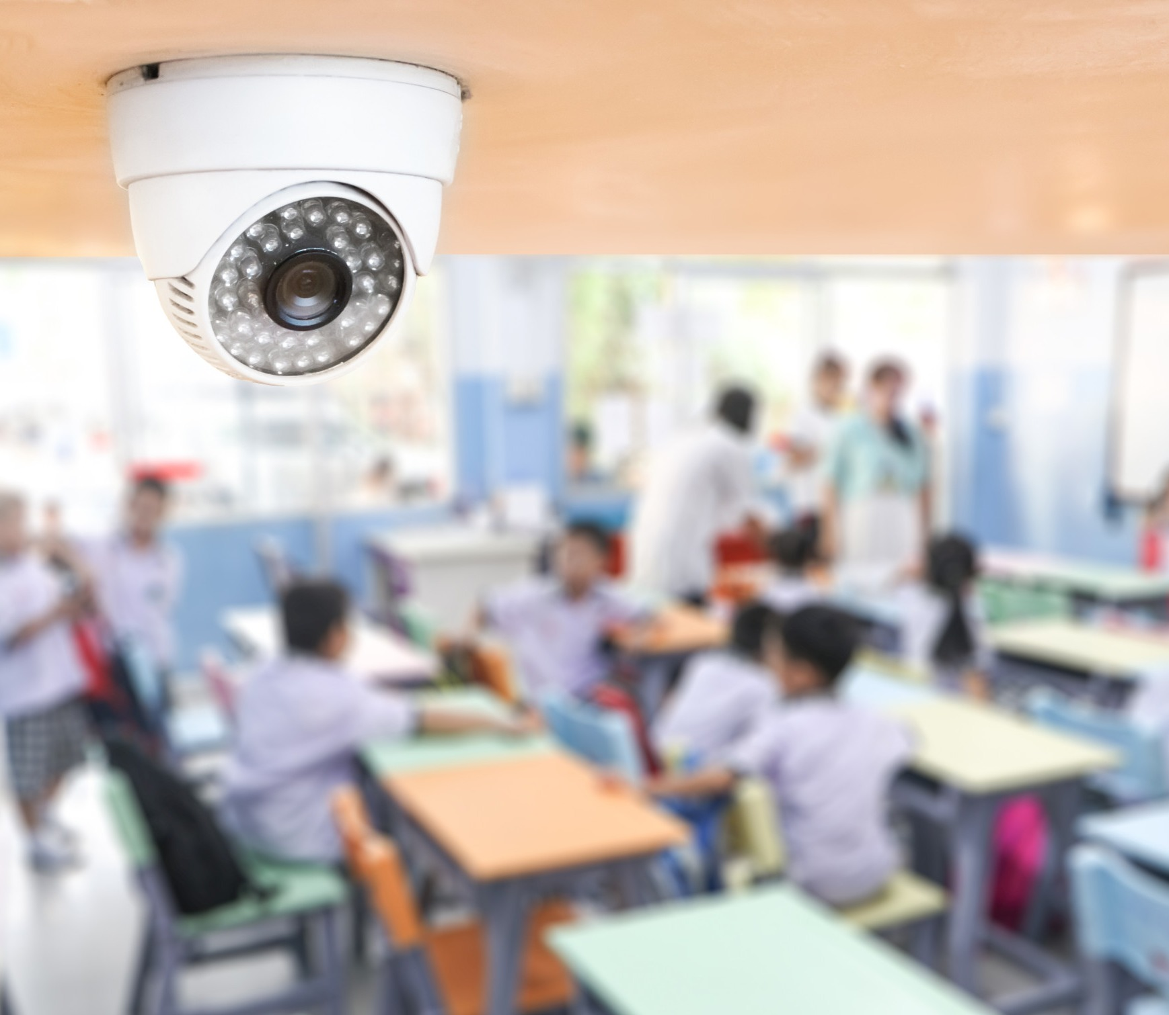
02 PROBLEM STATEMENT
Why manual classroom and exam-hall monitoring is difficult
MANUAL WATCH
MISSED EVENTS
One faculty member may need to observe many students.
Short or subtle suspicious actions can be overlooked.
SLOW REVIEW
NO INSTANT ALERT
Searching hours of recorded video takes time.
Traditional CCTV does not automatically notify faculty.
Visual reference: South China Morning Post
03

Slide 4
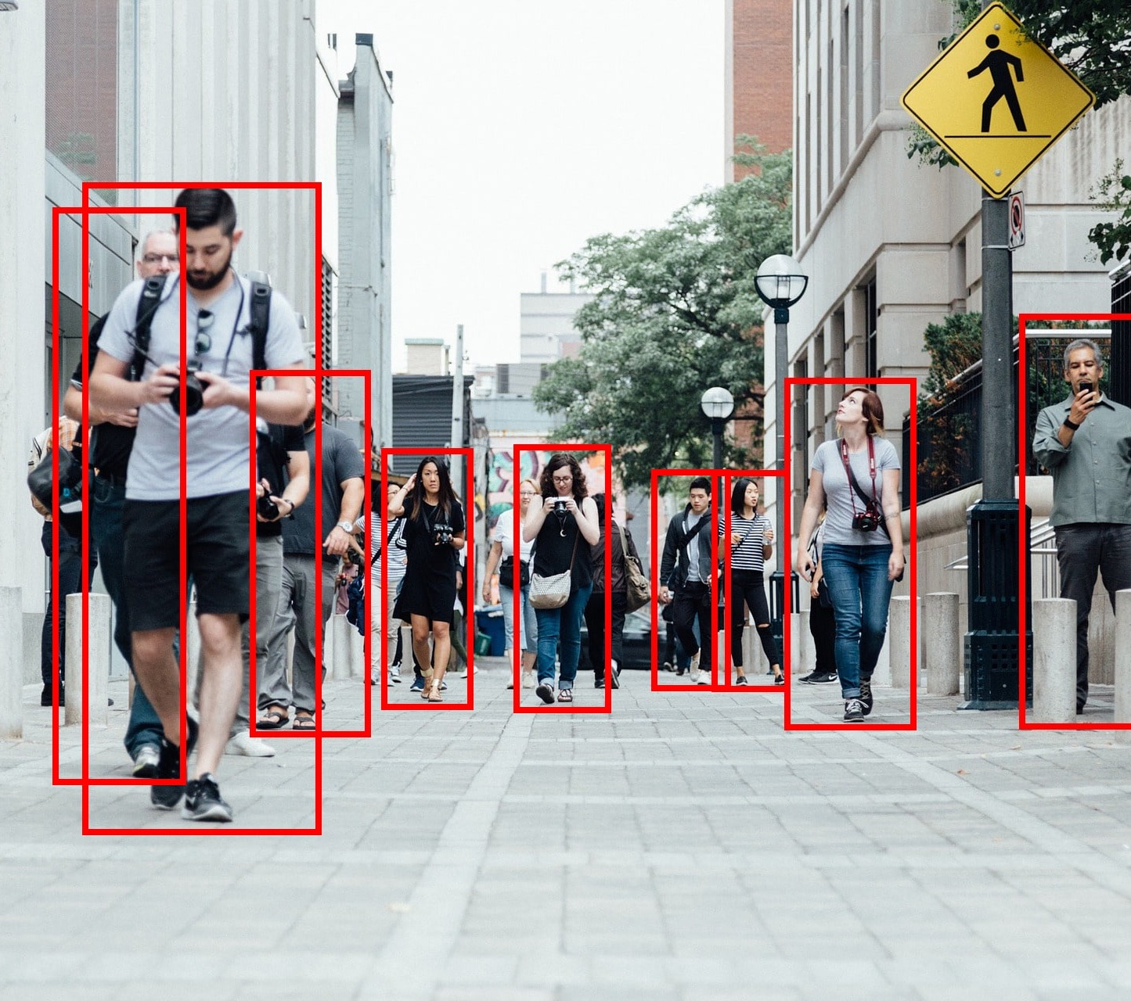
03 OBJECTIVES
What the proposed system should achieve
1
Monitor the live classroom/exam-hall camera feed.
2
Detect predefined potentially suspicious behaviors.
3
Capture the relevant evidence frame automatically.
4
Send a fast alert to the faculty dashboard.
5
Let faculty review and decide the next action.
Visual reference: VisAI Labs
04

Slide 5
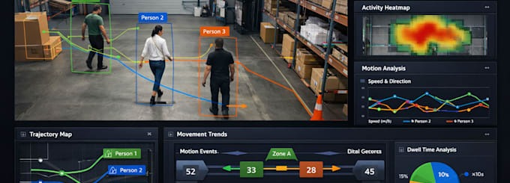
04 PROPOSED SYSTEM
The journey from camera input to faculty decision
CAMERA
→
AI
→
ANALYSIS
→
EVIDENCE
→
ALERT
→
REVIEW
Live video
Detection
Behavior rules
Capture frame
Notify faculty
Faculty decision
Visual reference: Fiverr / AI computer vision example
05

Slide 6
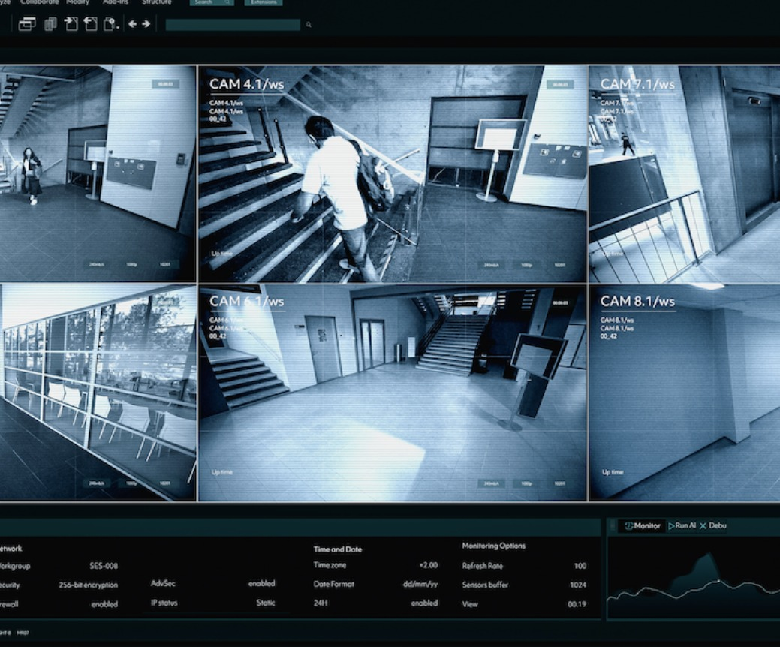
05 SYSTEM ARCHITECTURE
How the camera, AI engine, backend and website connect
IP CCTV / CAMERA
↓
RTSP / video input
VIDEO PROCESSING
↓
Python + OpenCV
AI DETECTION
↓
YOLO / computer vision
ALERT ENGINE
↓
Rules + evidence capture
BACKEND API
↓
FastAPI / Flask
WEB DASHBOARD
Faculty monitoring
Visual reference: MVP Tech
06

Slide 7
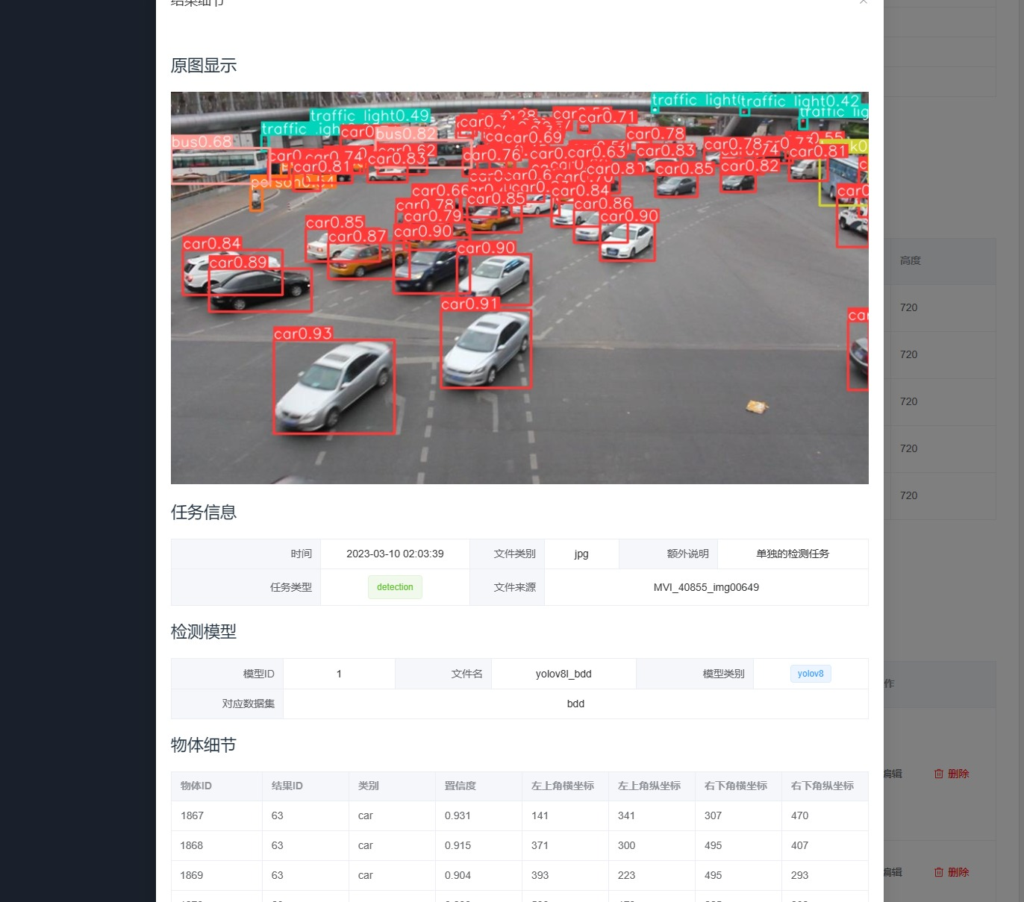
06 TECHNOLOGIES USED
Prototype and future implementation stack
WIX VIBE
HTML / CSS / JS
Prototype UI
Web interface
PYTHON
OPENCV
AI + backend
Video processing
YOLO
FASTAPI / FLASK
Object detection
API layer
MYSQL
IP CCTV / RTSP
Alert records
Camera source
Visual reference: CSDN / YOLOv8 dashboard example
07

Slide 8
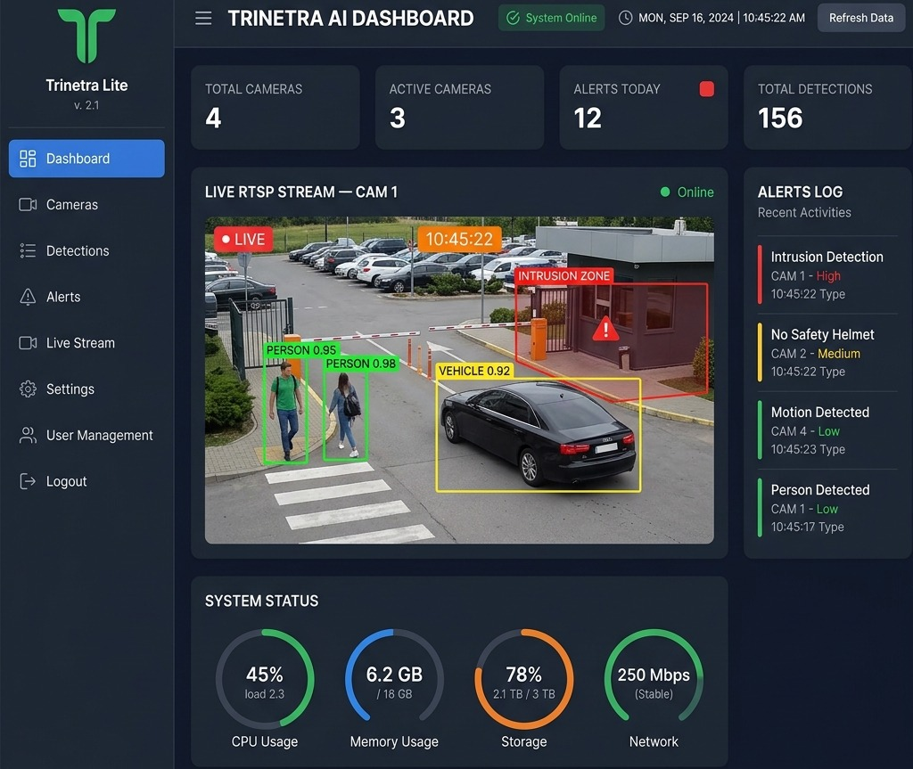
07 WORKING & WEBSITE PROTOTYPE
How the faculty experiences the system
1
START CAMERA
Camera permission
2
START AI
Begin analysis
3
DETECT
Potential event highlighted
4
CAPTURE
Evidence frame
5
ALERT
Faculty review
Visual reference: Trinetra Systems
08

Slide 9
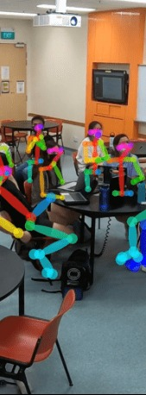
08 BENEFITS, LIMITATIONS & FUTURE SCOPE
Why the project is useful — and what comes next
BENEFITS
LIMITATIONS
FUTURE SCOPE
✓ Faster attention to events ✓ Evidence-based review ✓ Centralized dashboard ✓ Supports faculty monitoring ✓ Scalable to multiple cameras
• AI can generate false alerts • Needs reliable camera/network • RTSP needs backend integration • Privacy and access control are important
→ Multiple IP cameras → Better behavior recognition → Real-time notifications → Secure evidence storage
Visual reference: Times Higher Education
09

Slide 10
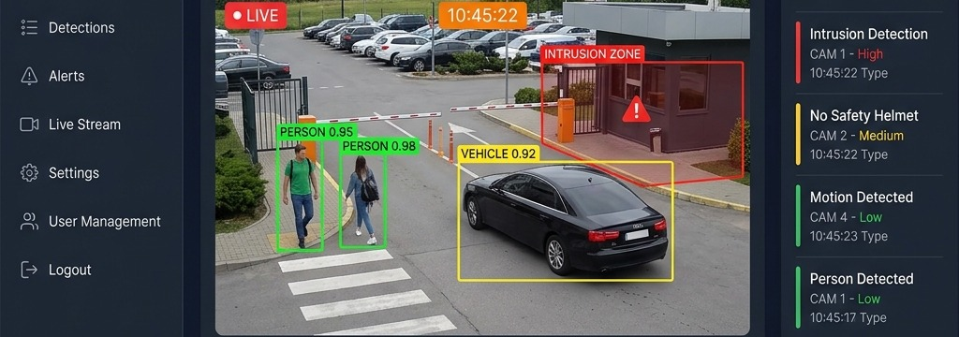
THANK YOU
Intelligent Classroom Monitoring System
BVSR ENGINEERING COLLEGE • CSE – Data Science
Visual reference: Trinetra Systems
QUESTIONS & ANSWERS
10

