Slide 1
Knowledge Discovery and Data Mining 1 - Phase 1
Antonia Lea Windisch
Emily Thomas
Vincent Jakl
Technische Universität Graz
Inffeldgasse
A 8010 Graz

Slide 2
Approach
Preserve as much information as possible
For contradictory columns, keep the more relevant one
Use domain knowledge but due to synthesized data set accept some values one wouldn’t normally expect
Diversity encouraged
Some assumptions taken were:
Time on ice portrayed in hours while power play time in seconds since a lot of
people have higher power play time than time on ice
Penalty kill time portrayed in minutes and changed to seconds

Slide 3
Preprocessing
Discrepancies found:
Depiction of gender values: f/female , m/male
Country and City names: Austria / austria
Weight and height: kg/no value, cm/m/no value
Fitness level
Percentage sign in body fat

Slide 4
Preprocessing
Identified quality issues in the data:
Save percentages greater than 100
Suspicious amount of first names ending in „ius“
International ids in roman numerals
37 rows with missing values
Age outliers found upon inspection, decided on upper bound of oldest person
alive due to diversity encouragement

Slide 5
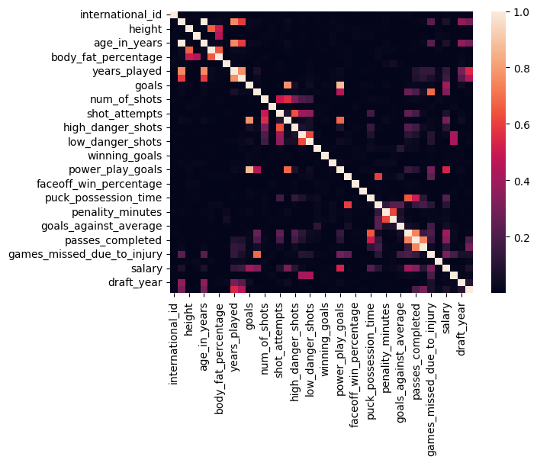
Data relationship
Visualize correlation between columns
using a Heatmap
Excerpt of columns with significant correlation:
Years played and goals
Power play goals and general goals
Columns with no significant correlation
that seemed surprising:
Power play time and Power play goals
Years played and salary

Slide 6
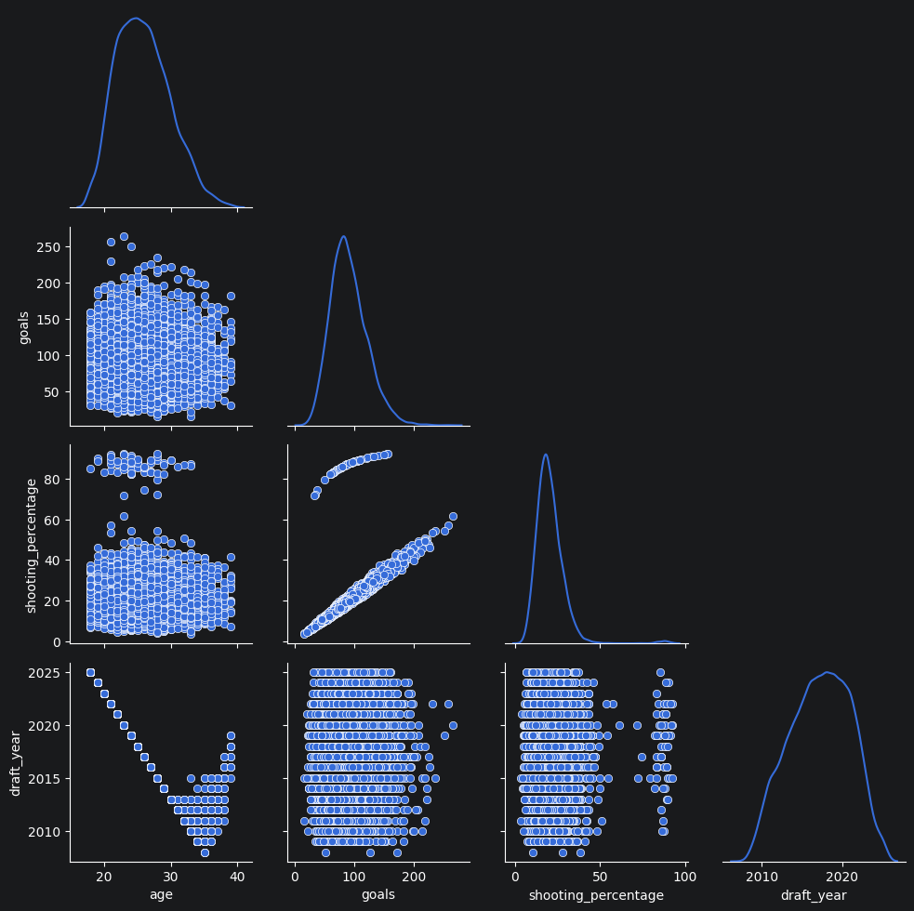
Data relationship
Portraying monotone relationships
found in the data
Draft year and age
Shooting percentage and goals

Slide 7
Data cleaning
Columns drop due to inconsistency with others:
Birth city
Puck touches
Time between penalties
Goals total
Rows dropped due to conflicting values:
Players with more years pro than years played
0 years of playing but experience level higher than a rookie
Age outliers, upper bound decided by oldest person alive on earth (122)
Draft year before 1922

Slide 8
Data cleaning
Additional actions taken:
Filled NaN values
Set penalty time to 0 for players without any penalties
Puck possession time reformatted from minutes to seconds
Newly calculated shooting percentage
Equation: shooting_percentage = goals/ number of shots *100

Slide 9
Most important findings
Inconsistent columns
Missing data values,
bizarre values such as age of 312 or draft year of 1850
Significant Correlation between power play goals and regular goals
Monotone relationship between shooting percentage and goals
Surprisingly no correlation between salary and years played or being captain

