Slide 1
CUSTOMER SHOPPING BEHAVIOR
Five growth levers
Translate 3,900 transactions into decisions on subscriptions, loyalty, discounts, products, and targeting.
Decision readout · Customer analysis
Notes:
Open with the central shift: 3,900 transactions become a set of practical growth decisions across subscriptions, loyalty, discounts, products, and targeting.

Slide 2
02
DECISION FRAME
EXHIBIT 01
The analysis is built to answer business questions, not just describe the data
SCOPE
OUTCOME
3,900
1
purchases across 18 columns
practical growth agenda
Customers, products, transactions, and shopping behavior in one decision base.
Connect customer segments and purchase behavior to actions the business can test.
SOURCE · Customer shopping behavior analysis
SO WHAT
The value is in turning patterns into choices, tests, and owners.

Slide 3
03
METHOD
EXHIBIT 02
A clean Python-to-SQL workflow made the dataset decision-ready
01
02
03
PYTHON
QUALITY
POSTGRESQL
Profile and clean
Impute and standardize
Load for analysis
Profile the dataset, check its shape, and prepare the fields for analysis.
Impute 37 missing review ratings using category medians and standardize columns.
Load the cleaned dataset into PostgreSQL for structured business analysis.
SOURCE · Python preparation and PostgreSQL analysis workflow
SO WHAT
The workflow makes the data reliable enough to support business choices.

Slide 4
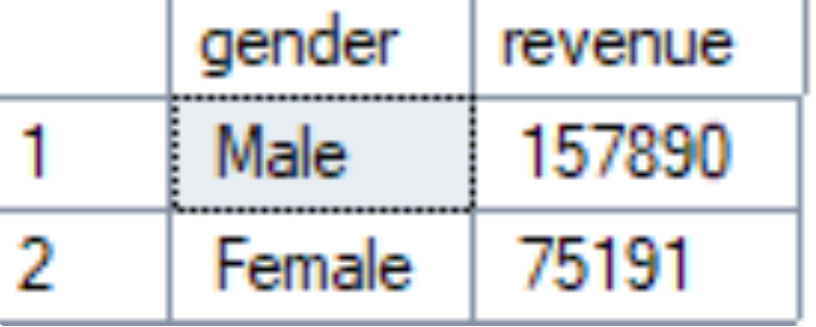
04
REVENUE LENS
EXHIBIT 03
Revenue differences reveal where customer strategy should focus
DECISION LENS
Compare revenue by gender and age group.
Use the strongest contributing groups as the starting point for targeted marketing.
The analysis identifies where attention should concentrate before targeting is scaled.
SOURCE · Customer shopping behavior analysis · supplied revenue figure
SO WHAT
Start with the groups already contributing the most revenue, then sharpen the message.

Slide 5
05
DISCOUNTS
EXHIBIT 04
Discounts can attract spenders, but some products may be over-dependent on them
CUSTOMER TEST
PRODUCT REVIEW
Find discount users who spend above the average purchase amount.
Flag the five products with the highest share of discounted purchases.
These customers show where discounts may be attracting valuable spend.
Review margin dependence before extending or broadening the offer.
SOURCE · Customer shopping behavior analysis
SO WHAT
Protect the customers discounts attract while challenging dependence where margin is exposed.

Slide 6
06
PRODUCTS
EXHIBIT 05
Product positioning should combine customer love with purchase momentum
PROOF POINTS
DEMAND CHECK
Use the top five products by average review rating.
Pair ratings with the top three products in each category.
Customer love gives campaigns a credible reason to feature them.
Balance satisfaction with purchase momentum before deciding what to scale.
SOURCE · Customer shopping behavior analysis
SO WHAT
Feature products that earn affection and already have a reason to move.

Slide 7
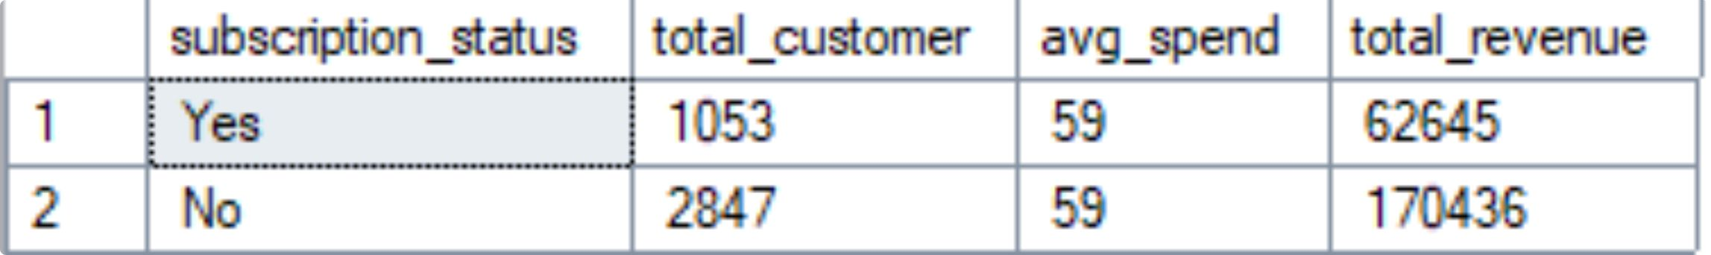
07
CONVERSION TESTS
EXHIBIT 06
Subscriptions and shipping behavior create clear tests for conversion
TWO COMPARISONS
Subscribers versus non-subscribers
Compare average spend and total revenue before shaping the subscription offer.
Standard versus express shipping
Test whether urgency correlates with higher-value baskets.
SOURCE · Customer shopping behavior analysis · supplied subscription figure
SO WHAT
Use observed behavior to define conversion tests, not assumptions about why customers spend.

Slide 8
08
LOYALTY
EXHIBIT 07
Purchase history gives the loyalty program a measurable ladder
01
02
03
01
02
03
New
Returning
Loyal
Classify customers by purchase history and establish the starting point.
Track repeat buyers and check whether more than five purchases changes subscription likelihood.
Use the relationship to design benefits that move repeat buyers toward loyalty and subscription.
SOURCE · Customer shopping behavior analysis
SO WHAT
Loyalty becomes measurable when each purchase moves a customer toward the next benefit.

Slide 9
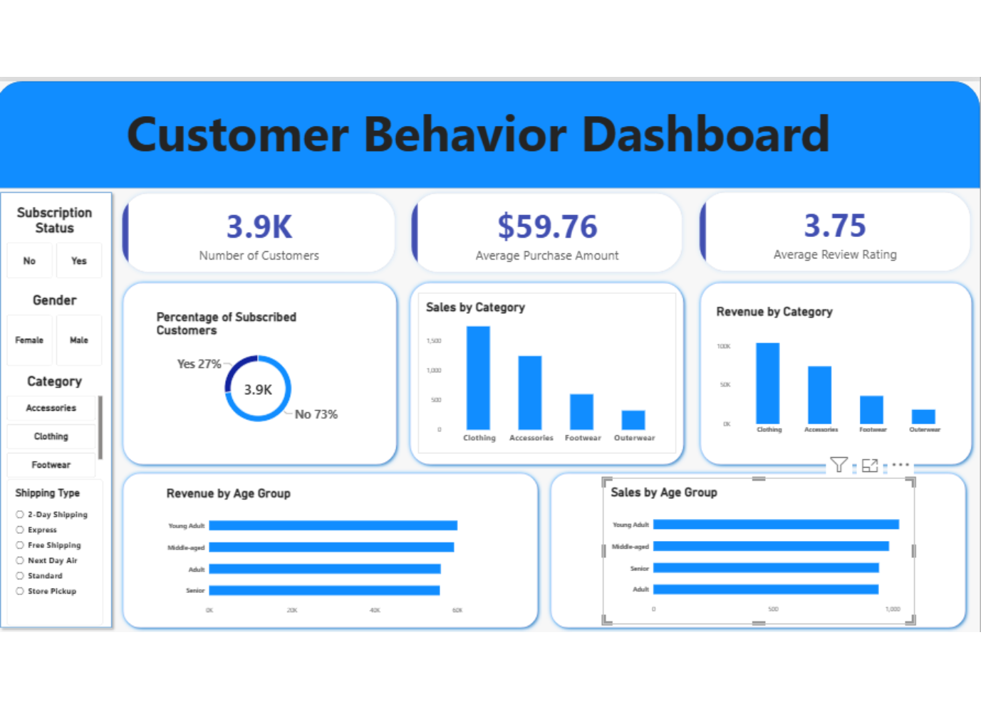
09
DECISION TOOL
EXHIBIT 08
The Power BI dashboard turns analysis into a repeatable decision tool
ONE VIEW, MANY CUTS
Keep the decision questions together.
Revenue and segments
Subscription behavior
Product performance
Discounts and shipping
Age groups
SOURCE · Customer shopping behavior analysis · supplied Power BI dashboard figure
SO WHAT
A repeatable dashboard keeps the same evidence in the room as decisions evolve.

Slide 10
10
GROWTH AGENDA
EXHIBIT 09
Five actions turn the analysis into a growth agenda
01
Boost subscriptions with exclusive benefits.
02
Reward repeat buyers and move more customers into the Loyal segment.
03
Review discount policy where dependence is highest.
04
Feature top-rated and best-selling products.
05
Target high-revenue age groups and express-shipping users.
SOURCE · Customer shopping behavior analysis
SO WHAT
Five focused moves connect the analysis to how customers spend, return, subscribe, and choose.

